Slide 1
Measurement of electric charge in gas dispersed particles using Particle Tracking Velocimetry
Miguel Ángel Sánchez Quintanilla
Javier Pérez Vaquero
Grupo de Electrohidrodinámica y Medios Granulares Cohesivos.
Departamento de Electrónica y Electromagnetismo, Facultad de Física, Universidad de Sevilla

Slide 2
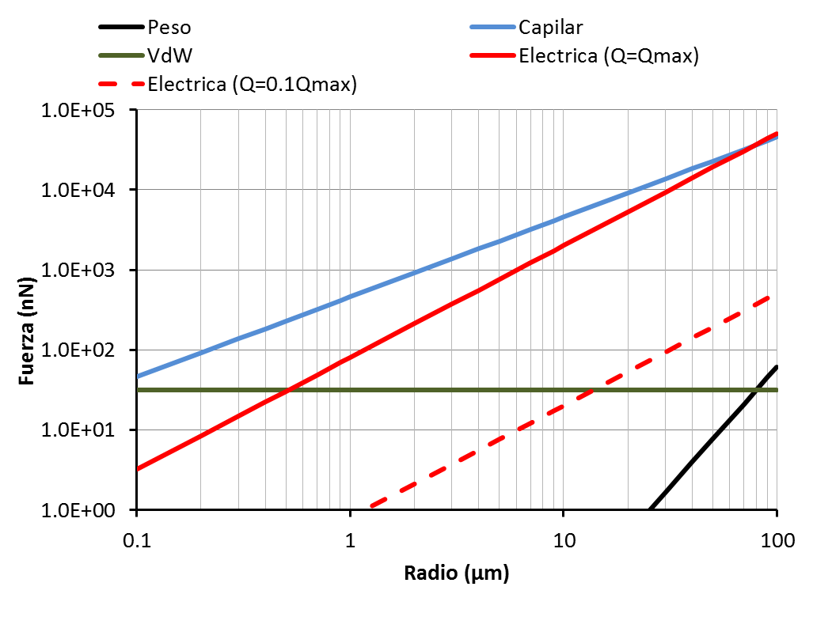
Motivation
Capilary forces.
$$F_{c}≃2πγR$$
$γ=73$ mJ/m²
Electric force.
$$F_{e}≃\frac{Q}{16πε_{o}R^{2}}$$
vdW forces
$$F_{vdW}≃2πωR^{∗}$$
$R^{∗}=0.1 μ$m
Weight.
$$W=\frac{4}{3}πR^{3}ρ$$
$ρ=1.5$ g/cm³

Slide 3
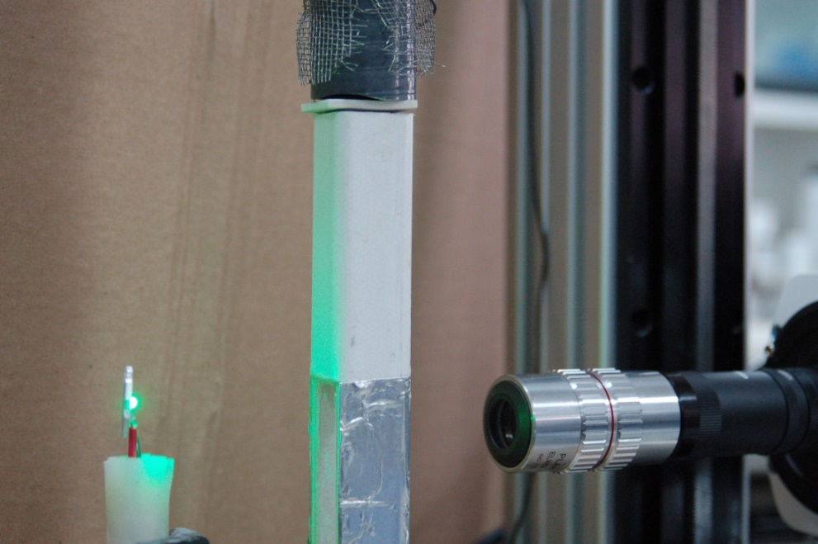
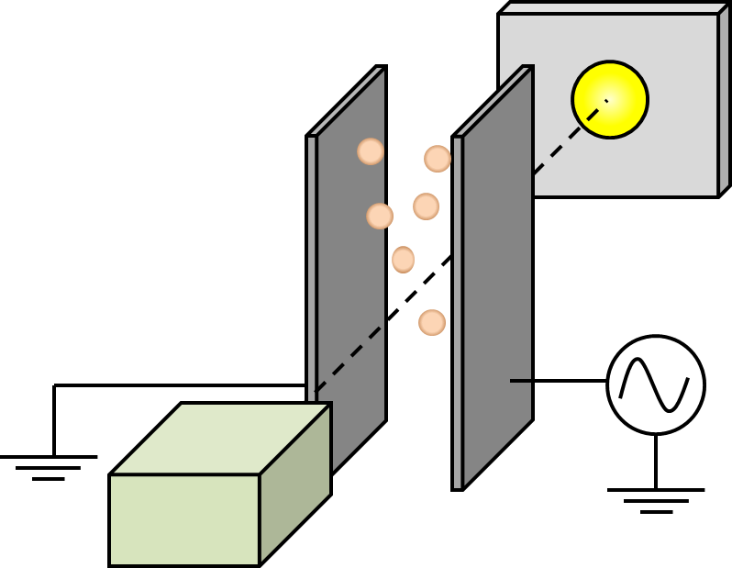
Experimental set-up
$$I_{tube}(t)$$
Compressed air
Venturi dispersion unit
A
Material feeding
End of steel tube tribocharger
Fiberglass extension with glass window
High- intensity led
LED
High voltage (AC)
High speed camera and magnifying optics
High speed camera

Slide 4
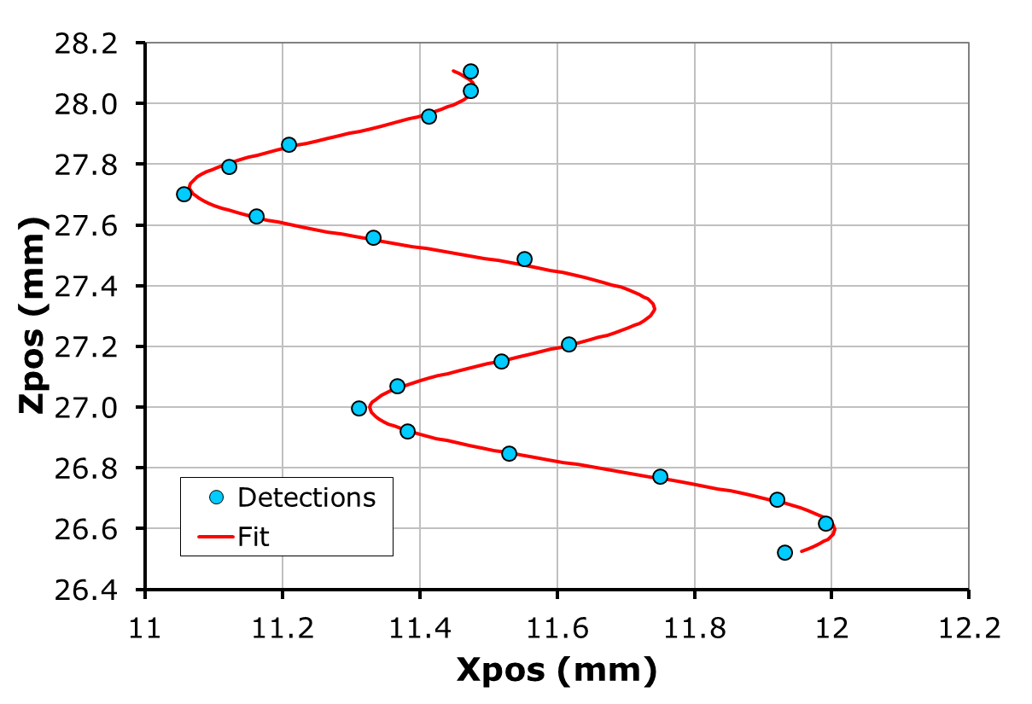
Detection algorithm
Background removal
Subtraction of average of all frames
Image segmentation by thresholding
Removes particles out of focus.
fr20
Particle identification
Own code based in nearest neighbours.
fr16
fr19
fr15
fr17
fr18
$$z={z_{ini}+v}_{z}t$$
fr14
fr12
fr13
fr7
fr8
fr9
Trajectory linkage
ImageJ tracking tool by Sbalzarini & KoumoutSakos
fr6
fr5
fr4
fr2
fr3
fr1
fr0
Except 5-50 µm glass beads (example, the largest sample tested), other samples appear agglomerated in the images.
$$x={x_{ini}+v}_{x}t+x_{o}\cos\left(ωt+θ\right)$$

Slide 5
Forces acting on a particle /agglomerate
Drag force opposing falling motion
$$F_{Dx}=−6πμRu_{z}$$
Drag force opposing oscillatory motion
Force due to the electric field
$$F_{Dx}=−6πμR\left(1+\frac{R}{δ}\right)u_{x}−3πR^{2}\sqrt{\frac{2μρ}{ω}}\left(1+\frac{2R}{9δ}\right)\frac{du_{x}}{dt}$$
$$F_{E}=qE_{o}e^{jωt}$$
Weight
From Landau & Lifschizt, course of theoretical physics, vol 6, Fluid mechanics.
$$W=mg$$
$$δ=\sqrt{\frac{2μ}{ρω}}$$
Is the width of the vorticity layer due to the oscillatory motion

Slide 6
Equations and range of validity
For the vertical motion:
$$m\frac{du_{z}}{dt}=mg−6πμRu_{z}$$
$$Re_{z}=\frac{ρRu_{z}}{μ}≪1$$
Valid if
For the horizontal motion:
$$m\frac{du_{x}}{dt}=qE_{o}e^{jωt}−6πμR\left(1+\frac{R}{δ}\right)u_{x}−3πR^{2}\sqrt{\frac{2μρ}{ω}}\left(1+\frac{2R}{9δ}\right)\frac{du_{x}}{dt}$$
Valid in each of these two cases:
$$Re_{x}=\frac{ρRu_{x}}{μ}≪1$$
Case 1:
Case 2:
$$x_{o}≪R$$
and
$$δ≪R$$
and
$$δ≫R$$
Where x_{o} is the amplitude of oscillation
For f=100 Hz in air $δ=223 μm$

Slide 7
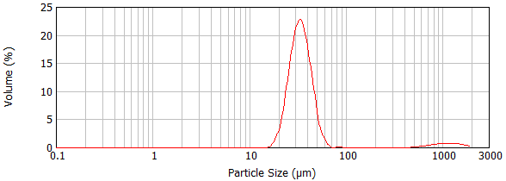
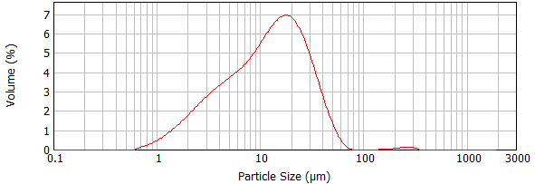
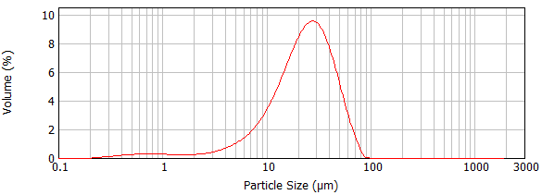
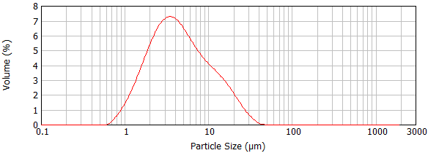
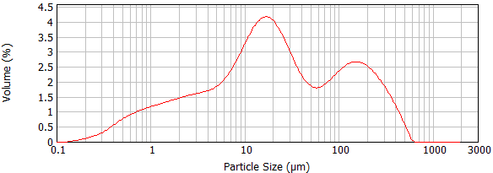
Materials
Glass beads $\left\langle d_{p}\right\rangle =33.9$ µm
Sipernat 320DS (hydrophylic)
$\left\langle d_{p}\right\rangle =6.6$ µm
Resolution limit
δ
Resolution limit
δ
Regolith simulant $\left\langle d_{p}\right\rangle =9.7 µm$
Resolution limit
δ
Sipernat D10 (hydrophobic)
$\left\langle d_{p}\right\rangle =3.3$ µm
δ
Milled sand $\left\langle d_{p}\right\rangle =4.0 µm$
Resolution limit
δ
Resolution limit
$\left\langle d_{p}\right\rangle$ is surface-weighed mean diameter.
Measured in Mastersizer 2000. Gas: air. Dispersion pressure 1 bar.

Slide 8
Relevant solutions
For the vertical motion:
$$τ_{z}=\frac{2}{9}\frac{ρ_{p}}{μ}R^{2}$$
Velocity relaxation time:
$$v_{z,term}=\frac{2}{9}\frac{ρ_{p}}{μ}R^{2}$$
Terminal velocity:
For the horizontal motion:
$$τ_{x}=τ_{z}\frac{1+\frac{1}{τ_{z}ω}\frac{R}{δ}\left(1+\frac{2R}{9δ}\right)}{1+\frac{R}{δ}}$$
Velocity relaxation time:
Steady state phase lag with the electric field
$$θ=\arctan\left(\frac{1}{ωτ_{x}}\right)$$
Steady-state amplitude of oscillation
$$\left|x_{o}\right|=\frac{1}{ω}\frac{qE_{o}}{6πμR}\frac{1}{1+\frac{R}{δ}}\frac{1}{\sqrt{1+ω^{2}{τ_{x}}^{2}}}$$
An estimation of x_{o} is needed to calculate the Reynolds number Re_{x}. For that we need to know the typical charge per particle q.

Slide 9
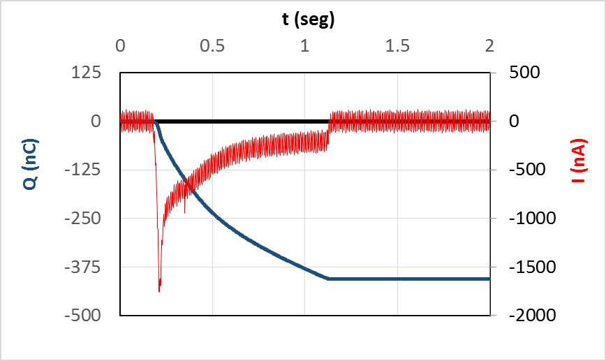
Average charge per particle.
We assume the charge to mass ratio of a particle q/m is the same as that of the whole sample Q/M
Compressed air
$$I_{tube}(t)$$
$$q=\frac{4}{3}πρ_{p}R^{3}\left(\frac{Q}{M}\right)$$
$$Q=\int_{t_{ini}}^{t_{end}}{I_{tube}(t)}$$
Venturi dispersion unit
A
Material feeding
$$M$$
The largest uncertainty comes from the value of the dispersed mass M.
We use the value of the surface-volume mean diameter for R.

Slide 10
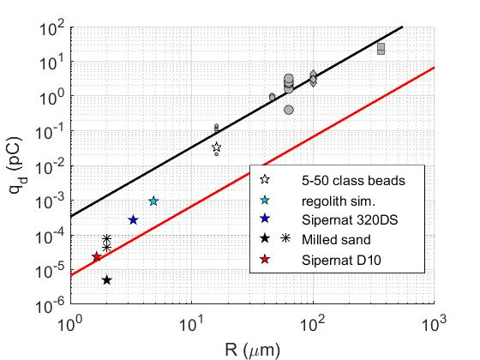
Average charge per particle vs. particle surface-mean diameter
Experiments with continuous flow
$$q_{d}=4πε_{o}R^{2}E_{c}$$
E_{c}=30 kV/cm
$$q_{d}≃6.67×{10}^{−6}R^{2}$$
$$q_{d}≃3.33×{10}^{−4}R^{2}$$
(q_{d} in pC, R in µm)
(q_{d} in pC, R in µm)
PTV experiments (pulsed flow)

Slide 11
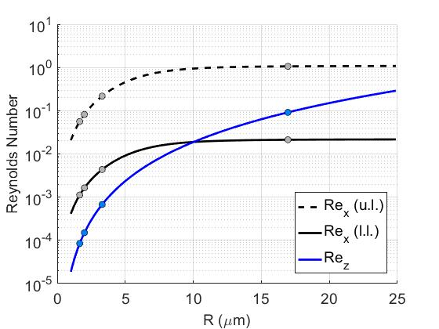
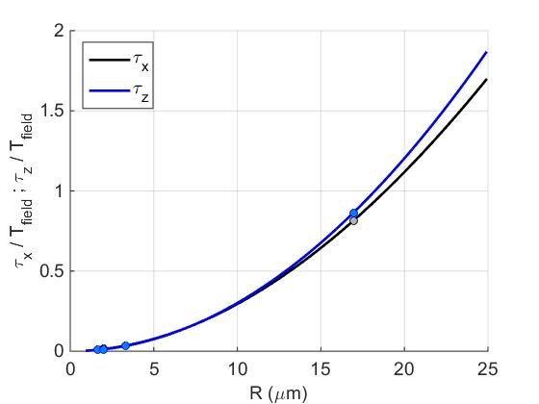
Check on validity for the surface volume mean diameter.
Reynolds number
Typical times to achieve steady state.
Using the surface-volume mean diameter both conditions are met.
Plots for ρ_{p}=2.5 g/cm³ E_{o}=3.4 kV/cm

Slide 12
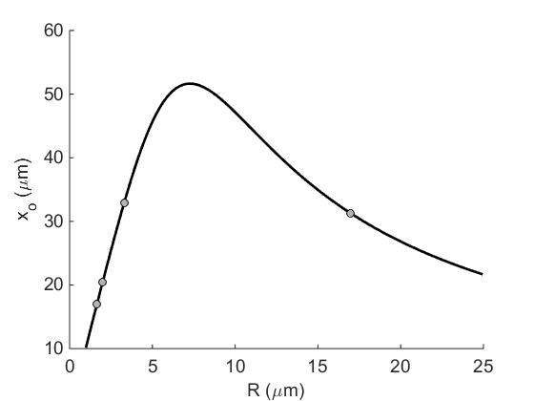
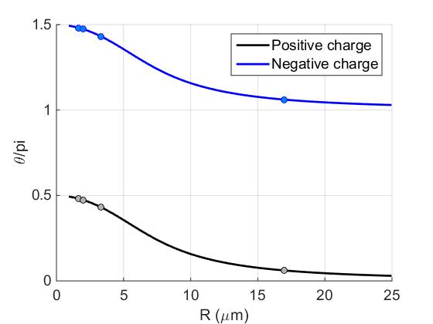
Relevant solutions
Amplitude of oscillation
Phase lag with the field
$$\left|x_{o}\right|=\frac{1}{ω}\frac{qE_{o}}{6πμR}\frac{1}{1+\frac{R}{δ}}\frac{1}{\sqrt{1+ω^{2}{τ_{x}}^{2}}}$$
$$θ=\arctan\left(\frac{1}{ωτ_{x}}\right)$$
Markers represent values for surface-mean diameter. Experiment yield a distribution of values.
Plots for ρ_{p}=2.5 g/cm³ E_{o}=3.4 kV/cm

Slide 13
Size determination from images
To evaluate the electric charge of each particle we need to know its radius R. Two options are possible:
Circular equivalent diameter.
Calculated from the number of pixels N_{p} of each particle in the image.
$$R_{ce}$$
$$R_{ce}=Δx_{p}\sqrt{\frac{N_{p}}{π}}$$
$$A=π{R_{ce}}^{2}$$
Δx_{p} = 7.4 µm/pixel is the resolution of our images
Aerodynamic diameter.
$$R_{ae}$$
Terminal velocity assuming Stokes drag:
Calculated from the vertical velocity v_{z} of the particle.
$$R_{ae}=\sqrt{\frac{9μv_{z}}{2gρ_{p}}}$$
$$v_{z,term}=\frac{2}{9}\frac{ρ_{p}}{μ}{R_{ae}}^{2}$$
$$v_{z,term}$$
$$v_{z,term}$$

Slide 14
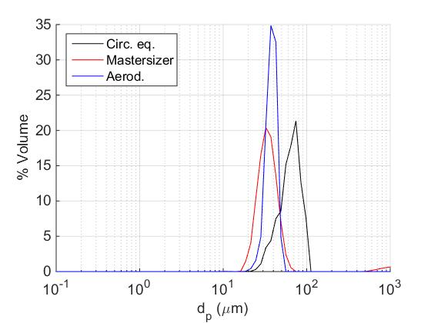
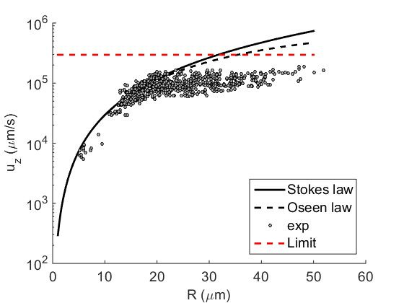
Sizing glass beads 5-50 µm
Vertical velocity vs. Circular equivalent diameter.
Size distributions
No. of particles analyzed: 708 (goodness of fit r²>0.6)
$\left\langle d_{p}\right\rangle =33.9$ µm, ρ_{p} = 2.5 g/cm³

Slide 15
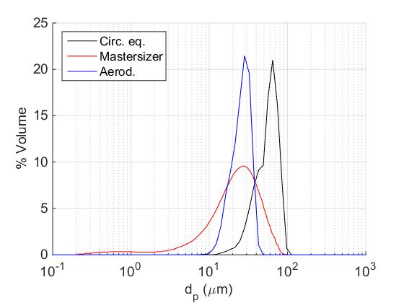
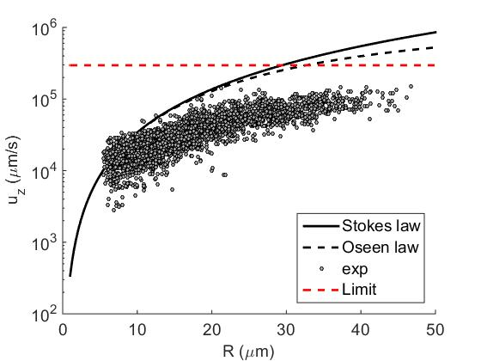
Sizing Regolith simulant
Vertical velocity vs. Circular equivalent diameter.
Size distributions
No. of particles analyzed: --- (goodness of fit r²>0.6)
$\left\langle d_{p}\right\rangle =9.7$ µm, ρ_{p}=2.9 g/cm³

Slide 16
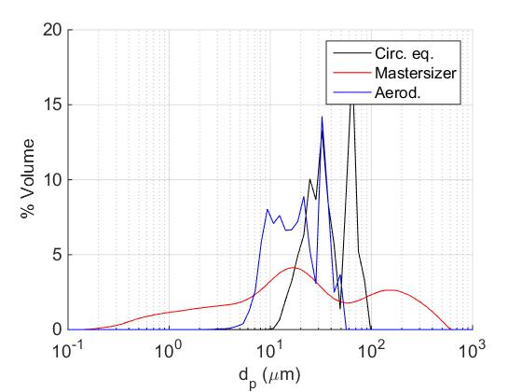
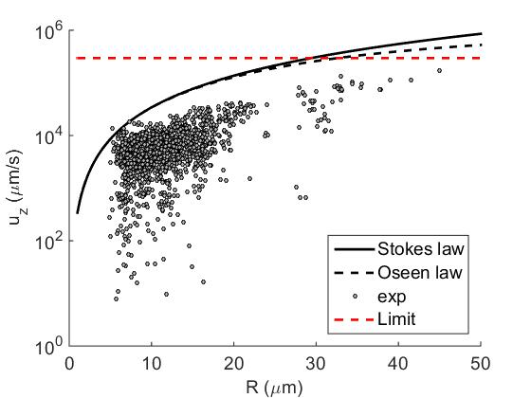
Sizing milled sand
Vertical velocity vs. Circular equivalent diameter.
Size distributions
No. of particles analyzed: 2009 (goodness of fit r²>0.6)
$\left\langle d_{p}\right\rangle =4.0$ µm, ρ_{p} = 2.5 g/cm³

Slide 17
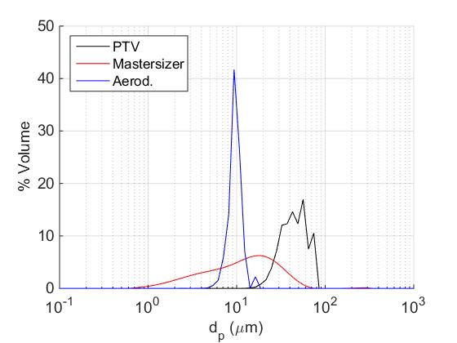
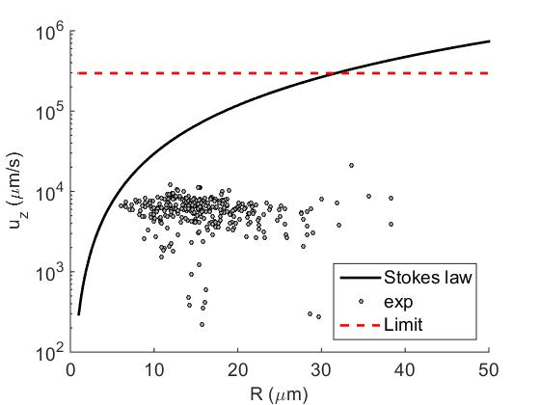
Sizing sipernat 320 DS
Vertical velocity vs. Circular equivalent diameter.
Size distributions
No. of particles analized: 305 (goodness of fit r²>0.6)
$\left\langle d_{p}\right\rangle =6.6$ µm, ρ_{p} = 2.5 g/cm³

Slide 18
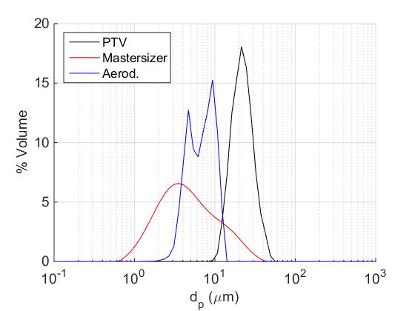
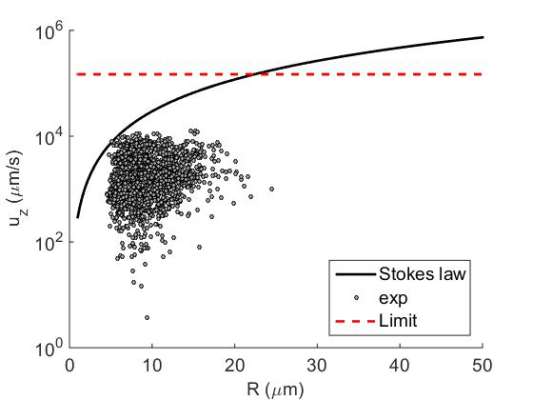
Sizing sipernat D10
Vertical velocity vs. Circular equivalent diameter.
Size distributions
No. of particles analyzed: 3616 (goodness of fit r²>0.9)
$\left\langle d_{p}\right\rangle =3.3$ µm, ρ_{p} = 2.5 g/cm³

Slide 19
Election of the sizing procedure
For all samples, specially the ones with smaller particle size, the circular equivalent diameter measured from the images tends to overestimate the size of the particles.
PSD of the circular equivalent diameter appear shifted to larger sizes compared from PSD from Mastersizer and aerodynamic diameter.
The measured vertical velocity of the particles is always smaller than the value expected from their circular equivalent diameter.
For these reasons we use the aerodynamic radius to substitute in the calculations.

Slide 20
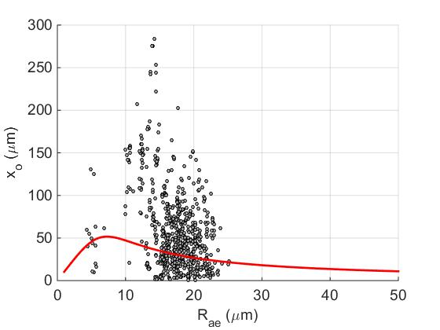
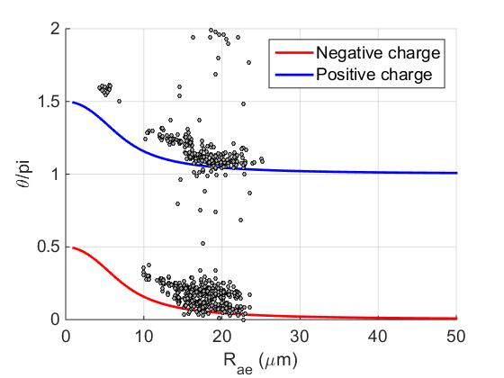
Glass beads 5-50 µm
Amplitude of oscillation
Phase with respect to the field
No. of particles analyzed: 708 (goodness of fit r²>0.6)
$\left\langle d_{p}\right\rangle =33.9$ µm, ρ_{p} = 2.5 g/cm³

Slide 21
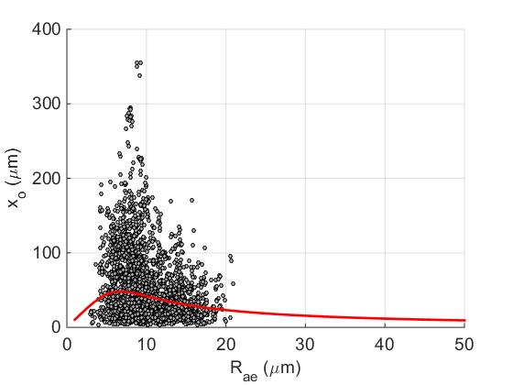
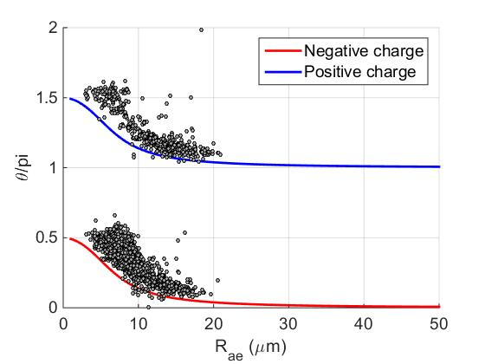
Regolith simulant
Amplitude of oscillation
Phase with respect to the field
No. of particles analyzed: --- (goodness of fit r²>0.6)
$\left\langle d_{p}\right\rangle =9.7$ µm, ρ_{p}=2.9 g/cm³

Slide 22
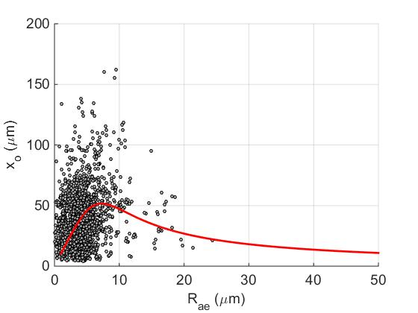
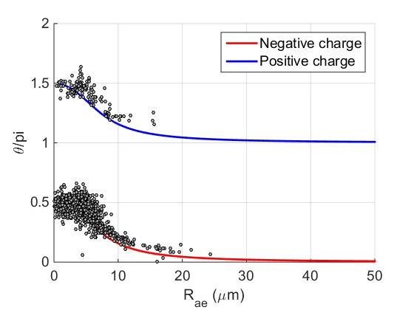
Milled sand
Amplitude of oscillation
Phase with respect to the field
No. of particles analyzed: 2009 (goodness of fit r²>0.6)
$\left\langle d_{p}\right\rangle =4.0$ µm, ρ_{p} = 2.5 g/cm³

Slide 23
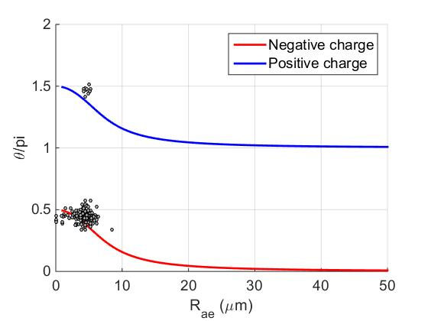
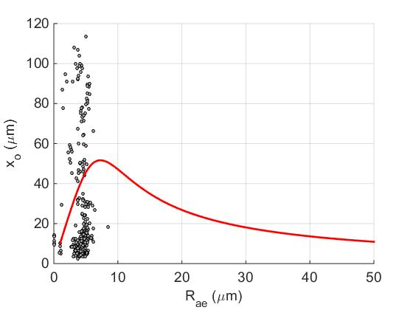
Sipernat 320DS
Amplitude of oscillation
Phase with respect to the field
No. of particles analized: 305 (goodness of fit r²>0.6)
$\left\langle d_{p}\right\rangle =6.6$ µm, ρ_{p} = 2.5 g/cm³

Slide 24
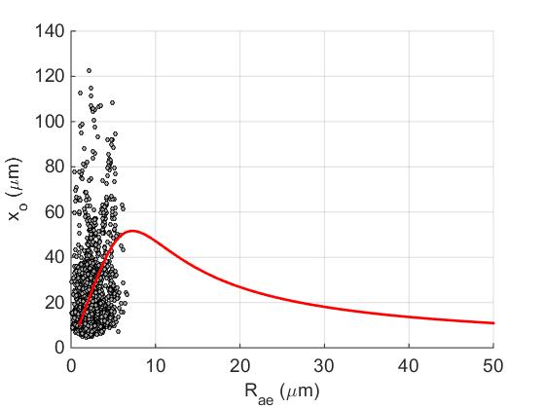
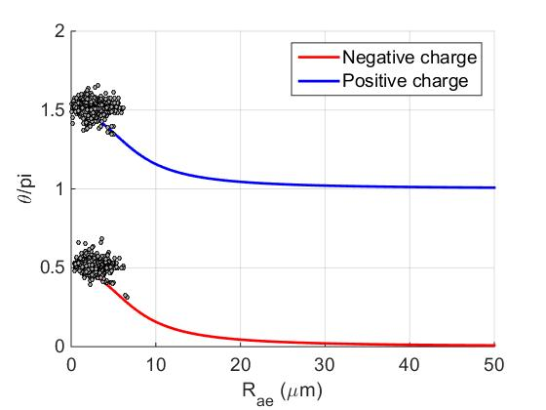
Sipernat D10
Amplitude of oscillation
Phase with respect to the field
No. of particles analyzed: 3616 (goodness of fit r²>0.9)
$\left\langle d_{p}\right\rangle =3.3$ µm, ρ_{p} = 2.5 g/cm³

Slide 25
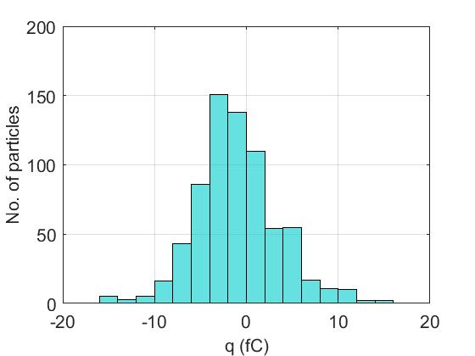
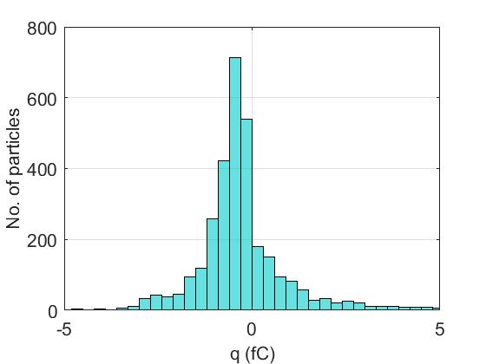
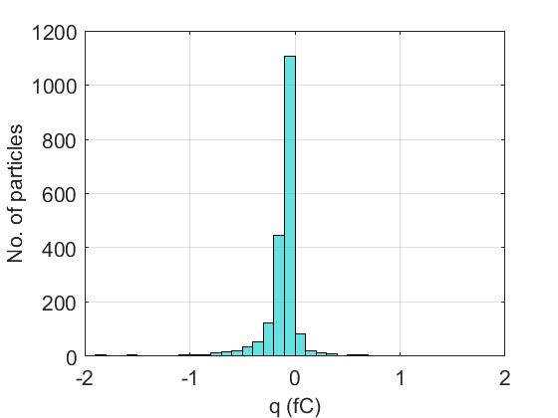
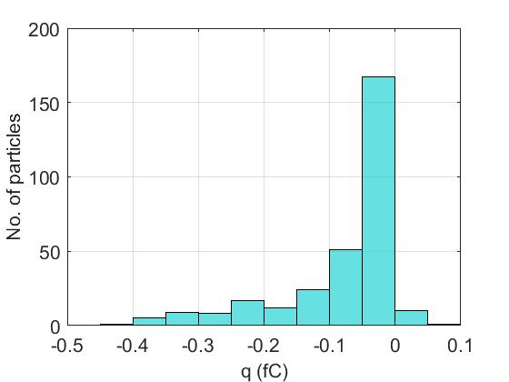
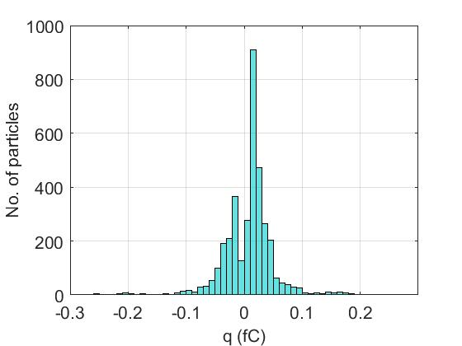
Charge distributions
All materials show a charge distribution spanning of both polarities
5-50 glass beads
Regolith simulant
Milled sand
Sipernat 320DS (hydrophylic)
Sipernat D10 (hydrophobic)

Slide 26
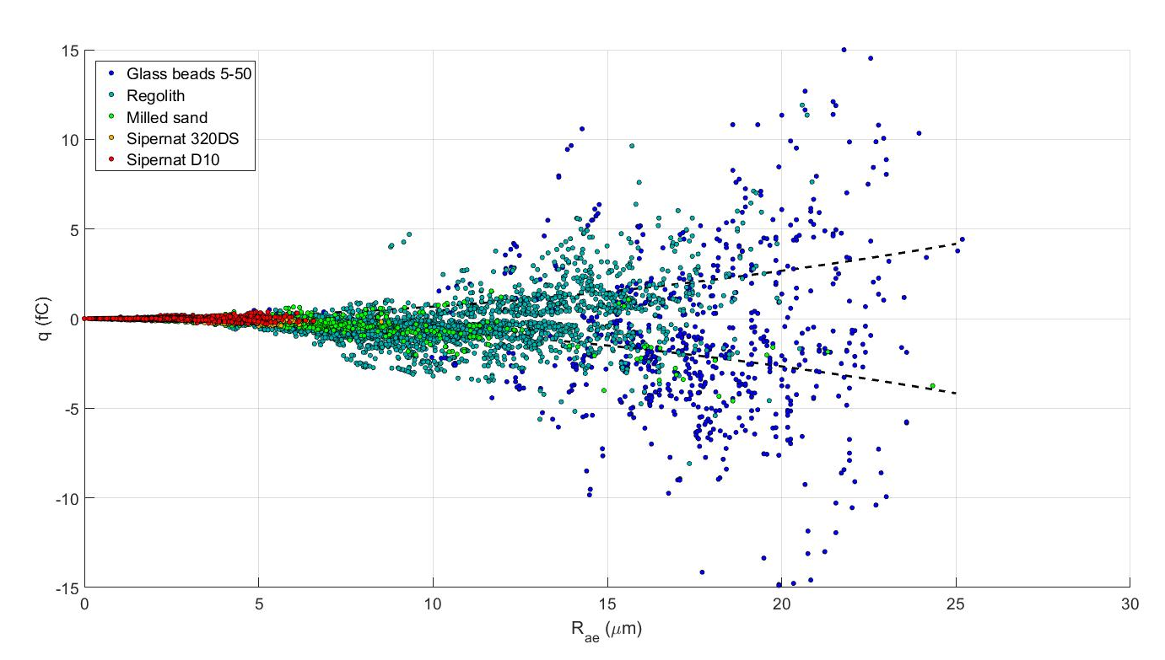
Overall charge distribution
$$q=6.67×{10}^{−3}×R^{2}$$

Slide 27
The following slides represent results vs. circular equivalent radius

Slide 28
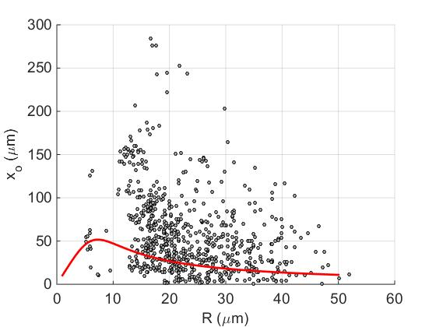
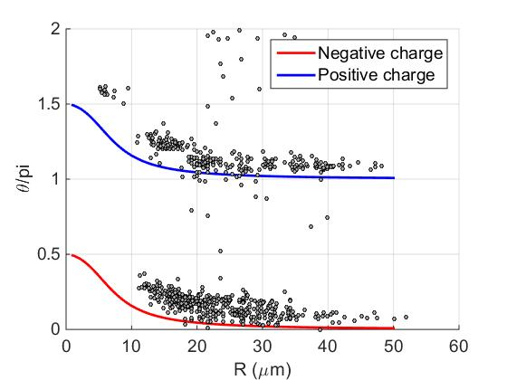
Glass beads 5-50 µm
Amplitude of oscillation
Phase with respect to the field
No. of particles analyzed: 708 (goodness of fit r²>0.6)
$\left\langle d_{p}\right\rangle =33.9$ µm, ρ_{p} = 2.5 g/cm³

Slide 29
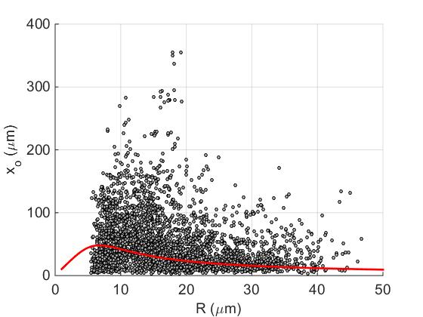
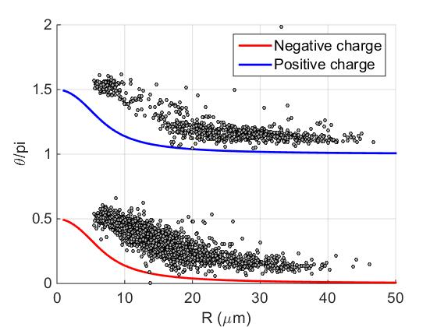
Regolith simulant
Amplitude of oscillation
Phase with respect to the field
No. of particles analyzed: --- (goodness of fit r²>0.6)
$\left\langle d_{p}\right\rangle =9.7$ µm, ρ_{p}=2.9 g/cm³

Slide 30
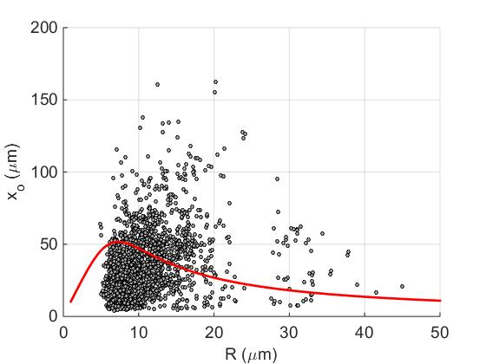
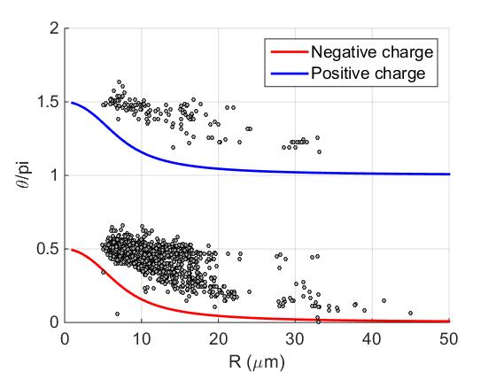
Milled sand
Amplitude of oscillation
Phase with respect to the field
No. of particles analyzed: 2009 (goodness of fit r²>0.6)
$\left\langle d_{p}\right\rangle =4.0$ µm, ρ_{p} = 2.5 g/cm³

Slide 31
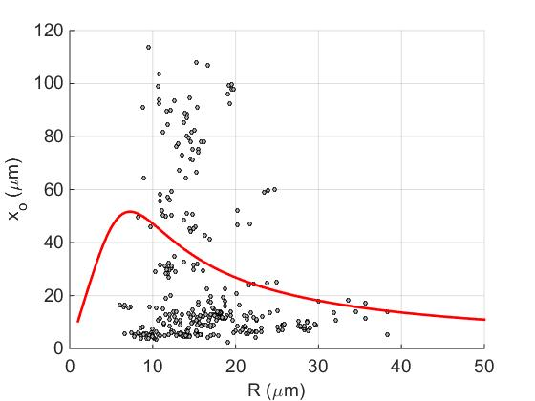
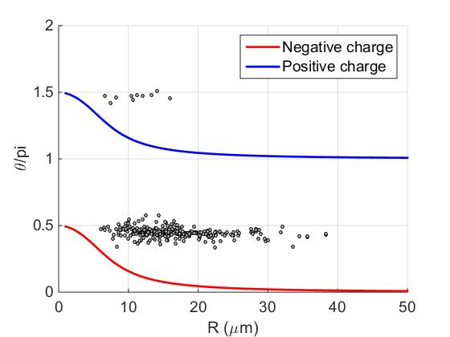
Sipernat 320DS
Amplitude of oscillation
Phase with respect to the field
No. of particles analized: 305 (goodness of fit r²>0.6)
$\left\langle d_{p}\right\rangle =6.6$ µm, ρ_{p} = 2.5 g/cm³

Slide 32
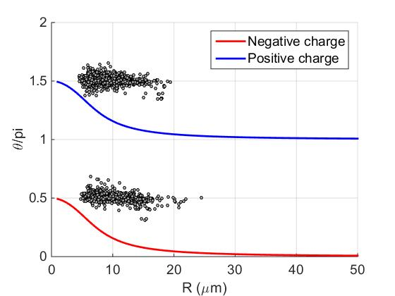
Sipernat D10
Amplitude of oscillation
Phase with respect to the field
No. of particles analyzed: 3616 (goodness of fit r²>0.9)
$\left\langle d_{p}\right\rangle =3.3$ µm, ρ_{p} = 2.5 g/cm³

Slide 33
Charge distributions
5-50 glass beads
Milled sand
All the data show a distribution with particles of both polarities
Sipernat 320DS (hydrophylic)
Sipernat D10 (hydrophobic)
Regolith simulant

