Slide 1
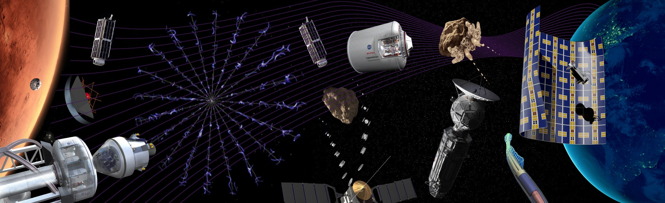

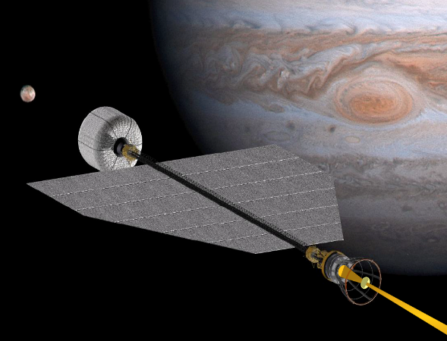



EXPERIMENTAL ANALYSIS OF EHD CONDUCTION PUMP IN DIELECTRIC LIQUIDS
Institut P’ • UPR CNRS 3346
SP2MI • Téléport 2
11, Boulevard Marie et Pierre Curie • BP 30179
F86962 FUTUROSCOPE CHASSENEUIL Cedex
Presented by:
Sachin Modh
01/09/2016
Poitiers

Slide 2


CONTENT
1
Introduction of EHD
2
Types of EHD Pump
3
Objective
4
Experimental set-up & Parameters
5
Experimental Results
6
Experimental Protocol
7
Conclusion

Slide 3
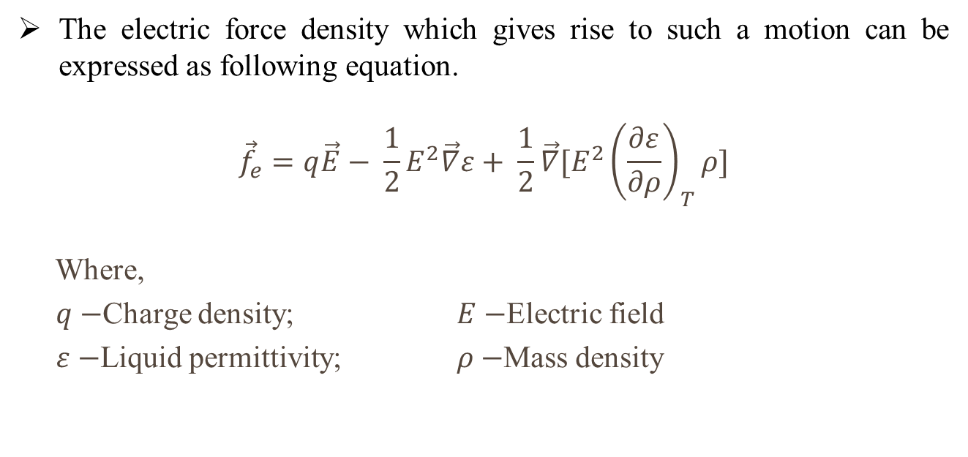
WHAT IS ELECTROHYDRODYNAMICS (EHD)?
1
Electrohydrodynamics deals with the interaction between an electrical field and a dielectric fluid medium under applied high voltage.
The electric force density which gives rise to such a motion can be expressed as following equation.
$${\vec{f}}_{e}=q\vec{E}− \frac{1}{2}E^{2}\vec{∇}ε+ \frac{1}{2}\vec{∇}[{E^{2}\left(\frac{∂ε}{∂ρ}\right)}_{T}ρ]$$
Where,
$q−$Charge density; $E−$Electric field
$ε−$Liquid permittivity; $ρ−$Mass density

Slide 4
2
TYPES OF EHD PUMP
Ion-Drag pump
a sharp electrode is used in order to generate a strong electric field and charge injection
2) Induction pump
Interaction between the induced charges and electric conductivity.
3) Conduction pump
In the absence of charge injection and induction, ions are mainly generated in the liquid by an imbalance in the dissociation/recombination process.

Slide 5
3
OBJECTIVE
Work on symmetric configuration
Create an experimental data base on EHD conduction pumping
Provide data for validation
Improve the analtical and numerical model
Measure the electric current in plane-plane configuration

Slide 6
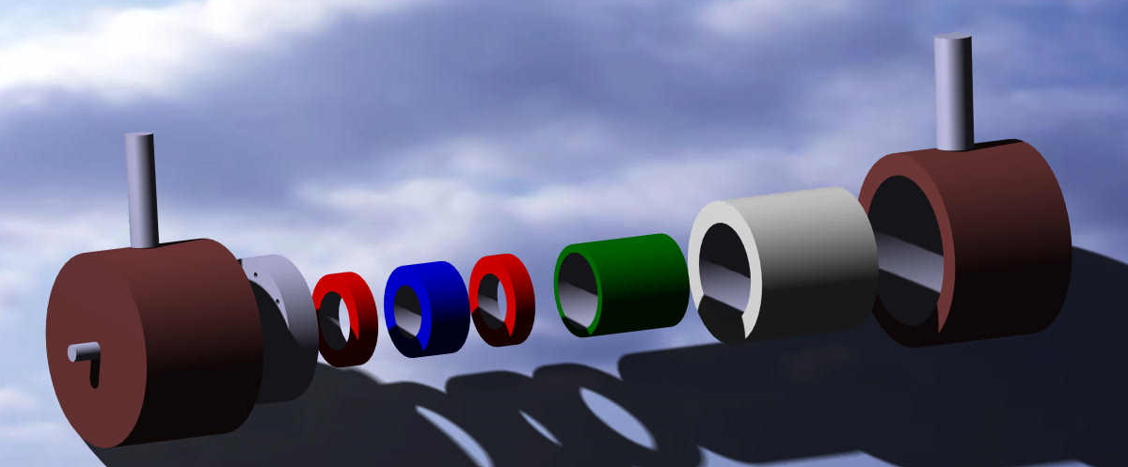
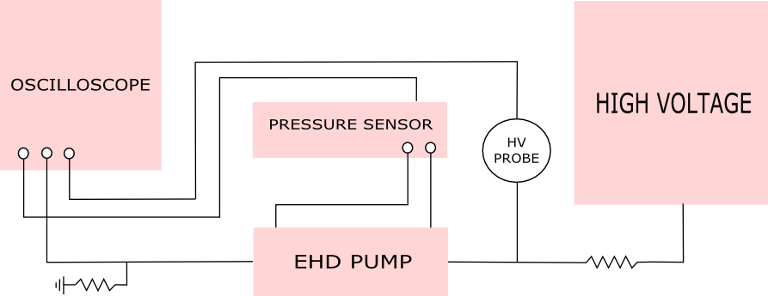
4
EXPERIMENTAL SET-UP
Washer type electrode ( Inner diameter(di) 0.5mm to 3mm)
( Outer diameter(Di) 12mm, Thickness(H)-1mm)
Dielectric spacer ( Inner diameter(di) 10mm )
(Outer diameter(Di) 12mm, Thickness(H) 1mm to 5mm )
EHD Pump
Experimental set-up

Slide 7
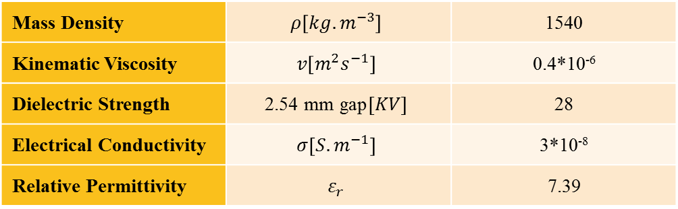
5
EXPERIMENTAL PARAMETERS
Static pressure recorded for 200 seconds
Highvoltage DC power supply is Spellman
Pressure sensor is HCLA
Typical characteristics of HFE7100 at 20°C
Mass Density | $$ρ\left[{kg.m}^{−3}\right]$$ | 1540
Kinematic Viscosity | $$v\left[m^{2}s^{−1}\right]$$ | 0.4*10⁻⁶
Dielectric Strength | $$\text{2}\text{.}\text{54 }\text{mm} \text{gap}\left[KV\right]$$ | 28
Electrical Conductivity | $$σ\left[{S.m}^{−1}\right]$$ | 3*10⁻⁸
Relative Permittivity | $$ε_{r}$$ | 7.39

Slide 8
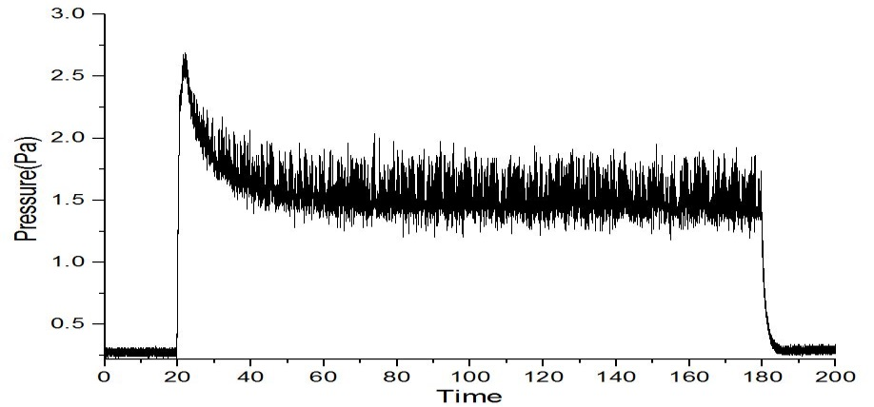
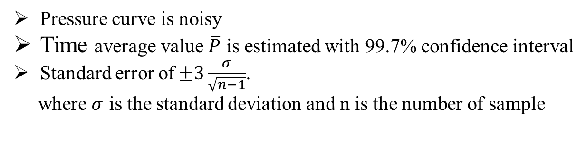

6
EXPERIMENTAL RESULT
Pressure vs Time curve for voltage 12KV
$$d_{i}=0.5mm,H=4mm,D_{i}=12mm$$
Pressure curve is noisy
Time average value $\overline{P}$ is estimated with 99.7% confidence interval
Standard error of$±3\frac{σ}{\sqrt{n−1}}$.
where $σ$ is the standard deviation and n is the number of sample

Slide 9
7
EXPERIMENTAL PROTOCOL
All parts of pump are washed and assembled
Warm up time is 20 minutes with supply of 6KV voltage
For better accuracy, every experiment relax time is set for 10 minutes

Slide 10
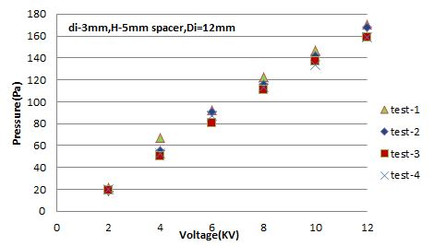
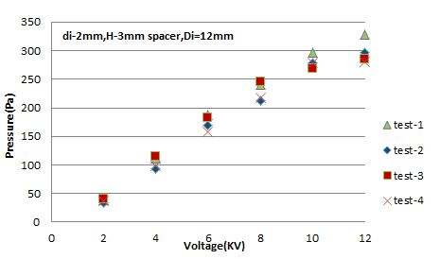
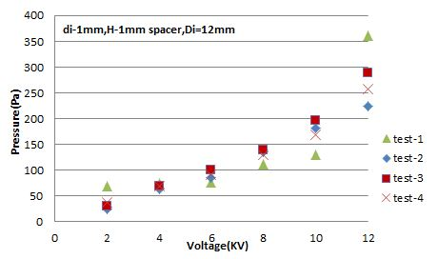
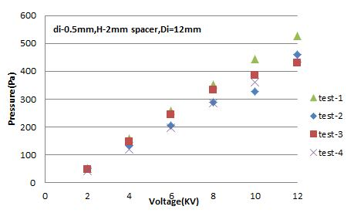
RESULT-INFLUENCE OF ELECTRODE HOLE SIZE IN PRESSURE
Graph-1
Graph-2
Graph-3
Graph-4

Slide 11
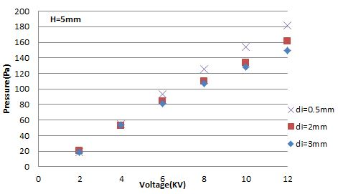
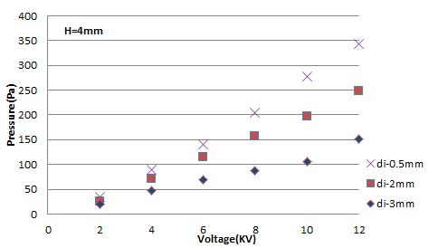
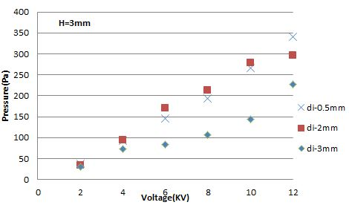
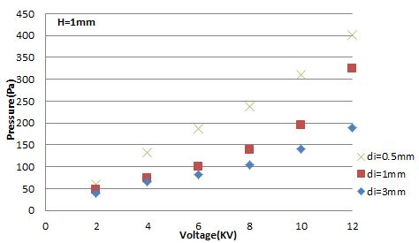
RESULT-INFLUENCE OF THE SPACER THICKNESS IN PRESSURE
Graph-1
Graph-2
Graph-3
Graph-4

Slide 12
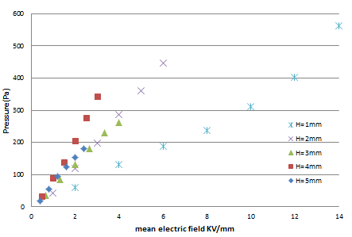

RESULT-INFLUENCE OF THE MEAN ELECTRIC FIELD
Pressure and mean electric field KV/mm
$$d_{i}=0.5mm,H=1 to 5mm,D_{i}=12mm$$

Slide 13
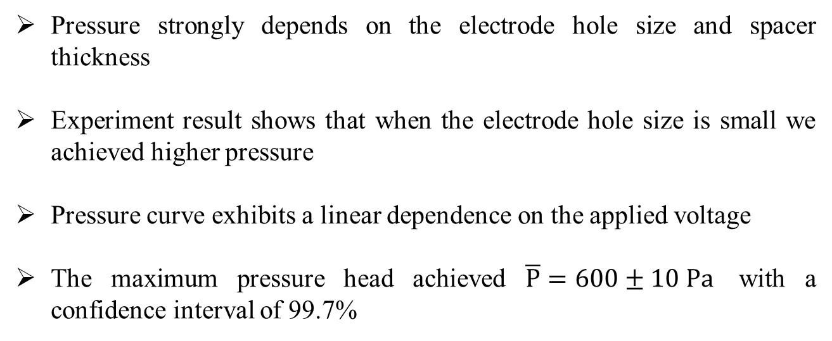
8
CONCLUSION
Pressure strongly depends on the electrode hole size and spacer thickness
Experiment result shows that when the electrode hole size is small we achieved higher pressure
Pressure curve exhibits a linear dependence on the applied voltage
The maximum pressure head achieved $\overline{P}=600±10 Pa$ with a confidence interval of 99.7%

Slide 14


Slide 15


