Slide 1


FIRST INTERNATIONAL WORKSHOP ON ELECTRO-HYDRO-DYNAMICS AND TRIBO-ELECTROSTATICS
UMSE
ELECTRODE ARRANGEMENT IMPACT ON HEAT TRANSFER IN HORIZONTAL CHANNELS
Rahma Gannoun, Walid Hassen, Mohamed Naceur Borjini, Habib Ben Aissia
Research Unit of metrology and energy systems, National School of Engineers of Monastir

Slide 2

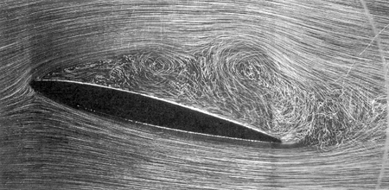
What is Electrohydrodynamic (EHD)
EHD is an interdisciplinary field dealing with the interaction of fluids and electric fields or charges
Simple devices
The size of the device is small and the shape and the size of the electrodes can be easily adjusted
Electric energy
Kinetic energy
The flow responds rapidly to the applied electric field
Lower power consumption and noise
Promising opportunities in heat transfer enhancement
High efficiency in the case of small temperature difference
Notes:
Then from this simple definition, we can conclude that if we apply an electric field to a fluid confined in a cavity, creating a potential difference, we will generate a movement so there is a transit from electric energy to kinetic energy
EHD presents many advantages
Based on all these advantages, EHD presents promising apportunities in heat transfer enhancement

Slide 3
Objectives
Resolution of the problem of electro-thermo-convection ( electro-convection coupled with heat transfer) in horizontal channels
The majority of the researches done until now are either theoretical or experimental, however the complete resolution of equations modeling the problem is still very rare
Effect of electrodes’ arrangement on heat transfer
Characteristics of the flow and heat transfer in conjunction with Rayleigh number, electric Rayleigh and electrodes position

Slide 4
Problem Geometry
θ_{F}
Generator
Dielectric fluid
(ε, K)
θ_{C}
Temperature Difference
Δθ =θ_{C}-θ_{F}
Potential
Difference
ΔV =V₀-V₁

Slide 5
Mathematical formulation
Continuity Equation
Navier Stokes equation
Energy equation
charge
conservation
Maxwell Gauss equation
equation
Defining the electric field

Slide 6
Mathematical formulation
Electric forces
Current density

Slide 7
Mathematical formulation
For universal and convenient description, it is customary to work with dimensionless equations and for this we introduce the dimensionless following quantities :
To simplify the calculation including the existence of the term of the pressure that appears in the Navier Stokes we had recourse to formalism "vorticity - stream function" (ψ-ω)

Slide 8
Mathematical formulation

Slide 9
Mathematical formulation
Ra Rayleigh number: characterizes the heat transfer mode in a fluid

Slide 10
Mathematical formulation
Prandtl number Pr: represents the ratio of the diffusivity of momentum and thermal diffusivity

Slide 11
Mathematical formulation
T number of electric Rayleigh: the ratio of the Coulomb force and the viscous forces

Slide 12
Mathematical formulation
The dimensionless number C which measures the level of injection

Slide 13
Mathematical formulation
The dimensionless number M represents electro-hydrodynamic properties of the fluid

Slide 14
Mathematical formulation
We define, for convenience electrical Reynolds R

Slide 15
Electrodes arrangement (Pr=0.72, Ra=10⁴, C=10, M=10, N=4)
Four different configurations
Electrodes asymmetrically placed on the left side
Electrodes placed equidistanly on either side of the center of the channel
Adjoined Electrodes
Spaced electrodes

Slide 16

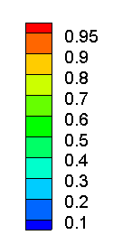



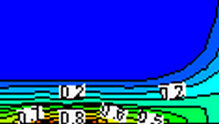











T=200
T=500
T=800
T=1200

Slide 17




Results: first electrodes’ arrangement (Pr=0.72, Ra=10⁴, C=10, N=2)
T=200
Emitting wall is gaining charges progressively
T=500
When T exceeds 200 , this parameter has no more effect on the receiving wall
T=800
T=1200

Slide 18




Results: second electrodes’ arrangement (Pr=0.72, Ra=10⁴, C=10, N=2)
T=200
Wider mushrooms when increasing T
T=500
Charges reaching the entire vertical left wall
T=800
T=1200

Slide 19




Results: third electrodes’ arrangement (Pr=0.72, Ra=10⁴, C=10, N=2)
T=200
T=500
T=800
T=1200

Slide 20




Results: fourth electrodes’ arrangement (Pr=0.72, Ra=10⁴, C=10, N=2)
T=200
Increasing T allows the narrowing of the surface covered with charges of the emitting wall
T=500
T=800
T=1200

Slide 21
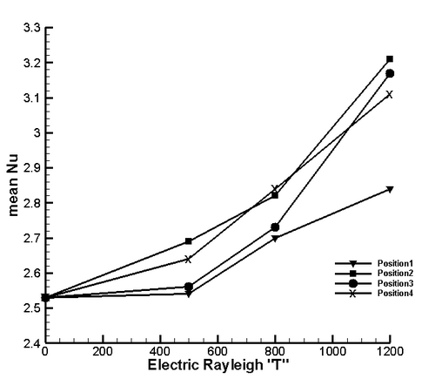
Results: heat transfer
There is a 31% increase in heat transfer comparing the conventional natural convection case and T=1200
For high T value electrodes symmetrically bonded position 3) achieve greater heat transfer
Heat transfer enhancement achieved by electrode arrangement can reach up to 13% (position 2)
Either symetrically or not, bonded electrodes provide the lowest Nu
Nusselt number in function of electric Rayleigh for different electrodes arrangement

Slide 22
Conclusion
Numerical simulations are performed to analyze the mechanism of natural convection inside horizontal channels incorporating an electrohydrodynamic effect induced by narrow strip electrodes
The flow pattern and charge density distribution are affected by the provided electric Rayleigh
placing electrodes symmetrically bonded should be avoided
Compromise should be put between electric Rayleigh, number of electrodes and convenient electrode arrangement

Slide 23


