Slide 1

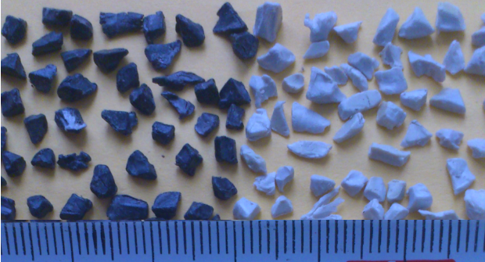
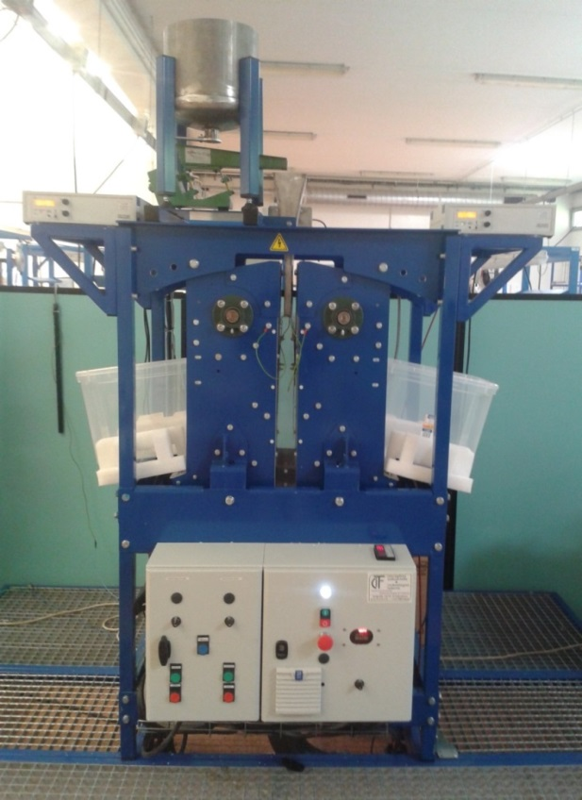
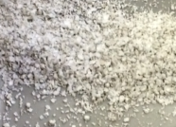
TRIBO-ELECTROSTATIC
SEPARATION OF MIXED
GRANULAR INSULATORS
ABS HIPS
Thami ZEGHLOUL
Lucien DASCALESCU
PPRIME Institute
University of Poitiers
FRANCE
HDPE

Slide 2
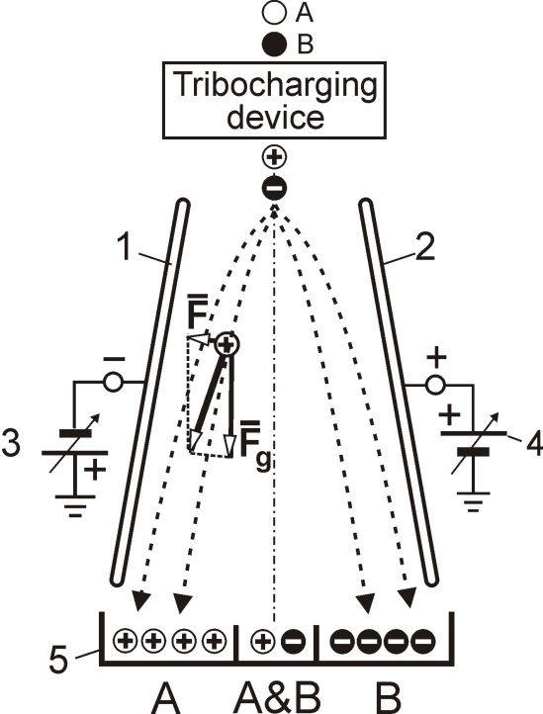
Background
Tribocharging devices
Tribo-electrostatic separators
Conclusions & Perspectives
OUTLINE

Slide 3
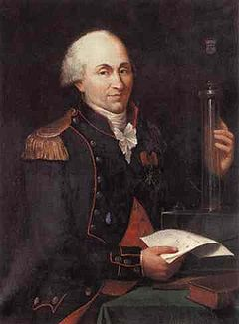
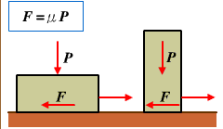
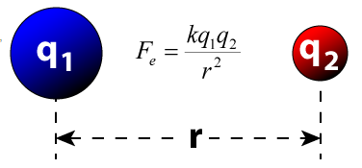
ELECTROSTATICS
Background
Tribocharging devices
Tribo-electrostatic
separators
Conclusions & Perspectives
TRIBOLOGY
Charles Auguste
COULOMB
b. 1736: Angoulême
d. 1806: Paris
PPRIME Institute – Angoulême Campus:
Two research units: “TRIBOLUB” – “ELSTAT”

Slide 4
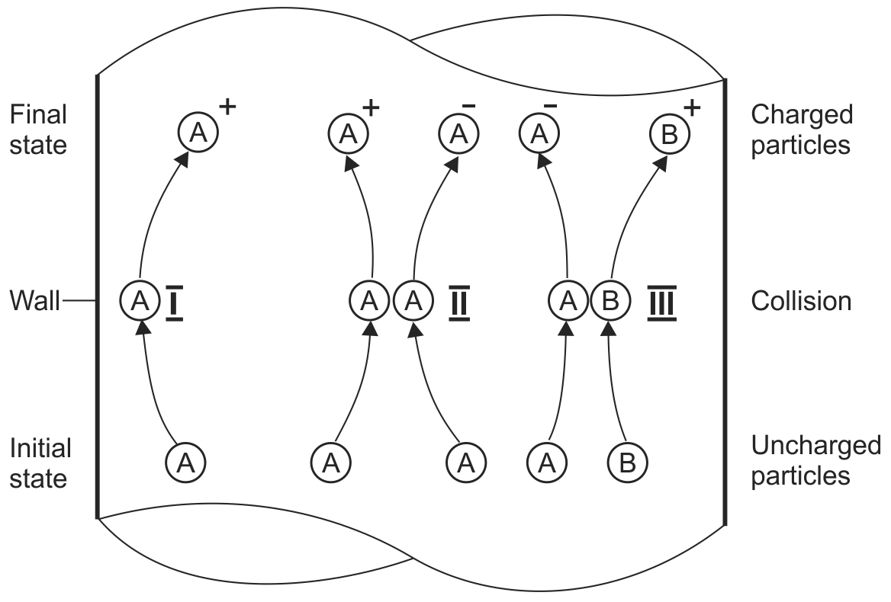
Triboelectric series
Ref. | (+) |  |  |  |  |  |  |  |  |  | (-)
Iuga et al. | Al | PMMA |  |  |  |  | PE | PET | PP | PVC
Diaz & Felix-Navarro | PA | PMMA | PC | PS |  |  | PE | PP | PET | PVC | PTFE
Park et al. |  | PMMA |  | PS | ABS |  | PET | PE | PP | PVC | PTFE
Park et al. |  | PMMA |  | PS | ABS | HIPS | PET | PE | PP | PVC
Background
Tribocharging devices
Tribo-electrostatic
separators
Conclusions & Perspectives
Tribo-
charging
mechanisms

Slide 5
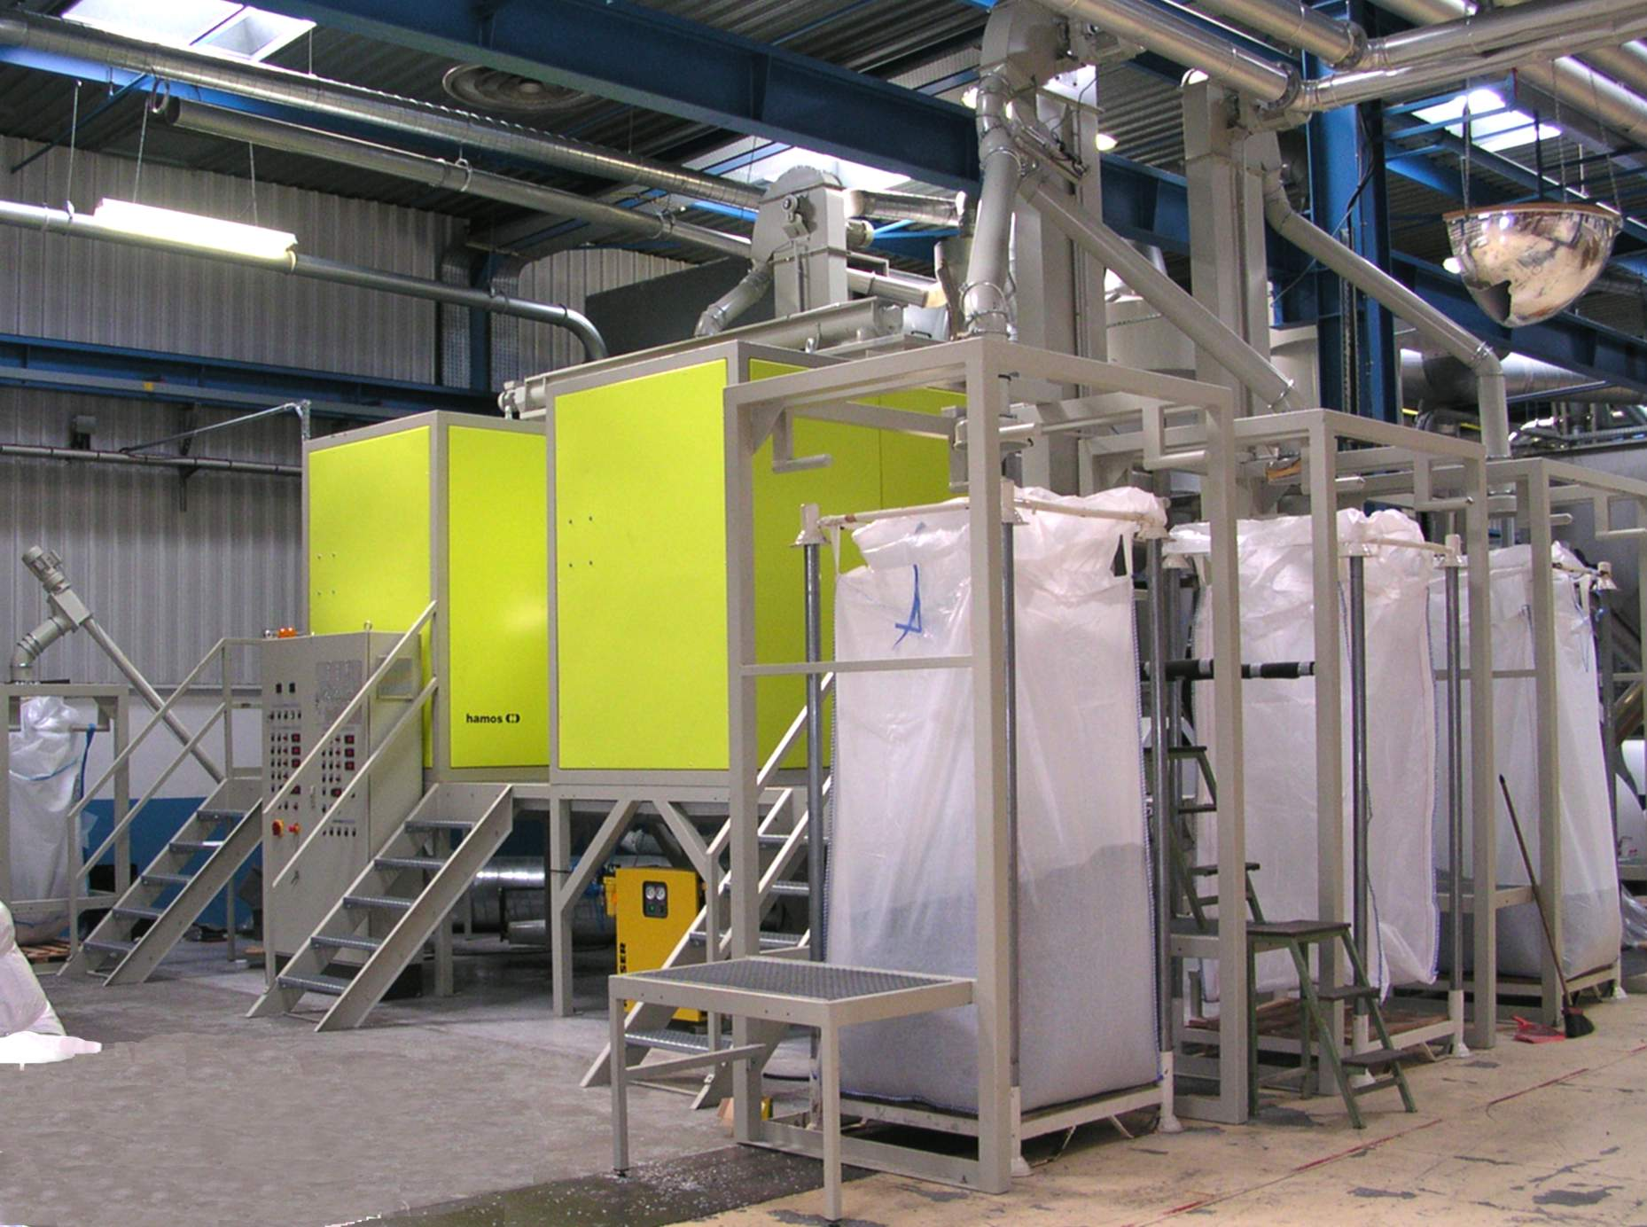
Industrial tribo-electrostatic separators
Background
Tribocharging devices
Tribo-electrostatic
separators
Conclusions & Perspectives
Hamos GmbH, Penzberg, Germany

Slide 6
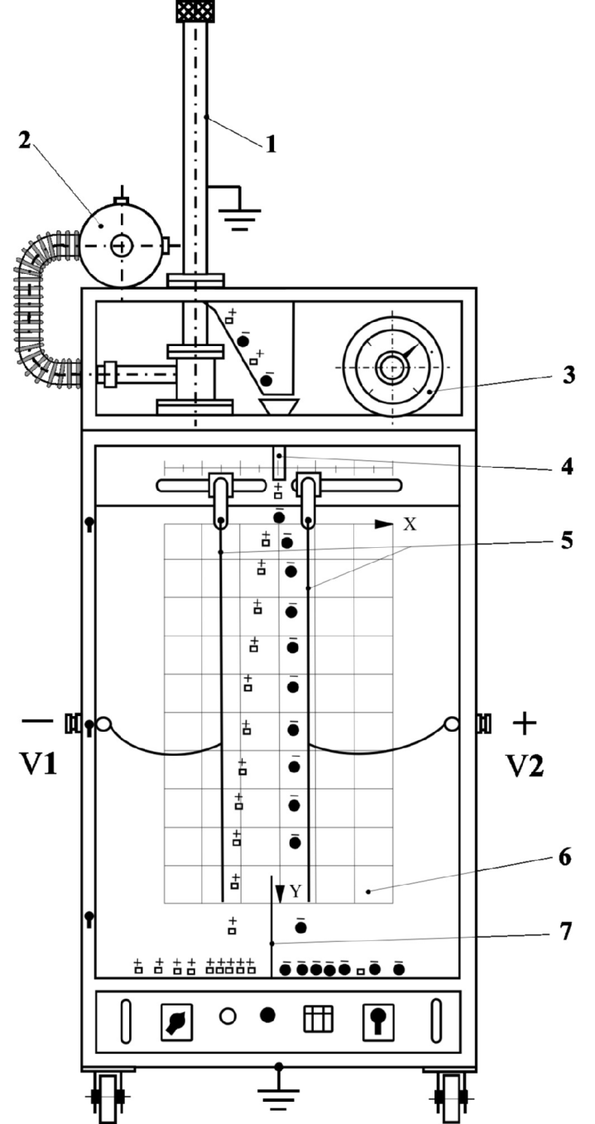
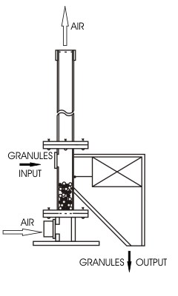
Fluidized Bed Device
Background
Tribocharging devices
Tribo-electrostatic
separators
Conclusions & Perspectives
6

Slide 7
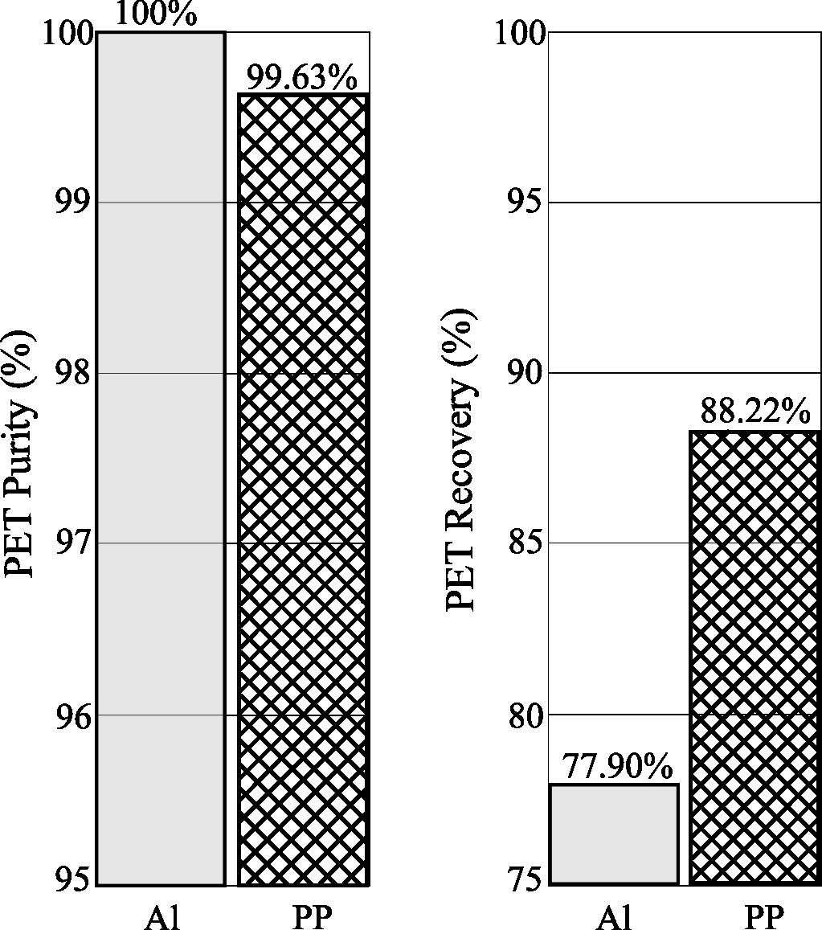
Choice of device wall material
Background
Tribocharging devices
Tribo-electrostatic
separators
Conclusions & Perspectives
PET concentrate obtained by electrostatic separation of the
90% PET & 10% PVC mixture
7

Slide 8
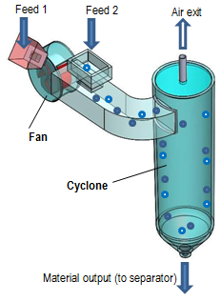
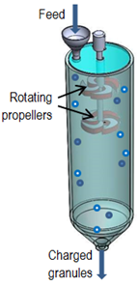
Propeller-type
device
Background
Tribocharging devices
Tribo-electrostatic
separators
Conclusions & Perspectives
Cyclone-type
device

Slide 9
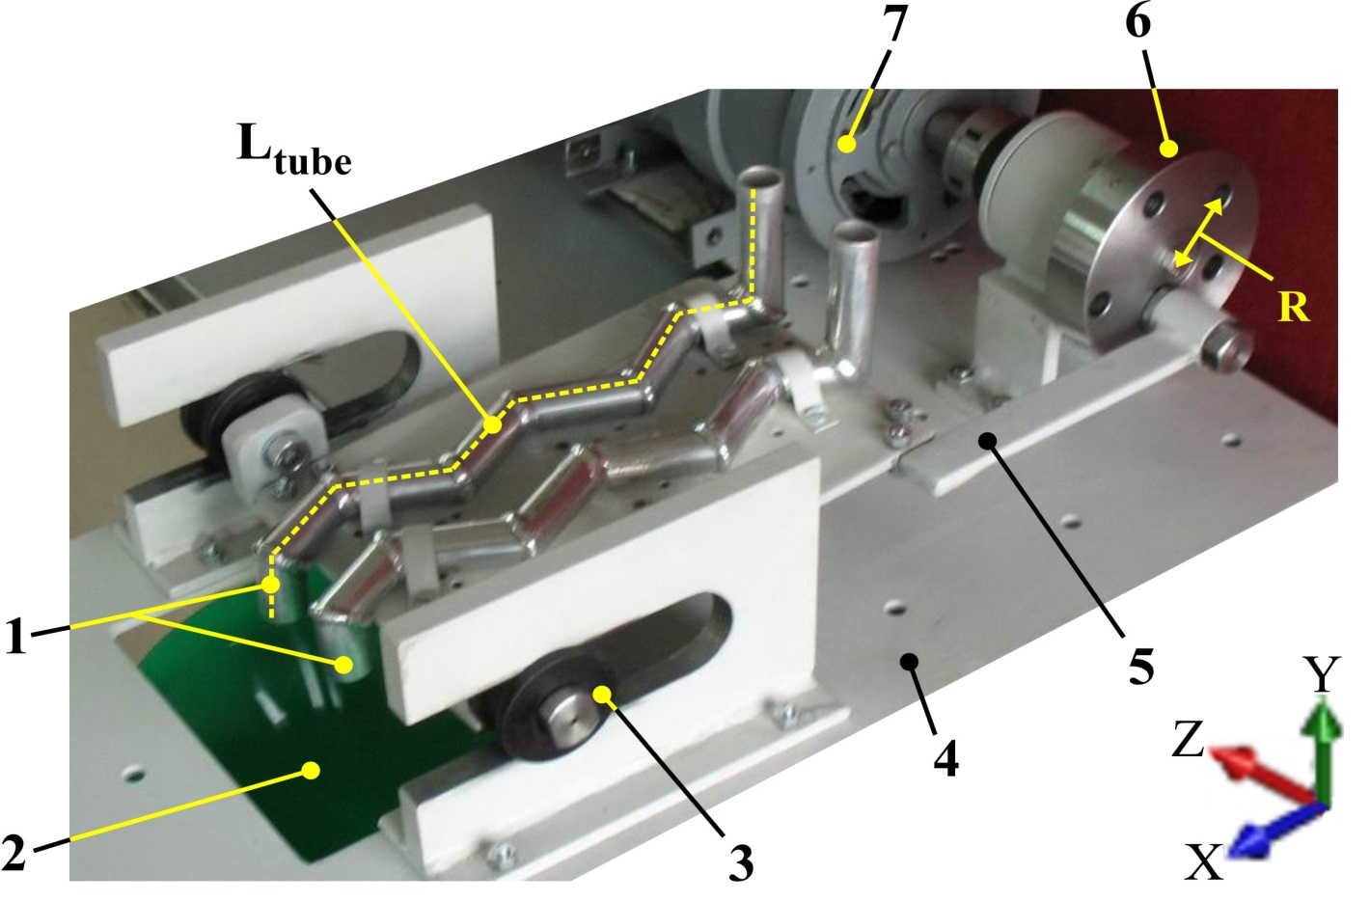
Vibratory device
Background
Tribocharging devices
Tribo-electrostatic
separators
Conclusions & Perspectives
1: tribocharging tubes; 2: opening for the evacuation
of the charged particles; 3: slider; 4: base plate;
5: tube-carrying plate; 6: eccentric wheel;
7: driving electric motor

Slide 10
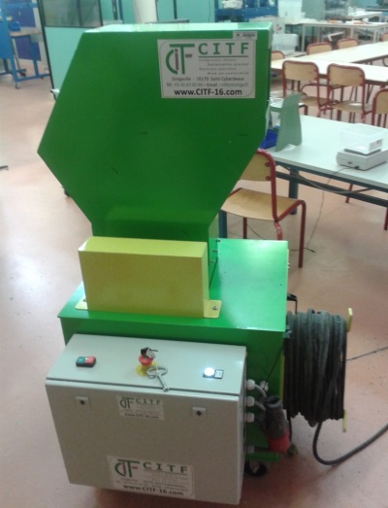
Free-fall electrostatic separator
Feeder
Upper
Frame
HV
Electrodes
Lower
Frame
Collector
Background
Tribocharging devices
Tribo-electrostatic
separators
Conclusions & Perspectives
Vibratory
tribo-
charging
device

Slide 11
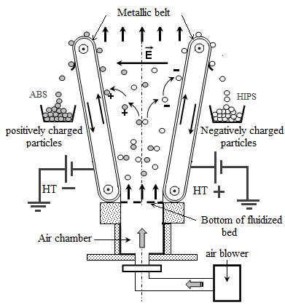
Tribo-aero-electrostatic Separator for
Granular Plastics from WEEE
Background
Tribocharging devices
Tribo-electrostatic
separators
Conclusions & Perspectives
Patent
FR2943561 (2009),
WO2010109096 (2010)

Slide 12

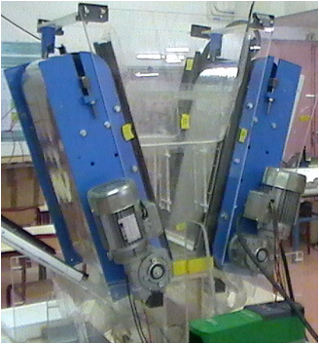
Tribo-aero-electrostatic Separator for
Granular Plastics from WEEE
Background
Tribocharging devices
Tribo-electrostatic
separators
Conclusions & Perspectives
ABS HIPS

Slide 13
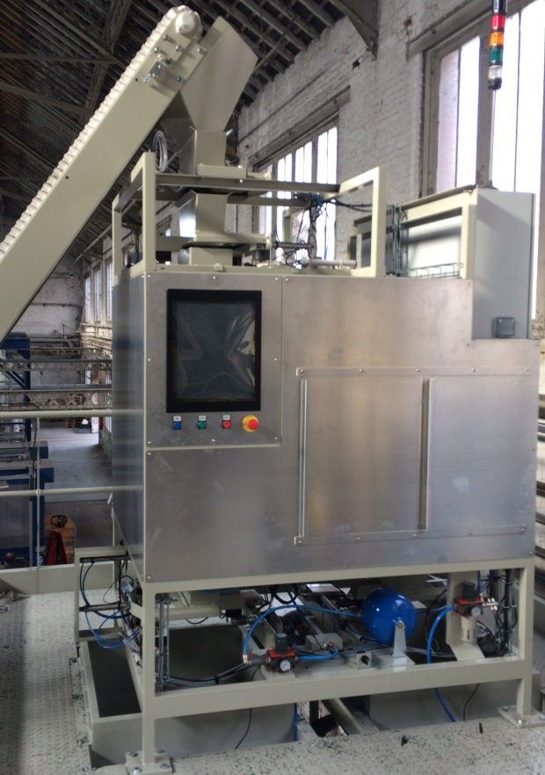
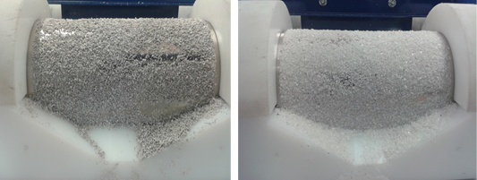
Industrial and pilot-plant TAE separators,
designed for APR2, France
Background
Tribocharging devices
Tribo-electrostatic
separators
Conclusions & Perspectives
ABS HIPS

Slide 14
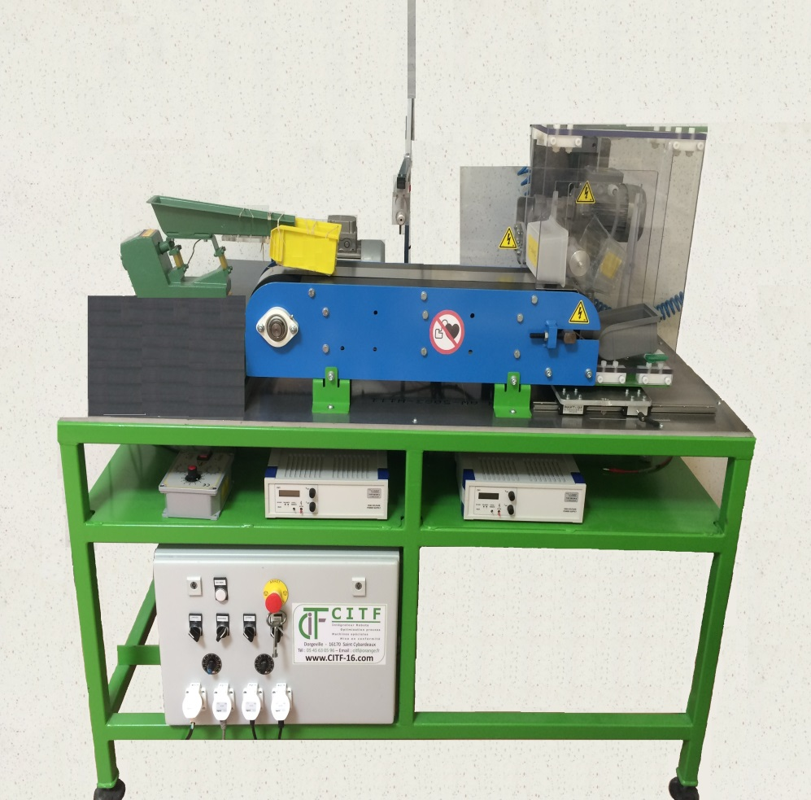
Multi-modal Electrostatic Separator for
Sub-millimetric Granular Materials
Background
Tribocharging devices
Tribo-electrostatic
separators
Conclusions & Perspectives
Partners : INRA Montpellier, U. Tech. Cluj-Napoca, U. Sidi-Bel-Abbes

Slide 15
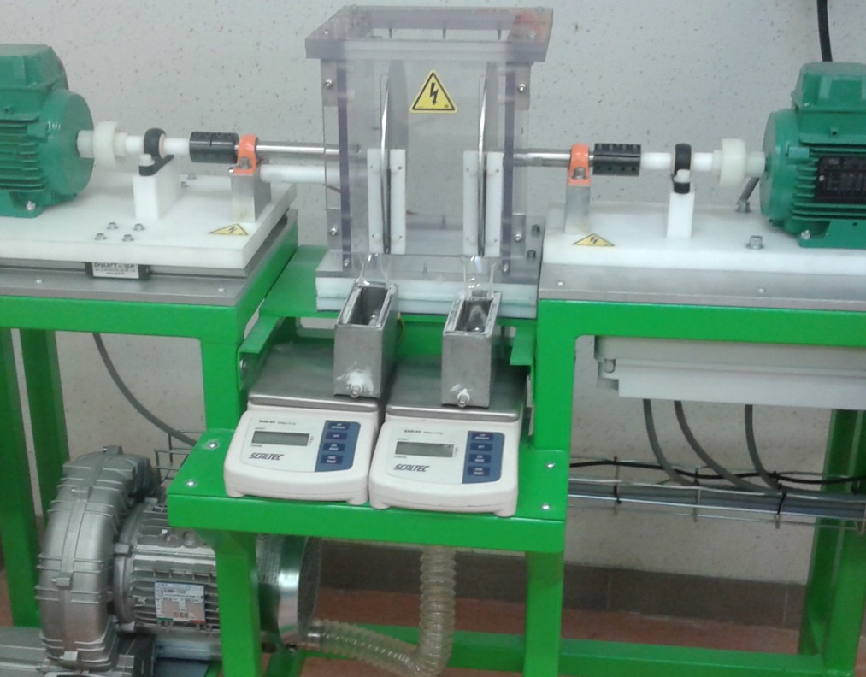
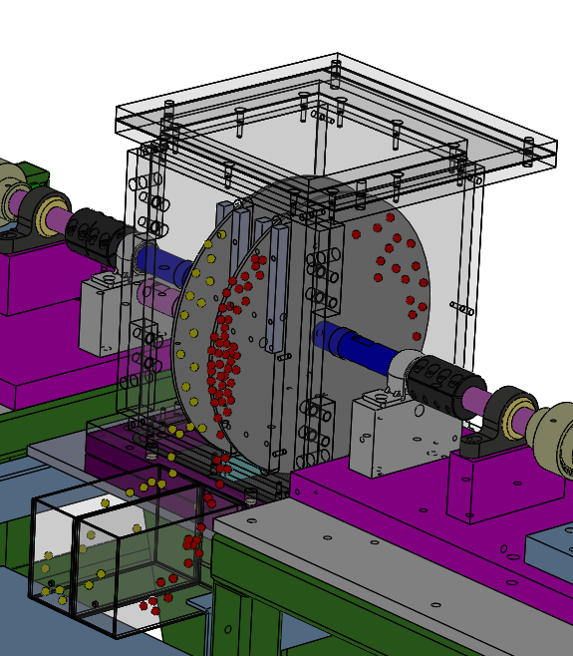
Tribo-Aero-Electrostatic Separator for
Sub-millimetric Granular Materials
Background
Tribocharging devices
Tribo-electrostatic
separators
Conclusions & Perspectives
Partners : CITF, APR2, INRA Montpellier, U. Sidi-Bel-Abbes

Slide 16
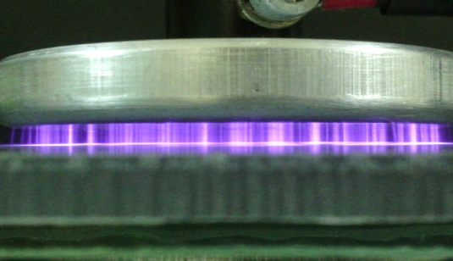
Using of DBD to modify the surface state
of the granular plastics and
improve the efficiency of
triboelectric charging
of larger particles
Background
Tribocharging devices
Tribo-electrostatic
separators
Conclusions & Perspectives
Numerical modelling of the
tribo-electrostatic separation
Processes
Development of novel
applications of the
tribo-electrostatic separation

Slide 17
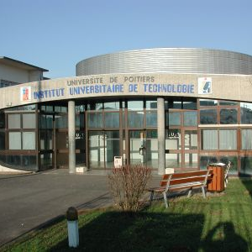

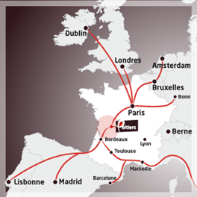
Thank you !
17

