Slide 1



1st International Workshop on Electro-Hydro-Dynamics and Triboelectrostatics,
Sept. 1-2, 2016, Poitiers, France
Lattice Boltzmann modelling of electro-hydro-dynamic flows
Kang Luo^{b}, Jian Wuª, Hong-liang Yi^{b}, He-ping Tan^{b}
ª GeoRessources Lab, Université de Lorraine/CNRS/CREGU, Nancy, France
^{b} School of Energy Science and Engineering, Harbin Institute of Technology, Harbin, PR China

Slide 2
Outline
BACKGROUND
LATTICE BOLTZMANN METHOD
NUMERICAL RESULTS
SUMMARY & PERSPECTIVES
LBM with EHD flows
Jian Wu (Univ. Lorraine)
IWEHD

Slide 3
BACKGROUND
During the last three decades, the lattice Boltzmann method (LBM), which is another kind of mesoscopic modelling approach, has experienced rapid development and has become a well-established alternative for simple and complex flows.
Owing to its kinetic particulate nature, in comparison with the conventional CFD methods, the LBM shows some attractive advantages, such as the simplicity of calculation procedure, ease in programming and boundary treatment of complex geometry, intrinsic parallelism and so on.
However, only until one decade ago, LBM has been introduced into the EHD (2006) and electrokinetic fields (2004), which is in contrast to the fact that LBM has long been applied to magneto-hydrodynamic (MHD) flows since the early 1990s.
The objective of this study is to extend the LBM to EHD flows.
LBM with EHD flows
Jian Wu (Univ. Lorraine)
IWEHD
3/20

Slide 4
Macroscopic governing equations
The classical EHD/ETHD governing equations include the Navier-Stokes equations, a reduced set of Maxwell's equations in the electroquasistatics limit and the energy equation.
Electric potential
Reduced
Maxwell's
equations
Electric field
Charge density
Navier
-Stokes
equations
Flow field
Energy equation
Temperature field
LBM with EHD flows
Jian Wu (Univ. Lorraine)
IWEHD
4/20

Slide 5
BACKGROUND
The LBM was originally used to compute the solutions of NSEs.
From the mathematical point of view, the LBM can also be viewed as a modelling approach for PDEs. Following this train of thought, the LBM has been used to various macroscopic systems (examples: …). In this study, a LBM approach is formulated for the Poisson’s equation and the charge conservation equation.
The basic idea of LBM is to solve a set of discrete equations for the mesoscopic distribution functions in a discretized computational domain. Then the macroscopic quantities (i.e., the fluid density and velocity, electric potential and charge density) can be determined by taking the hydrodynamic moments of their corresponding distribution functions.
Since the discrete equations are first order PDEs, they are much easier to solve than the macroscopic governing equations. In addition, the solution procedure of these discrete equations can be vividly understood by the collision-streaming process of some pseudo particles.
Indirect way!

Slide 6
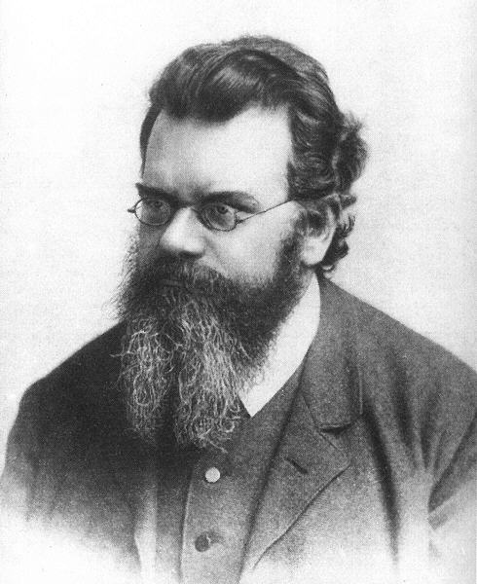
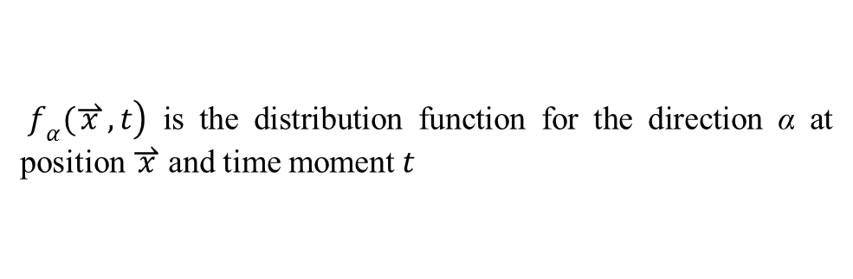
Lattice Boltzmann method
A mesoscopic method for simulations of fluid flow
$\left.f_{α}(\overset{⇀}{x},t\right)$ is the distribution function for the direction α at position $\overset{⇀}{x}$ and time moment$t$
Ludwig Boltzmann (1844 - 1906)
Navier-Stokes equations
Macroscopic
Applying multi-scale analysis
Taking moments
Taking moments
Integration, Taylor
-series expansion
Lattice Boltzmann equation
Boltzmann BGK equation
Mesoscopic
Discretization in
momentum space
LBM with EHD flows
Jian Wu (Univ. Lorraine)
IWEHD
6/20

Slide 7
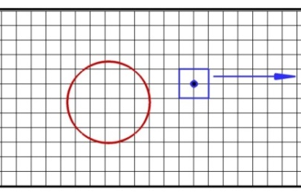
Lattice Boltzmann method
D2Q9 model
Collision
streaming
LBM with EHD flows
Jian Wu (Univ. Lorraine)
IWEHD
7/20

Slide 8
Lattice Boltzmann method
Macroscopic equations
Lattice Boltzmann equations
The macroscopic equations can be recovered from LBEs using a multi-scale analysis (e.g., the Chapman-Enskog expansion and regular expansion analysis)
LBM with EHD flows
Jian Wu (Univ. Lorraine)
IWEHD
8/20

Slide 9
Lattice Boltzmann method
Unified: all D2Q9
The Body force model in LBM
History stages: hybrid technique and Poisson-Boltzmann model
LBM with EHD flows
Jian Wu (Univ. Lorraine)
IWEHD
9/20

Slide 10
Boundary condition treatment
The BC treatment of mesoscopic method is not straightforward.
In the two-step collision-streaming implementation style, before the streaming step some distribution functions from the boundary nodes or outside of the domain are unknown, which are required to be supplemented with the given macroscopic boundary conditions.
There are a variety of boundary schemes based on different design principles have been proposed for LBE. In this study, we choose the non-equilibrium extrapolation scheme for all variables (V, q, u and θ).
LBM-DEM coupling algorithm
Jian Wu (Univ. Lorraine)
DEM7
10/18

Slide 11
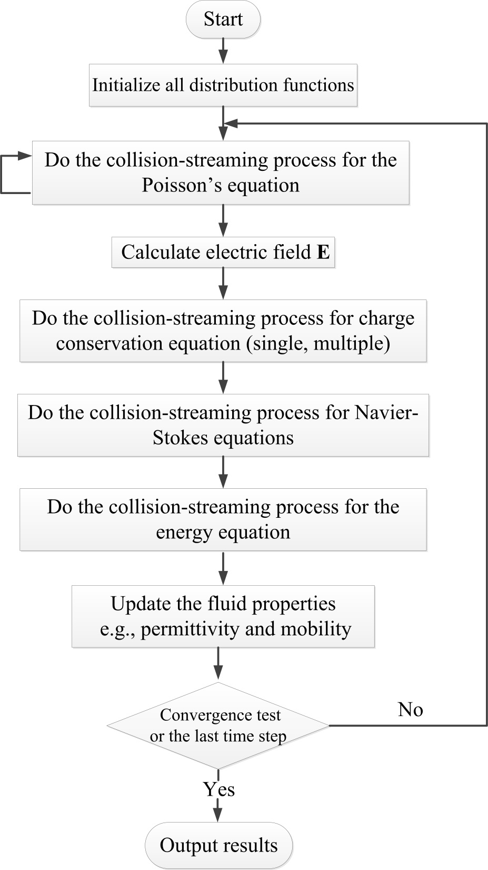

Slide 12
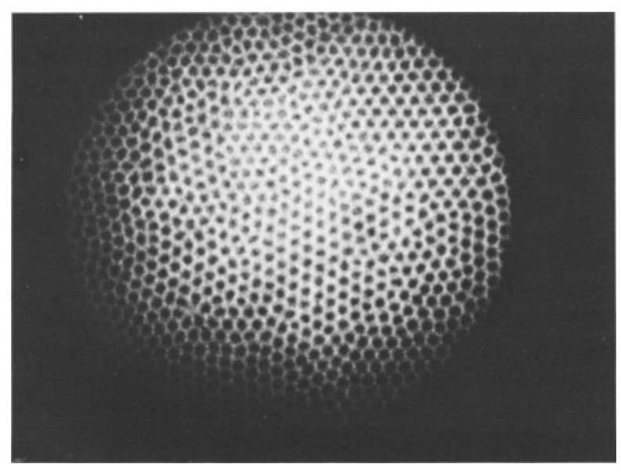
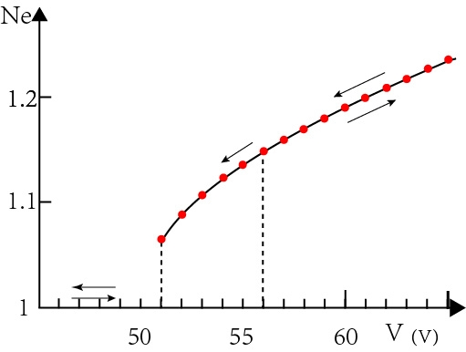
Numerical results
Electro-convection: simple geometry
ATTEN & LACROIX _ experiments
Non-linear stability
Fundamental and widely studied
Analogy to RBC, linear stability
Linear stability
Nonlinear stabilities
LBM-DEM coupling algorithm
Jian Wu (Univ. Lorraine)
IWEHD
12/20

Slide 13
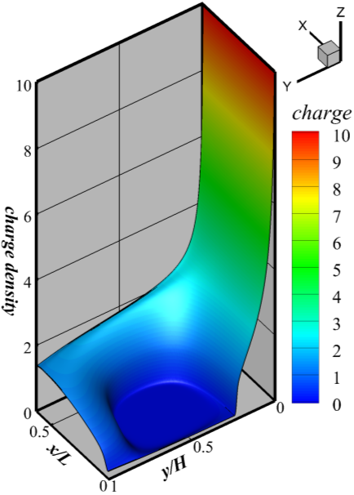
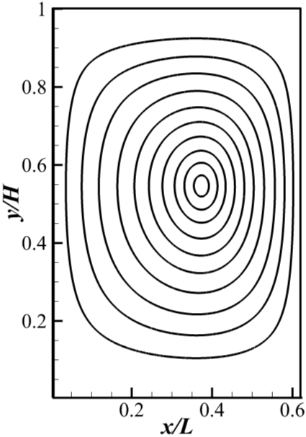
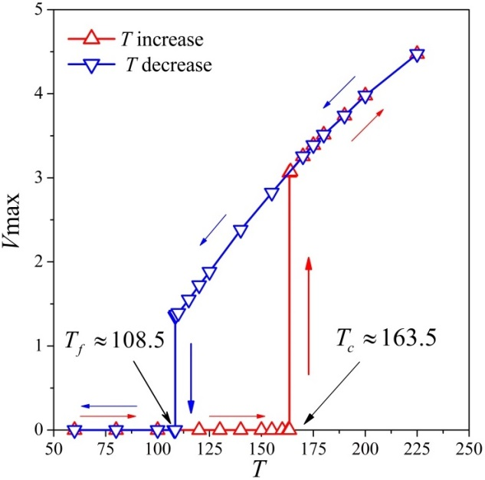
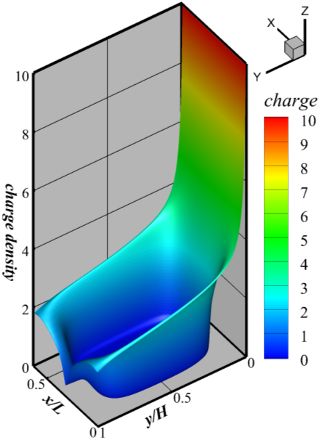
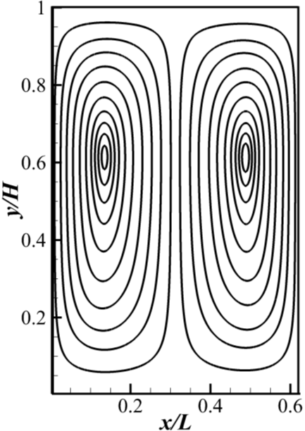
Numerical results
Electro-convection: simple geometry
LBM-DEM coupling algorithm
Jian Wu (Univ. Lorraine)
IWEHD
13/20

Slide 14
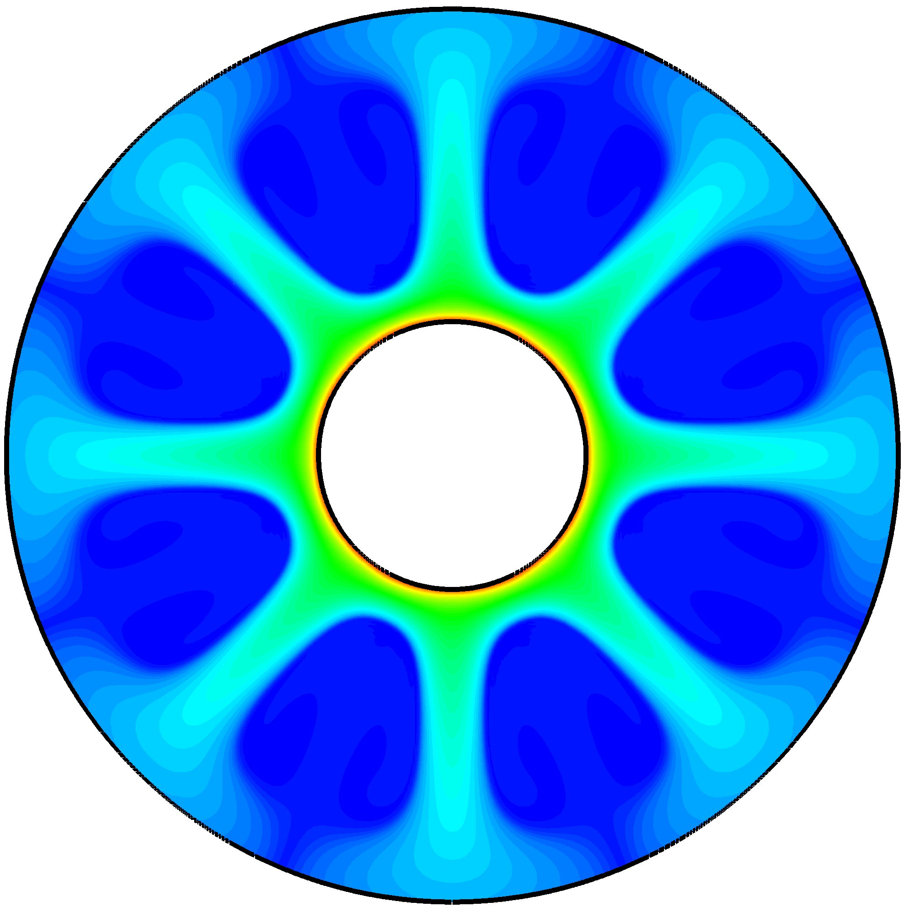
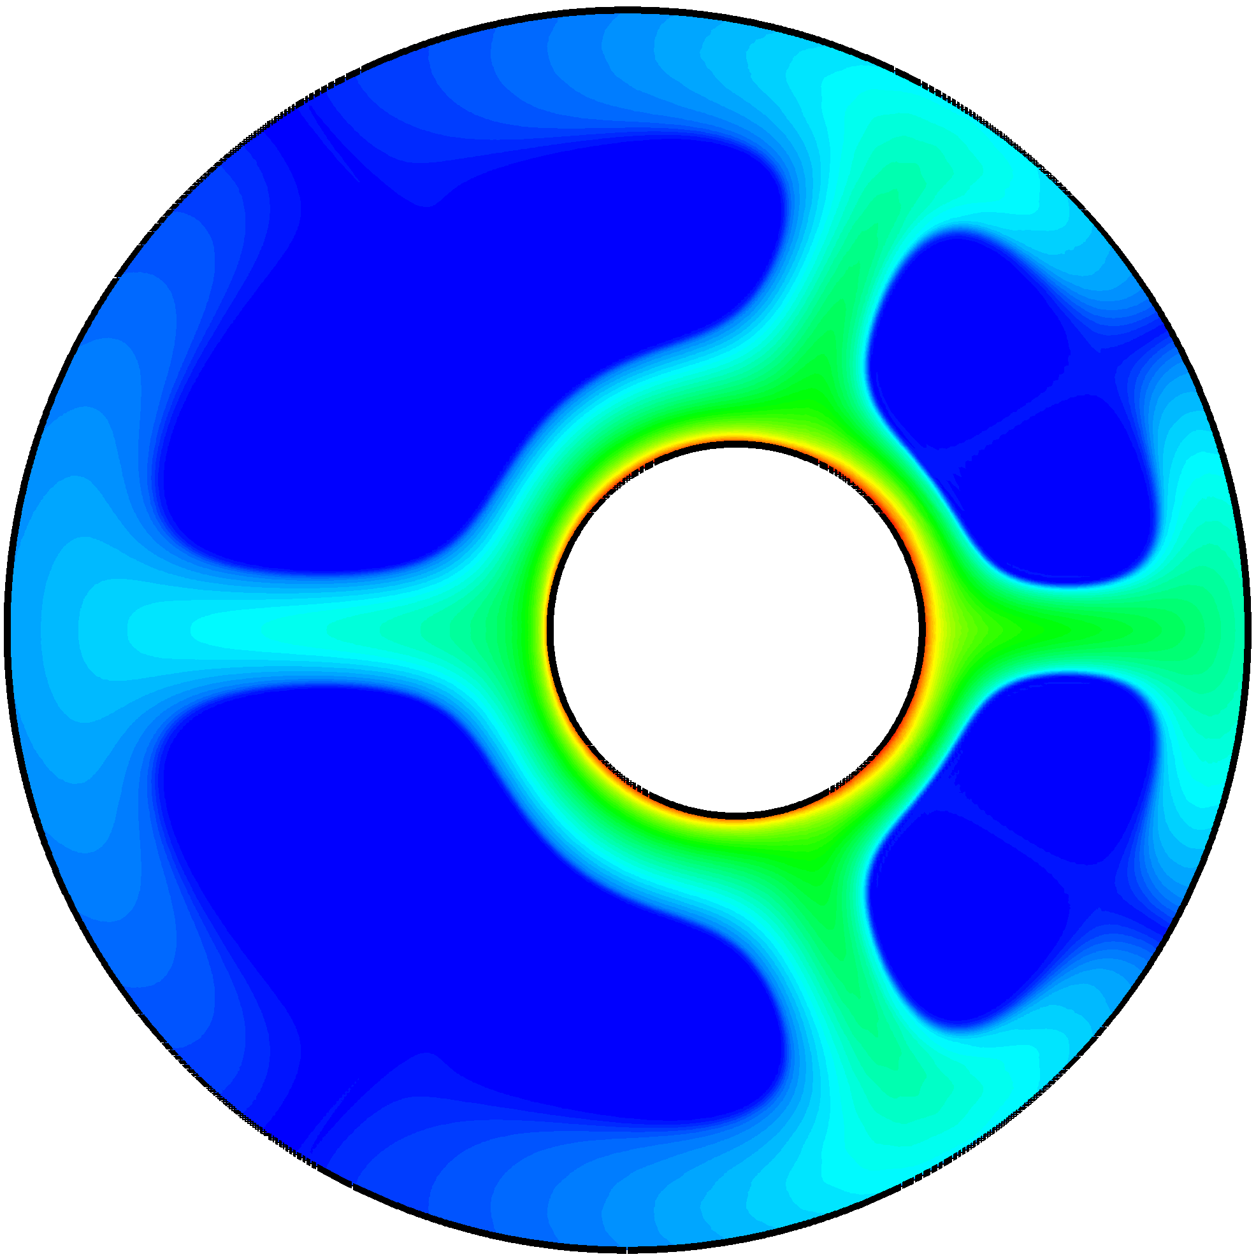
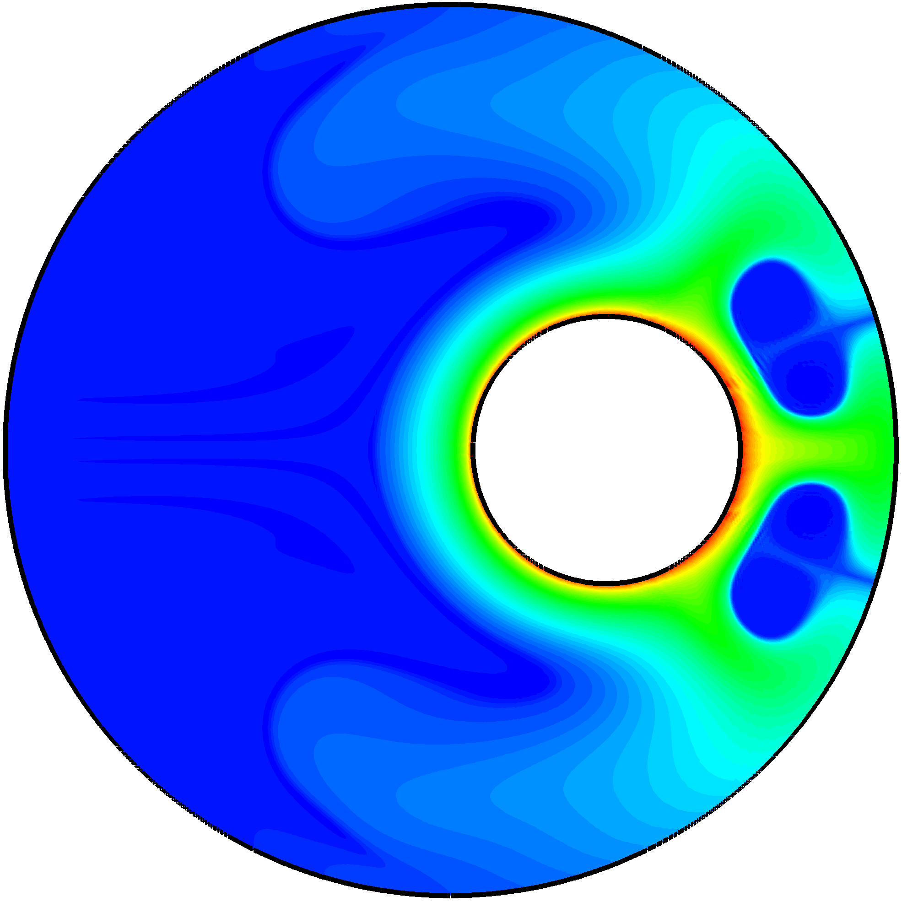
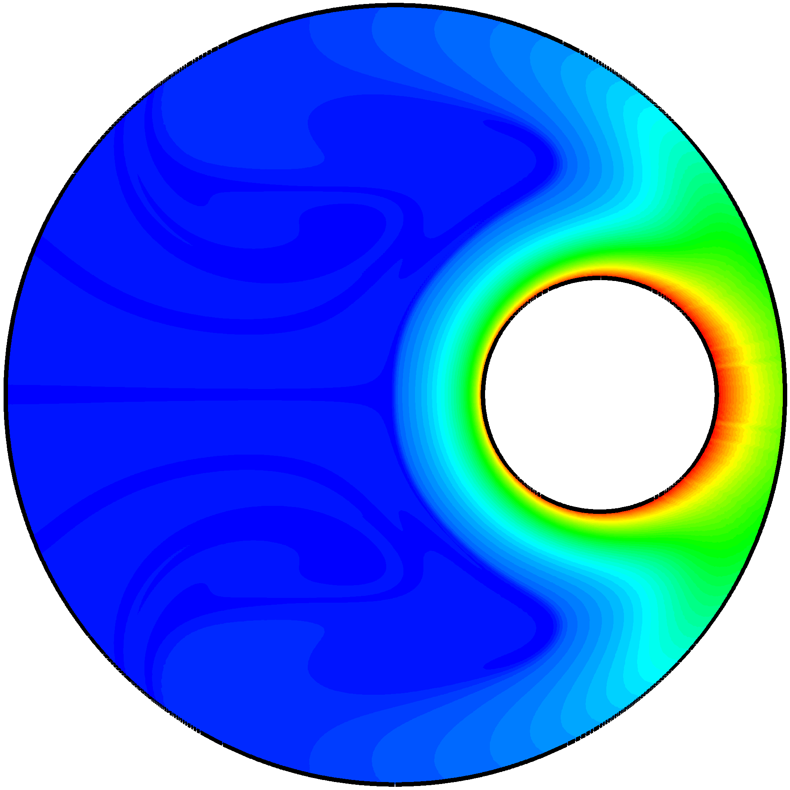
Numerical results
Electro-convection: complex geometry
Annular electroconvection at different eccentricities ( η = 0, 0.25, 0.5, 0.75) with Γ = 0.3, C = 10, T = 180, M = 10 and D = 10⁻⁴.
LBM-DEM coupling algorithm
Jian Wu (Univ. Lorraine)
IWEHD
14/20

Slide 15
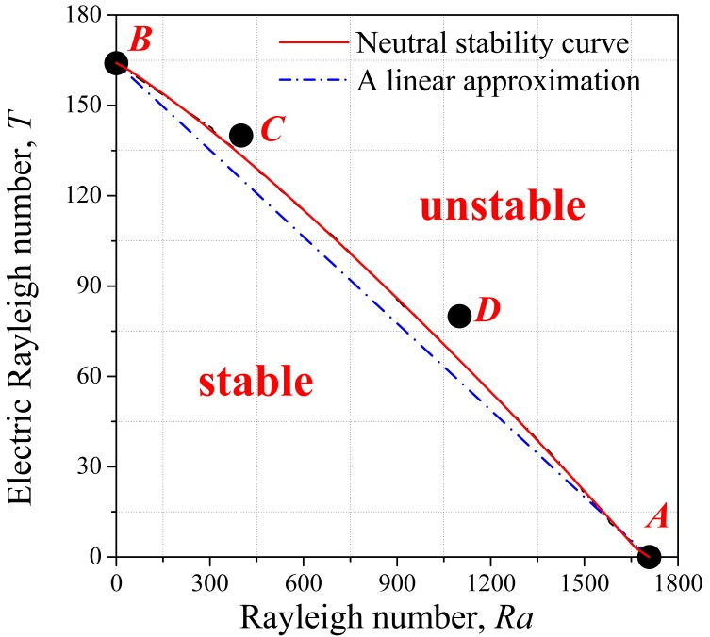
Numerical results
Electro-thermo-convection
A combination of the Rayleigh-Bénard thermal convection (RBC) and injection induced the electro-convection;
The Coulomb force and the buoyancy force cooperate with each other in destabilizing the system;
LBM-DEM coupling algorithm
Jian Wu (Univ. Lorraine)
IWEHD
15/20

Slide 16
Numerical results
Electro-thermo-convection
LBM-DEM coupling algorithm
Jian Wu (Univ. Lorraine)
IWEHD
16/20

Slide 17
Summary & Perspectives
We developed a unified lattice Boltzmann model for the simulation of electro-convective and electro-thermo-convective phenomena in single-phase dielectric liquids.
Several model problems have been considered to validate our method. The numerical tests demonstrate the strong capability and high accuracy of our LBM.
LBM can be a promising alternative for EHD and ETHD flows in simple and complex geometries.
1. Physical model: multiple species of ions
2. Extension to 3D and GPU computation
3. Benefits of LBM for turbulence modelling and multiphase flows
LBM-DEM coupling algorithm
Jian Wu (Univ. Lorraine)
IWEHD

Slide 18
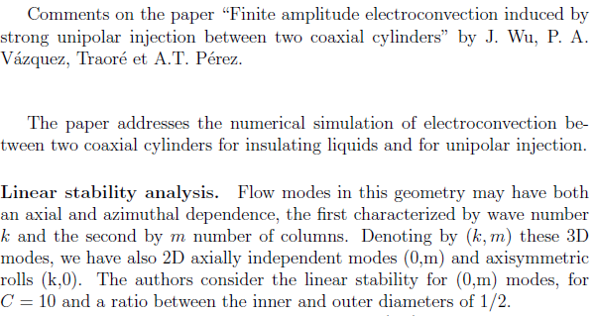
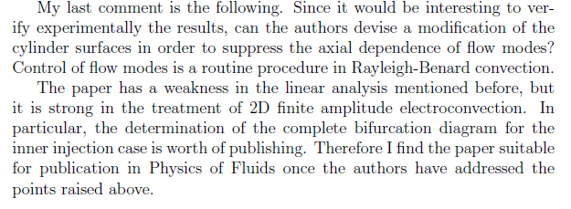
A. Castellanos
1. The life in Seville
2. The book “Electrohydrodynamics”
3. I am lucky: a review for my first PoF paper
A. Castellanos
LBM-DEM coupling algorithm
Jian Wu (Univ. Lorraine)
IWEHD

Slide 19
A. Castellanos
Electro-convection
1.1 first DNS by FDM (1987, with Atten); JFM (1997, PIC)
1.2 role of diffusion, FDM-FCT (~ 1989, with Alberto)
1.3 linear stability analysis: with various configurations (PoFx2)
1.4 injection-conduction model (with Pontiga)
1.5 other numerical methods (with Perdo; 2006, 2008 JPD, 2013C&F)
2. Electro-thermo-convection
2.0 W. J. Worraker & A. T. Richardson (1979, 1981 - JFM)
2.1 Castellanos & Velarde (1981 PoF)
2.2 Castellanos, Atten & Velarde (1984 PoF; 1984 JNET)
2.3 Rodriguez-Luist, Castellanost & A T Richardson (JPD, 1986)
2.4 Agrait & Castellanos (JNNFM, 1986)
2.5 Pontiga, Castellanos & A T Richardson (QJMAM, 1992)
2.6 Pontiga & Castellanos (IEEE_IA, 1992, 1994)
2.7 Castellanos (IEEE, 2003): rigorously derive the temperature equation from first principles.
LBM-DEM coupling algorithm
Jian Wu (Univ. Lorraine)
IWEHD

Slide 20
Thanks
Thanks for your attention. Questions?
Publications
K Luo#, J Wu*, H. L. Yi* and H. P. Tan, A unified lattice Boltzmann method for electric field-space charge coupled problems, Electrostatics Joint Conference, 13-16 June 2016, West Lafayette, IN, USA.
K Luo, J Wu, H. L. Yi* and H. P. Tan, 2016, Lattice Boltzmann model for Coulomb-driven flows in dielectric liquids, Physical Review E, Vol.93, 023309.
K Luo#, J Wu#, H. L. Yi* and H. P. Tan, 2016, Lattice Boltzmann modelling of electro-thermo-convection in a layer of dielectric liquid subjected to unipolar injection and thermal gradient, Int J Heat and Mass Transfer, Vol.103, pp. 832-846.
LBM-DEM coupling algorithm
Jian Wu (Univ. Lorraine)
IWEHD

Slide 21
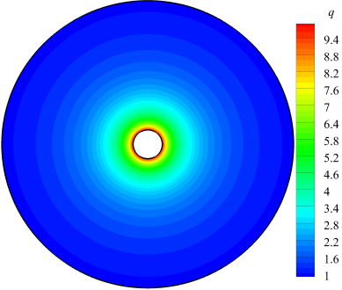
Numerical results
LBM with EHD flows
Jian Wu (Univ. Lorraine)
IWEHD
21/20

