Slide 1


Electric charge limits on settled powders
Project leader (PH.D. director): M.A.S. Quintanilla.
IFPRI Ph.D. student: J. Pérez-Vaquero.
Dept. of Electronics and Electromagnetism, Faculty of Physics, University of Seville, Spain.
CHISA 2016, Prague (Czech Republic)

Slide 2
Contents.
# Introduction
- Basic theory, charge transfer models.
# Experimental setup
# Results
- Charge in suspended particles.
- Charge in settled particles.
- Particle charge distributions.
- Charge layer model.
# Conclusions
J.Pérez-Vaquero, M.A.S. Quintanilla, A. Castellanos, Journal of Applied Physics 119, 223302(2016)

Slide 3
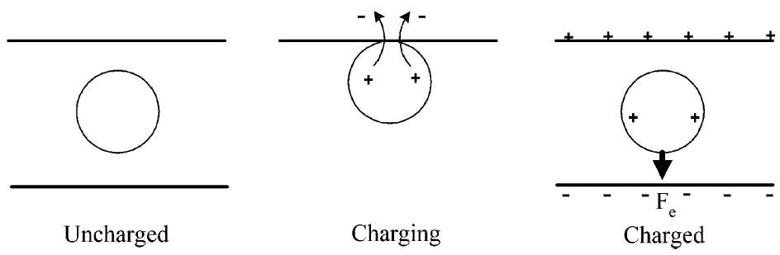
Introduction.
Tribocharging or frictional charging is the process whereby a net electric charge emerge after the contact of two solid surfaces. Different energy levels in the contacting materials give rise to a transfer of electric charge from one surface to the other, thus breaking the initial charge balance in the system.

Slide 4
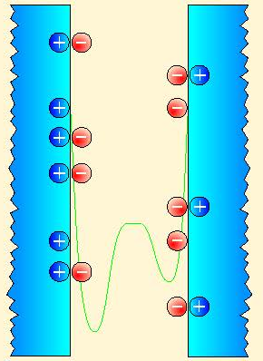
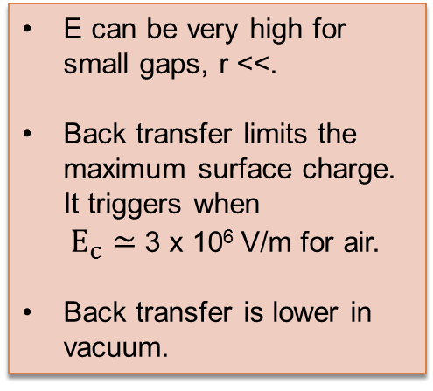

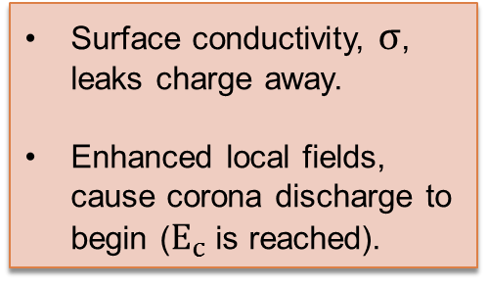

Introduction.
Contact/Impact
Separation
Aggregation
q
-q
+
-
+
r
-
$$σ$$
E_{F}^{B}
Energy
$$E=\frac{1}{4πε_{o}}\frac{q}{r^{2}}$$
eV_{C}
E_{F}^{A}
d
E can be very high for small gaps, r <<.
Back transfer limits the maximum surface charge. It triggers when $E_{c}≃$ 3 x 10⁶ V/m for air.
Back transfer is lower in vacuum.
Metal A
Metal B
Insulator A -Insulator B
Surface conductivity, $σ$, leaks charge away.
Enhanced local fields, cause corona discharge to begin ($E_{c}$ is reached).
Charge carriers
Potential energy

Slide 5
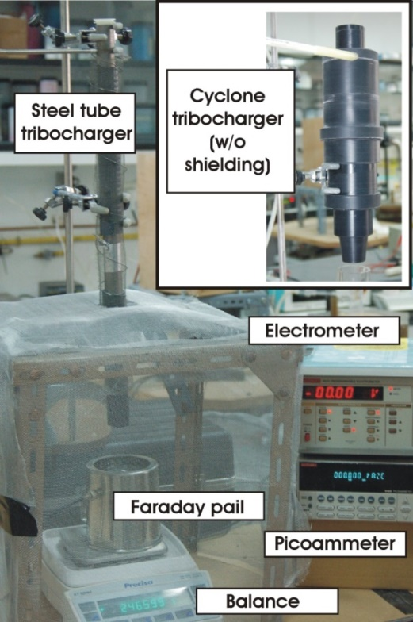
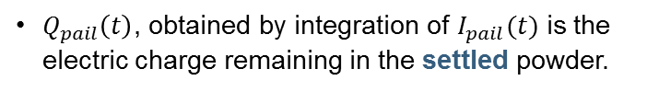

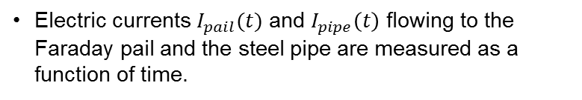


Experimental setup.
Compressed gas
Cornstarch.
5-50 µm glass beads.
70-110 µm glass beads.
90-150 µm glass beads.
PMMA beads.
Semoline.
Sugar.
Tested materials:
$$I_{tube}(t)$$
Venturi dispersion unit
A
Material feeding
$$I_{pail}(t)$$
Electric currents $I_{pail}(t)$ and $I_{pipe}\left(t\right)$ flowing to the Faraday pail and the steel pipe are measured as a function of time.
A
$Q_{tube}\left(t\right)$, obtained by integration of $I_{pipe}(t)$ is the electric charge acquired by the dispersed powder.
0.0000 g
I/O
Tare
$Q_{pail}\left(t\right)$, obtained by integration of $I_{pail}(t)$ is the electric charge remaining in the settled powder.

Slide 6
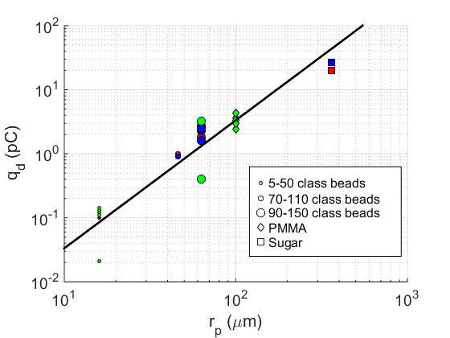

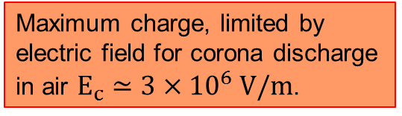
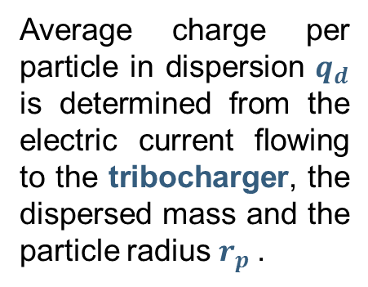
Charge limits in suspended particles.
Blue: stored at 56% RH, dispersed in compressed air.
Average charge per particle in dispersion $q_{d}$ is determined from the electric current flowing to the tribocharger, the dispersed mass and the particle radius $r_{p}$.
| |
Red: stored at 30% RH, dispersed in compressed air.
Green: stored in dry N₂, dispersed in dry N₂.
Maximum charge, limited by electric field for corona discharge in air $E_{c}≃3×{10}^{6} V/m$.
$$q_{d}≃4πε_{o}{r_{p}}^{2}E_{c}$$

Slide 7

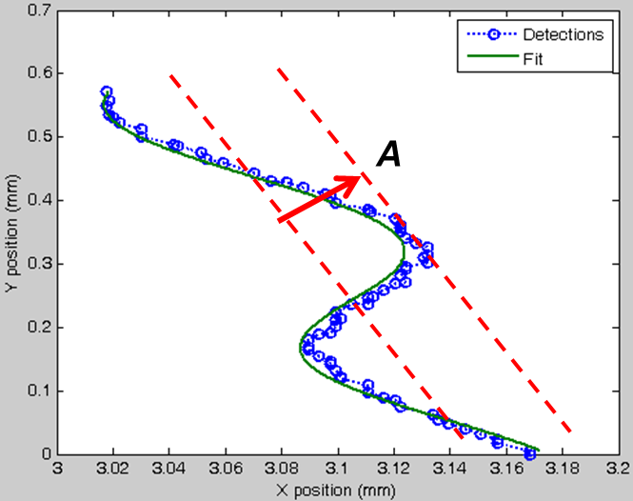
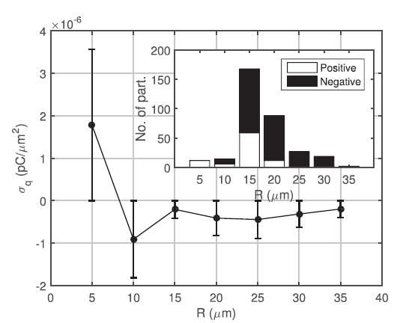
Particle charge distributions.
Particle Tracking Velocimetry (PTV) of charged 5-50 µm glass beads.
There is a bipolar charge distribution in particle charging.
After addition, the net charge is of the same polarity as that measured in the Faraday pail.
Surface charge is roughly constant with particle size for larger radii.

Slide 8
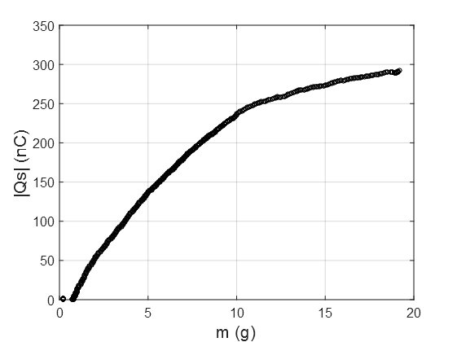
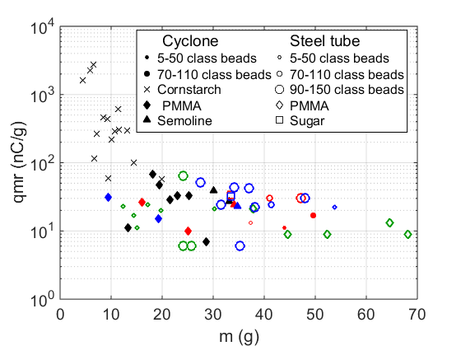


Charge in settled powders.
$$Q_{s}^{T}$$
Charge to mass ratio, qmr, depends on total cumulative charge and total collected mass:
Black: storage RH not controlled, dispersed in compressed air.
$$qmr=\frac{Q_{s}^{T}}{M_{T}}$$
Blue: stored at 56% RH, dispersed in compressed air.
Red: stored at 30% RH, dispersed in compressed air.
Cumulative charge in the Faraday pail and collected mass have a sublinear relation.
Newer settling powder retain lesser charge than the older.
Green: stored in dry N₂, dispersed in dry N₂.

Slide 9



Charge layer model.
It assumes an infinite powder layer in the horizontal plane, made of dielectric material.
The settled powder has a charge per unit volume, ρ, an electrical conductivity, σ, a bulk density, ρ_{m}, and a height, z.
The incoming powder layer has a charge, ρ_{ο}, and is fed at a mass rate F_{m}.
The bottom plate has a zero surface charge, σ_{p}, at the beginning of the experiment, that becomes non zero afterwards.
ρ_{ο}
Electrical conduction
ρ
Conductive plate
σ_{p}
System equations:
$$\frac{∂ρ}{∂t}+∇∙\vec{j}=ρ_{o}δ(t−z\frac{ρ_{m}}{F_{m}})$$
$$∇\vec{∙D}=ρ+σ_{p}δ(z)$$
$$\frac{dσ_{p}}{dt}=−j_{z}\left(0,t\right)=−\frac{σ}{ε}D_{z}(0,t)$$

Slide 10
Charge layer model.
Charge (adimensional)
Sublinear relation

Slide 11
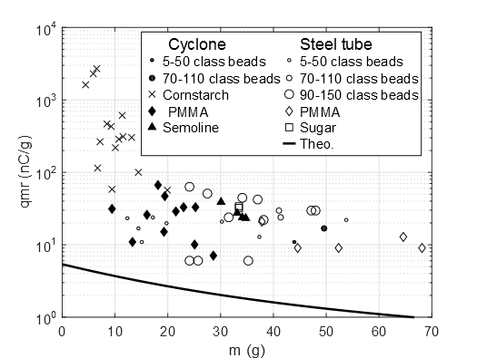
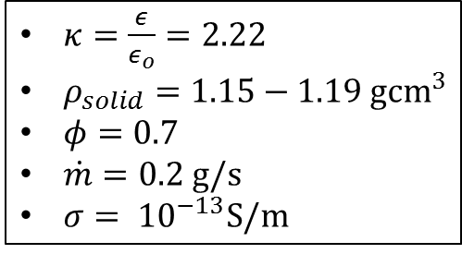
Charged layer model.
Solid line: Prediction of qmr vs collected mas for pmma beads.
$κ=\frac{ε}{ε_{o}}=2.22$
$ρ_{solid}=1.15−1.19 g{cm}^{3}$
$φ=0.7$
$\dot{m}=0.2 g/s$
$σ= {10}^{−13}S/m$

Slide 12
Conclusions.
The maximum electric charge on a particle surface in dilute suspension is limited by the breakdown field of gas rather than physical mechanisms during charge transfer.
Charge in settled powders is concentrated in the layers close to the powder surface.
Charge to mass ratio (qmr) in the powder decreases with the collected mass.
Aggregation and deposition of charged particles is accompanied by corona discharge.

