Slide 1
Water flows induced by AC electric fields in microsystems
Antonio Ramos
Collaborators:
Antonio Castellanos¹
Pablo García-Sánchez¹
Antonio González¹
Nicolas G. Green²
Hywel Morgan²
¹Univ. Seville, ²Univ. Southampton
University of Seville
FIRST INTERNATIONAL WORKSHOP ON ELECTRO-HYDRO-DYNAMICS AND TRIBO-ELECTROSTATICS
Poitiers, France, 2016

Slide 2
This talk builds upon the following work…

Slide 3
Outline
Introduction: AC electric fields in microsystems
Equations and boundary conditions
Flows induced by electrical forces in liquid bulk
Flows induced by electrical forces in double layer
Flow maps

Slide 4
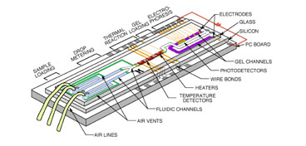
Why microsystems?
Burns et al. 1998.
An integrated nanoliter DNA analysis device. Science 282:484–87
The lab on a chip
Notes:
Example: bio-chemical analysis of a drop of blood

Slide 5
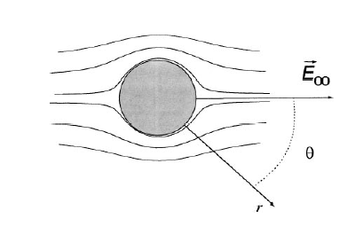
DC fields are widely used in microsystems: electrophoresis and electroosmosis
-
+
-
+
+
electrophoresis
-
-
+
+
+
-
V
∼λ_{D} ∼10nm
E(x)
zero back
pressure
diffuse charge
velocity
profile
fixed charge
(in glass)
electroosmosis

Slide 6
Why to use AC electric fields?
One reason:
We want the electrodes inside microchannels in order to have low voltage
DC voltage
V
e-
V
e-
X⁻
Y⁺
X
X
X⁻
Y⁺
X⁻
X⁻
E=0
E
X⁻
Y⁺
Y⁺
Y⁺
X⁻
Y⁺
Y
Y
red-ox reactions
below threshold voltage
above threshold voltage
Notes:
charge carriers are different in the metalic wires and in the liquid, redo reactions appear.

Slide 7
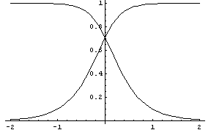
To employ low voltages
One reason:
We want the electrodes inside microchannels => low voltage Using AC voltages we avoid Faradaic reactions
V(t)
~
usually negligible
C_{DL}
C_{b}
C_{DL}
2|V_{DL}|/V₀
|V_{bulk}|/V₀
R_{DL}
R_{b}
R_{DL}
double
layer
bulk
double
layer
log(ω/ω_{c})
ω_{c}=1/R_{bulk}C_{DL}
For AC currents, double layer
charging must be considered
Notes:
This allows us the use of normal batteries for portable devices

Slide 8
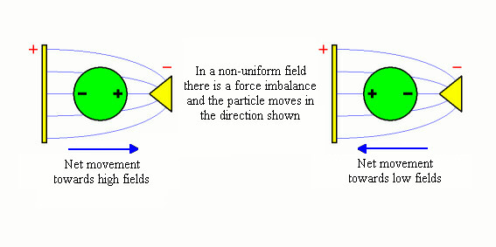
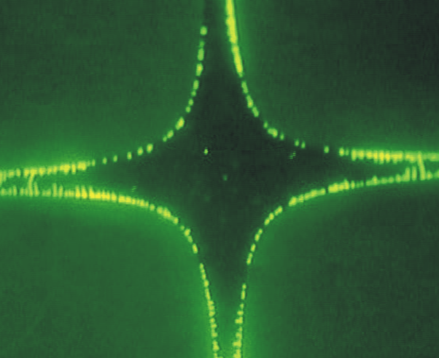
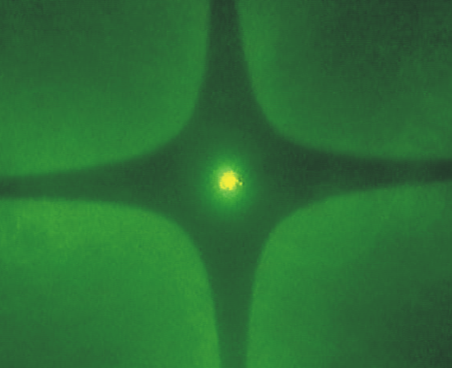
To take advantage of frequency-dependent properties
Another reason: Dielectrophoresis depends on frequency
0.5 MHz
5 MHz

Slide 9
Outline
Introduction: AC electric fields in microsystems
Equations and boundary conditions
Flows induced by electrical forces in liquid bulk
Flows induced by electrical forces in double layer
Flow maps
Notes:
I am not going to talk about jets and drops subjected to electric fields in mycrosystems: electrowetting, electrified jets

Slide 10
The electrical volume forces acting on liquid are…
Coulomb force Dielectric force Electrostriction
The Coulomb force represents the force on the free charge. It is the main term responsible for generating pumping in EHD.
Dielectric force represents the force on the induced dipoles.
Electrostriction redefines pressure, p* = p-p_{E} , no mechanical effect in liquids (incompressible).
Notes:
Once we have electric fields in water to move particles, we also have electrical forces on the liquid

Slide 11
Electric fields follow equations of Quasi-Electrostatics
In effect, magnetic fields can be neglected
either H~σ E l
or H~ε ω E l
<< 1
<< 1
(σ <10 S/m, l < 1 mm, f < 10¹⁰ Hz)
Notes:
Currents in microsystems will be in the realm of Quasi-Electrostatics.

Slide 12
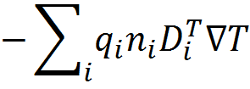
Conservation of ionic species closes the problem
electro-migration
diffusion
convection
thermo-diffusion
(strong electrolye)
When doing EHD experiments in water, it is wise to add some electrolyte in order to keep the level of conductivity (equal or above 10⁻⁴ S/m)

Slide 13
In the bulk, electrical current equation can be simplified to Ohm’s law
electro-migration
diffusion
convection
diffusion
migration
convection
migration
electric
Reynolds
number
<< 1

Slide 14
The equation that determines E is…
After a short transient (t=ε/σ),
for AC fields the equation becomes…
AC fields using phasors if
…and it is now the equation that determines E
Notes:
conductivity and permittivity vary slowly with time

Slide 15
Simplified model
AC fields using phasors if
…and it is the equation that determines E
…and it is used to get charge density

Slide 16
Electrolytes are quasi-electroneutral in bulk
(1-1 electrolyte)
=0.07
the small difference is sufficient to generate observable forces

Slide 17
Origin of residual charge in the liquid bulk
we can obtain
induced charge
time-averaged force
zero if grad ε and grad σ are equal to zero

Slide 18
Conductivity is known through ionic species
Gradients in σ may come from gradients in n_{i} :
usually imposed gradients
Faradaic reactions can produce concentration polarization
Gradients in σ may also come from gradients in μ_{i} due to gradients in temperature, μ_{i} = μ_{i}(T), that is σ = σ (T)

Slide 19
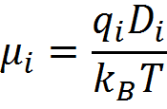
We can use bi-polar conduction model to find equation for σ under iso-thermal conditions
from electroneutrality n₊=n₋

Slide 20
Mechanical equations in microsystems
Liquid motion is governed by
Navier-Stokes with Re=0
In microsystems, Reynolds number is very small (inertial force / viscous force) R_{e} = ρ_{m}ul /η < 0.1
(u < 1000 μm/s, l < 100μm)
Notes:
Boussinesq approximation

Slide 21
Energy equation in microsystems
Poisson’s for T with Joule heating
we assume
Pe ~ 0.07
it can generate grad ε and grad σ because ε(T) and σ(T)
conductivity variation with T is mainly due to mobility variation with T,
Soret effect is one order of magnitude smaller

Slide 22
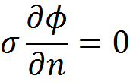
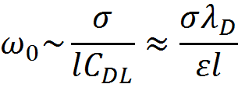
Electrical boundary conditions
polarizable surfaces (electrodes)
valid for small voltage drops in DL
other boundaries (glass)
Typical transition frequency of RC circuit.
For ω >>ω ₀ there is electric field in bulk.
For ω <<ω ₀ voltage drops mainly in DL.
~ 1kHz
V(t)
~
C_{DL}
R_{b}
C_{DL}
double
layer
bulk
double
layer
Notes:
small voltages

Slide 23
Mechanical boundary conditions
u·n=0
rigid boundaries
electroosmotic slip velocity on polarizable surfaces
for ω >>ω₀ u_{slip} goes to zero
no slip velocity on other surfaces
u·t=0
Temperature boundary condition
T=T₀ at outer boundaries

Slide 24
Outline
Introduction: AC electric fields in microsystems
Equations and boundary conditions
Flows induced by electrical forces in liquid bulk
Flows induced by electrical forces in double layer
Flow maps

Slide 25
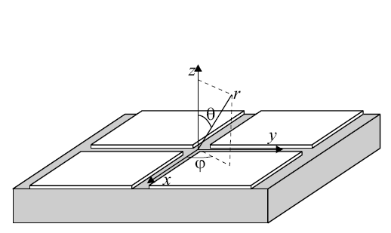
Example: Electrothermal rotating flow
(González et al, JFM, 2006)
Top view
V₀cos(ωt)
V₀sin(ωt)
-V₀sin(ωt)
-V₀cos(ωt)
3 MHz, 12 Vpp
temperature gradient comes from light heating electrodes

Slide 26
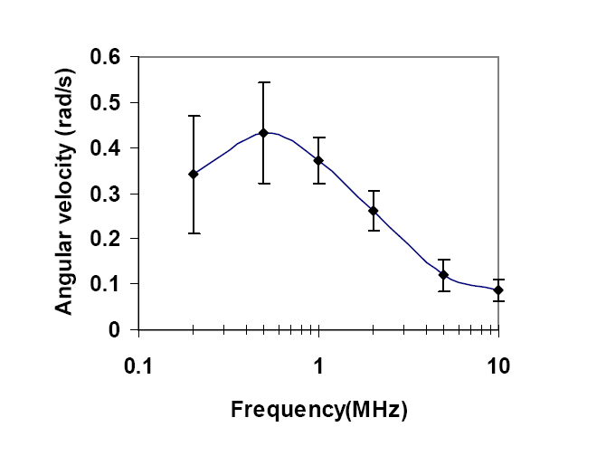
Experimental angular velocity vs frequency

Slide 27
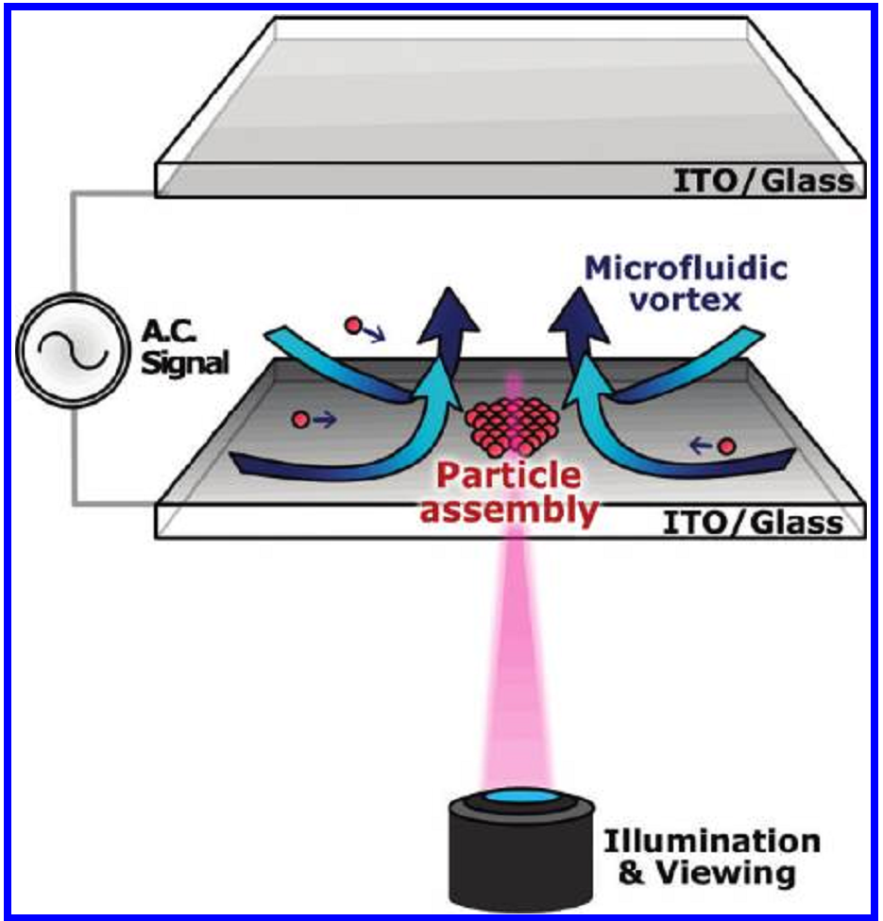
Light-induced electrothermal flow for particle collection
(Kumar et al, Langmuir, 2010)

Slide 28
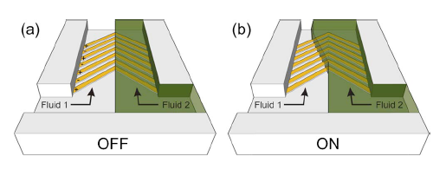
Example: control of two-phase flow
Two KCl solutions running parallel
(Morgan et al, APL, 2007)
top view
20 μm
Notes:
two phases of different salt concentration running parallel and we apply a potential difference

Slide 29
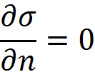
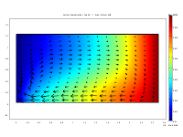
Charge induced due to grad σ
σ₁<σ₂
-
-
-
σ equation
b.c.
+ + +
- - -
(Ren et al, J Electrost, 2009)
cross section
array of electrodes

Slide 30
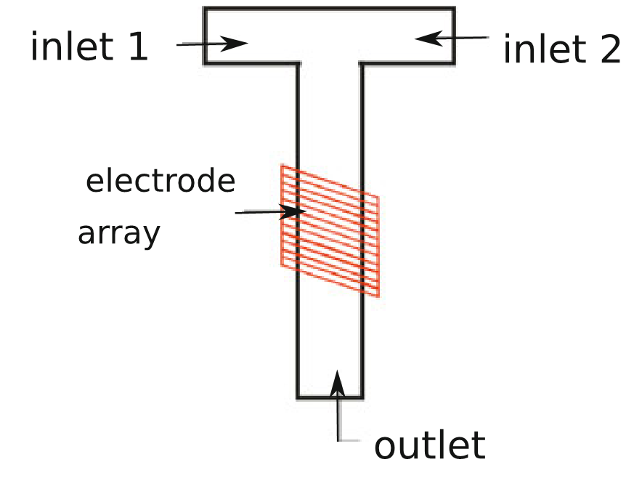
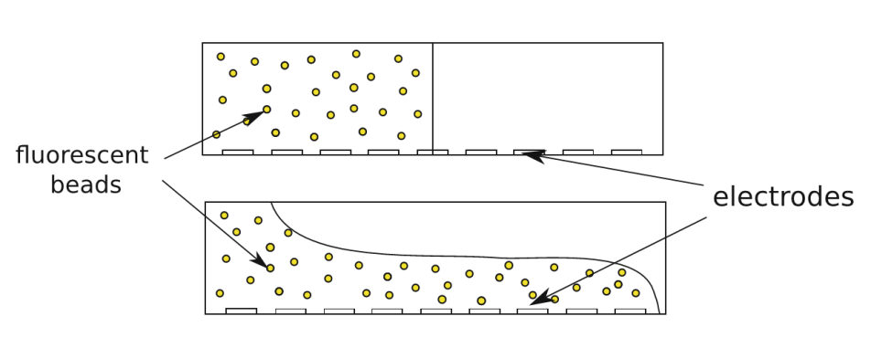
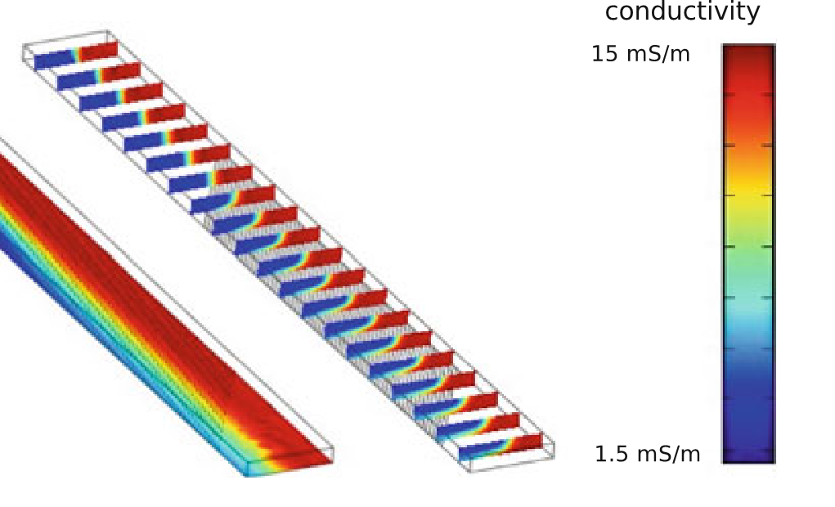
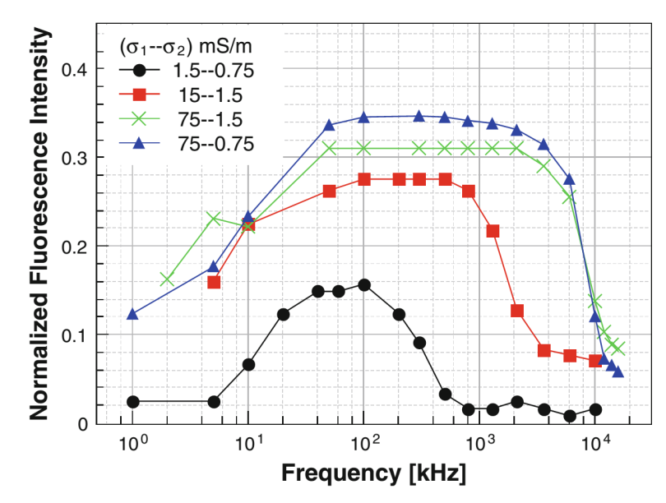
Actuation on co-flowing KCl solutions
(García-Sánchez et al, Microfluid Nanofluid, 2012)
KCl solutions
500 μm
fluorescent beads
electrodes

Slide 31
Electrokinetic instability with conductivity gradients
HV
Ground
HV
(Chen et al, JFM, 2005)

Slide 32
Outline
Introduction: AC electric fields in microsystems
Equations and boundary conditions
Flows induced by electrical forces in liquid bulk
Flows induced by electrical forces in double layer
Flow maps

Slide 33
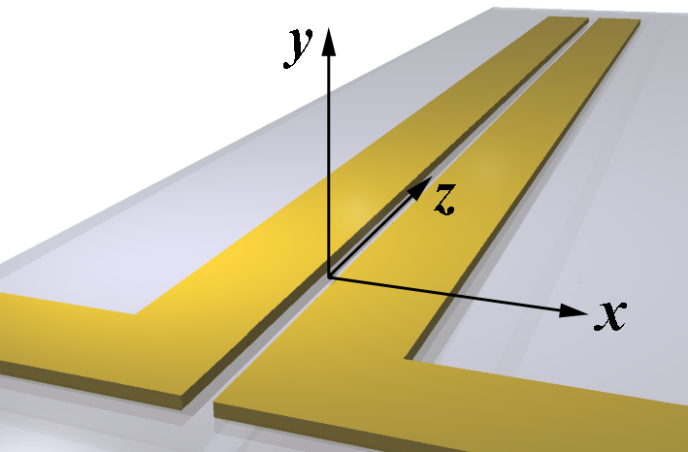
Charge induced in the double-layer: the appearance of electrokinetic slip velocity
normal E charges double layer
tangential E actuates on induced charge
fluid flow
K⁺
Cl⁻
Induced Charges, q
E
E_{n}
F = qE_{t}
E_{t}
F = qE_{t}
E_{t}
+
+
+
+
+
+
-(V/2)
+
+
+
+
+
+
+(V/2)
E_{n}
Glass substrate
electroosmotic slip velocity
Electrodes
low voltage, frequency around 1/R_{bulk}C_{DL}
Notes:
Hablamos de la ac electroosmosis. Ejemplo la pareja de dos electrodos

Slide 34
Charge induced in the double-layer: the appearance of electrokinetic slip velocity
Alternating-current electroosmosis results from the Coulomb force on the induced-charge in the double layer.
4 Vpp
1 kHz
low voltage
low frequency
25 μm
Notes:
Hablamos de la ac electroosmosis. Ejemplo la pareja de dos electrodos

Slide 35
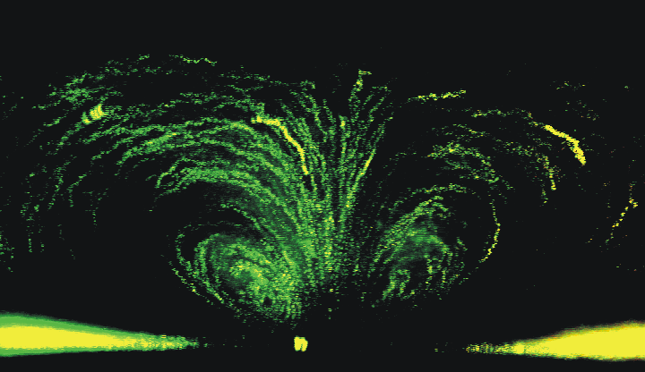
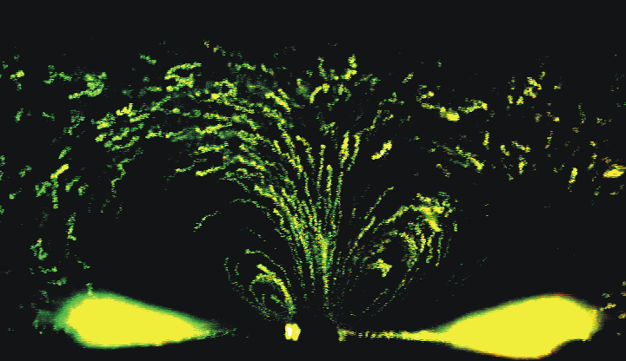
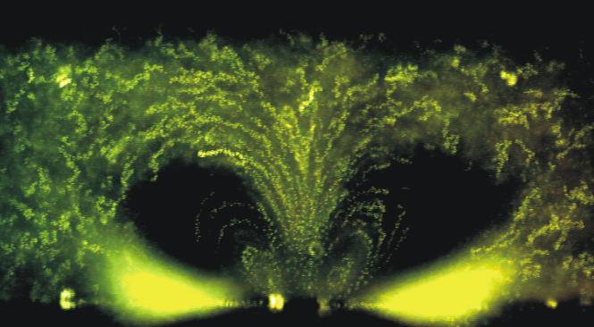
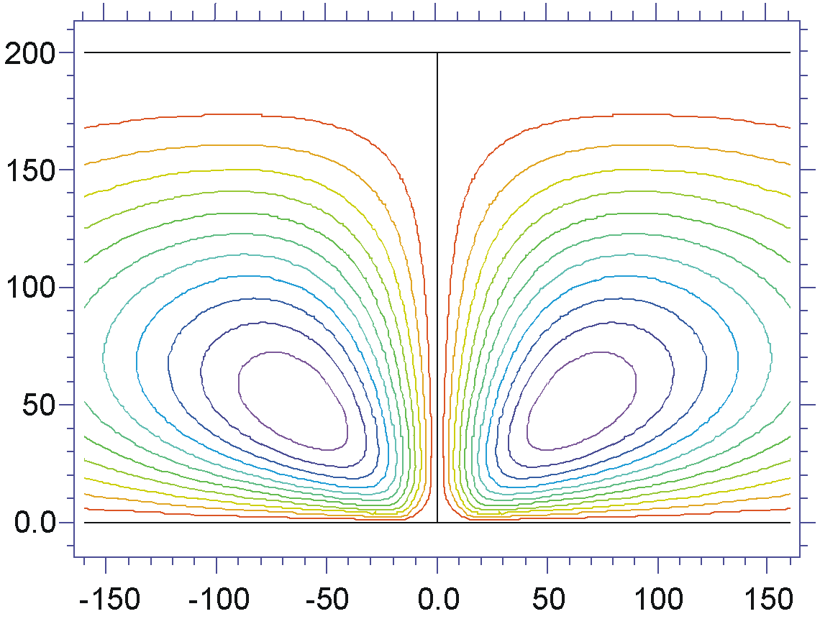
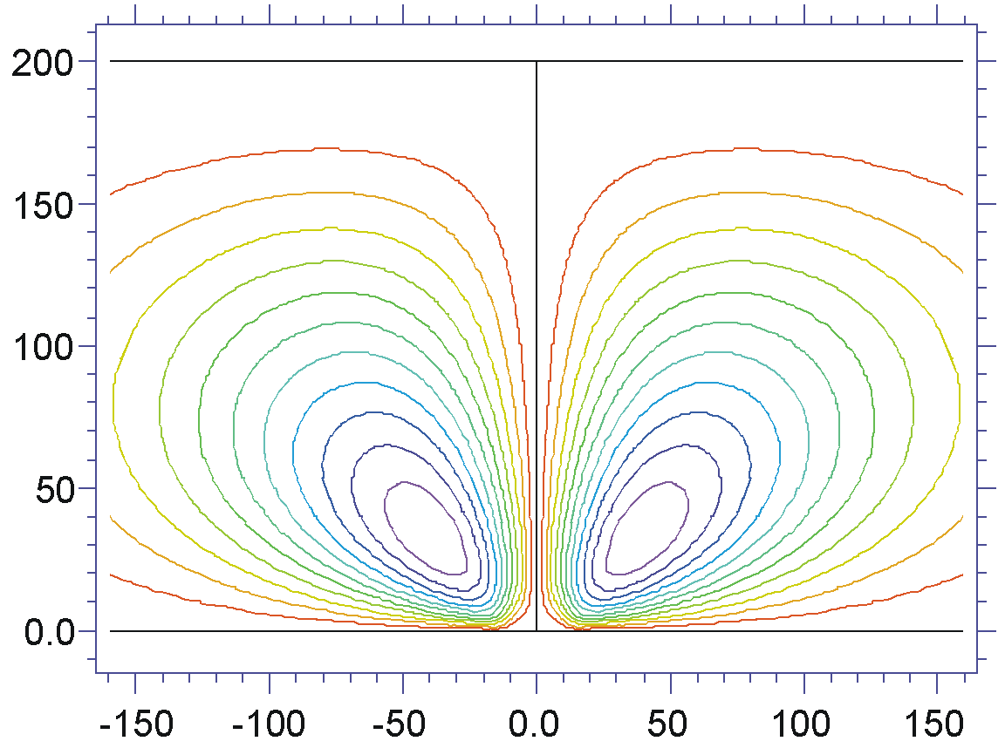
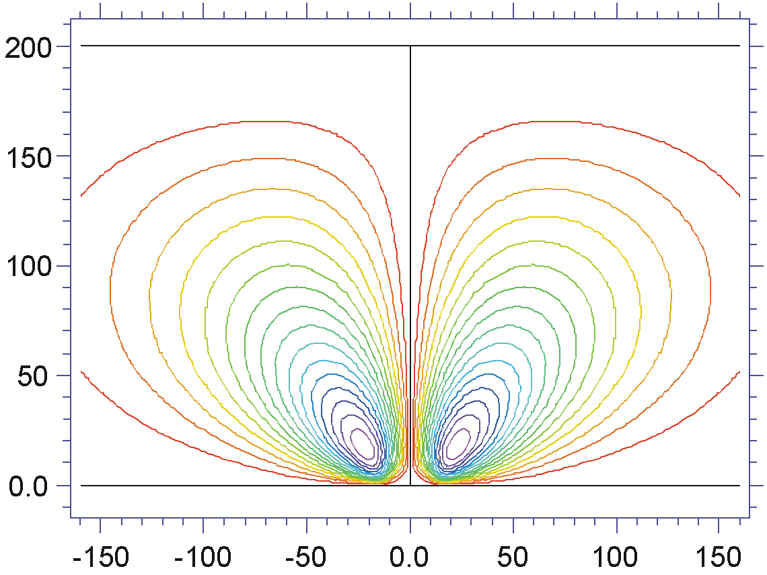
Comparison between theory and experiments
(Green et al, PRE, 2002)
100Hz
300Hz
1kHz
Equations
Boundary Conditions

Slide 36
Comparison between theory and experiments
Λ=0.25, V=0.5 volts

Slide 37
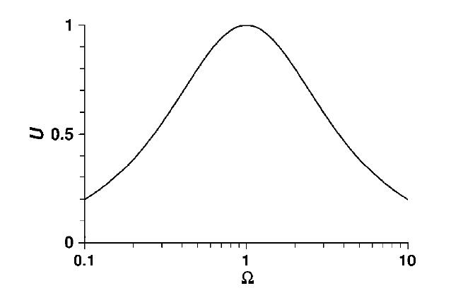
AC Electrokinetic pump: travelling-wave potential induces flow in the wave direction
bulk
Potential wave attracts counterions, which charge double-layer with a time delay
There is a Coulomb time-averaged force in the direction of the wave that moves the fluid
diffuse
compact
Nondimens. velocity
ω=1/RC
Nondimens. frequency
Notes:
Proponemos el campo viajero y el pump de travelling-wave

Slide 38
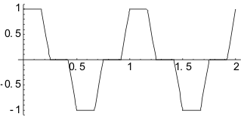
Arrays of microelectrodes are used to generate the travelling-wave potential
TW direction
a)
λ = 160 μm
Electrodes
y
0º
90º
180º
270º
0º
x
20 μm wide electrodes separated by 20 μm gaps
Applied Signal 2.4 Vpp, 1 kHz
(Ramos et al, JAP, 2005)

Slide 39
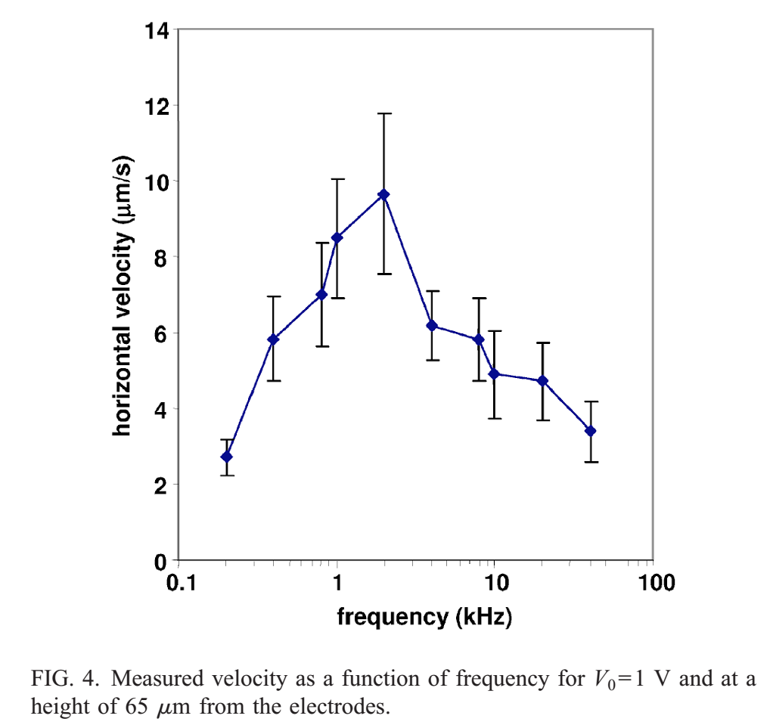
Peak velocity at characteristic frequency

Slide 40
Increasing voltage appears reverse flow
TW direction
a)
λ = 160 μm
Electrodes
y
0º
90º
180º
270º
0º
x
20 μm wide electrodes separated by 20 μm gaps
Applied Signal
6 Vpp 1 kHz
(García-Sánchez et al, IEEE, 2006)

Slide 41
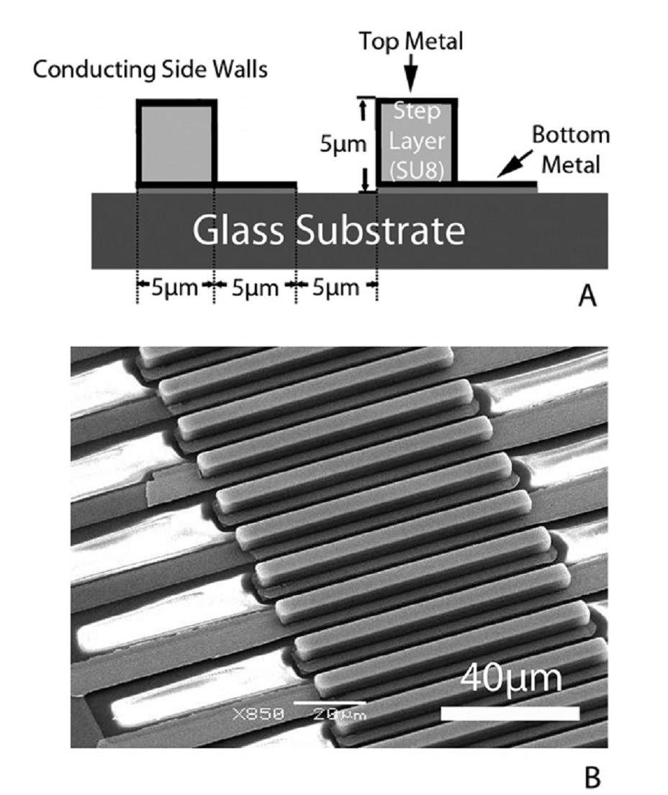
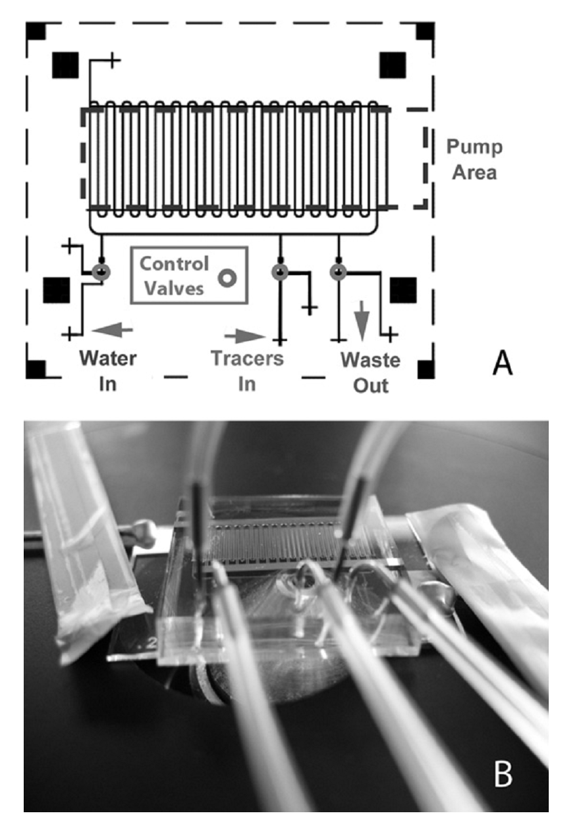
Ultrafast high-pressure AC electro-osmotic pumps for portable biomedical microfluidics
(Huang et al, Lab Chip, 2010)

Slide 42
Outline
Introduction: AC electric fields in microsystems
Equations and boundary conditions
Flows induced by electrical forces in liquid bulk
Flows induced by electrical forces in double layer
Flow maps

Slide 43
Model system for computation of flow velocities due to different forces
n_{θ}
E
n_{r}
r
+(V/2)
θ
-(V/2)

Slide 44
Flow maps
conductivity: σ=10⁻³ Sm⁻¹
2
2
100
100
RO
Electrothermal
10⁻³
1.5
1.5
Red-Ox
10⁻³
1
1
10⁻⁵
10
10
A.C.
E.O.
V (V)
10⁻⁵
0.5
0.5
V (V)
10⁻⁷
Buoyancy
0
1
A.C. Electro-osmosis
Buoyancy
0
1
-
0.5
10⁻⁷
-
0.5
0.1
0.1
10⁻⁶
10⁻⁵
10⁻⁴
10⁻³
10⁻²
10⁻⁶
-
5.5
10⁻⁵
10⁻⁴
10⁻³
10⁻²
-
5.5
-
5
-
4.5
-
4
-
3.5
-
3
-
2.5
-
2
-
5
-
4.5
-
4
-
3.5
-
3
-
2.5
-
2
l (m)
l (m)
Low frequency behavior: f=10²Hz
High frequency behavior: f=10⁵Hz

Slide 45
Flow maps
conductivity: σ=10⁻¹ Sm⁻¹
2
2
100
Boiling
ET
100
RO
Boiling
1.5
10⁻¹
1.5
10⁻¹
Red-Ox
Electrothermal
1
1
10
10
10⁻³
10⁻³
0.5
0.5
V (V)
V (V)
Buoyancy
Buoyancy
A.C. Electro-osmosis
0
A.C.
E.O.
0
1
1
10⁻⁵
10⁻⁵
0.5
-
0.5
10⁻⁷
10⁻⁷
0.1
0.1
10⁻⁵
10⁻⁴
10⁻³
10⁻²
10⁻⁶
-
5.5
10⁻⁵
10⁻⁴
10⁻³
10⁻²
10⁻⁶
-
5.5
-
5
-
4.5
-
4
-
3.5
-
3
-
2.5
-
2
-
5
-
4.5
-
4
-
3.5
-
3
-
2.5
-
2
l (m)
l (m)
Low frequency behavior: f=10⁴Hz
High frequency behavior: f=10⁷Hz

Slide 46
Conclusions
boiling induced by Joule heating
electrochem.
bubble generation
Forces in liquid bulk
red-ox with no bubbles
Forces in the double layer metal/electrolyte
voltage
frequency

