Slide 1
Stability of subcritical electrohydrodynamics in dielectric fluids
IWEHD, Poitiers 2016
Mengqi Zhang
Institut Pprime, University of Poitiers
in collaboration with
Fulvio Martinelli, Jian Wu, Peter J. Schmid and Maurizio Quadrio

Slide 2
Outline
Motivation
Methodology: linear and weakly nonlinear stability
Results
Conclusions and perspectives

Slide 3
Motivation

Slide 4
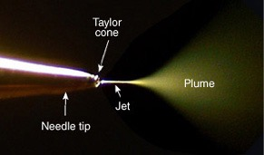
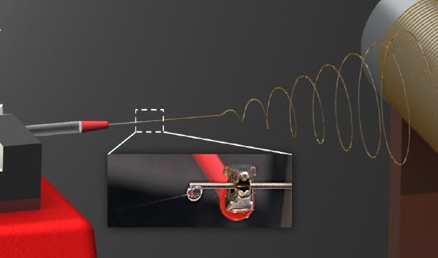
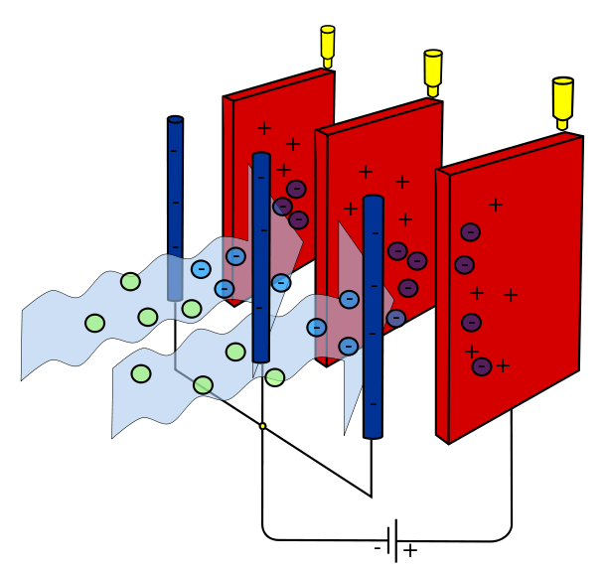
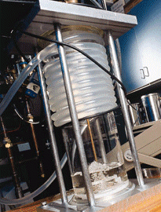
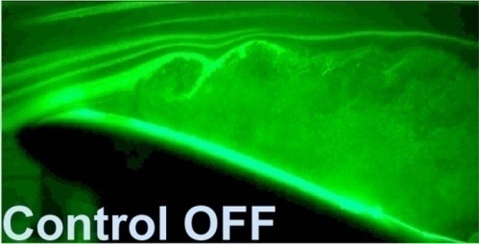
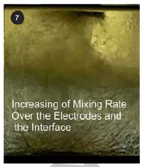
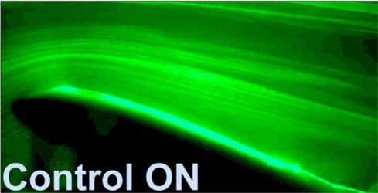
Various applications of EHD in industry
Motivation
Electrostatic
Precipitator
Electrospray
Electrospinning
Flow control
Mixing

Slide 5
Methodology

Slide 6
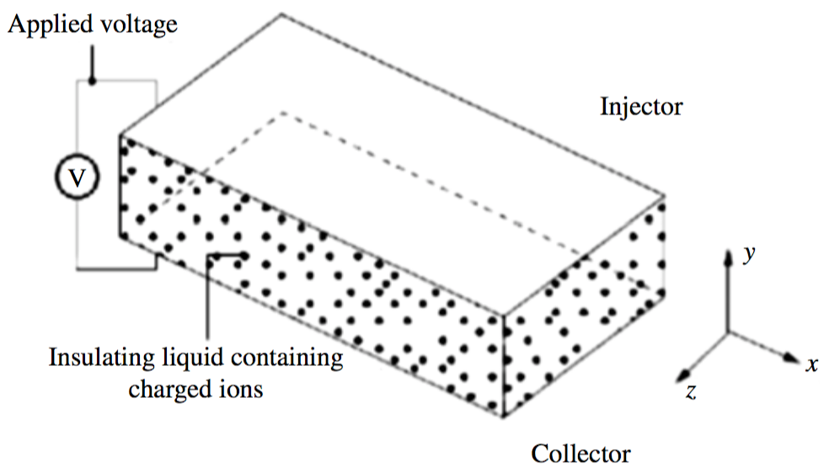
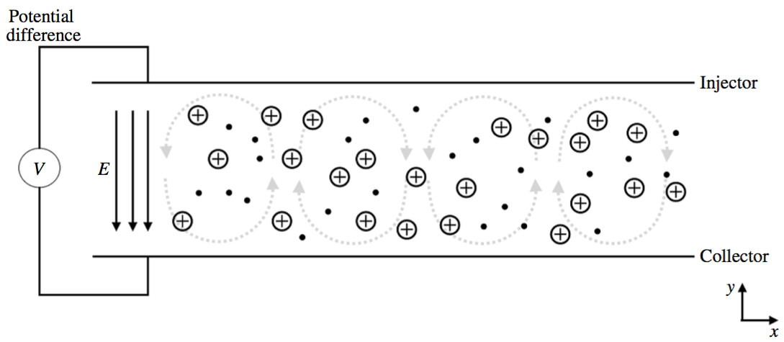
Geometry
Strong injection
We use simple geometry
(two infinite plate electrodes)
to investigate
the essential flow dynamics
Injected ions
Fluid particles
Hydrostatic EHD:
No cross-flow
Poiseuille-EHD:
with cross-flow

Slide 7
Mathematical tools

Slide 8
Linear stability analysis

Slide 9
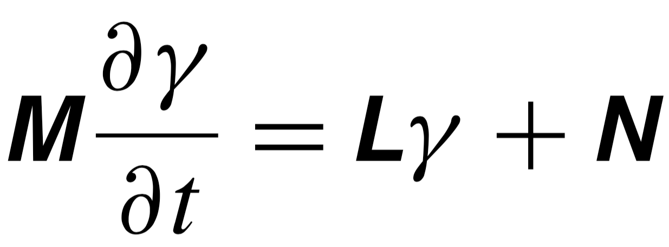
Linear stability analysis
Navier-Stokes equation:
Governing equation for the potential:
Linear stability analysis
Modal | Non-modal
Instability/stability in the asymptotic time as an eigenvalue problem | Transient growth in a short time as an initial value problem
Normal operator: L*L = LL* (the eigenfunctions are orthogonal to each other) | Non-normal operator: L*L ≠ LL* (the eigenfunctions are not orthogonal to each other)
Schmid & Henningson (2001)
Trefethen & Embree (2005)
Schmid (2007)
*: complex-conjugate

Slide 10
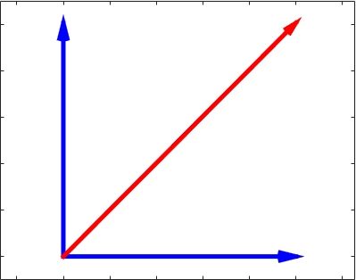
Linear stability analysis: normal operator
Linear stability analysis: normal operator
Red: linear
operator
Blue: its
eigen-
expansion
Stable orthogonal modes decaying at different rates
>1, energy growth
<1, energy decay
1
0

Slide 11
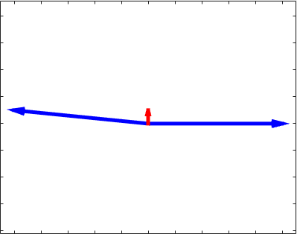
Linear stability analysis: non-normal operator
Linear stability analysis: non-normal operator
Red: linear
operator
Blue: its
eigen-
expansion
Stable non-orthogonal modes decaying at different rates
>1, energy growth
<1, energy decay
Transient growth
(non-modal stability
analysis)
1
0
Growth/decaying rate
(modal/non-modal
stability analysis)
In the case of shear flow…..,

Slide 12
Linear stability analysis: non-modal analysis
Linear stability analysis: non-modal analysis
In the case of shear flow…..,
what about the non-modal effect in EHD？
Flow types (Shear flows) | Critical Reexp | Critical Relin
Pipe flow | ~ 2000 | ∞
Plane Couette flow | ~ 360 | ∞
Plane Poiseuille flow | ~ 1000 | 5772
by modal linear
stability analysis
Schmid &
Henningson (2001)
Flow types | Critical Texp | Critical Tlin
EHD flow (SCL) | ~ 100 | 160.75
?
Atten & Moreau
(1972)

Slide 13
Weakly nonlinear stability analysis

Slide 14
Weakly nonlinear stability analysis
Weakly nonlinear stability analysis
Multiple-scale expansion method
1.Substitution
2.Regrouping
Stewartson & Stuart (1971)

Slide 15
Weakly nonlinear stability analysis
Weakly nonlinear stability analysis
Linear problem
Ginzburg-Landau equations
Solvability conditions

Slide 16
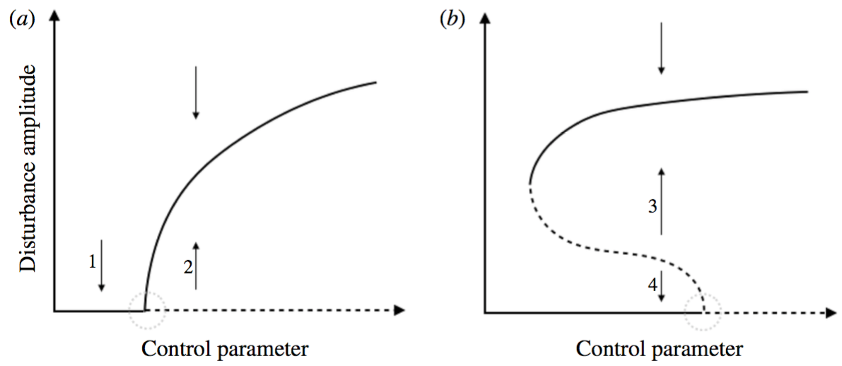
Weakly nonlinear stability analysis
Weakly nonlinear stability analysis
Ginzburg-Landau equations
Supercritical bifurcation
Subcritical bifurcation
Guckenheimer & Holmes (1983)

Slide 17
Results

Slide 18
The cases studied
Hydrostatic EHD flow
Linear stability
analysis (3D)
Poiseuille-EHD flow
Hydrostatic EHD flow
Weakly nonlinear
stability analysis (2D)
Poiseuille-EHD flow

Slide 19
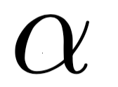
Parameters in the problems
C: charge injection level.
M: ratio between hydrodynamic mobility and the ion mobility.
T: electric Rayleigh number.
Fe: the inverse of electric charge diffusion coefficient. 1/Fe.
Re: Reynolds number.
: streamwise wavenumber
: spanwise wavenumber

Slide 20
Linear stability analysis of
hydrostatic EHD flow
Hydrostatic EHD flow
Linear stability
analysis (3D)
Poiseuille-EHD flow
Hydrostatic EHD flow
Weakly nonlinear
stability analysis (2D)
Poiseuille-EHD flow

Slide 21
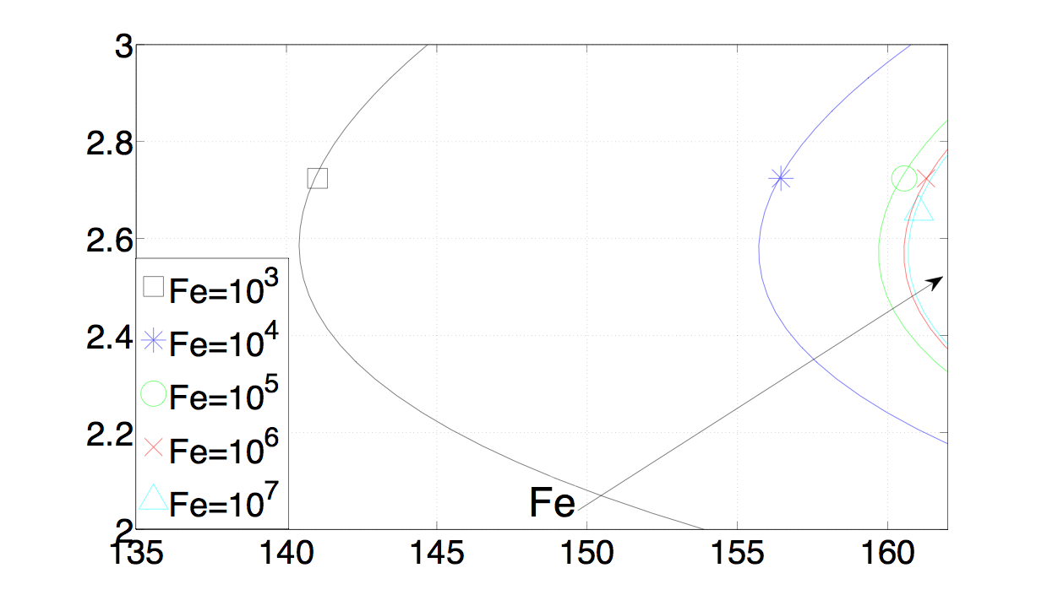
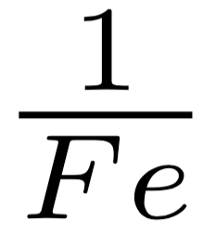
Effect of charge diffusion 1/Fe
（neutral stability curves in -T plane）
Linear stability analysis: hydrostatic EHD flow
C=50, M=100
Charge
diffusion
coefficient
Tc=160.75
The stronger charge diffusion effect, the more unstable the flow is.

Slide 22
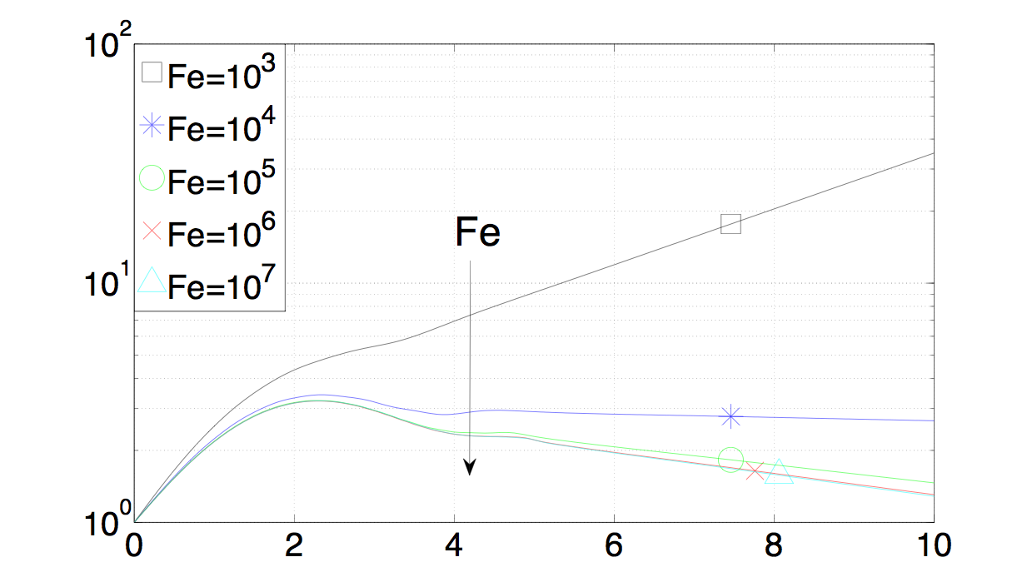
Effect of charge diffusion
（transient growth）
Linear stability analysis: hydrostatic EHD flow
C=50, M=100, T=155, =2.5
The stronger charge diffusion, the higher transient growth.
But the transient growth is in general very small in hydrostatic EHD.

Slide 23
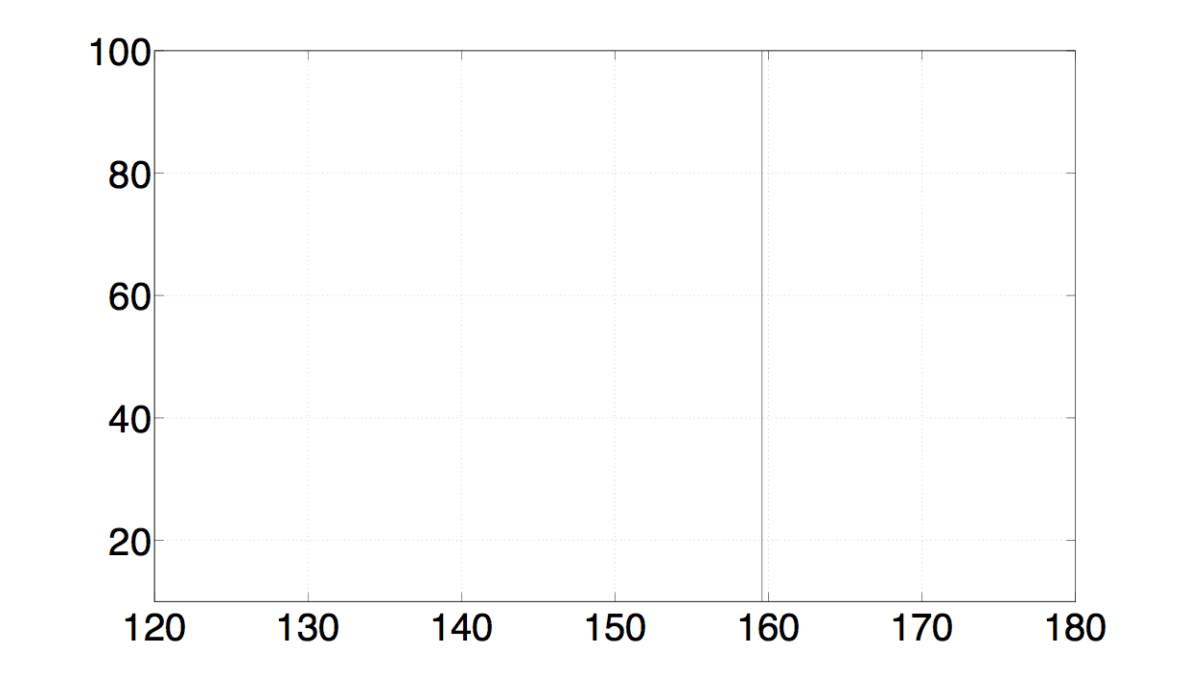
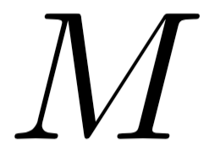
Effect of mobility ratio M
（neutral stability curves in M-T plane）
Linear stability analysis: hydrostatic EHD flow
C=100, Fe=10⁵
The mobility ratio does not affect the linear stability criterion Tc.

Slide 24
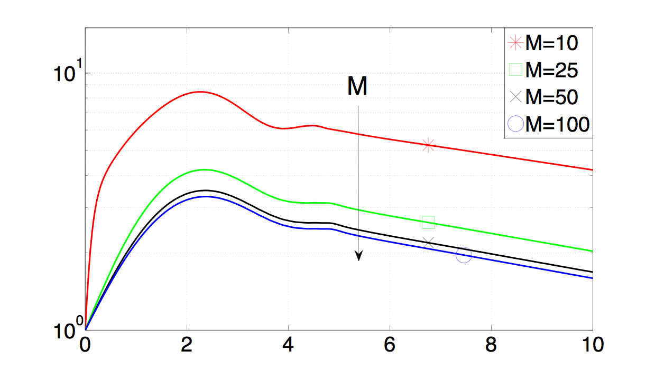
Effect of mobility ratio M
（transient growth）
Linear stability analysis: hydrostatic EHD flow
C=50, Fe=10⁵, T=155, =2.57
The mobility ratio does affect the transient growth. Higher M, smaller transient growth.

Slide 25
Conclusions
Linear stability analysis for hydrostatic EHD:
Stronger charge diffusion will make the EHD flow more unstable
The non-modal effect in hydrostatic EHD is generally small, so it probably cannot explain the discrepancy between the theoretical Tc and the experimentally-determined Tc.

Slide 26
Linear stability analysis of
Poiseuille-EHD flow
Hydrostatic EHD flow
Linear stability
analysis (3D)
Poiseuille-EHD flow
Hydrostatic EHD flow
Weakly nonlinear
stability analysis (2D)
Poiseuille-EHD flow

Slide 27
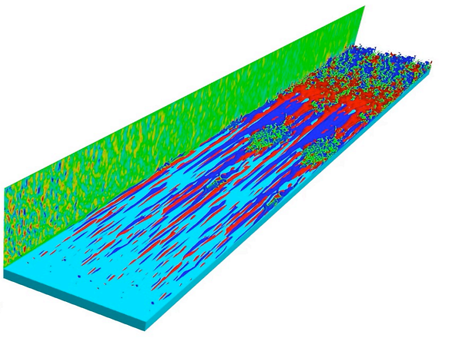
Linear stability analysis: transition to turbulence in Poiseuille flow
Fully developed turbulence
Turbulence spot
Streaks breakdown
Streaks formation
Non-modal linear stability analysis
Low-speed streaks
High-speed streaks
Schmid & Henningson (2001)

Slide 28
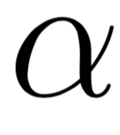
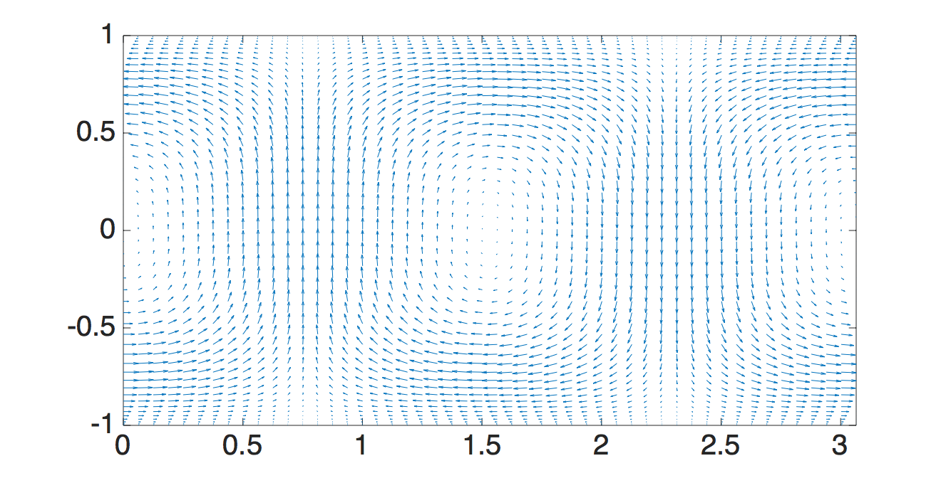
Linear stability analysis: lift-up mechanism
In non-modal stability analysis
the optimal initial conditions:
Streamwise wavenumber =0
Spanwise wavenumber =2.05
Poiseuille flow:
Streamwise rolls
Base flow
Optimal perturbation
y
z
Low-speed streaks
High-speed streaks

Slide 29
Linear stability analysis: transition to turbulence in Poiseuille flow
Fully developed turbulence
Turbulence spot
Streaks breakdown
Streaks formation
The streaky structure in the transition to turbulence process can be predicted successfully by the non-modal linear stability analysis. This process is coined lift-up mechanism.

Slide 30
Linear stability analysis: transition to turbulence in Poiseuille flow
Fully developed turbulence
What’s the impact of EHD on
the lift-up mechanism?
?
Turbulence spot
E
Streaks breakdown
V
Streaks formation
The streaky structure in the transition to turbulence process can be predicted successfully by the non-modal linear stability analysis. This process is coined lift-up mechanism.

Slide 31
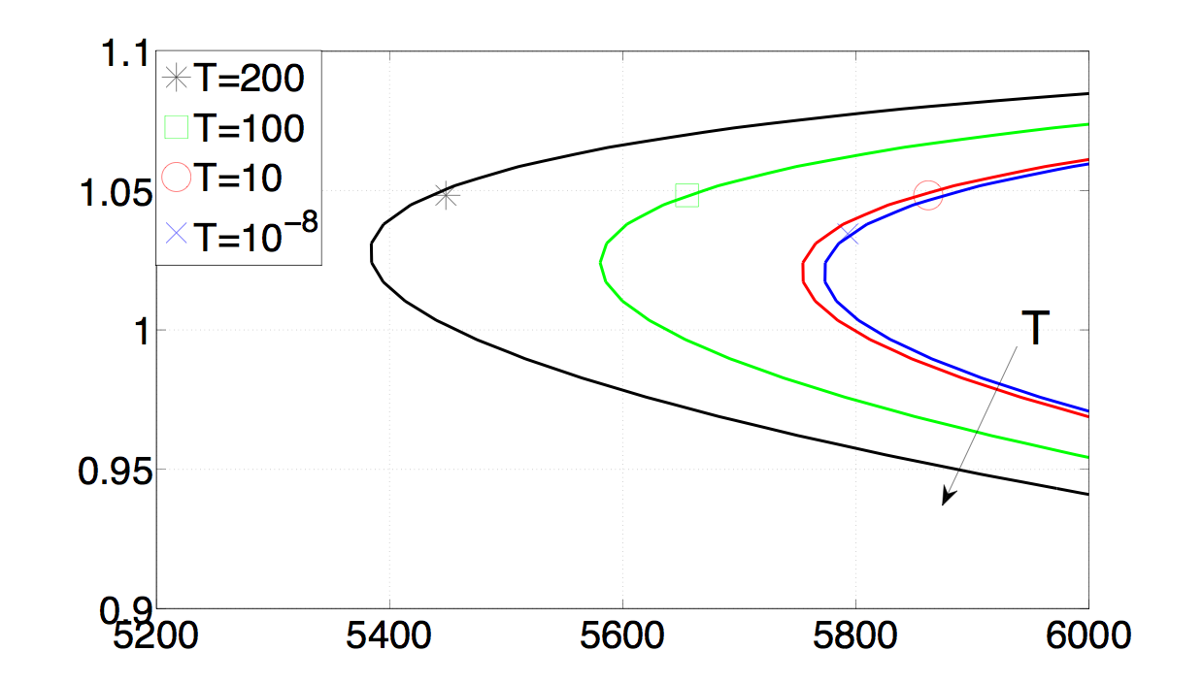
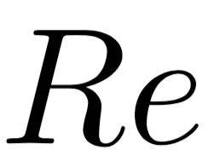
Effect of electric Rayleigh T
（neutral stability curves in -Re plane）
Linear stability analysis: Poiseuille-EHD flow
C=100, Fe=10⁵, =0
Rec=5772.22
With increasing T, the Poiseuille-EHD flow destabilises.

Slide 32
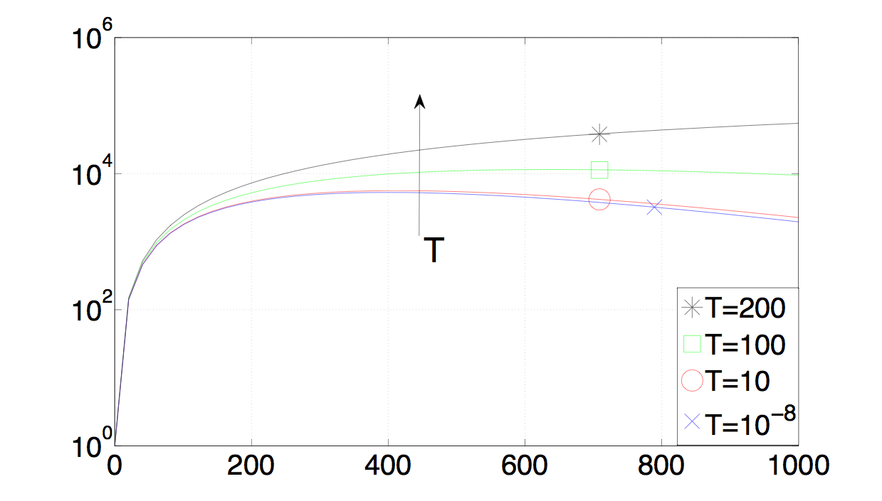
Effect of electric Rayleigh T
（transient growth）
Linear stability analysis: Poiseuille-EHD flow
C=100, Fe=10⁵, Re=5200, =0, =2
The transient growth is quite large due to the lift-up mechanism.
The electric field enhances its growth.

Slide 33
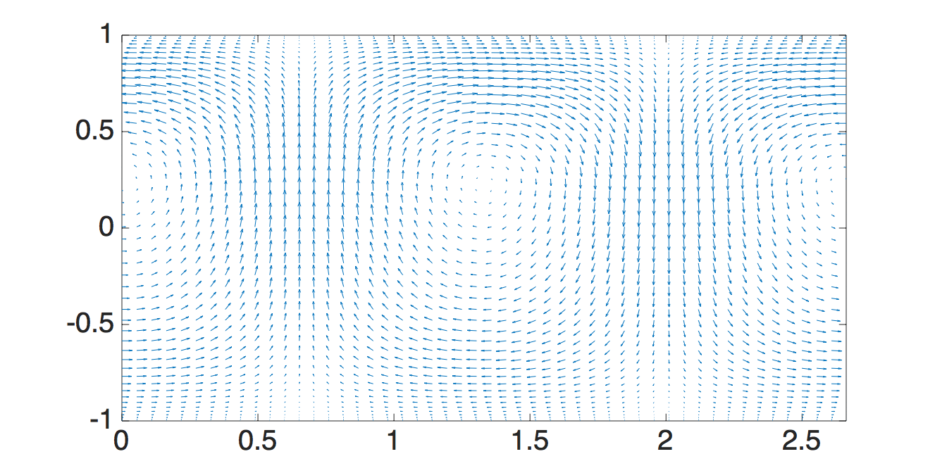
Linear stability analysis: enhanced lift-up mechanism
effect of the electric field on lift-up mechanism: streamwise rools
Poiseuille flow:
symmetric
y
Spanwise wavenumber =2.05
z
+
+
+
+
Poiseuille-EHD flow:
asymmetric due to
the electric field
+
+
+
+
+
+
+
y
+
E
+
+
+
+
+
Optimal initial conditions:
Streamwise wavenumber =0
Spanwise wavenumber =2.36
+
+
+
+
z

Slide 34
Linear stability analysis: enhanced lift-up mechanism
effect of the electric field on lift-up mechanism: streaks
When the electric field is imposed, due to the drift velocity…
Injector
+
+
y
+
E
V
+
+
z
Collector
Lower low-speed streaks
Higher high-speed streaks
The electric field makes it easier to form the streaky structures:
enhanced lift-up mechanism.

Slide 35
Conclusions
Linear stability analysis for hydrostatic EHD:
Stronger charge diffusion will make the EHD flow more unstable
The non-modal effect in hydrostatic EHD is generally small, so it probably cannot explain the discrepancy between the theoretical Tc and the experimentally-determined Tc.
Linear stability analysis for Poiseuille-EHD:
The lift-up mechanism, which is a powerful energy growth route in Poiseuille flow, is enhanced by the electric field in the Poiseuille-EHD flow.

Slide 36
Weakly nonlinear stability analysis of
hydrostatic EHD flow
Hydrostatic EHD flow
Linear stability
analysis (3D)
Poiseuille-EHD flow
Hydrostatic EHD flow
Weakly nonlinear
stability analysis (2D)
Poiseuille-EHD flow

Slide 37
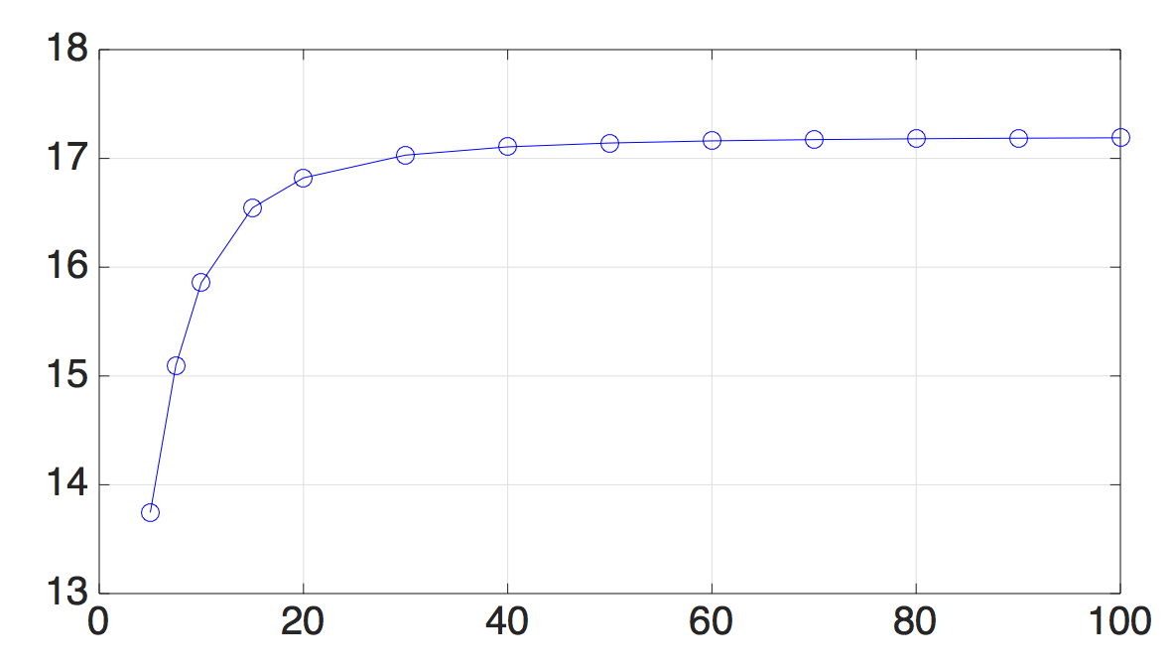
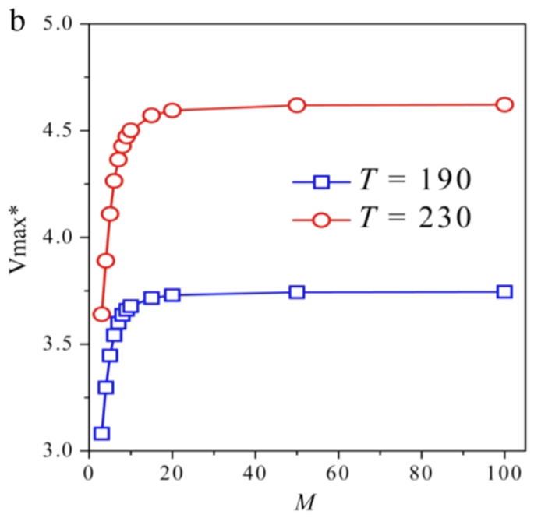
Effect of mobility ratio M
Weakly nonlinear stability analysis: hydrostatic EHD flow
C=50, Fe=10³, at the critical condition
DNS
Wu et al. (2015)
The higher M, the stronger destabilizing effect of nonlinearity (higher positive a3).

Slide 38
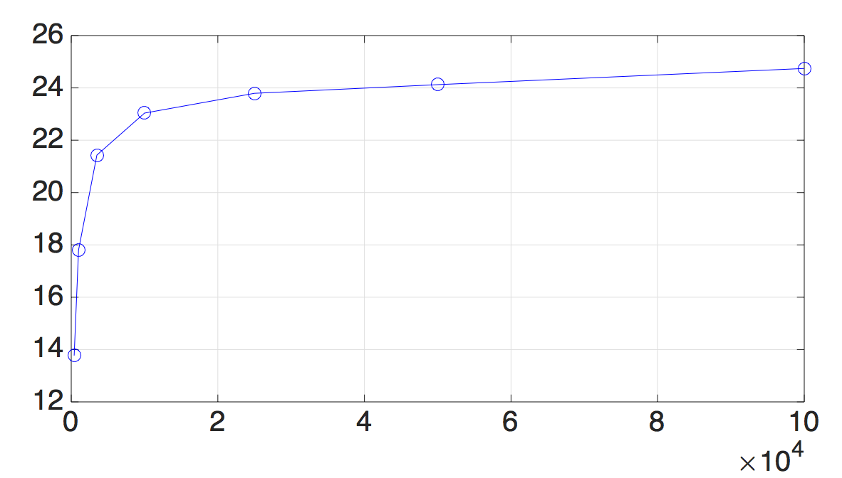
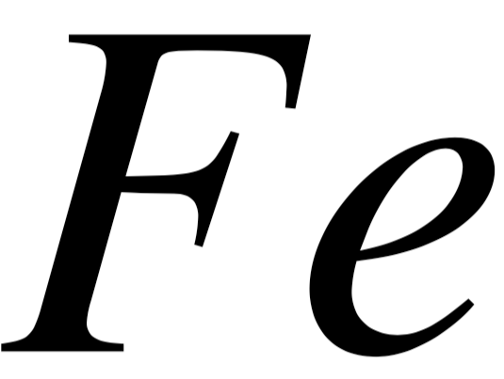
Effect of charge diffusion
1/Fe
Weakly nonlinear stability analysis: hydrostatic EHD flow
In previous prediction of Tf
No charge diffusion
The critical finite-amplitude Tf
Actual charge diffusion
(10³<1/Fe<10⁴)
destabilizing less!
Tf with charge diffusion > Tf without charge diffusion
C=12.5, M=100, at the critical condition
The weaker the charge diffusion, the stronger the destabilizing effect of nonlinearity (higher positive a3).

Slide 39
Conclusions
Linear stability analysis for hydrostatic EHD:
Stronger charge diffusion will make the EHD flow more unstable
The non-modal effect in hydrostatic EHD is generally small, so it probably cannot explain the discrepancy between the theoretical Tc and the experimentally-determined Tc.
Linear stability analysis for Poiseuille-EHD:
The lift-up mechanism, which is a powerful energy growth route in Poiseuille flow, is enhanced by the electric field in the Poiseuille-EHD flow.
Weakly nonlinear stability analysis for hydrostatic EHD:
In the weakly nonlinear phase, the stronger charge diffusion will less destabilize the flow, but the higher mobility ratio will more destabilize the flow.
The actual Tf should be higher than the values predicted in the previous works without taking into account the charge diffusion effect (which destabilizes less).
Castellanos et al. (1989)

Slide 40
Weakly nonlinear stability analysis of
Poiseuille-EHD flow
Hydrostatic EHD flow
Linear stability
analysis (3D)
Poiseuille-EHD flow
Hydrostatic EHD flow
Weakly nonlinear
stability analysis (2D)
Poiseuille-EHD flow

Slide 41
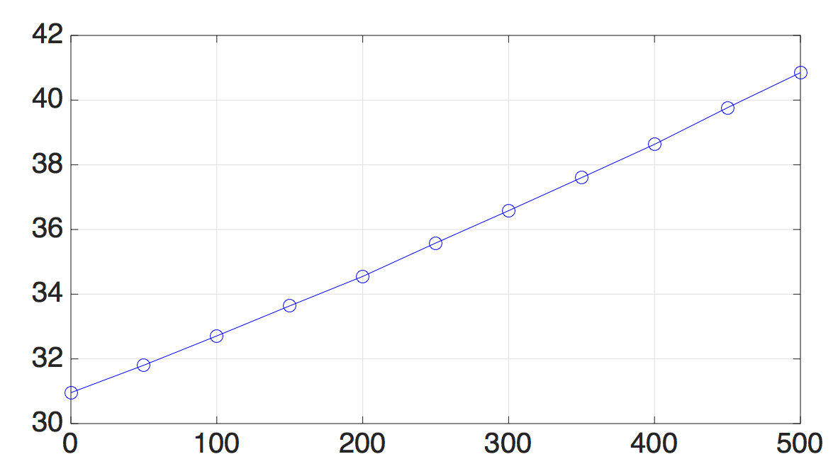
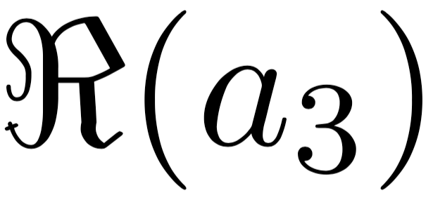
Effect of electric Rayleigh T
Weakly nonlinear stability analysis: Poiseuille-EHD flow
C=50, Fe=10³, at the critical condition
=30.96
The higher the T, the stronger the weakly nonlinear effect destabilizing the flow, i.e., the Poiseuille-EHD flow is more subcritical than the conventional Poiseuille flow.

Slide 42
Which part of the nonlinearity destabilizing the flow?
Weakly nonlinear stability analysis: Poiseuille-EHD flow

Slide 43
Weakly nonlinear stability analysis: Poiseuille-EHD flow
Third-order nonlinear terms in the governing equation for the streamfunction
Third-order nonlinear terms in the governing equation for the electric potential

Slide 44
Weakly nonlinear stability analysis: Poiseuille-EHD flow
C=50, Fe=10³, at the critical condition
Poiseuille flow
Third-order nonlinear terms in the governing equation for the streamfunction
Poiseuille-EHD flow
Poiseuille flow
Third-order nonlinear terms in the governing equation for the electric potential
Poiseuille-EHD flow
The enhanced subcriticality of Poiseuille-EHD flow results from the modified hydrodynamic part (streamfunction), rather than directly from the electric potential.

Slide 45
Conclusions
Linear stability analysis for hydrostatic EHD:
Stronger charge diffusion will make the EHD flow more unstable
The non-modal effect in hydrostatic EHD is generally small, so it probably cannot explain the discrepancy between the theoretical Tc and the experimentally-determined Tc.
Linear stability analysis for Poiseuille-EHD:
The lift-up mechanism, which is a powerful energy growth route in Poiseuille flow, is enhanced by the electric field in the Poiseuille-EHD flow.
Weakly nonlinear stability analysis for hydrostatic EHD:
In the weakly nonlinear phase, the stronger charge diffusion will less destabilize the flow, but the higher mobility ratio will more destabilize the flow.
The actual Tf should be higher than the values predicted in the previous works without taking into account the charge diffusion effect (which destabilizes less).
Castellanos et al. (1989)
Weakly nonlinear stability analysis for Poiseuille-EHD:
The Poiseuille-EHD flow becomes more subcritical than the conventional Poiseuille flow,
and the enhanced subcriticality comes from the modified streamfunction, rather than directly from the electric effect. So we can infer that it is important to calculate correctly the hydrodynamic field.
Traoré & Wu (2013)

Slide 46
Conclusions
Linear stability analysis for hydrostatic EHD:
Stronger charge diffusion will make the EHD flow more unstable
The non-modal effect in hydrostatic EHD is generally small, so it probably cannot explain the discrepancy between the theoretical Tc and the experimentally-determined Tc.
Linear stability analysis for Poiseuille-EHD:
The lift-up mechanism, which is a powerful energy growth route in Poiseuille flow, is enhanced by the electric field in the Poiseuille-EHD flow.
Weakly nonlinear stability analysis for hydrostatic EHD:
In the weakly nonlinear phase, the stronger charge diffusion will less destabilize the flow, but the higher mobility ratio will more destabilize the flow.
The actual Tf should be higher than the values predicted in the previous works without taking into account the charge diffusion effect (which destabilizes less).
Castellanos et al. (1989)
Weakly nonlinear stability analysis for Poiseuille-EHD:
The Poiseuille-EHD flow becomes more subcritical than the conventional Poiseuille flow,
and the enhanced subcriticality comes from the modified streamfunction, rather than directly from the electric effect. So we can infer that it is important to calculate correctly the hydrodynamic field.
Traoré & Wu (2013)

Slide 47
These works have been published recently in
M. Zhang, F. Martinelli, J. Wu, P. J. Schmid and M. Quadrio. Modal and nonmodal stability analysis of electrohydrodynamic flow with and without cross-flow. Journal of Fluid Mechanics, 770, 319-349, 2015
M. Zhang, Weakly nonlinear stability analysis of subcritical electrohydrodynamic flow subject to strong unipolar injection. Journal of Fluid Mechanics, 792, 328–363, 2016

Slide 48
Perspectives
Perspectives on the future works of the stability analysis of EHD flow
Transition to turbulence in hydrostatic EHD flow.
The pattern formation of hydrostatic EHD flow.
Convective/absolute instability in the Poiseuille-EHD system.
How does the electric field affect the turbulence in Poiseuille flow? The auto-generation cycles. Drag reduction by EHD.
Schmid & Henningson (2001)
Drazin & Reid (2004)
Atten & Lacroix(1979) for infinite M
Carrière & Monkewitz (1999) for Poiseuille-RBC
Soldati & Banerjee (1998)
Hamilton et al. (1995)

Slide 49
Thank you for your attention!

