Slide 1
PIV Investigation of EHD Flow Caused by Field-enhanced Dissociation
I International workshop on electro-hydro-dynamics
and tribo-electrostatics
Chasseneuil-du-Poitou, France, September 1–2, 2016
V. A. Chirkov, Yu. K. Stishkov, S. A. Vasilkov
St. Petersburg State University
Physics Department
Electrophysics Research and Education Center

Slide 2
Outline
Background
Background
EHD system
EHD system
Computer simulation
Computer simulation
PIV investigation
PIV investigation

Slide 3
Problem Statement
Field-enhanced dissociation (the Wien effect)
In the context of electrohydrodynamics
In the strong electric field E > 10⁶ V/m
Simulation: few studies
Experiment (velocity distributions): no studies

Slide 4
EHD equation set
$div\left(\vec{E}\right)=\frac{ρ}{εε_{0}} \vec{E}=−∇φ ρ=\sum_{i}{Z_{i}en_{i}}$
$\frac{∂n_{i}}{∂t}+div\left({\vec{j}}_{i}\right)=g_{i}$
${\vec{j}}_{i}=Z_{i}n_{i}b_{i}\vec{E}−D_{i}∇n_{i}+n_{i}\vec{u}$
$γ\frac{∂\vec{u}}{∂t}+γ\left(\vec{u},∇\right)\vec{u}=−∇P+η∆\vec{u}+ρ\vec{E}$
$div\left(\vec{u}\right)=0$
Electrostatic equations
Nernst–Planck equations ($i=1,2$)
Navier–Stokes equations
Source function
Dissociation rate
Recombination rate
$$W_{0}=\frac{σ_{0}^{2}}{2εε_{0}eb}$$
$$α_{r}=\frac{2eb}{εε_{0}}$$
where ,
$$g=F\left(p\right)W_{0}−α_{r}n_{1}n_{2}$$
$$F\left(p\right)=\frac{I_{1}\left(4p\right)}{2p}$$
$$p=\frac{e^{2}}{2k_{B}T}\sqrt{\frac{E}{4πεε_{0}e}}$$
Onsager function (relative increase in the dissociation rate)

Slide 5
Problems
Field-enhanced dissociation
EHD
Injection
Ion mobilities

Slide 6
Outline
Background
EHD system
Computer simulation
PIV investigation

Slide 7
Problem of injection
Classical system
New system
Solid insulation
✔ Field-enhanced dissociation
✘ Injection
✔ Field-enhanced dissociation
✔ Injection

Slide 8
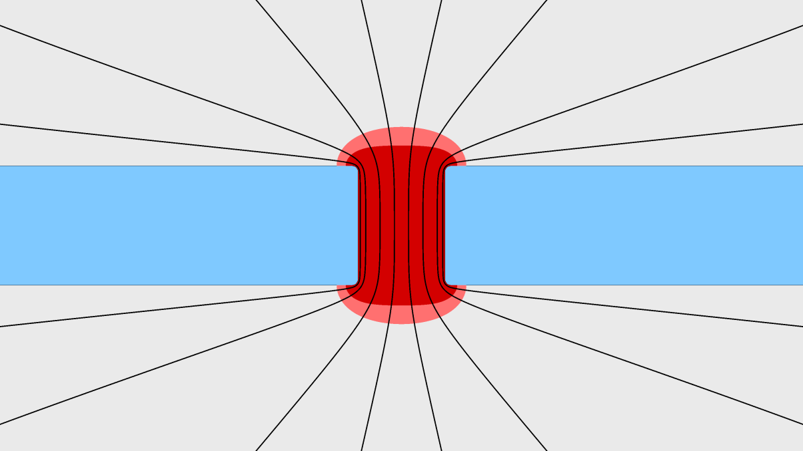
EHD system
Grounded electrode
Electric field lines
Plane
Symmetry axis
Barrier
Barrier with the hole
Barrier
Hole
Region of the strong electric field
Hole
Plane
High-voltage electrode
Region of interest
Initially, the electric field lines pass through the barrier
The barrier accumulates charge
All electric field lines pass through the hole

Slide 9
Problems
Field-enhanced dissociation
Injection
Ion mobilities

Slide 10
Outline
Background
EHD system
Computer simulation
PIV investigation

Slide 11
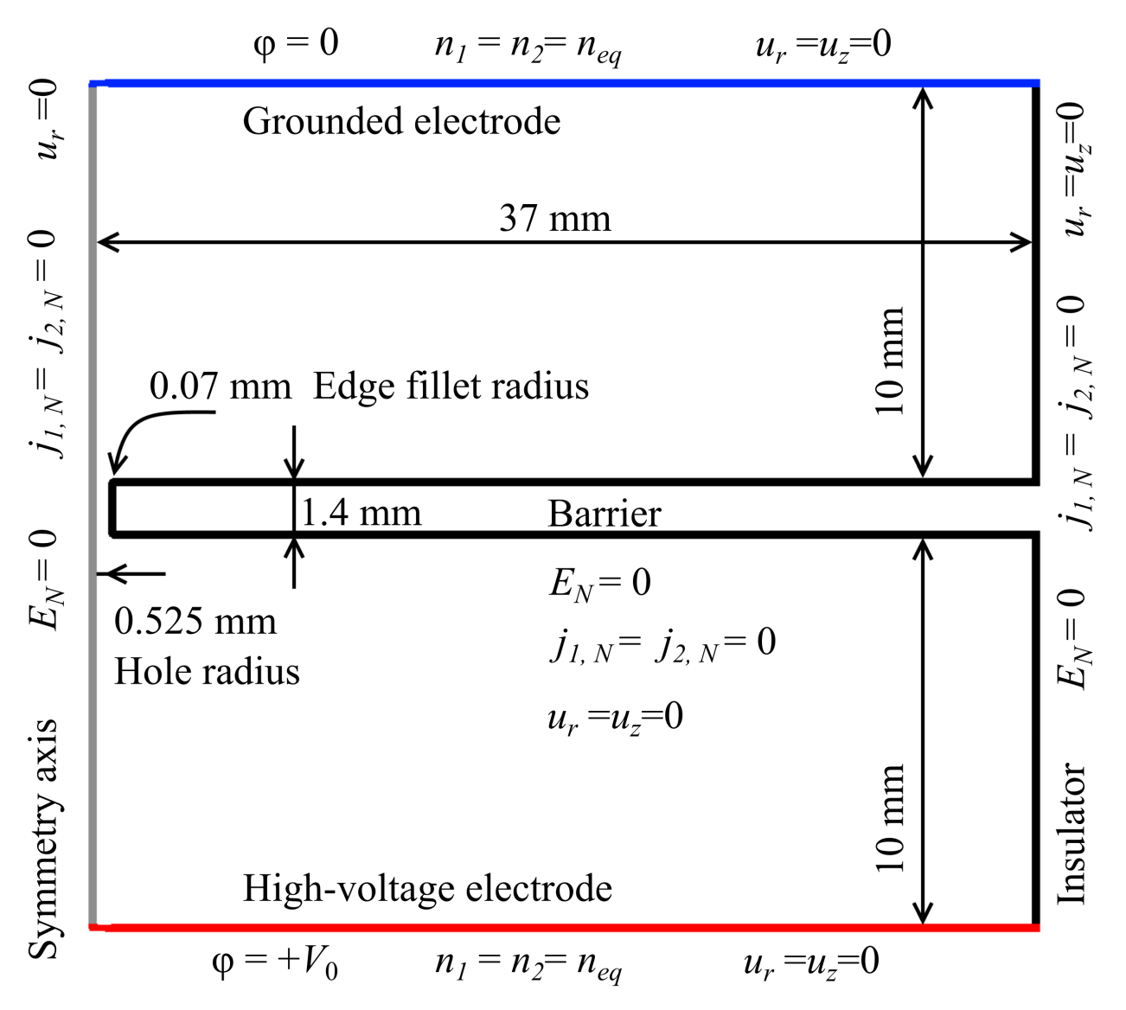
Computer model
Software package: COMSOL Multiphysics
Boundary conditions
Subscript N indicates the normal component of a vector
Condition$E_{N}=0$ implies that the electrical charge on the surface has already been accumulated

Slide 12
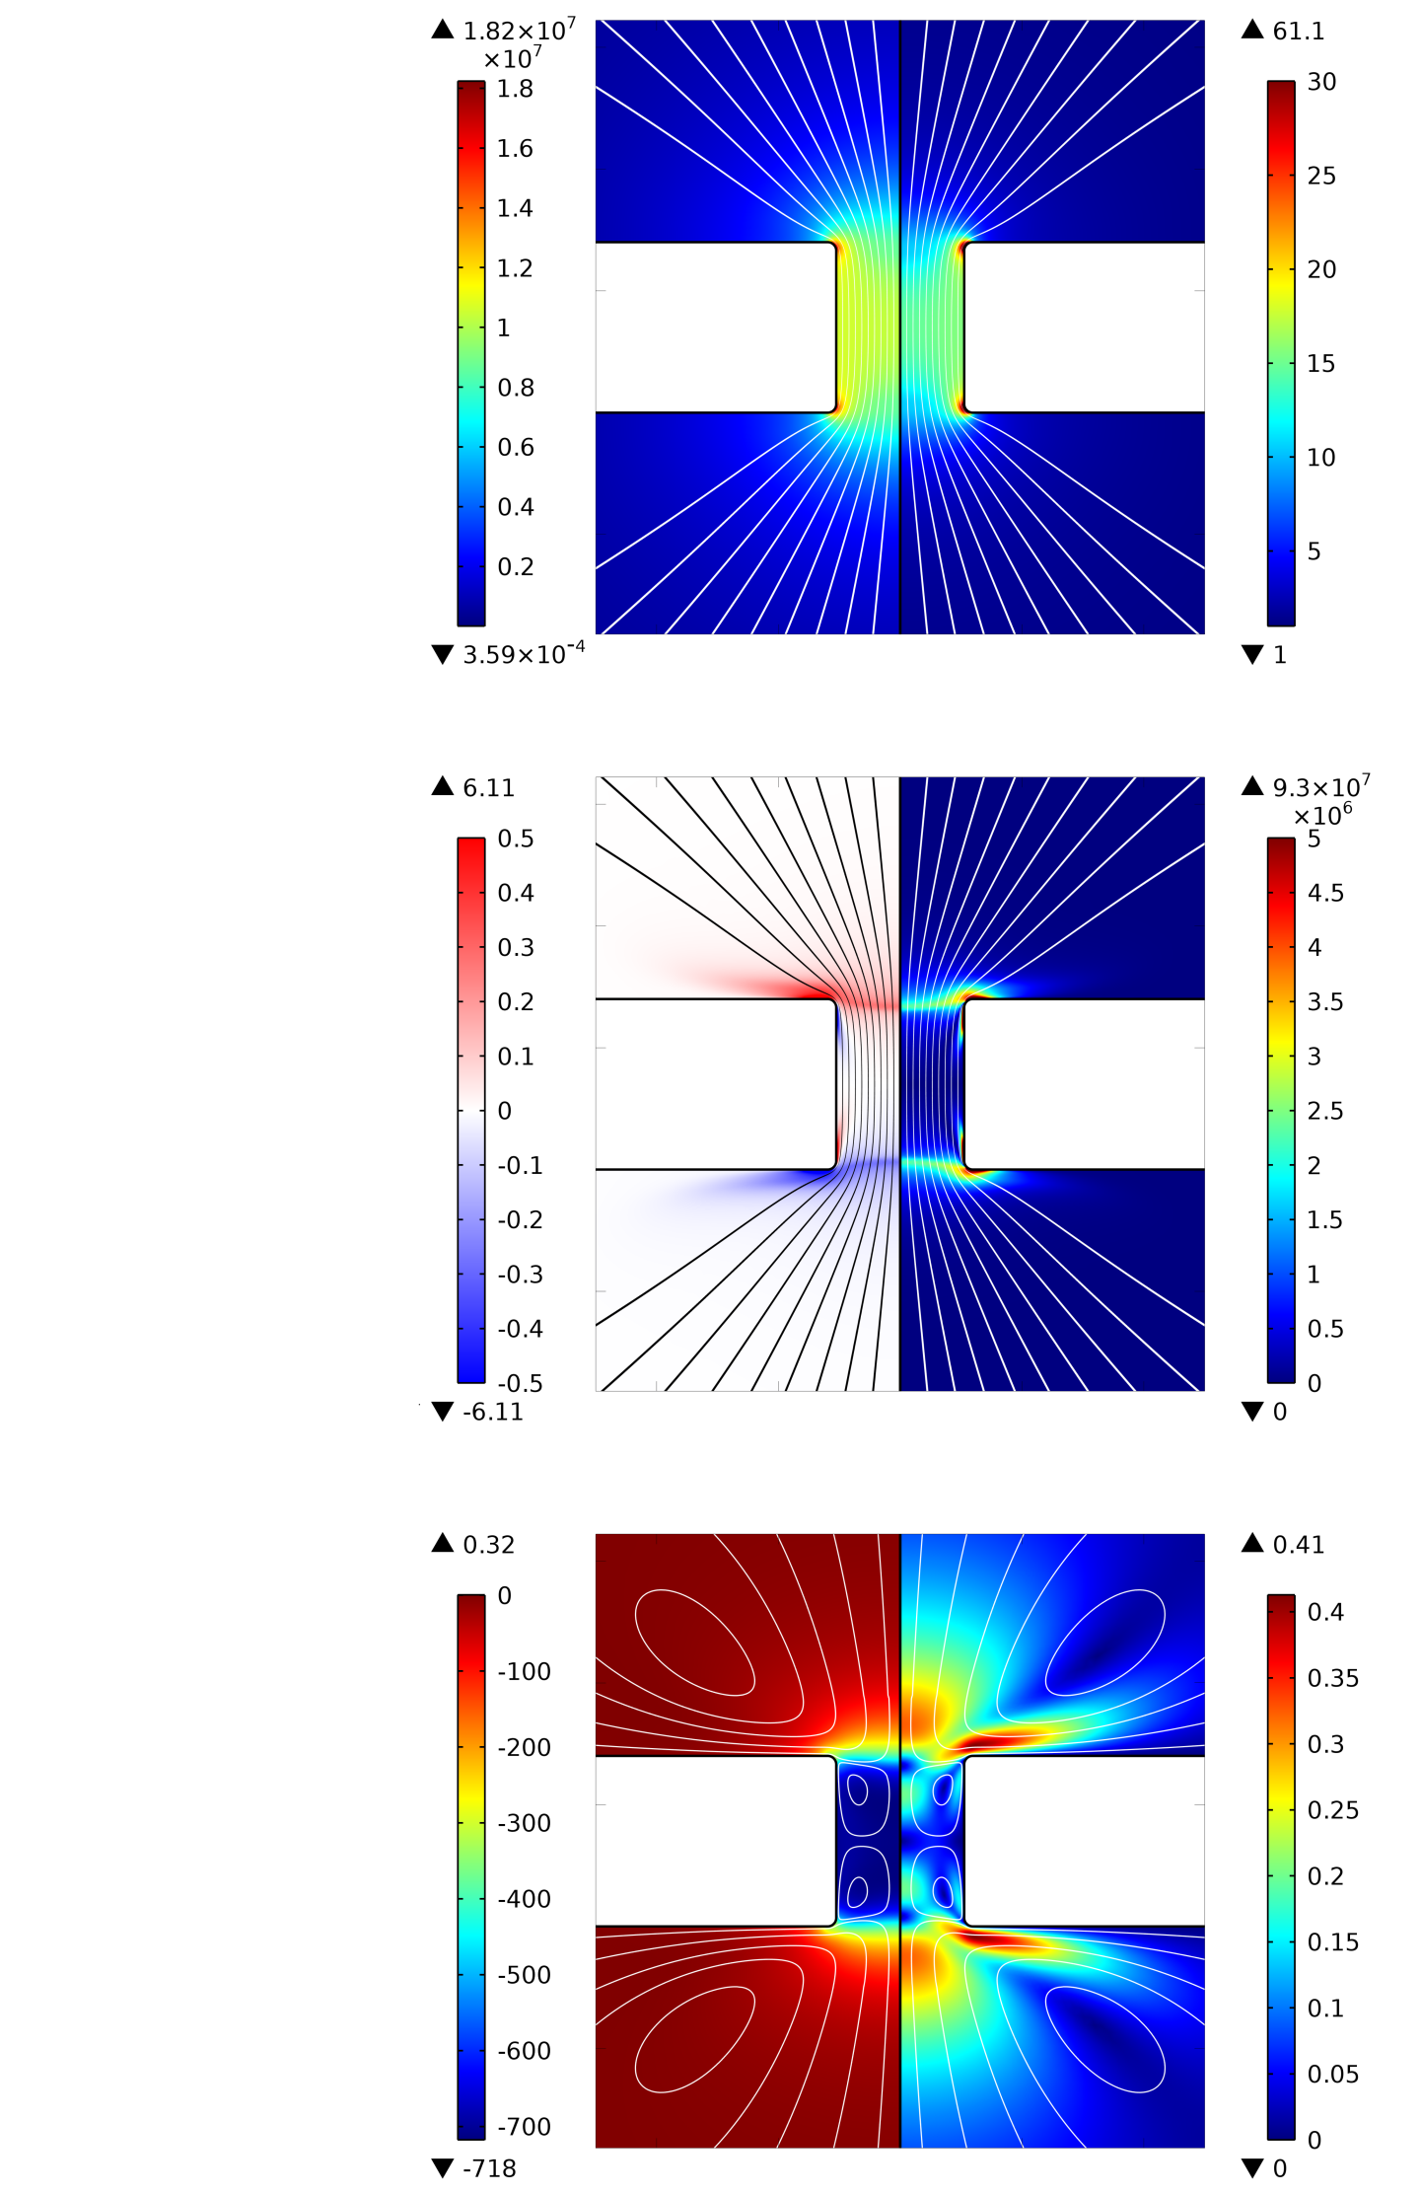
Simulation results
Liquid low-voltage conductivity $σ_{0}≈{10}^{−8} S/m$, v$oltage V_{0}=30 kV$
Electric field strength (V/m)
Inside the hole ≈ 10⁷ V/m
At the electrodes ≈ 10⁵ V/m
Relative increase in the dissociation rate (1)
If $σ_{0}≈{10}^{−8} S/m$, flow structure is independent from the ion mobility values
Space charge density (C/m³)
Coulomb force density (N/m³)
Pressure (Pa)
Velocity magnitude (m/s)

Slide 13
Problems
Field-enhanced dissociation
Ion mobilities
Injection

Slide 14
Outline
Background
EHD system
Computer simulation
PIV investigation

Slide 15
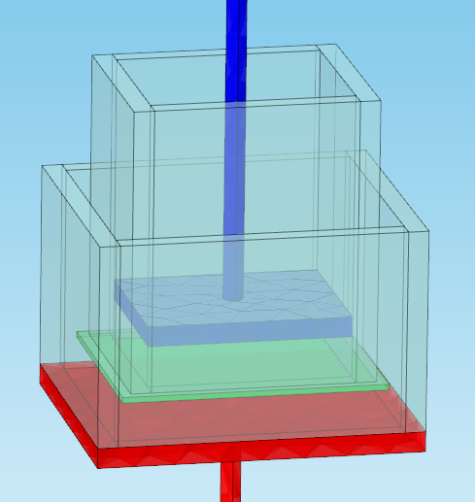
Experiment
Inner cell
Outer cell
Grounded electrode
Barrier with the hole
High-voltage electrode
Experimental set-up
Working liquid:
mixture of transformer oil and alcohol, conductivity $σ_{0}= 9.2∙{10}^{−9} S/m$

Slide 16
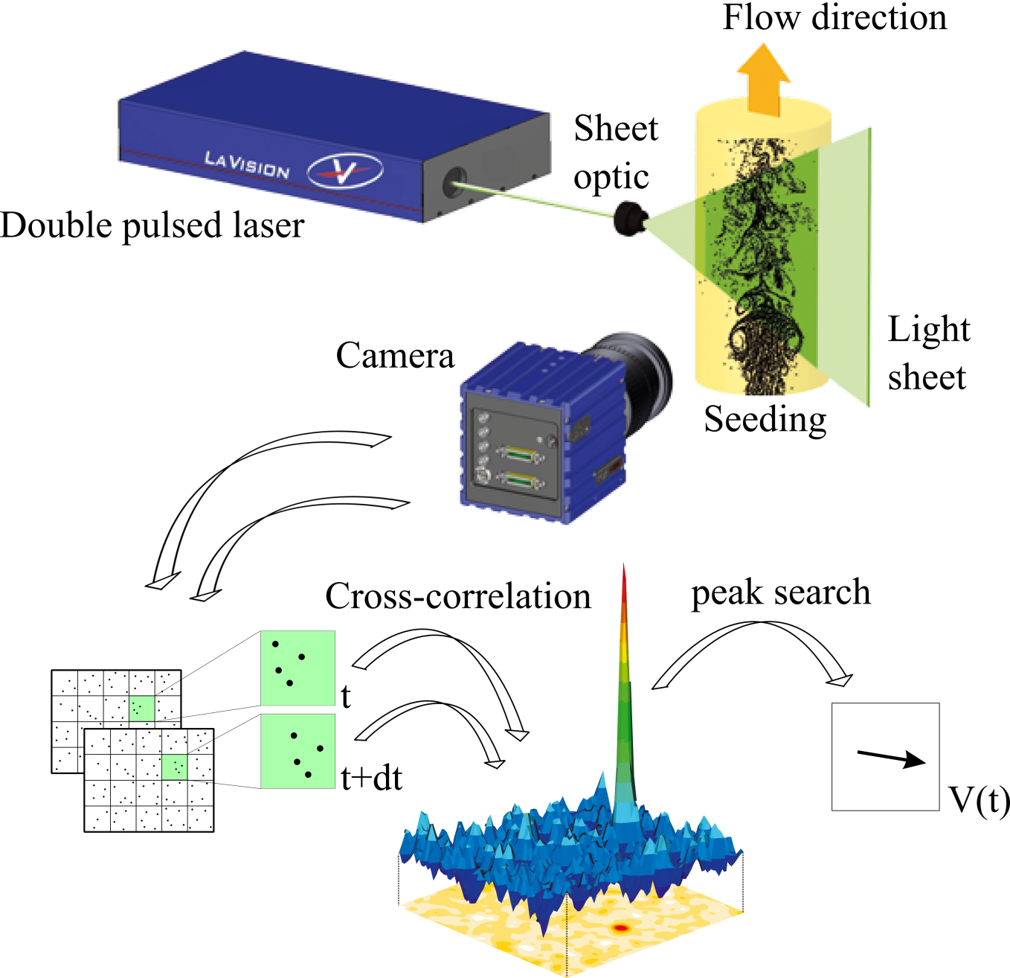
Particle Image Velocimetry
(© LaVision GmbH, Germany, http://www.lavision.de)

Slide 17
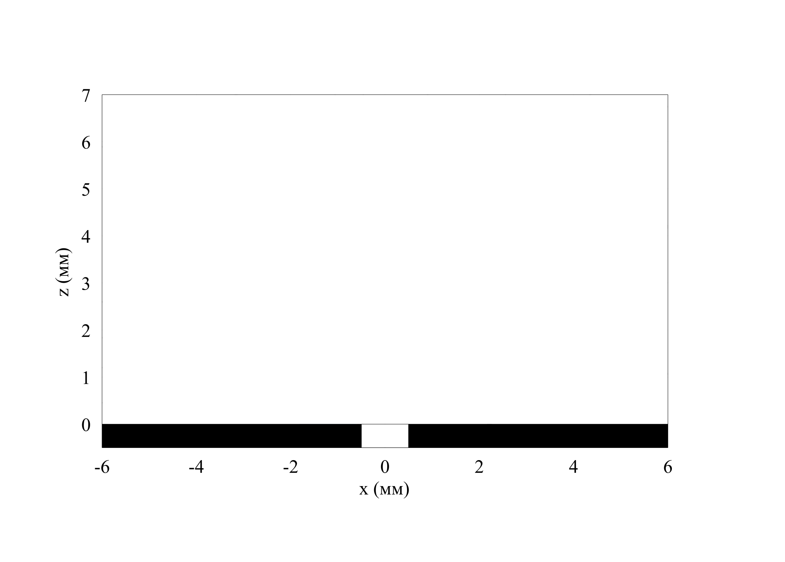
PIV results
V₀ = 10 kV — poorest agreement
15 kV
20 kV
30 kV — best agreement
$$z (mm)$$
Hole
Barrier
Barrier
$$x (mm)$$

Slide 18
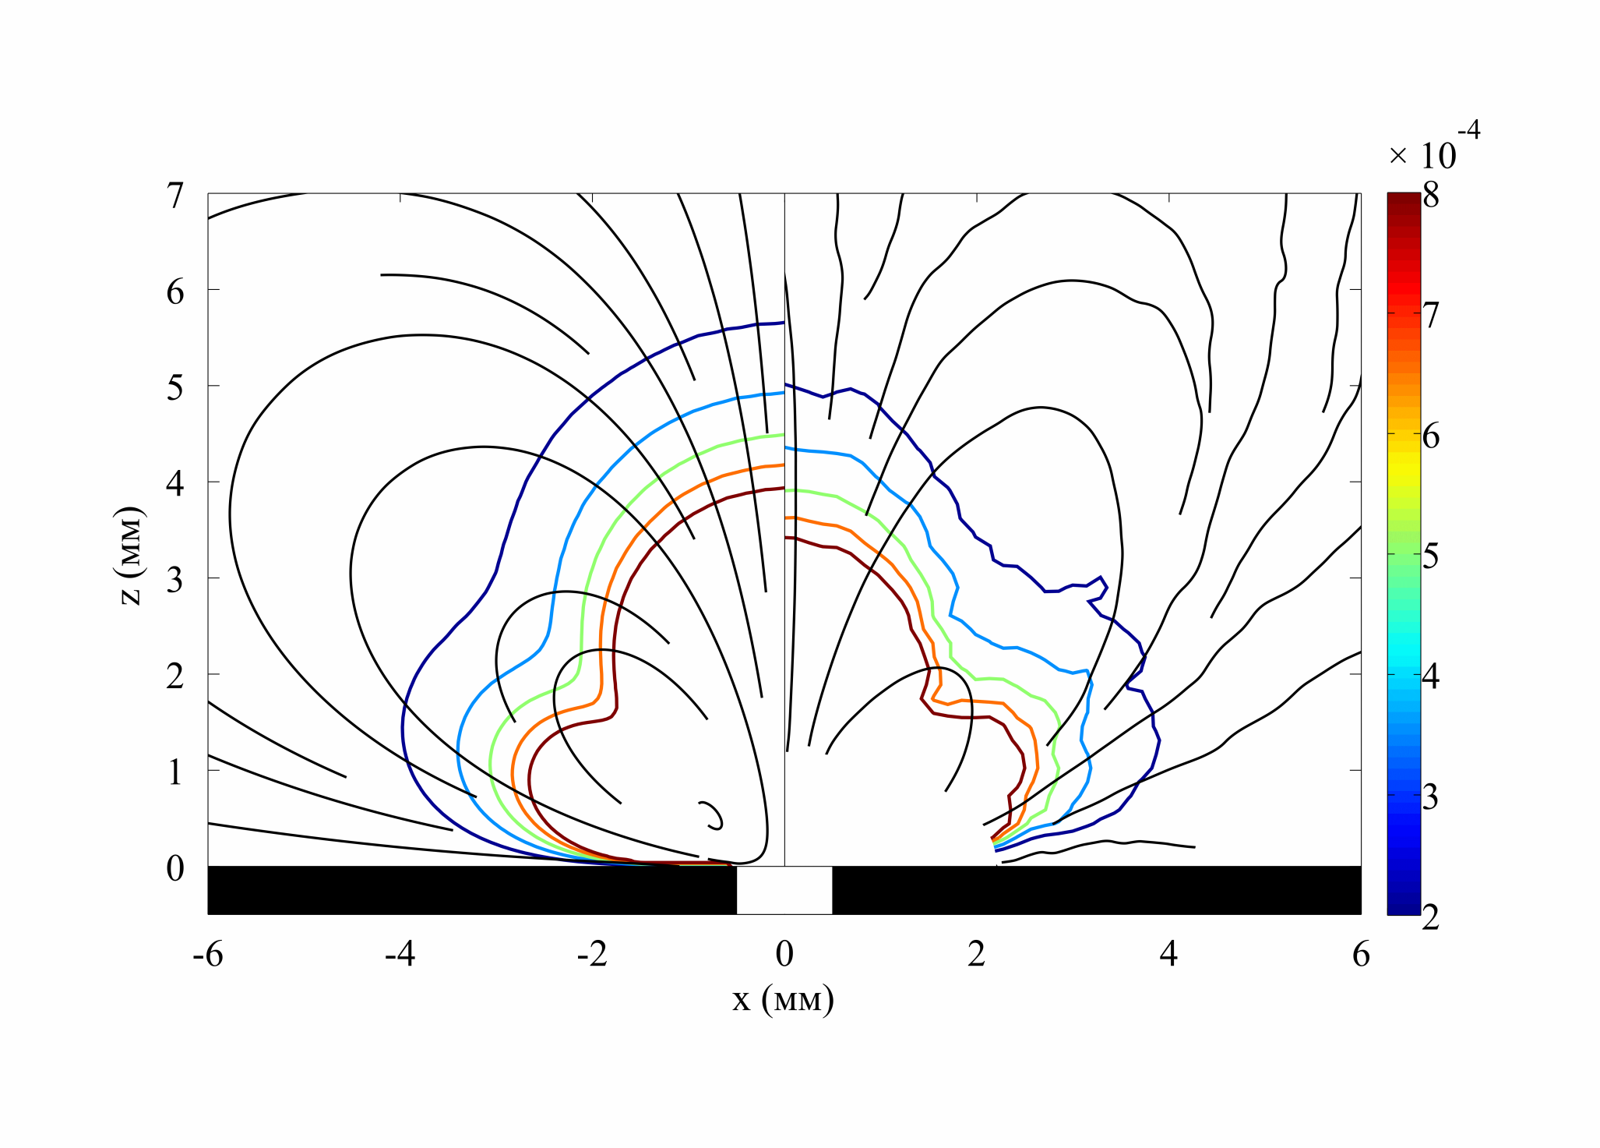
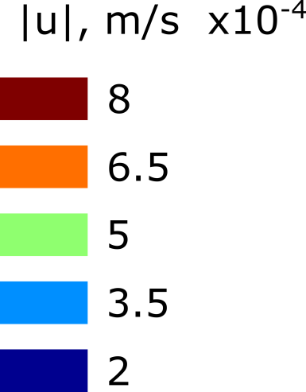
PIV results
$$V_{0}=10 kV$$
$$z (mm)$$
$$x (mm)$$
Simulation
Experiment

Slide 19
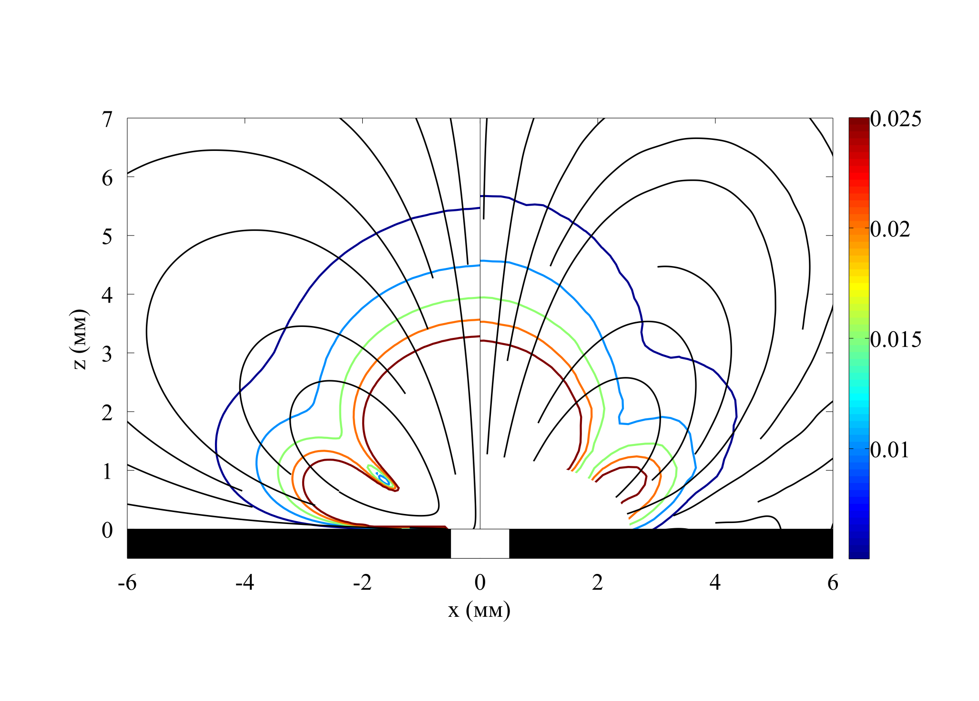
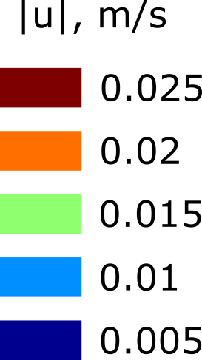
PIV results
$$V_{0}=30 kV$$
$$z (mm)$$
$$x (mm)$$
Simulation
Experiment

Slide 20
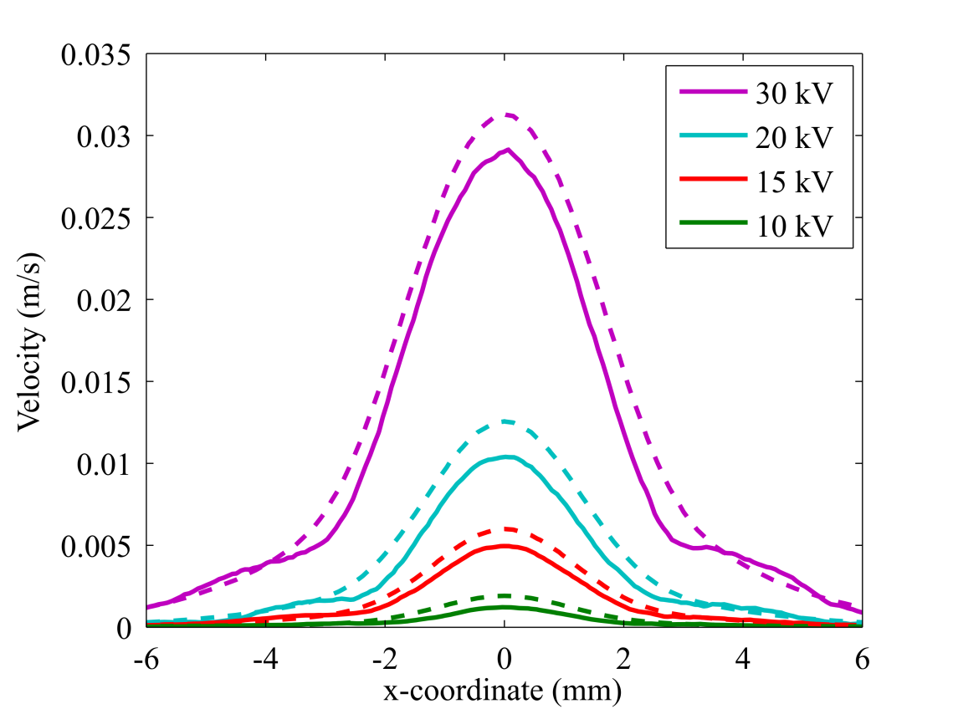
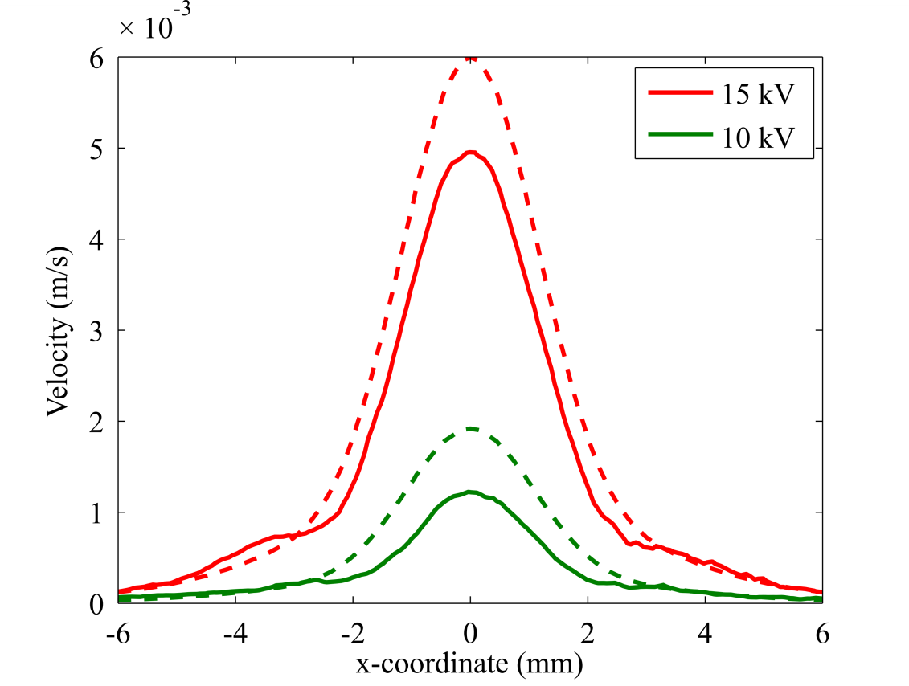
Horizontal velocity profiles at z = 3 mm
Simulation
Simulation
Experiment
Experiment
Difference at the peak between simulation and experiment
10 kV: ≈ 60% of experimental value
30 kV: ≈ 10% of experimental value
Decreases

Slide 21
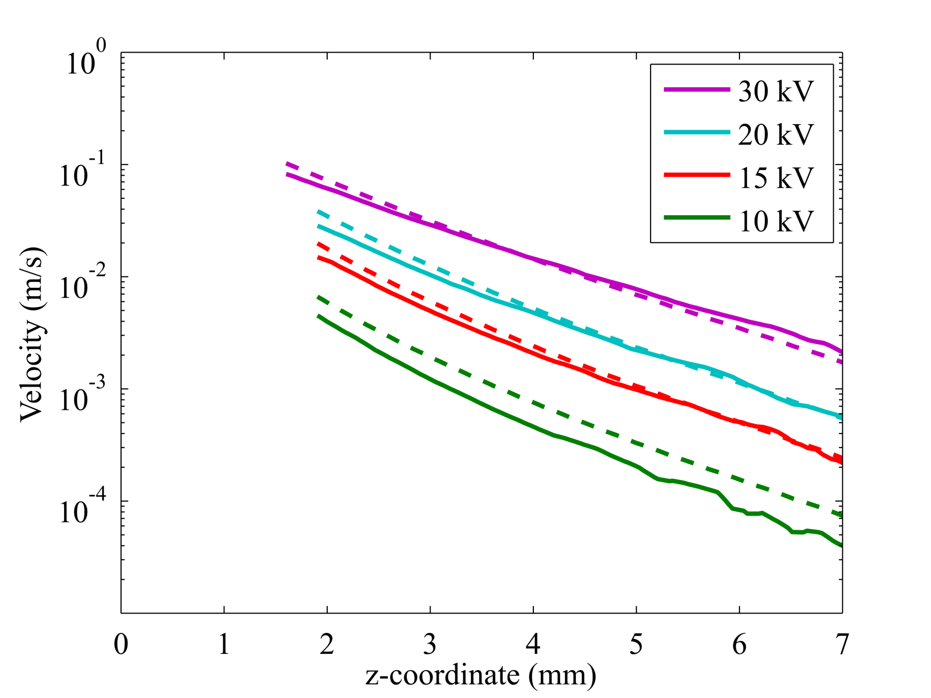
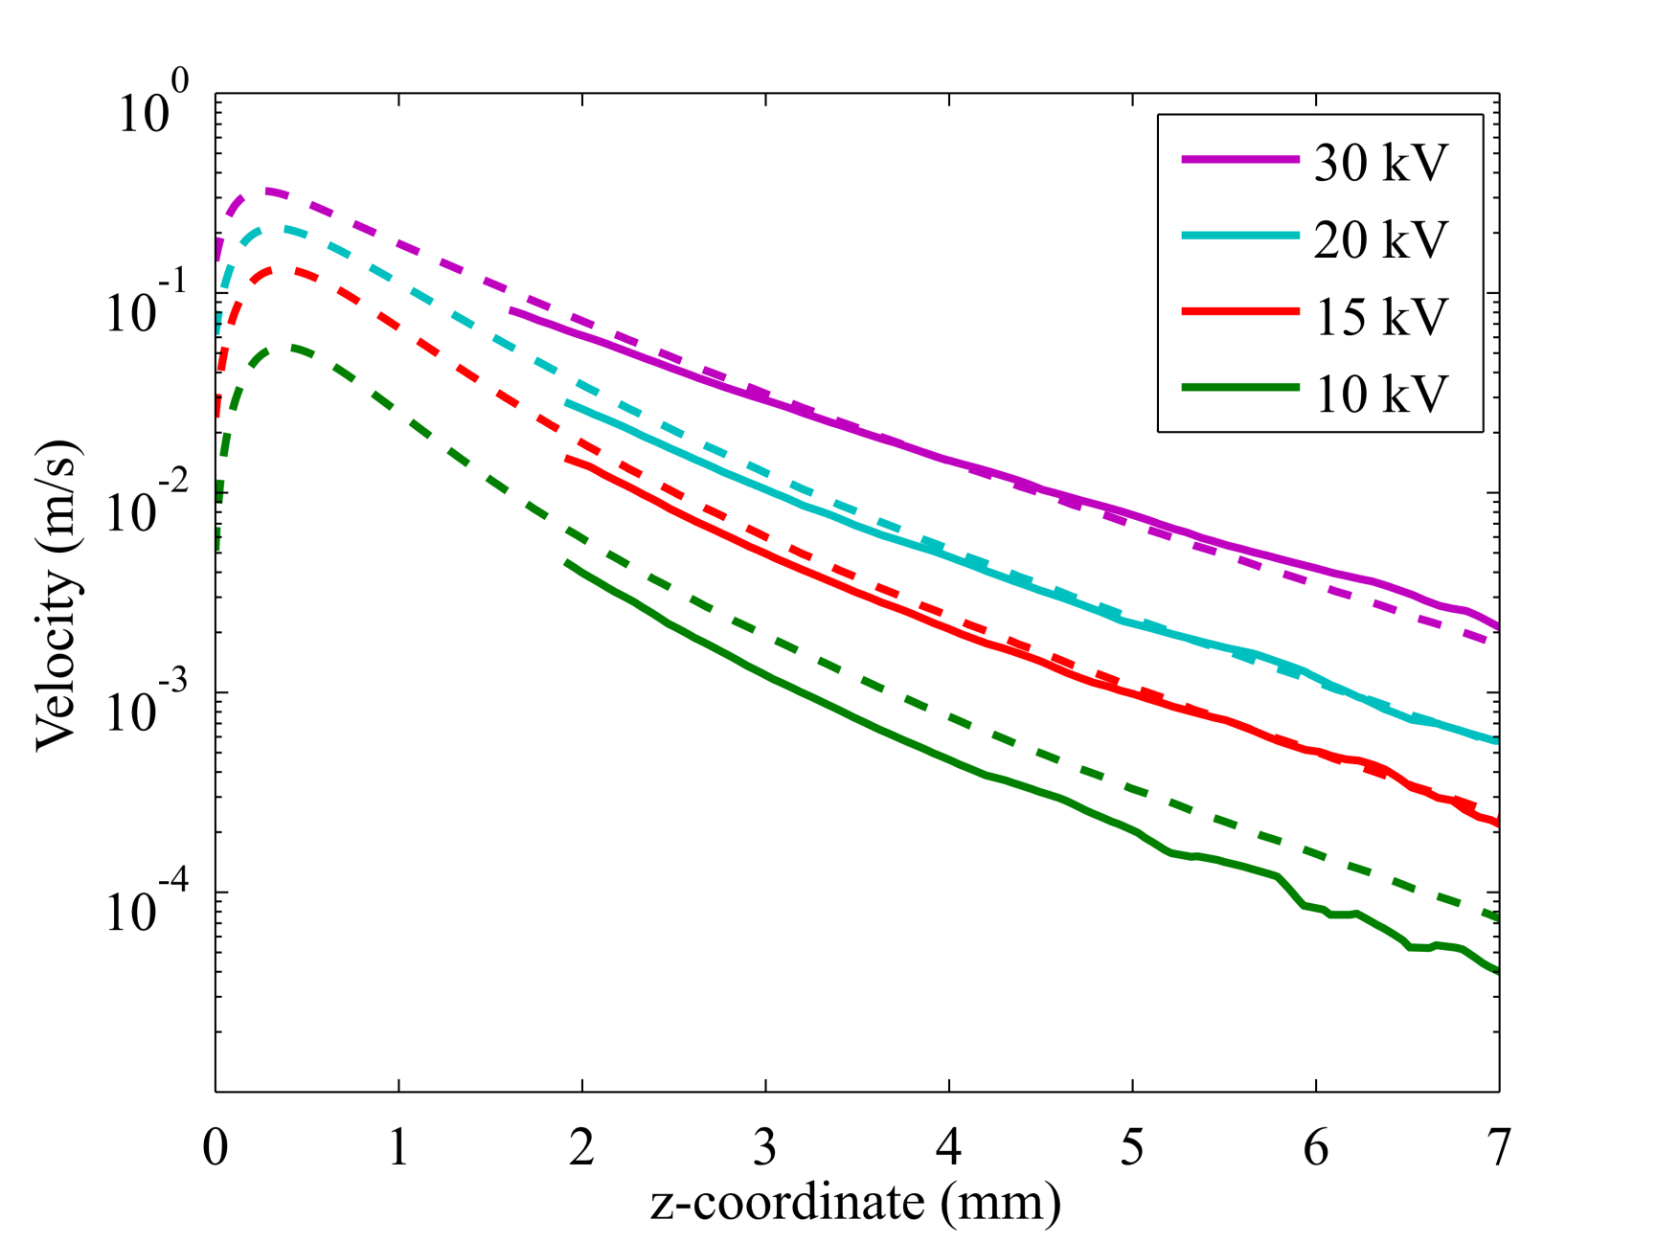
Axial velocity profiles
Tens of centimeters per second
Simulation
Experiment

Slide 22
Conclusions
Special EHD system and liquid allow conducting the experiment and comparing its results with those of simulation quantitatively.
For the first time, an EHD flow caused solely by field-enhanced dissociation has been investigated experimentally in a wide range of voltages with the electric field strength rising up to 10⁷ V/m: intense flows are observed.
The theoretical description of the field-enhanced dissociation is suitable in computer simulation: it yields correct flow structure and sufficient quantitative agreement with the experiment. Nevertheless, systematic undershoot of experimental data is observed.

Slide 23
Field-enhanced dissociation
Thank you for your kind attention
Injection
Ion mobilities

Slide 24
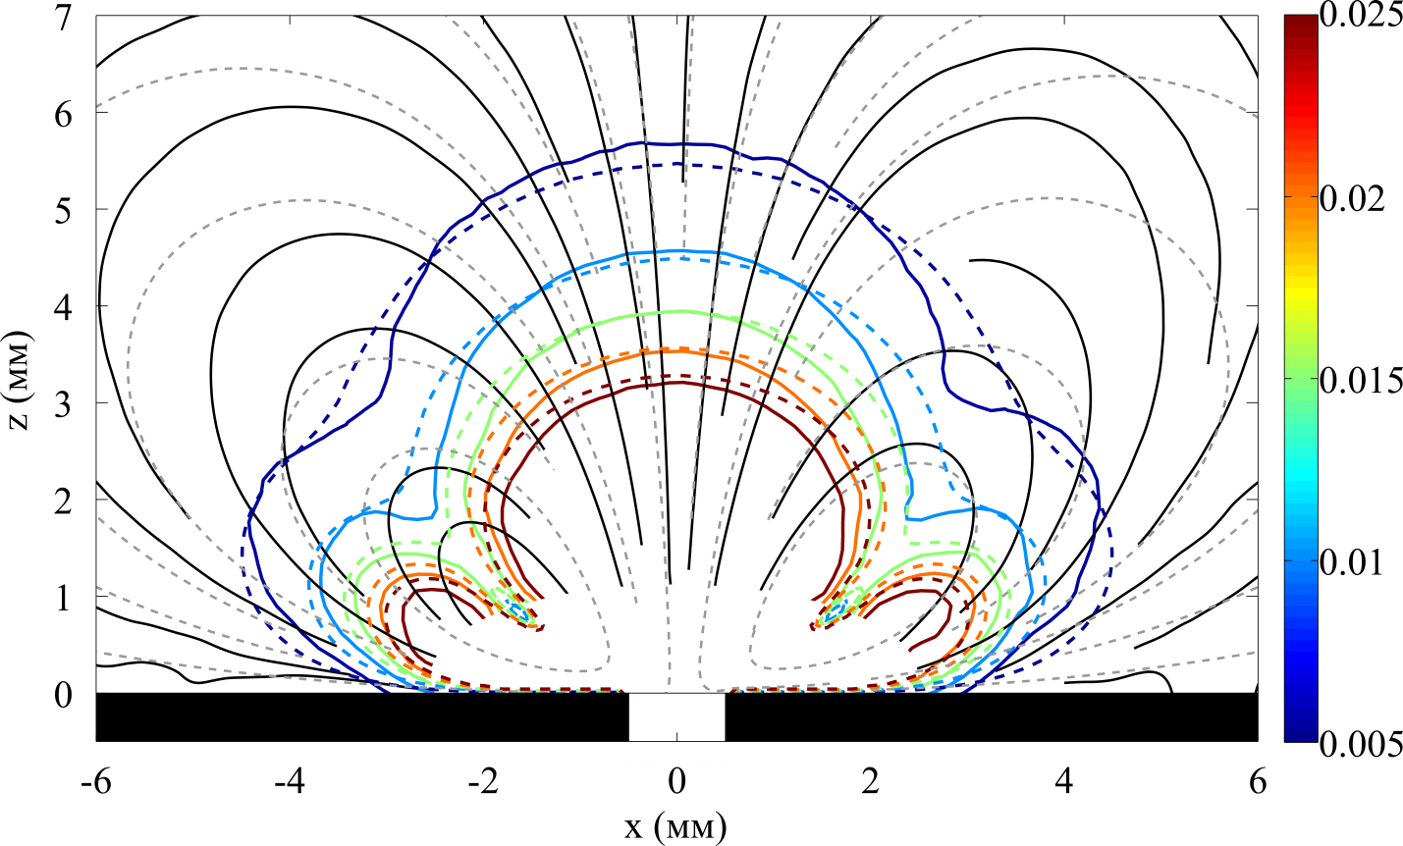
PIV results
$$V_{0}=30 kV$$
$$z (mm)$$
$$x (mm)$$
Simulation
Experiment

