Slide 1
International Workshop on Electrohydrodynamics and Triboelectrostatics
http://iwehd.conference.univ-poitiers.fr/
1-2 September, 2016

Slide 2
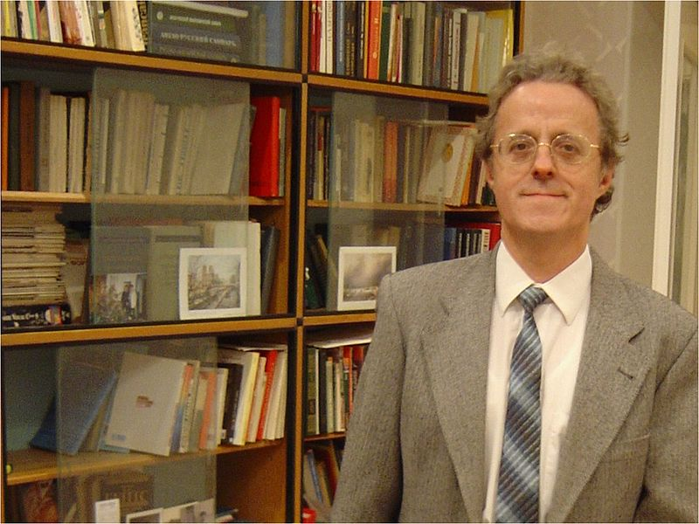
1st IWEHD
In memory of our dear
friend and longtime colleague
Prof. Antonio Castellanos Mata
( 7 March 1947 – 27 January 2016 )
Group of Electrohydrodynamics and Cohesive Granular Media
University of Seville, Spain

