Slide 1
Numerical Simulation and Experimental Study of
EHD Flow Generated by Microplasma Actuator
Marius Blajan¹, Akihiko Ito², Jaroslav Kristof²,
Hitoki Yoneda⁴, and Kazuo Shimizu^{1,2,3}
¹ Organization for Innovation and Social Collaboration, Shizuoka University, Japan
² Graduate School of Integrated Science and Technology, Shizuoka University, Japan
³ Graduate School of Science and Technology, Shizuoka University, Japan
⁴University of Electro-Communications, Tokyo, Japan

Slide 2
List
1. Introduction
2. Experimental setup
3. Simulation conditions
4. Results
→ Simulation results
5. Conclusions

Slide 3
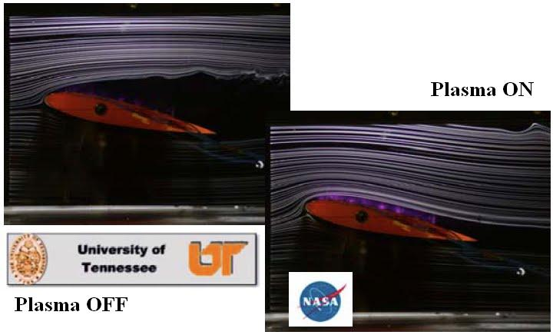
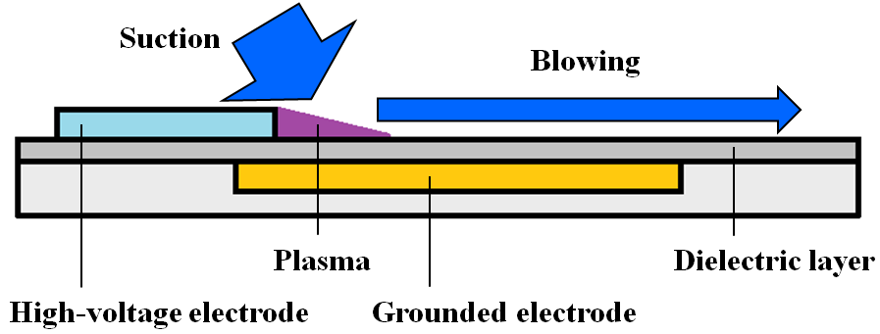
Introduction
Plasma actuator : New flow control device
J. R. Roth, D. M. Sherman, S. P. Wilkinson, AIAA, 1998.
J. R. Roth, H. Sin, R. C. M. Madhan, S. P. Wilkinson, AIAA, 2003.
Advantages of the plasma actuator
1. No-moving parts
2. Simple construction
3. Thickness under 1 mm (our device was 100 µm !)

Slide 4
List
1. Introduction
2. Experimental setup
3. Simulation conditions
4. Results
→ Simulation results
5. Conclusions

Slide 5

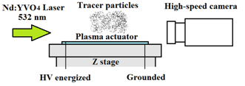
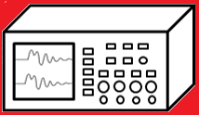
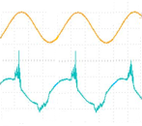
Experimental conditions
Experimental setup
Flow visualization
Microplasma actuator
・ Using particle tracking velocimetry
Z-stage
High Voltage probe
Oscilloscope
Power
supply

Slide 6
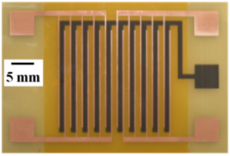
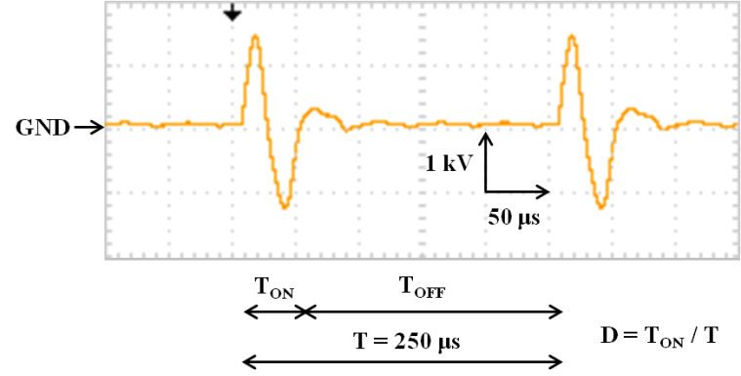
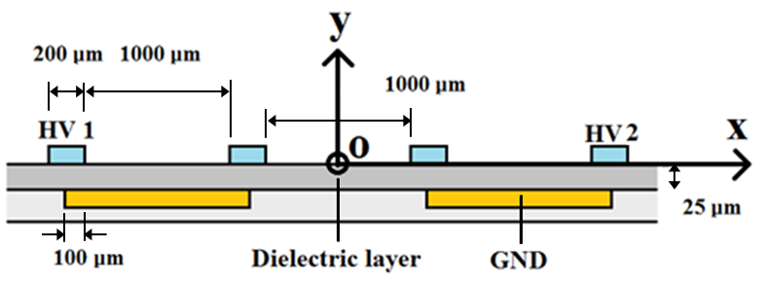
Experimental conditions
Microplasma actuator
Applied voltage
Top view
AC voltage was burst with FET switches
HV 1
・ Original voltage：AC (1.4 kV & 20 kHz)
GND
・ Duty ratio (D) : 20% & 70%
HV 2
Cross section view

Slide 7
List
1. Introduction
2. Experimental setup
3. Simulation conditions
4. Results
→ Simulation results
5. Conclusions

Slide 8
Simulation conditions
・ Numerical simulations were carried out using Suzen model
Computational geometry
Voltage waveform
The effective value of 1.4 kV AC voltage
is about 1 kV
1 kV pulse voltage was utilized
as the applied voltage

Slide 9



Simulation Theory (I)
・ Suzen model + Navier-Stokes Equations
The electrohydrodynamic force is:
where f is the body force per unit volume, ρ_{c} is the net charge density and E is the intensity of the electric field. The magnetic forces where neglected.
(1)
The electric field is:
(2)
where V is the potential.
According to Gauss’ law:
(3)
and furthermore:
where ε is permittivity that can be expressed as the product of relative permittivity ε_{r} and the permittivity of free space ε₀.
(4)
Y. B. Suzen, P. G. Huang, J. D. Jacob, and D. E. Ashpis, 35th Fluid Dynamics Conference and Exhibit, June 6-9, 2005, Toronto, Ontario, AIAA 2005-4633.
Y. B. Suzen, P. G. Huang, D. E. Ashpis, 45th AIAA Aerospace Sciences Meeting and Exhibit, 8 - 11 January, 2007, Reno, Nevada, AIAA 2007-937.

Slide 10



Simulation Theory (II)
・ Suzen model + Navier-Stokes Equations
The charge density can be expressed in terms of the potential V and the Debye length λ_{D}:
(5)
Thus the body force can be calculated using equations (1) and (5). Because the gas particles are weakly ionized the potential V can be decoupled in a potential due to the external electric field ø, and a potential due to the net charge density φ:
(6)
It results two independent equations:
(7)
(8)
Considering:
(9)

Slide 11




Simulation Theory (III)
・ Suzen model + Navier-Stokes Equations
We can re-write equation (8) as:
(10)
Furthermore the body force is calculated by:
(11)
The permittivity between dielectric and air was considered as the harmonic mean between dielectric permittivity taken as ε_{rd}=2.7 and air permittivity ε_{rair}=1 in order to conserve the electric field. The outer boundary conditions for equation (7):
(12)
The outer boundary conditions for equation (10):
(13)

Slide 12



Simulation Theory (IV)
・ Suzen model + Navier-Stokes Equations
The charge distribution over the encapsulated electrode was calculated from equation (10) after considering the covered electrodes as the source charge. The source charge was considered same as Suzen ρ_{c} =0.00750 C/m³. The value of Debye length was λ_{D} =0.00017 m for the air and λ_{D}= ∞ for the dielectric. After obtaining the body force from equation (11) the Navier-Stokes equations were used to simulate the plasma actuator as shown in (14), (15) and (16):
(14)
where u and v are the components of the flow velocity on x and y, ρ is the fluid density, p is the pressure and υ is the kinematic viscosity.
(15)
(16)
The dynamic viscosity μ is:
(17)
Air density ρ=1.177 kg/m³ and kinematic viscosity υ=1.57*10⁻⁵ m²/s thus dynamic viscosity μ=1.8*10⁻⁵ kg/m s.

Slide 13
List
1. Introduction
2. Experimental setup
3. Simulation conditions
4. Results
→ Experimental results
5. Conclusions

Slide 14
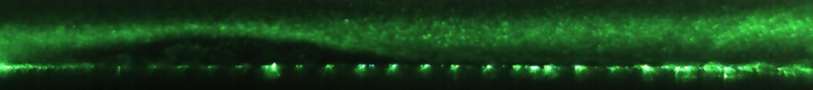
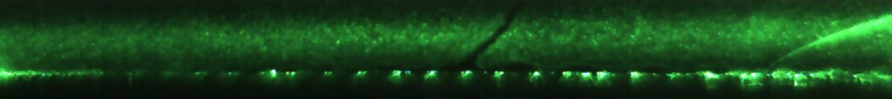
Experimental results
Flow visualization
D = 20% (Left flow)
Microplasma actuator
2 mm
D = 70% (Right flow)
Microplasma actuator
2 mm
・ Diagonal flow was obtained at both cases
・ Induced flow angle was 60 degree at 20% and 130 degree at 70 %

Slide 15
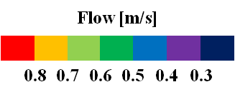
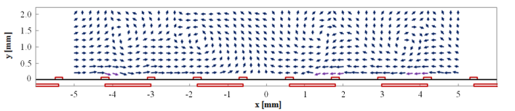
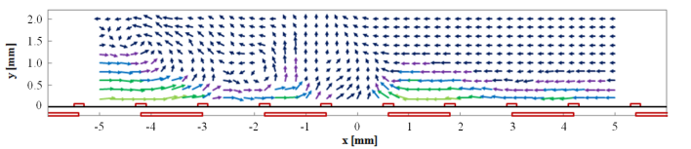
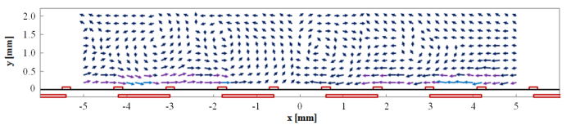
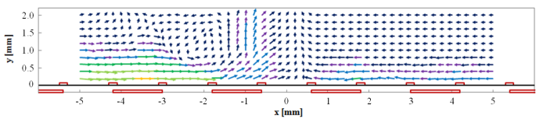
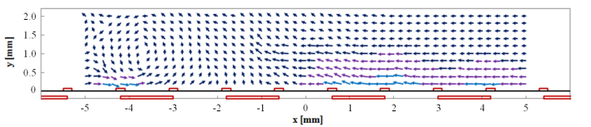
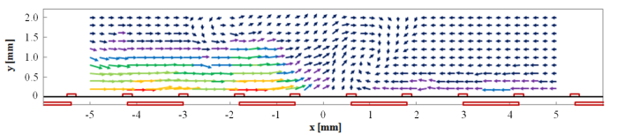
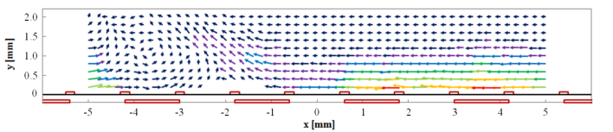
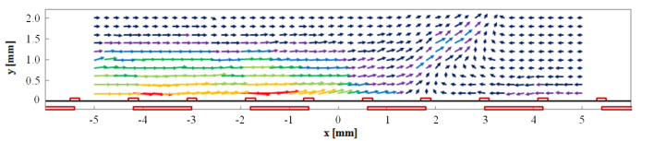
Experimental results
PTV result (D = 20%)
PTV result (D = 70%)
t=2.5 ms
t=52.5 ms
t=5 ms
t=55 ms
t=10 ms
t=60 ms
t=50 ms
t=100 ms
・ Near the electrode surface the maximum velocity was 0.85 m/s
・ The diagonal left and right flow of 0.58 m/s and 0.6 m/s was generated

Slide 16
List
1. Introduction
2. Experimental setup
3. Simulation conditions
4. Results
→ Simulation results
5. Conclusions

Slide 17
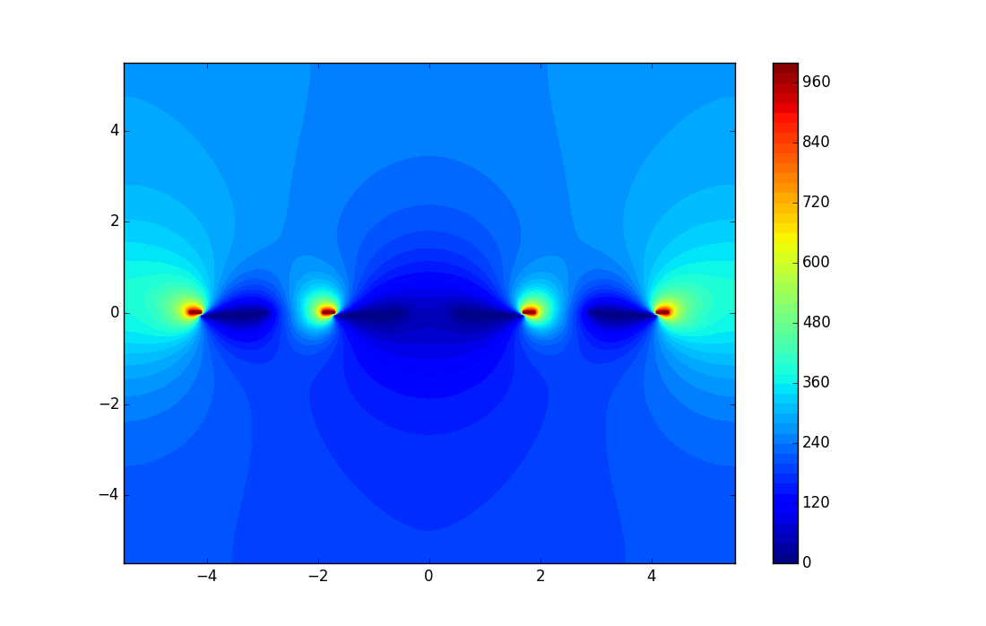
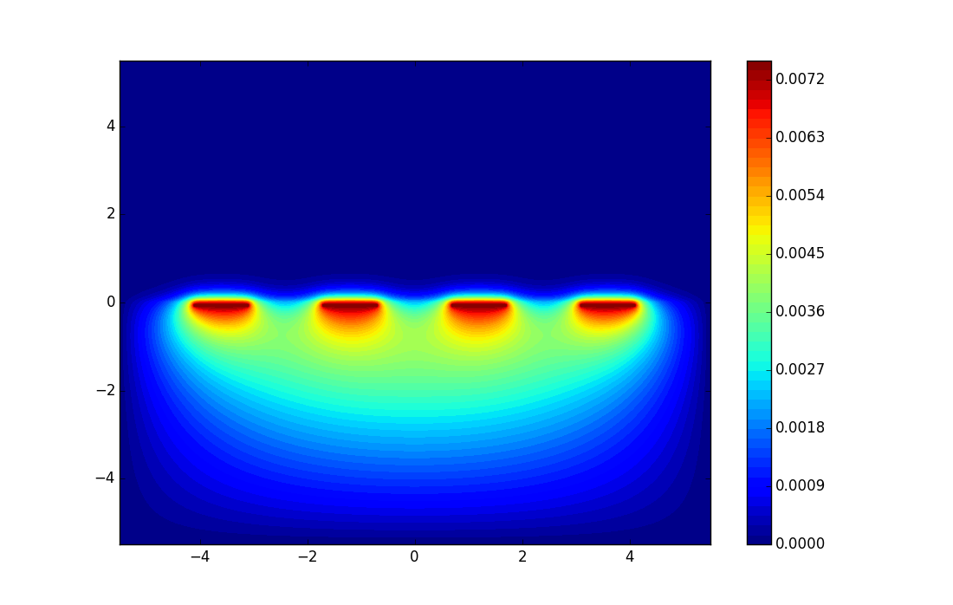
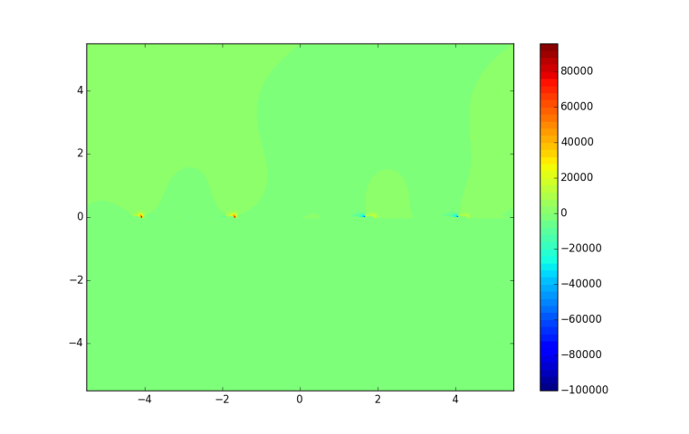
Simulation Results Plasma
Electric potential
Electric charge
Y axis (mm)
Potential (V)
Y axis (mm)
Charge (C/m³)
X axis (mm)
X axis (mm)
Body force
A Cartesian grid with 441 x 441 nodes was used. The grid size was 11 x 11 mm. The equations were discretized with Finite Difference Method.
All the simulations were carried out using Julia programming language.
http://julialang.org/
Body Force (N/m³)
Y axis (mm)
X axis (mm)

Slide 18
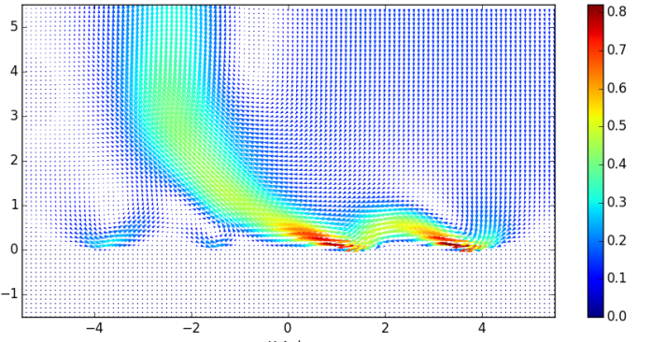
Simulation Results Flow (I)
At the initial stages vortices were developed.
At about 50 ms a steady state was reached.
0.6 m/s diagonal left flow occurred.
Above the electrodes the maximum flow velocity was about 0.83 m/s. The data fits the experimental results.
During experiments some measurement error could occur above electrodes due to the plasma light emission.
Flow (m/s)
Flow (m/s)
Y axis (mm)
Y axis (mm)
Duty ratio 20%
5 ms
Duty ratio 20%
10 ms
X axis (mm)
X axis (mm)
Flow (m/s)
Flow (m/s)
Y axis (mm)
Y axis (mm)
Duty ratio 20%
20 ms
Duty ratio 20%
30 ms
X axis (mm)
X axis (mm)
Flow (m/s)
Flow (m/s)
Y axis (mm)
Y axis (mm)
Duty ratio 20%
40 ms
Duty ratio 20%
50 ms
X axis (mm)
X axis (mm)

Slide 19
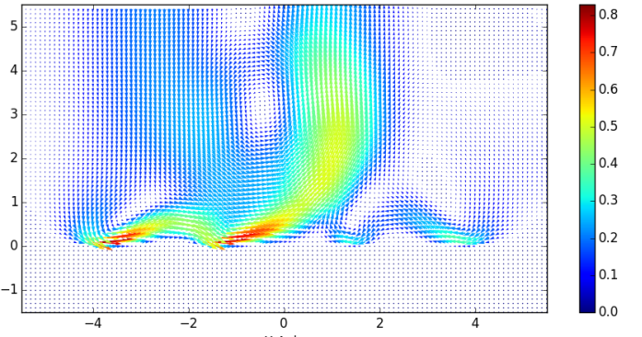
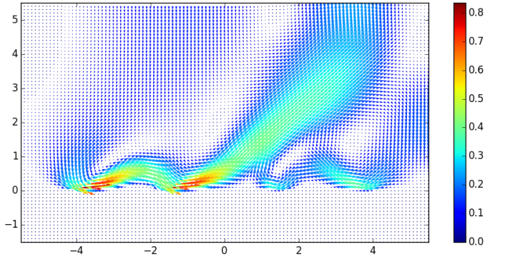
Simulation Results Flow (II)
Flow (m/s)
Flow (m/s)
Y axis (mm)
Y axis (mm)
After 50 ms duty ratio was changed from 20% to 70% thus gradually the flow changed its direction from diagonal left to diagonal right.
0.58 m/s diagonal flow occurred.
Above the electrodes the maximum flow velocity was about 0.8 m/s.
Duty ratio 70%
55 ms
Duty ratio 70%
60 ms
X axis (mm)
X axis (mm)
Flow (m/s)
Flow (m/s)
Y axis (mm)
Y axis (mm)
Duty ratio 70%
80 ms
Duty ratio 70%
90 ms
X axis (mm)
X axis (mm)
Y axis (mm)
Flow (m/s)
Flow (m/s)
Y axis (mm)
Duty ratio 70%
100 ms
Duty ratio 70%
120 ms
X axis (mm)
X axis (mm)

Slide 20
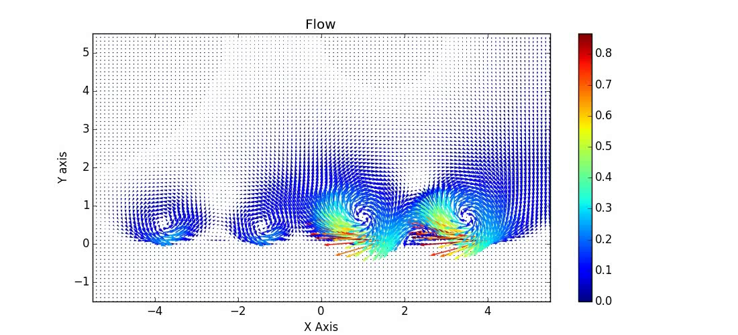
Simulation Results Flow (III)
Duty ratio was varied from 20% up to 50 ms to 70% up to 120 ms.
Up to 50 ms left diagonal flow; From 50 ms to 120 ms right diagonal flow.

Slide 21
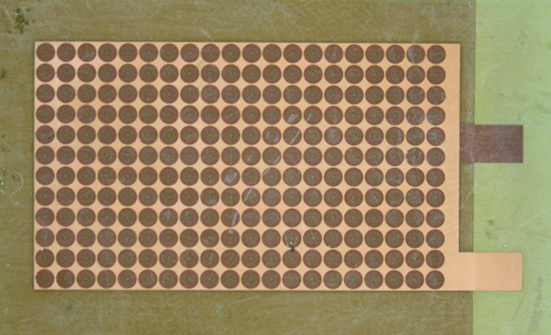
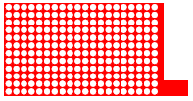
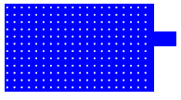
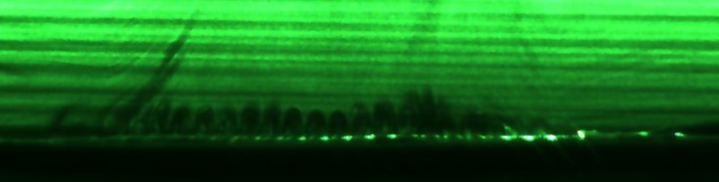
Vortex generator
Active Electrode Top View
Grounded Electrode Top View
5 mm
Flow visualization when an AC voltage with 1 kV and 10 kHz was applied to the electrode.
Vortex generator
3 mm

Slide 22
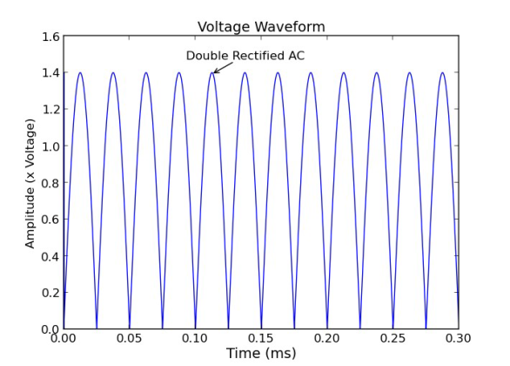
3D Model of vortex generator
A Cartesian grid with 41 x 41 x 41 nodes was used. The grid size was 4 x 4 x 4 mm.
Y = 2 mm
Air ε_{r} = 1
Z= 2 mm
Active
Electrode
Perforated Holes
X = -2 mm
X = 2 mm
Gap
0.1 mm
0
0.1 mm
0.1 mm
Grounded
Electrode
Z= -2 mm
Dielectric ε_{r} = 2.7
Y = -2 mm
Applied voltage was double rectified AC 1.4 kV at 20 kHz
Active Electrode Top View
Grounded Electrode Top View
3.6 mm
3.6 mm
Perforated Holes
0.9 mm
1.5 mm
0.9 mm
1.6 mm
0.2 mm
3.6 mm
1.6 mm
3.6 mm
Perforated Holes
0.9 mm
0.2 mm
0.9 mm
0.2 mm
0.2 mm

Slide 23
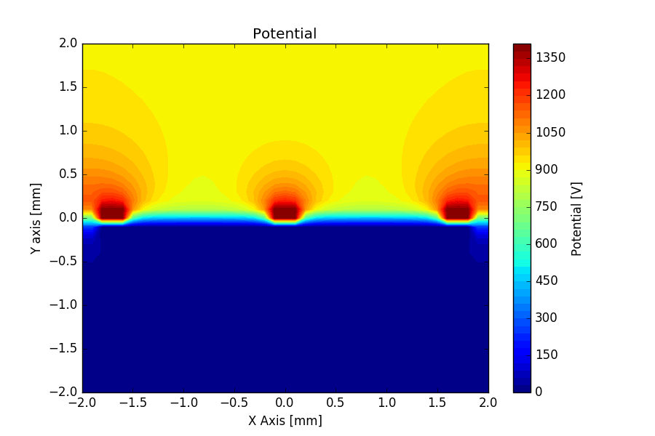
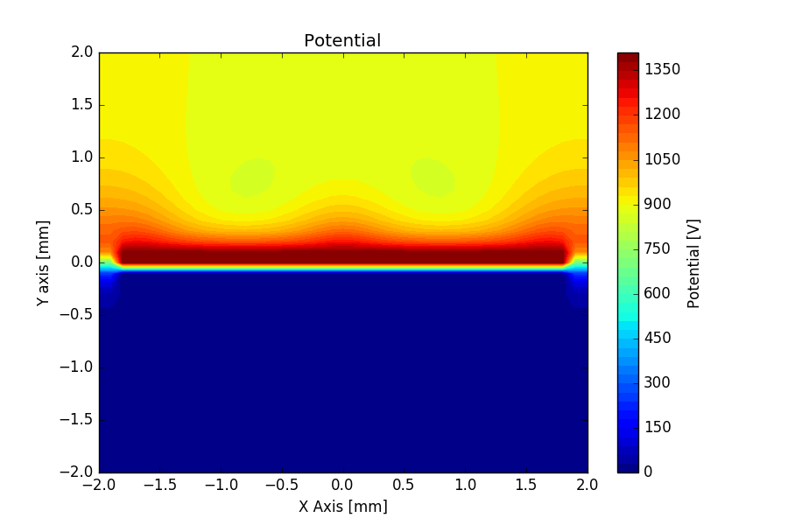
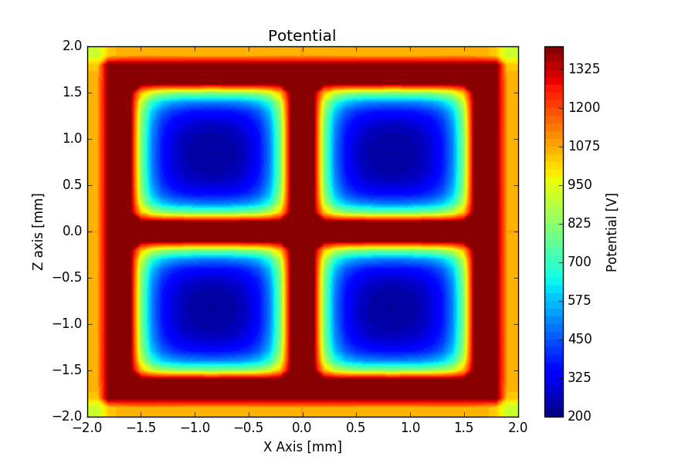
Simulation Results Plasma 3D Model (I)
Potential
Z = -1.6 mm
Z = -0.1 mm
Y = 0.1 mm
A Cartesian grid with 41 x 41 x 41 nodes was used. The grid size was 4 x 4 x 4 mm. The equations were discretized with Finite Difference Method.
All the simulations were carried out using Julia programming language.
http://julialang.org/

Slide 24
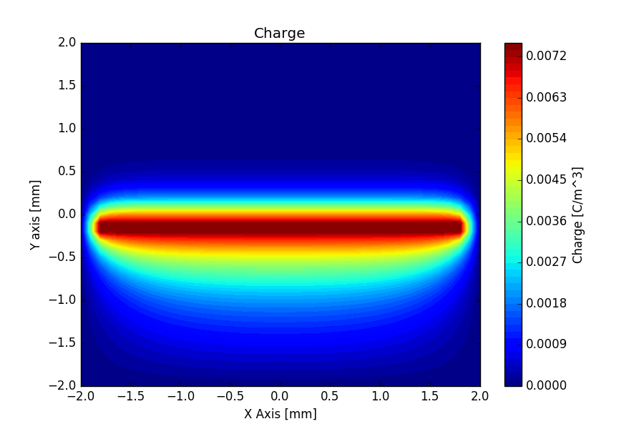
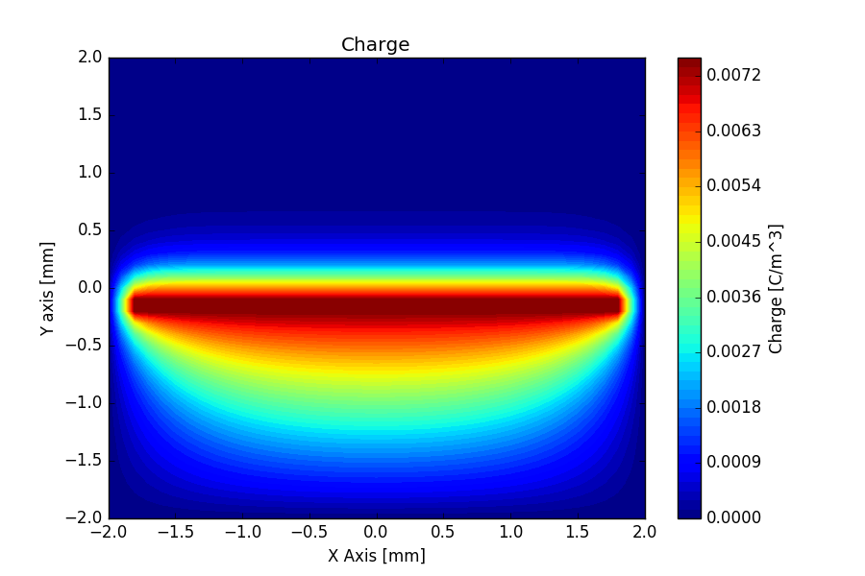
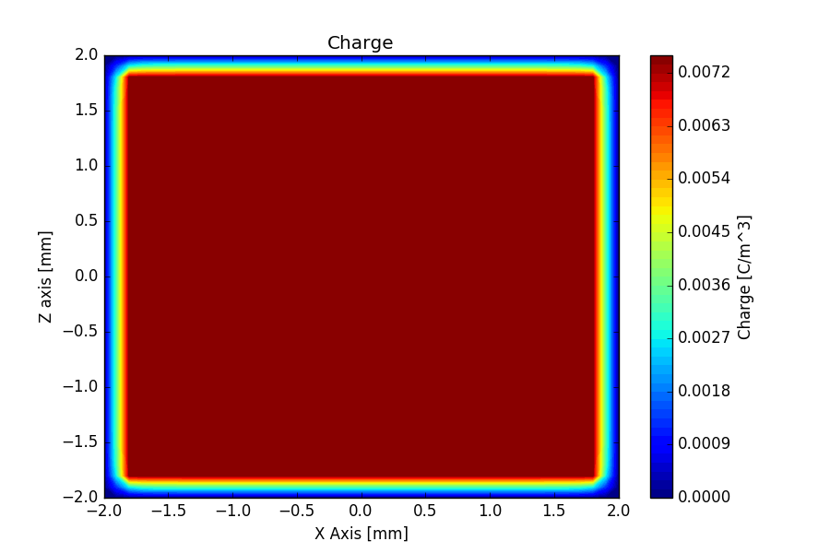
Simulation Results Plasma 3D Model (II)
Charge
Z = -1.6 mm
Z = -0.1 mm
Y = -0.1 mm

Slide 25
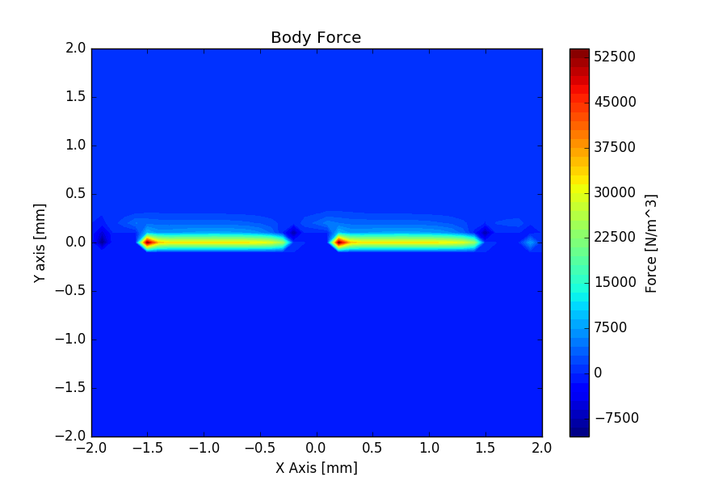
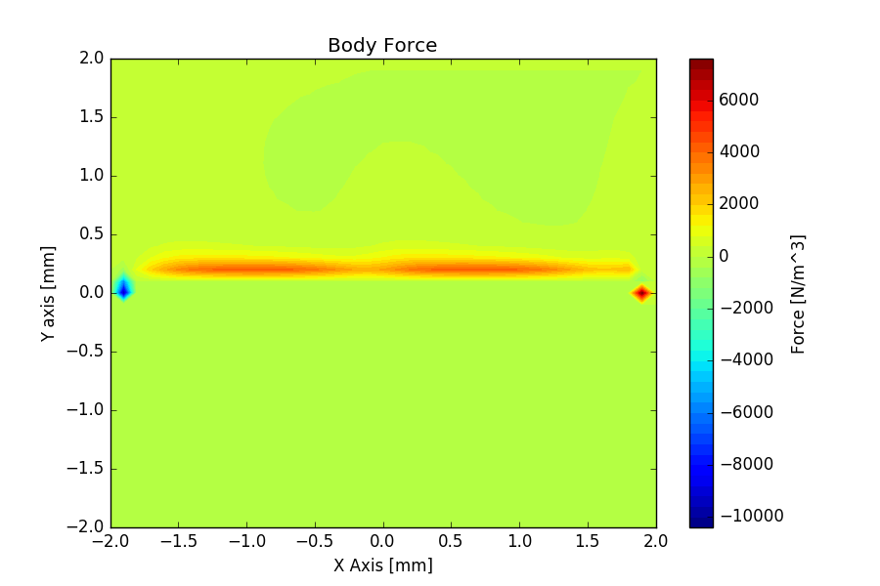
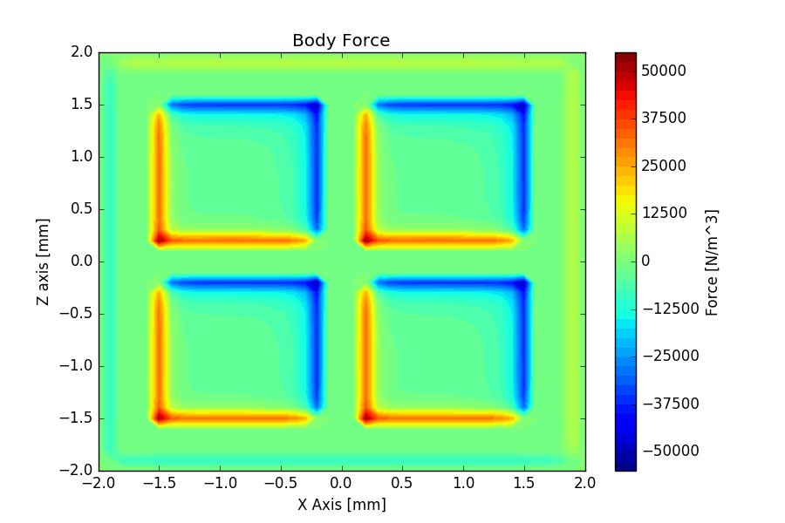
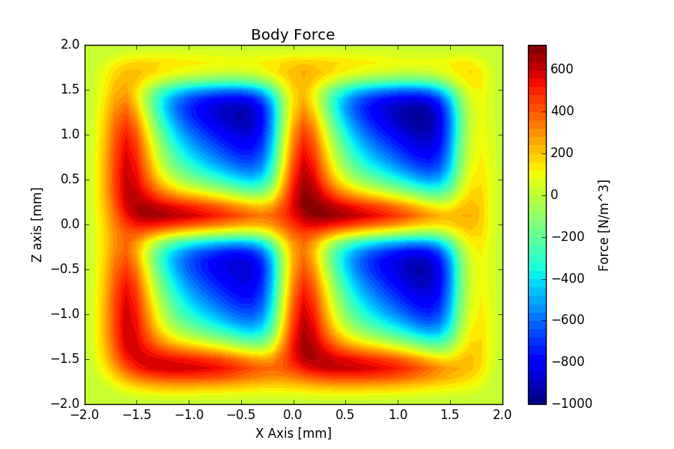
Simulation Results Plasma 3D Model (III)
Body Force
Z = -1.6 mm
Z = -0.1 mm
Y = 0 mm
Y = 0.4 mm

Slide 26
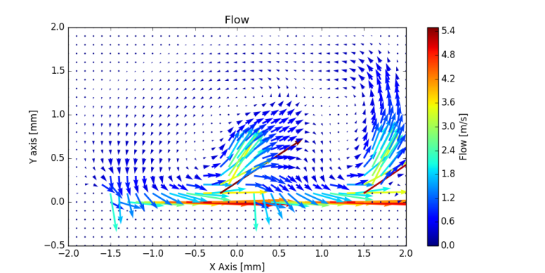
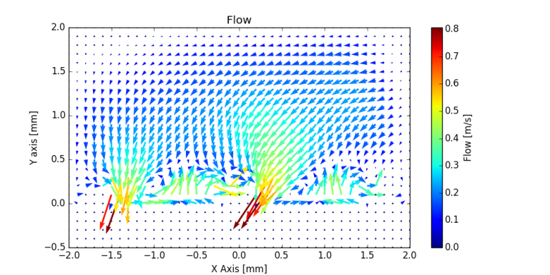
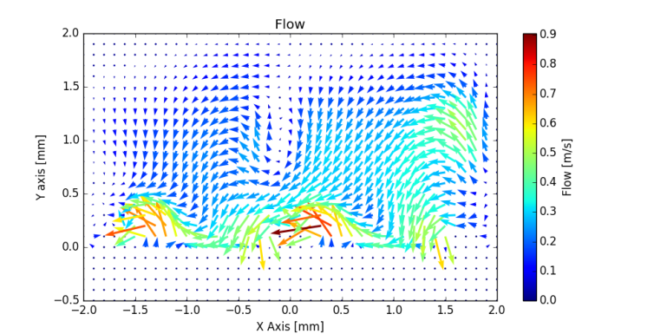
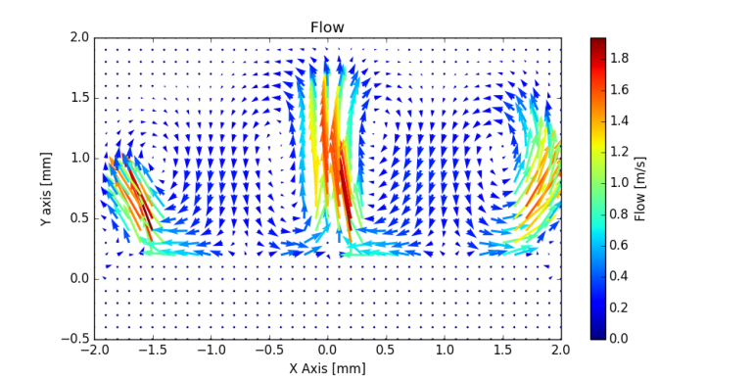
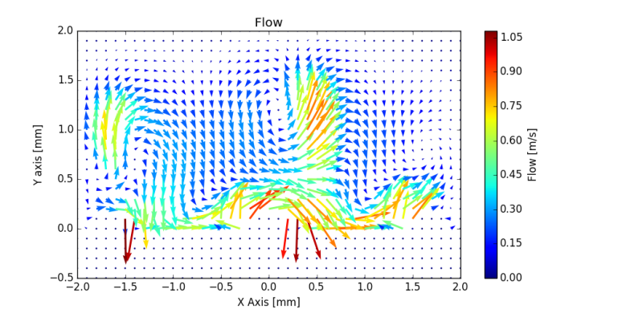
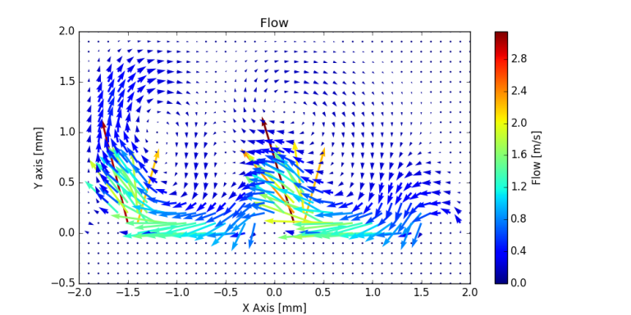
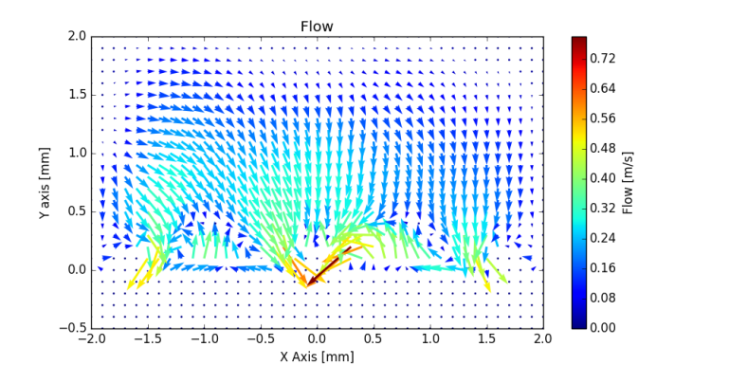
Simulation Results Flow 3D Model (I)
Flow
Z = -1.6 mm at 2.5 ms
Z = -1.1 mm at 2.5 ms
Z = -0.6 mm at 2.5 ms
Z = -0.1 mm at 2.5 ms
Z = 0.4 mm at 2.5 ms
Z = 1.4 mm at 2.5 ms
Z = 0.9 mm at 2.5 ms
Y = 2 mm
Air ε_{r} = 1
Z= 2 mm
X = -2 mm
X = 2 mm
Gap
0.1 mm
0
0.1 mm
0.1 mm
Z= -2 mm
Dielectric ε_{r} = 2.7
Y = -2 mm

Slide 27
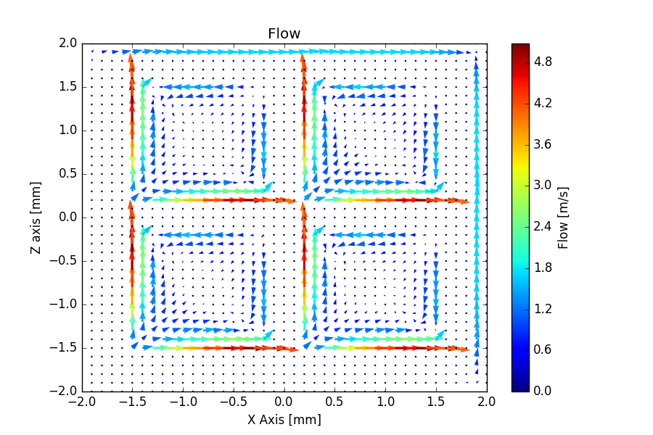
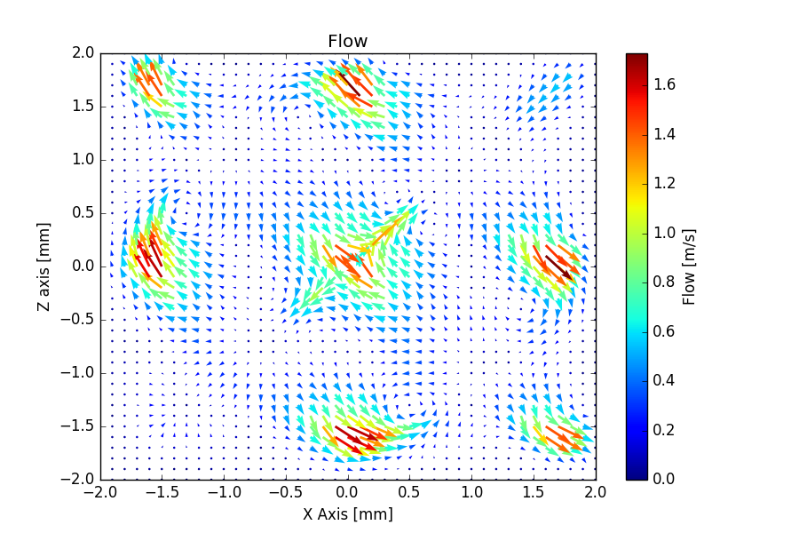

Simulation Results Flow 3D Model (II)
Flow
y = 0.1 mm at 2.5 ms
y = 0.5 mm at 2.5 ms
y = 1.2 mm at 2.5 ms
Air ε_{r} = 1
Gap
0.1 mm
0.1 mm
0.1 mm
Dielectric ε_{r} = 2.7

Slide 28







Simulation Results Flow 3D Model (III)
Flow
Z = -1.6 mm at 10 ms
Z = -1.1 mm at 10 ms
Z = -0.6 mm at 10 ms
Z = -0.1 mm at 10 ms
Z = 0.4 mm at 10 ms
Z = 0.9 mm at 10 ms
Z = 1.4 mm at 10 ms

Slide 29




Simulation Results Flow 3D Model (IV)
Flow at 0.5 ms
Iso-Surfaces of the magnitude
[m/s]
Flow at 2.5 ms
Iso-Surfaces of the magnitude
[m/s]

Slide 30




Simulation Results Flow 3D Model (V)
Flow at 5 ms
Iso-Surfaces of the magnitude
[m/s]
Flow at 7.5 ms
Iso-Surfaces of the magnitude
[m/s]

Slide 31




Simulation Results Flow 3D Model (VI)
Flow at 10 ms
Iso-Surfaces of the magnitude
[m/s]
Flow at 25 ms
Iso-Surfaces of the magnitude
[m/s]

Slide 32




Simulation Results Flow 3D Model (VII)
Flow at 25 ms
Different angle
Iso-Surfaces of the magnitude
[m/s]
Flow at 25 ms
Different angle
Iso-Surfaces of the magnitude
[m/s]

Slide 33




Simulation Results Flow 3D Model (VIII)
Flow at 25 ms
Different angle
Iso-Surfaces of the magnitude
[m/s]
Flow at 25 ms
Different angle
Iso-Surfaces of the magnitude
[m/s]

Slide 34
List
1. Introduction
2. Experimental setup
3. Simulation conditions
4. Results
→ Simulation results
5. Conclusions

Slide 35
Conclusions
The following results were obtained in this study.
Microplasma actuator for flow control is a simple and efficient solution for flow control.
When duty ratio was D = 20% the flow velocity was 0.6 m/s and diagonal left flow was measured. The maximum flow velocity was 0.58 m/s when D = 70% and diagonal right flow was measured.
The numerical simulations were carried out using Suzen model and the results were in agreement with the experimental one.

Slide 36

Thank you for your attention!

