Slide 1



ElectroFluidDynamic
Gérard G. Touchard
Gerard.touchard@univ-poitiers.fr
Electrofluidodynamic Group (EFD)
Institut P’ • UPR CNRS 3346
SP2MI • Téléport 2
Boulevard Marie et Pierre Curie • BP 30179
F86962 FUTUROSCOPE CHASSENEUIL Cedex

Slide 2


Slide 3


Slide 4


Slide 5
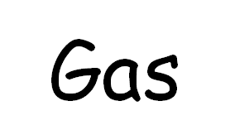

Slide 6
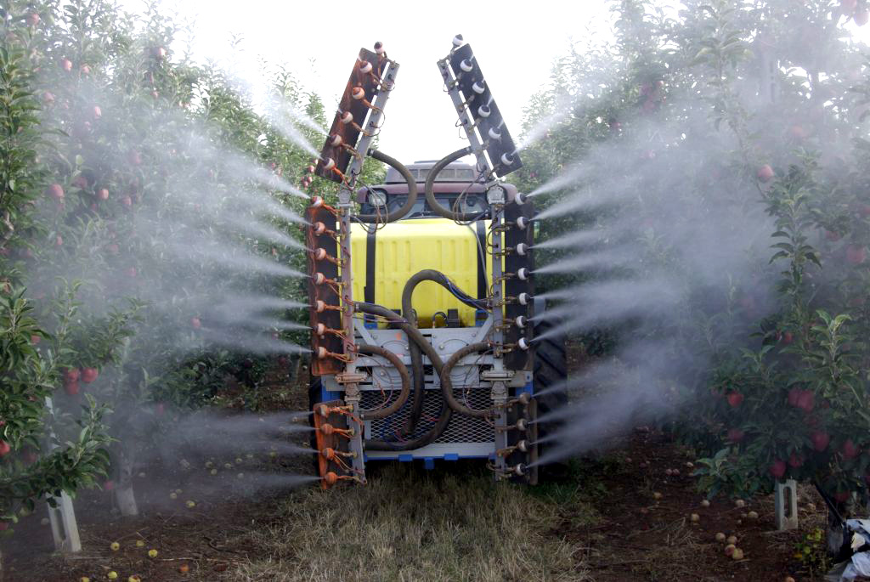
Other applications
Electrospraying for agriculture

Slide 7
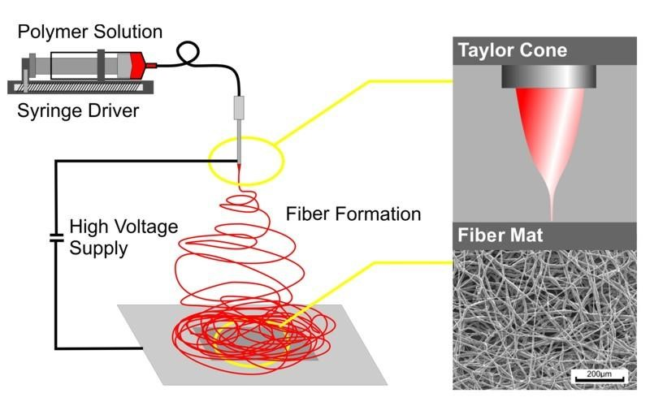
Other applications
Electrospining

Slide 8
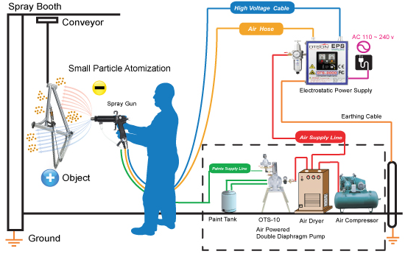
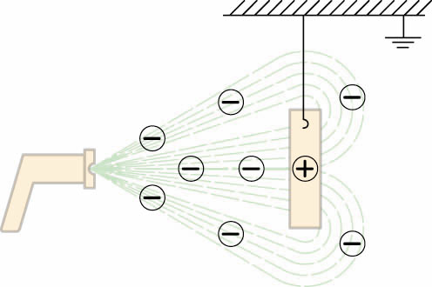
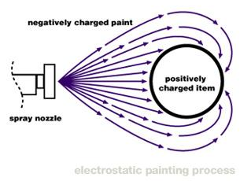
Other applications
Electrostatic painting

Slide 9
Thank you very much

