Slide 1




Changing of the Ionic Wind Direction in Accordance with the Inclination of the
Corona-producing Electrode
I International workshop on electro-hydro-dynamics
and tribo-electrostatics
Chasseneuil-du-Poitou, France, September 1–2, 2016
Ilia Elagin, Andrey Samusenko, Dmitrii Begal, Ilia Ashikhmin, Yurii Stishkov
St. Petersburg State University
Physics Department
Electrophysics Research and Education Center

Slide 2
Outline
Experiments with the ionic wind in the needle-plane electrode system, PIV visualization.
- The needle is normal to the plane.
- The needle is inclined relative to the axis normal to the grounded plane.
3D simulation of the ionic wind in the needle-plane electrode system with normal and inclined positions of the needle.
- Model, equation set and boundary conditions.
- Velocity, concentration of ions, electric field and electric field distributions.
2/12

Slide 3
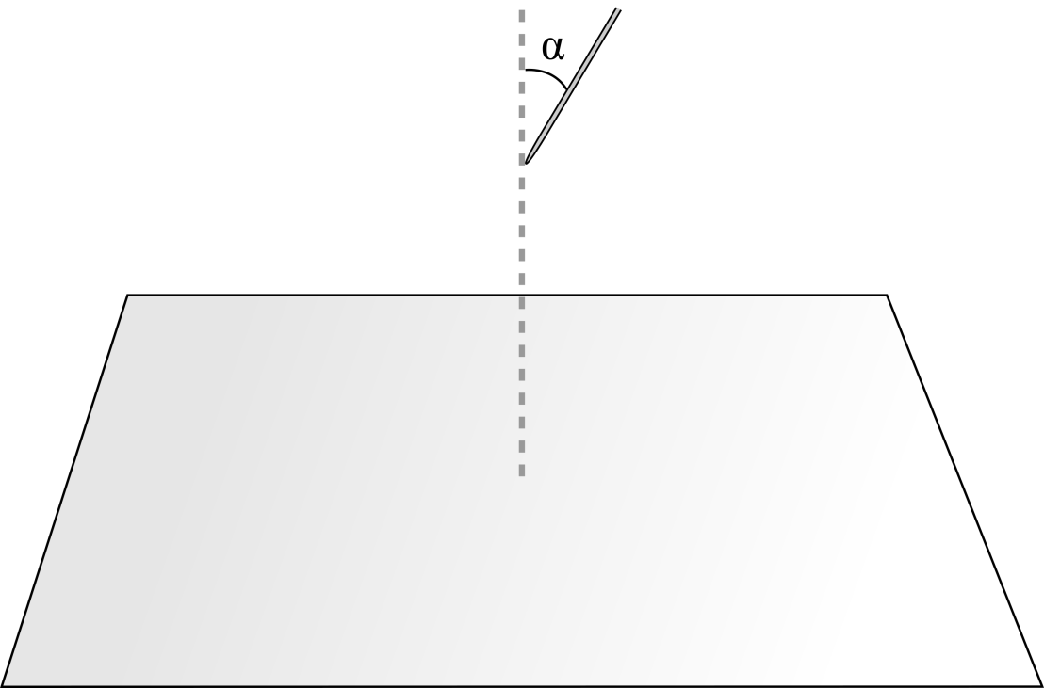
Experimental setup
Needle:
Thickness 1.2 mm
Tip curvature radius 0.3 mm
Positive Polarity
Potential 10.4 kV
Interelectrode gap 20 mm
α = 0°, 30°, 45°, 60°, 90°
3/12

Slide 4
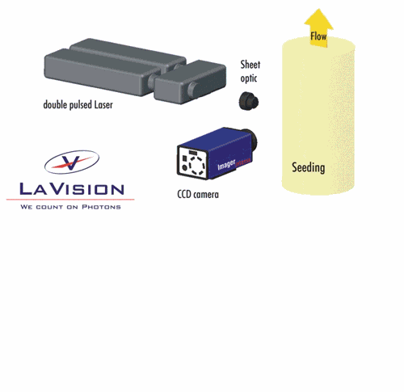
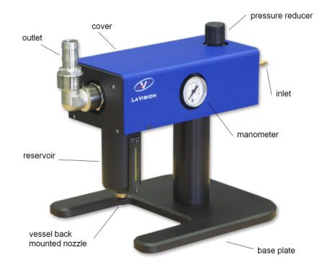
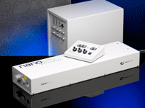
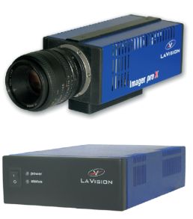
Experimental technique
PIV-method
Seeding particles
Aerosol Generator (production rate: 10⁸ #/s)
DEHS (Di-Ethyl-Hexyl-Sebacate)
Formula: C₂₆H₅₀O₄
Molar mass 426.7 g/mol
Density 0.91 g/cm³
Average size < 1 μm
LaVision FlowMaster Setup
PIV-parameters
Camera resolution: 1600x1200, dynamic range: 14 bit
Interrogation window size: 48x48 first pass, 24x24 second pass
Overlap: 50%
Time between laser flashes satisfies the inequality 0.1 px < ds < 1/4 d_{intWin}. Here ds is the particle displacement and d_{intWin} is the window size
Double pulse
Nd:YAG-laser
Image pro X CCD camera
Programmable Timing Unit
Information on this slide provided by LaVision Inc. (http://lavision.com)
4/12

Slide 5
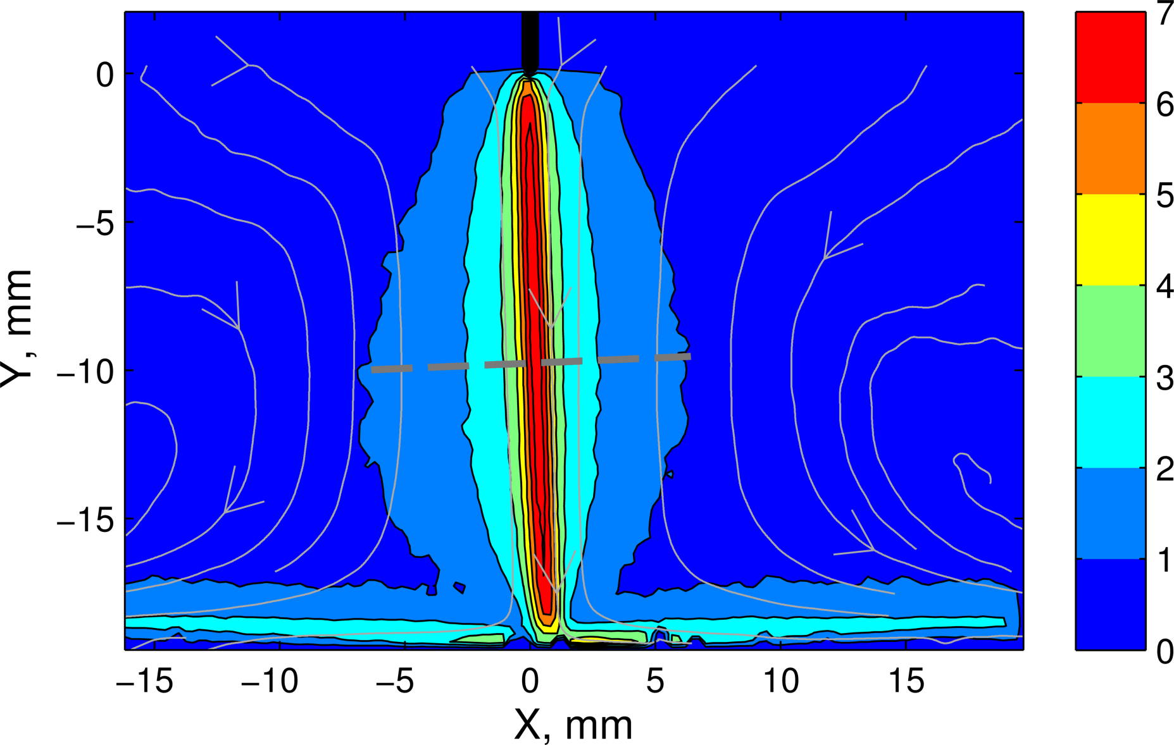
Flow velocity distribution (m/s)
Normal Direction
5/12

Slide 6
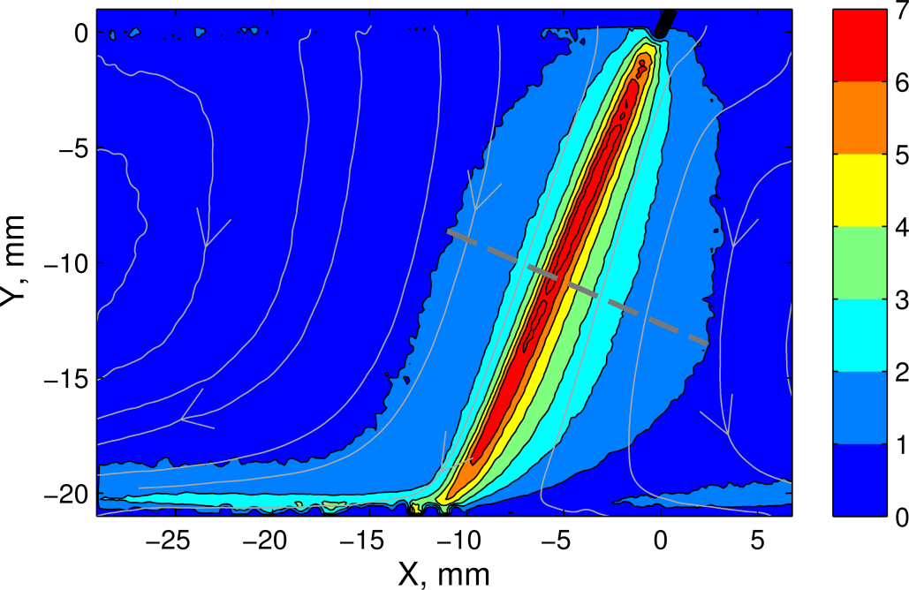
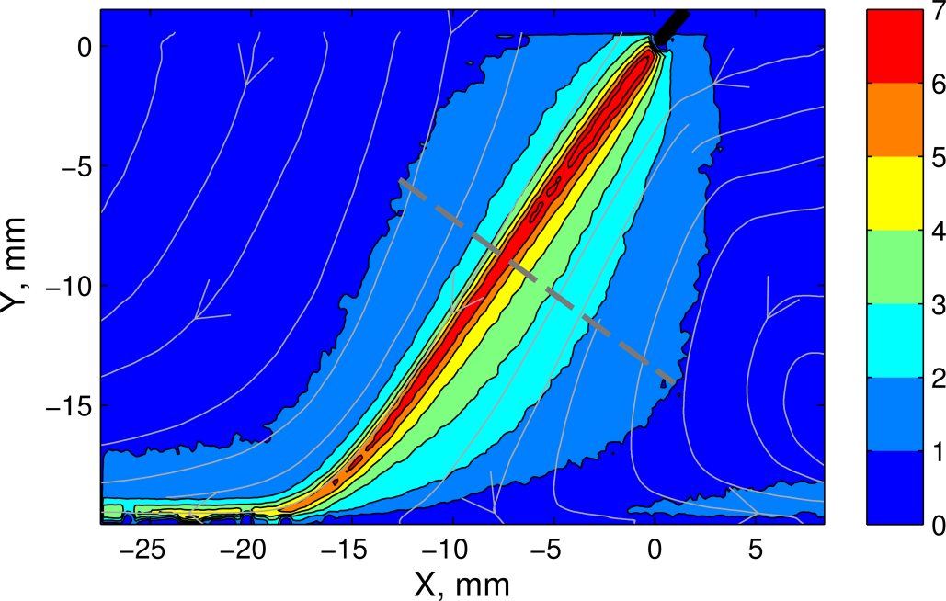
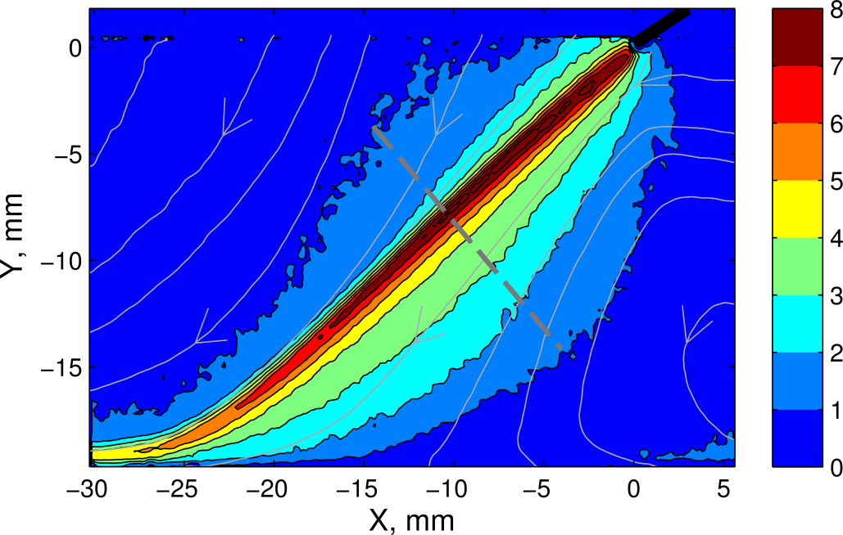
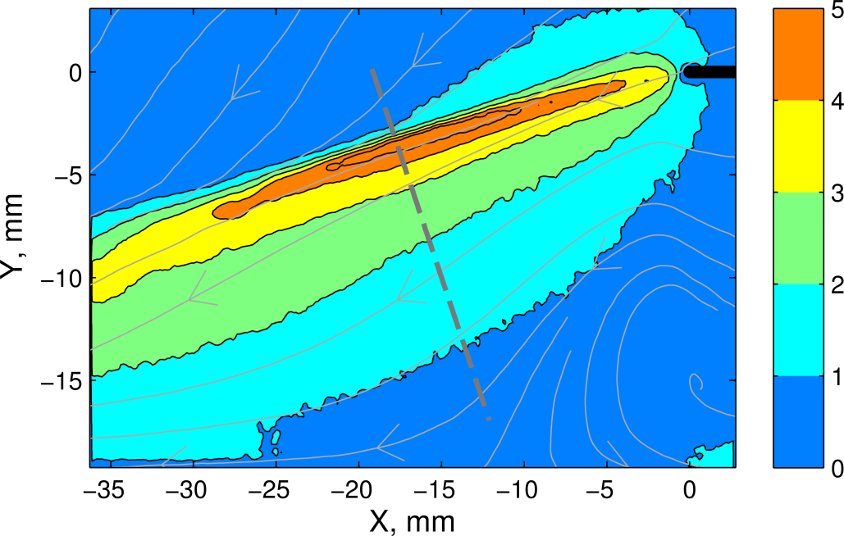
Flow velocity distribution (m/s). Inclination.
α = 30°
α = 45°
α = 60°
α = 90°
6/12

Slide 7
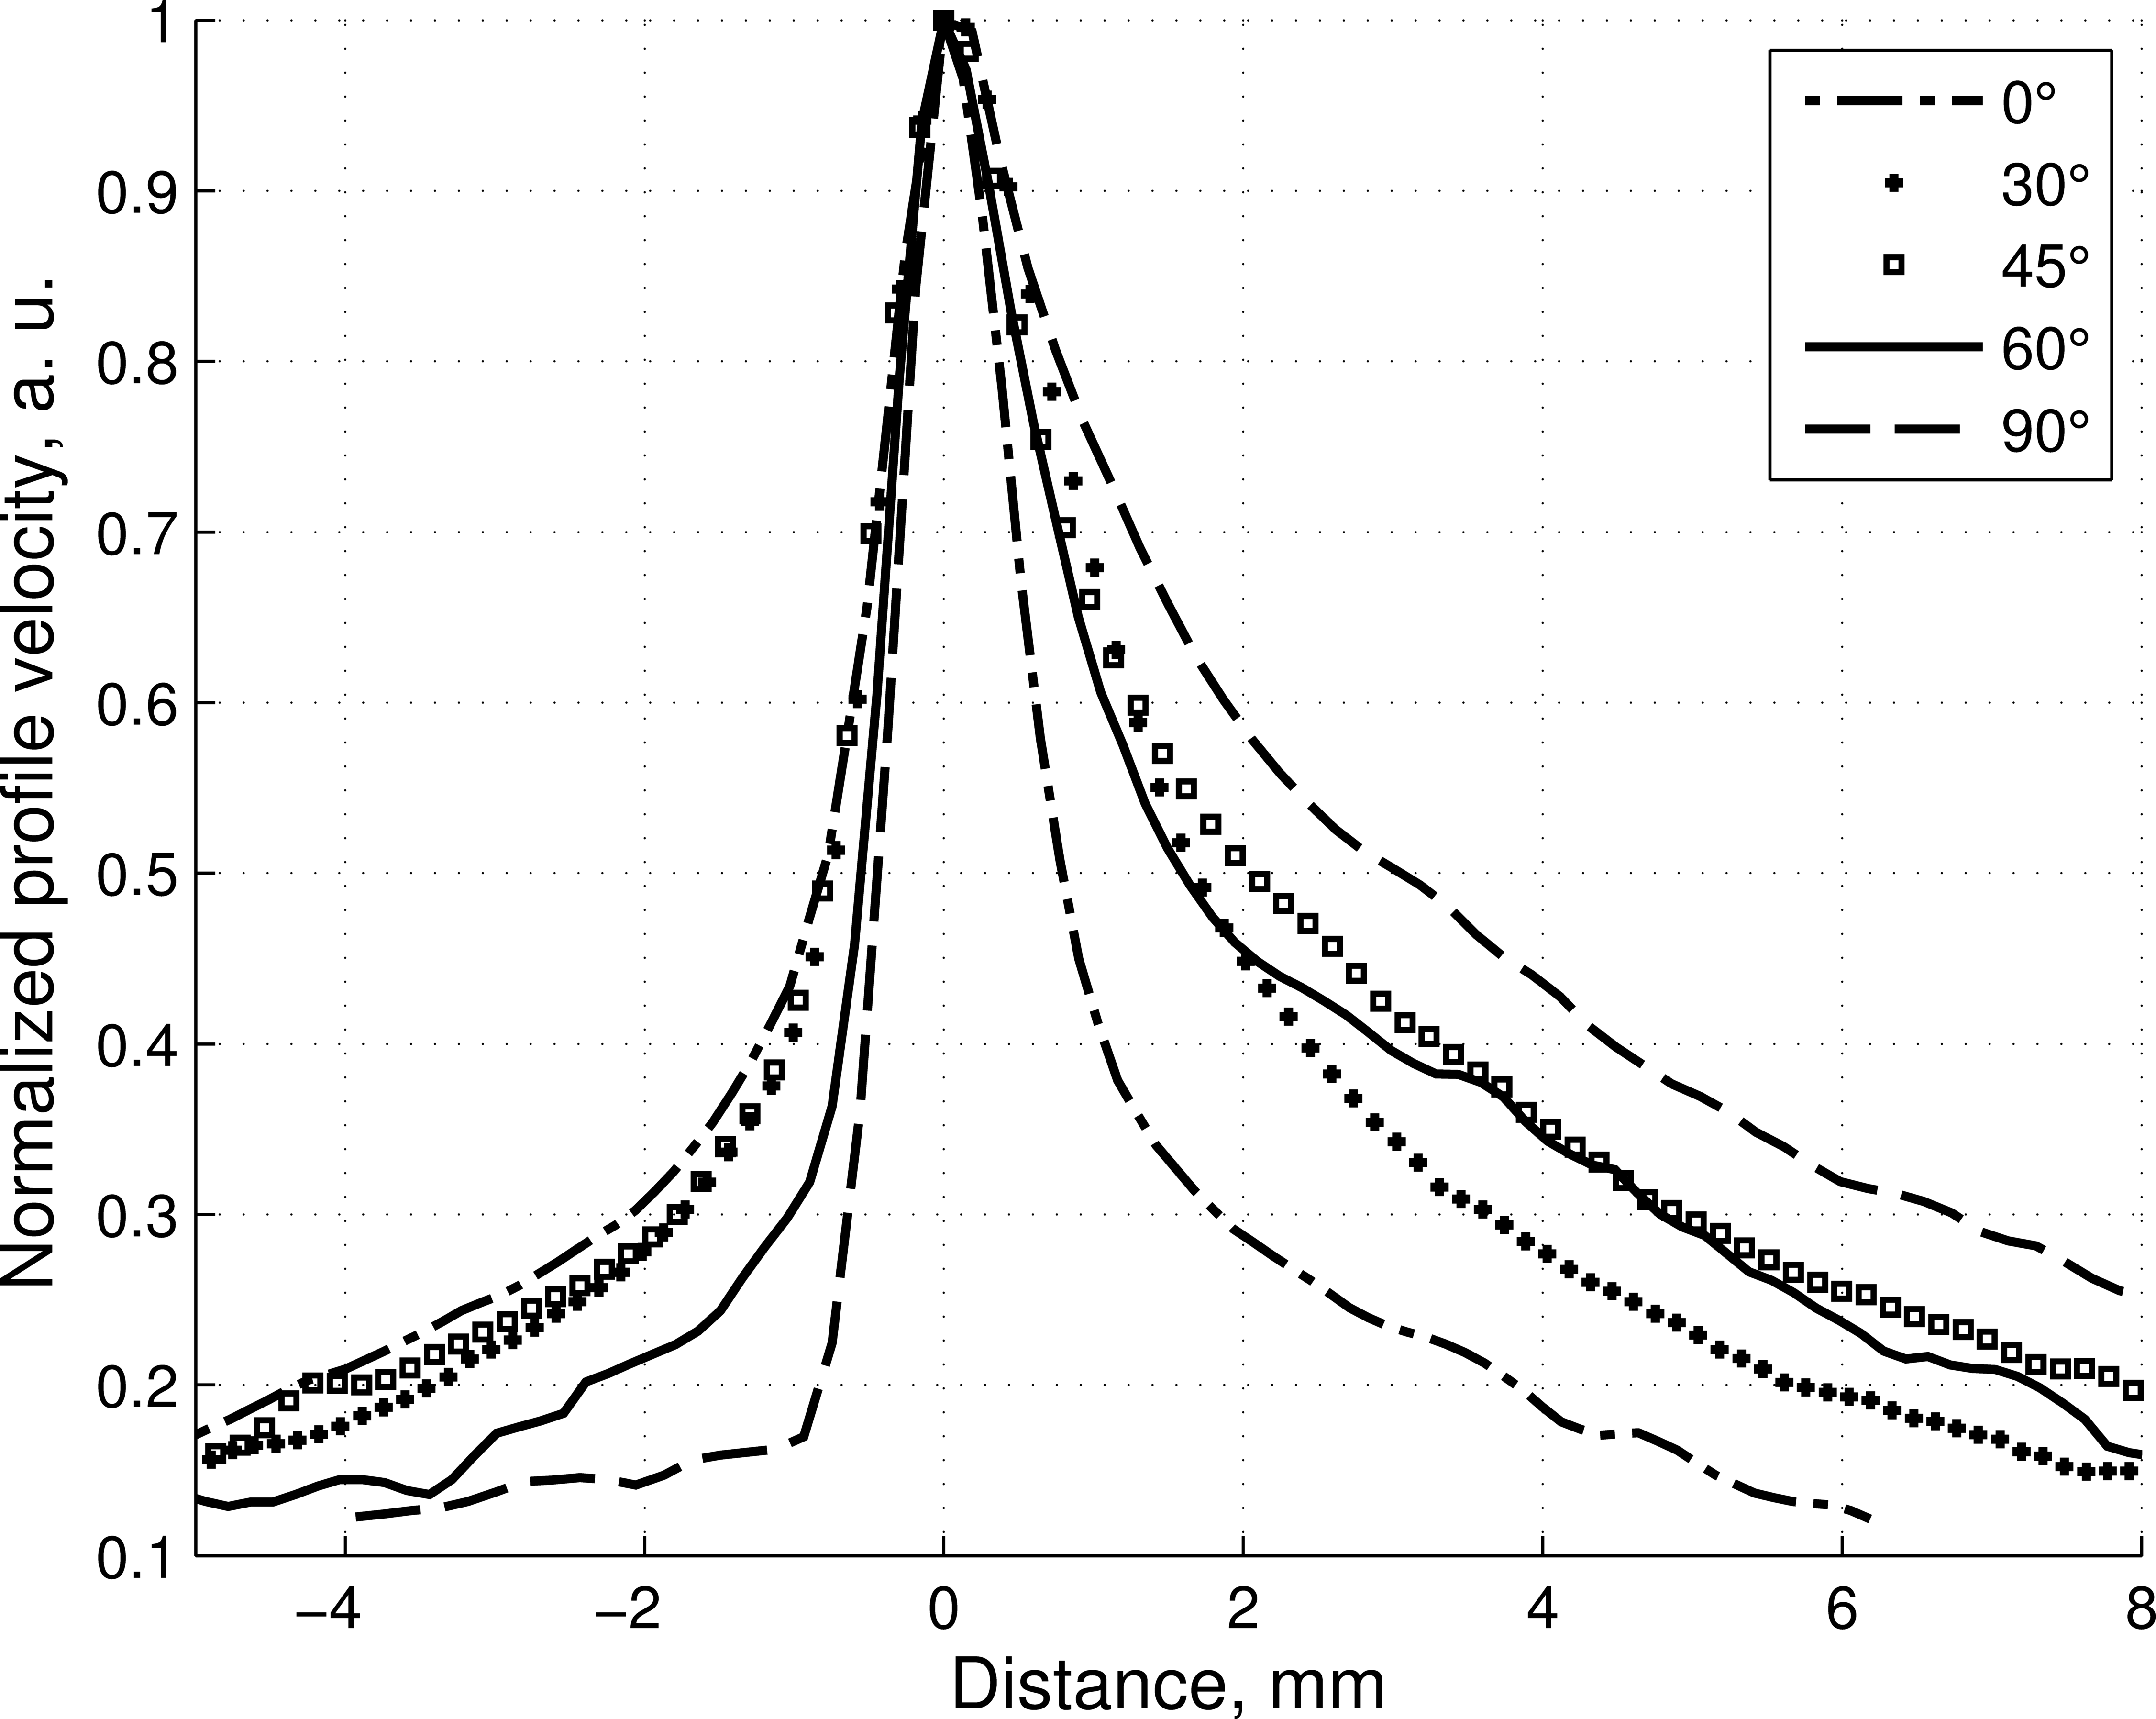
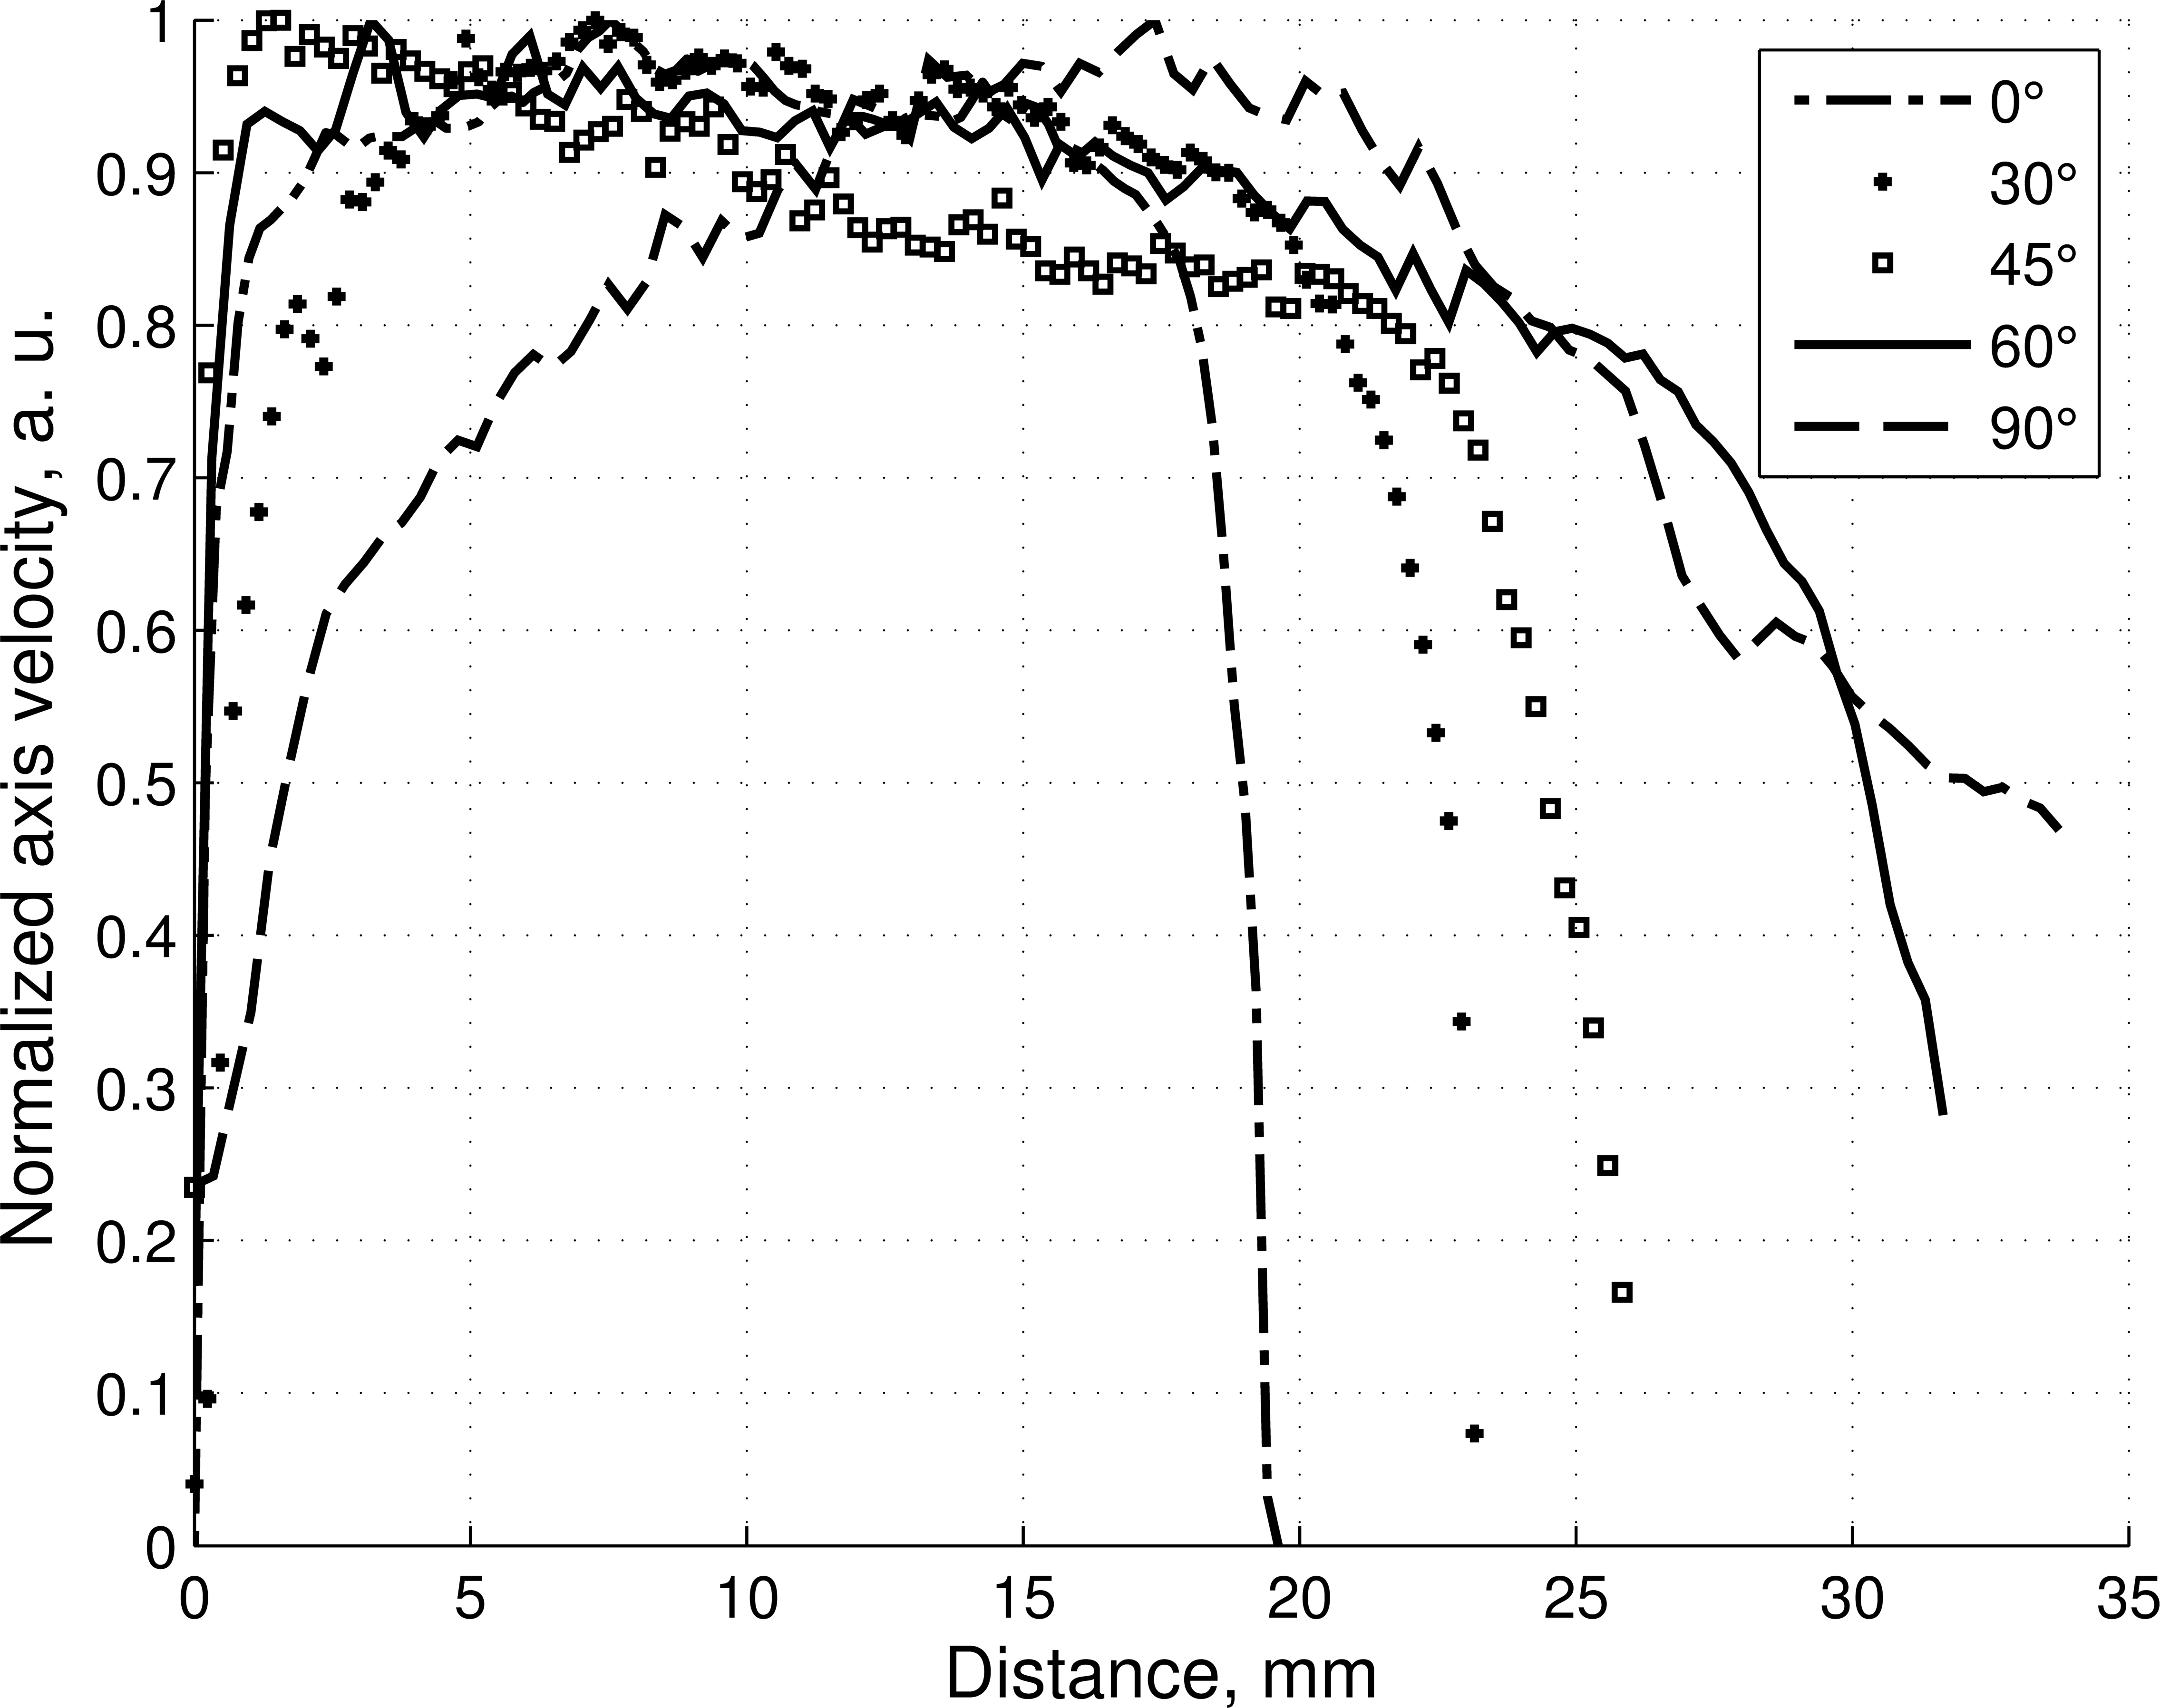
Axial velocity
Velocity profiles
7/12

Slide 8
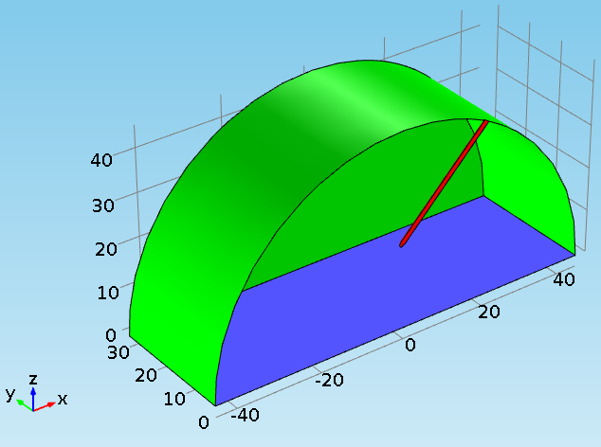
3D Simulation
Equations
Model
open
boundary
high voltage electrode
grounded electrode
Corona sheath is described by the boundary condition on the needle:
γ - the secondary photoionization coefficient
τ - the time of ion drift through the corona sheath
α - the impact ionization coefficient
8/12

Slide 9
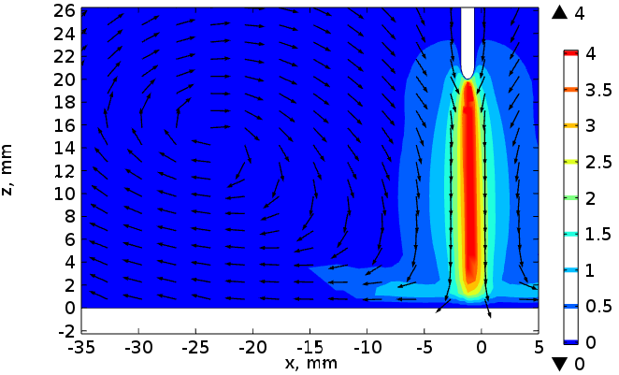
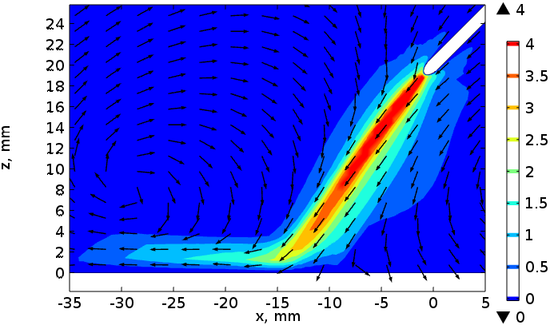
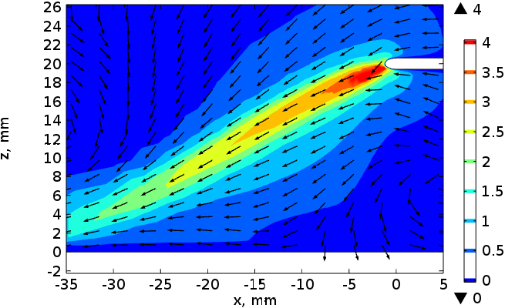
Flow velocity distribution (m/s). Simulation.
α = 0°
α = 45°
α = 90°
Strong inclination of the ionic wind jet.
Small acceleration zone.
Good agreement with the experiment.
9/12

Slide 10
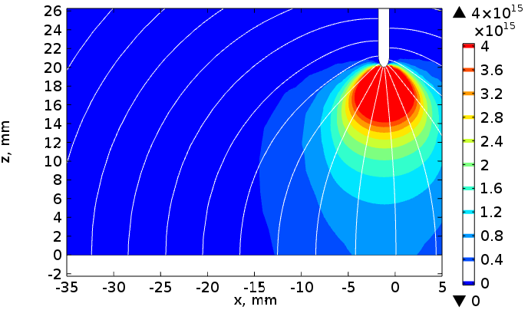
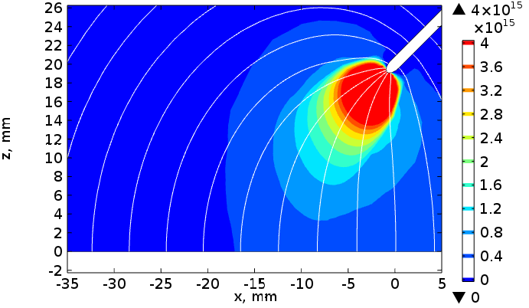
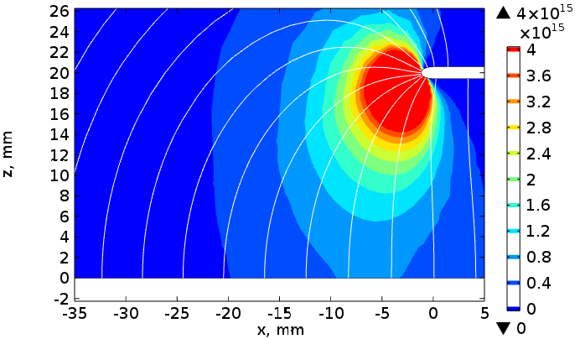
Ion concentration (1/m³). Electric field lines.
α = 0°
α = 45°
The direction of electric field lines near the needle tip follows the needle inclination.
Ion cloud displacement.
The electric field in the major part of the interelectrode gap retains its direction towards
the plane electrode.
α = 90°
10/12

Slide 11
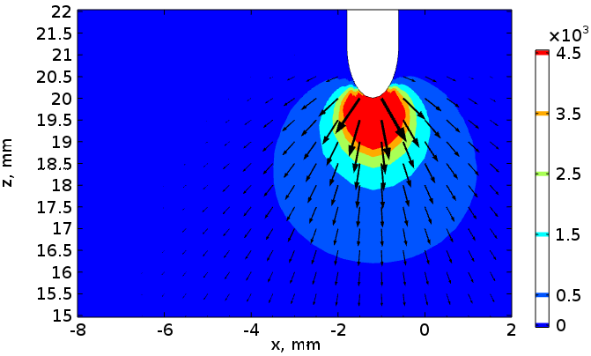
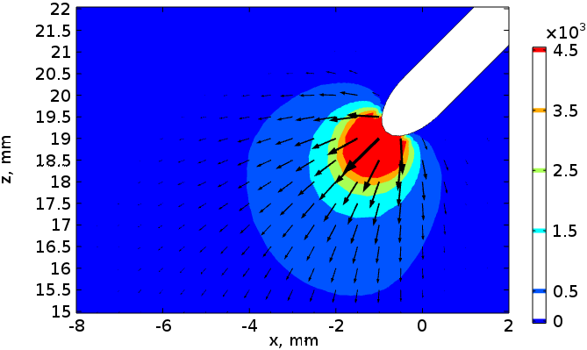
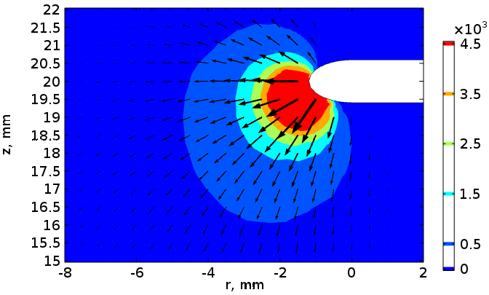
Coulomb force distribution (N/m³). Needle tip area.
α = 0°
α = 45°
The forces are localized
in the area of a very small size
(about 1-2 mm).
45°: the direction of forces coincides with the needle direction.
90°: the direction of forces deviates from the horizontal.
α = 90°
11/12

Slide 12
Conclusions
For the perpendicular arrangement of the coronating needle relative to the grounded plane, a classic flow structure of narrow and fast ionic wind jet has been obtained with the use of PIV-method.
The inclination of the needle relative to the axis normal to the grounded plane resulted in a strong inclination of ionic wind jet, which velocity profile also was slightly changed.
3D simulation of the considered problem showed good agreement with the experimental data.
The electric field, space charge and Coulomb force distributions have been analyzed. The inclination of the ionic wind jet was caused by changing of electric field direction, which was localized near the needle tip in a small (1-2 mm) area.
12/12

Slide 13
THANK YOU!

