Slide 1



Validation of the Particle Image Velocimetry (PIV) for flow control around NACA 0015 with EHD actuator in silicone oil
Clément Gouriou
Christophe Louste
Institut P’ • UPR CNRS 3346
SP2MI • Téléport 2
11, Boulevard Marie et Pierre Curie • BP 30179
F86962 FUTUROSCOPE CHASSENEUIL Cedex
UPR3346-POW02

Slide 2
Outline
Introduction
PIV method
Theoretical study of particle charge
Experimental setup
Velocity measurement with PIV
Current measurement
Conclusion
Flow control in liquids

Slide 3
Introduction
Development of flow control in liquids with ElectroHydroDynamic (EHD) actuators
Flow measurement is used
  Particle Image Velocimetry (PIV) technique
Seeding particles are necessary for PIV measurements

Slide 4
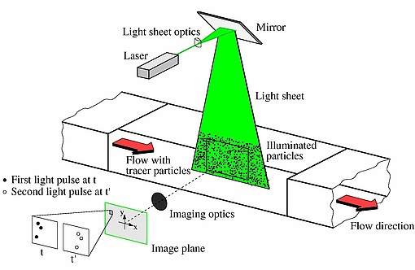
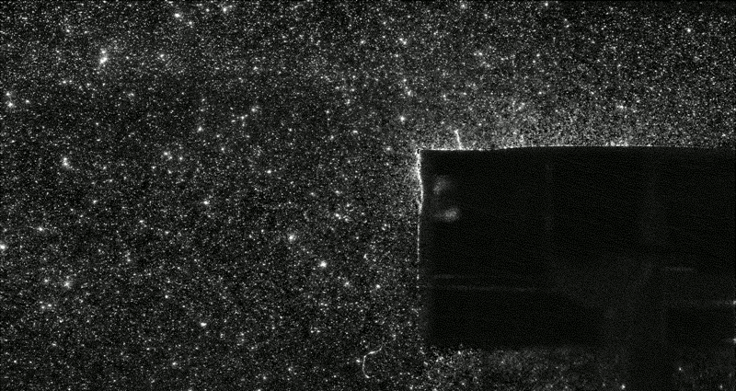
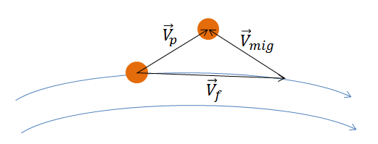
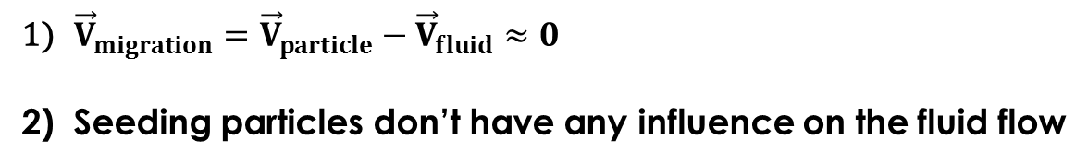
PIV (Particle Image Velocimetry)
Fig. 2 Example of a double frame in PIV
Fig. 1 PIV principle
2 Main hypothesis in PIV:
${\vec{V}}_{migration}={\vec{V}}_{particle}−{\vec{V}}_{fluid}≈0$
Seeding particles don’t have any influence on the fluid flow
Notes:
Vmig=relative velocity between particle and fluid

Slide 5
Criteria of a suitable seeding particle:
A micrometer size in order to follow flow fluctuations
Well adapted mechanical properties (density, buoyancy etc.)
Right wettability conditions for an homogeneous mixing in the liquid

Slide 6
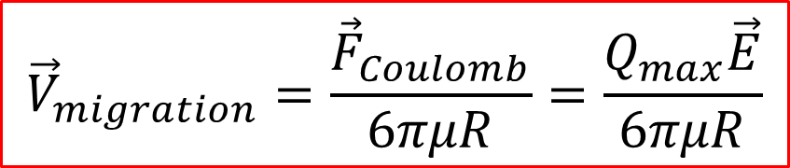
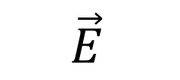

$V_{migration}$ induced by high electric field:
$${\vec{E}}_{ }$$
-
-
-
-
-
$$U_{HV}$$
-
-
-
$${\vec{V}}_{migration}=\frac{{\vec{F}}_{Coulomb}}{6πμR}=\frac{Q_{max}\vec{E}}{6πμR}$$
Notes:
Unipolar injection of charge on the HV electrode
Particle displacement thanks to Coulomb force

Slide 7
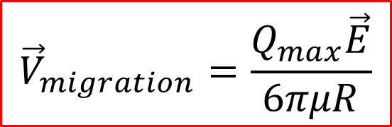
How to avoid $V_{migration}$ induced by the Coulomb Force?
$${\vec{V}}_{migration}=\frac{Q_{max}\vec{E}}{6πμR}$$
Limit the maximum charge carried by seeding particles
Choose adapted physical properties (electric permittivity, conductivity etc.)
Study of the influence of high voltage on different seeding particle types

Slide 8

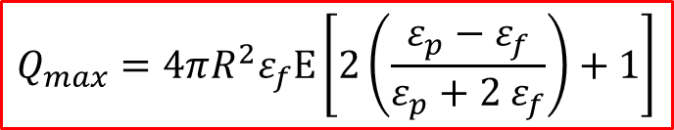



Theoretical maximum charge
Maximum charge collected by a dielectric particle in an outter electric field (cf. Pauthenier)
$$Q_{ }<Q_{max}$$
$$Q_{ }=Q_{max}$$
$$Q_{ }=Q_{max}$$
Fig. 3 Distribution of the radial component of the electric field during the charging process
$$Q_{max}=4πR_{}^{2}ε_{f}E\left[2\left(\frac{ε_{p}−ε_{f}}{ε_{p}+2 ε_{f}}\right)+1\right]$$
If $\frac{ε_{p}}{ε_{f}}⟶0$ then $q_{max}⟶0$
Notes:
$\frac{ε_{p}}{ε_{f}}⟶0$ alors $q_{max}⟶0$

Slide 9
We compare 3 particle types:
 | PTFE | PMMA | Glass
Relative electric permittivity | 2.1 | 3.1 | 5
Table. 1 Electric permittivies of seeding particles
Fig. 5 Variations of maximum charge as a function of the electric field
The higher the electric permittivity, the bigger the maximum charge is

Slide 10
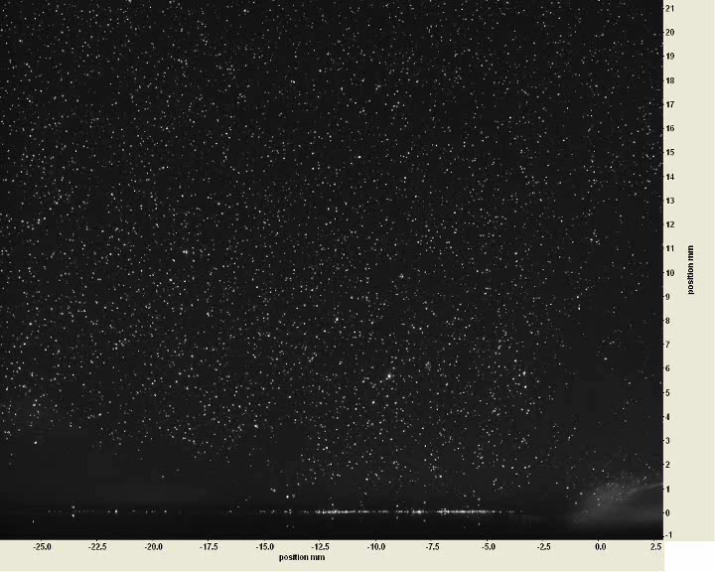
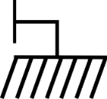

Experimental setup:
A planar EHD actuator
Images of particles in silicone oil
$$\vec{F_{EHD}}$$
UHV
Dielectric barrier (glass)
Epoxy Resin
Electrodes

Slide 11
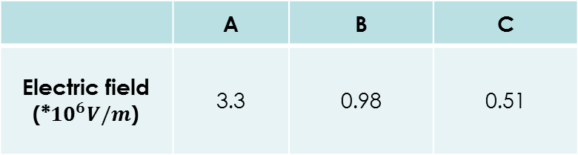
Computation of the electric field (Maxwell)
Fig. 6 Electric field created by the planar actuator ($U_{HV}=−30kVDC)$
 | A | B | C
Electric field (*${10}^{6}V/m$) | 3.3 | 0.98 | 0.51
Table. 2 Electric field intensities at points A, B, C

Slide 12
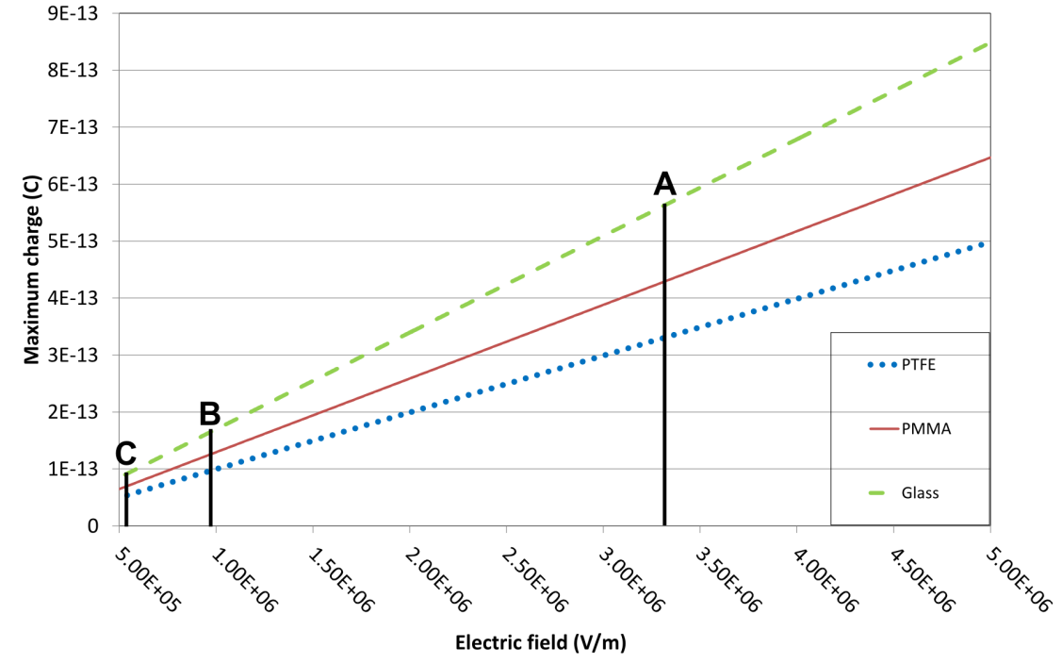
Fig. 7 Variations of maximum charge as a function of the electric field
Maximum charge of glass particle is 30% higher than the PMMA one, and 70% higher than the PTFE one

Slide 13
Velocity measurements with PIV
Fig. 8 Variations of the velocity as a function of the PTFE concentration
Variability of the velocity in the EHD wall jet is bigger than the statistical standard error.
Concentration of seeding particle seems to not have any influence on the measured velocity
Notes:
Velocity as a function of the relative concentration of particles

Slide 14



Differences between velocities measured with the 3 particle types?
Fig. 9 Variations of the velocity measured with different particle types
Particle types seems to not have any influence on the measured velocity
$$\left\langle V_{A}\right\rangle ≈−1.1cm/s∓0.3$$
$$\left\langle V_{B}\right\rangle ≈−5.5cm/s∓0.7$$
$$\left\langle V_{C}\right\rangle ≈−9.9cm/s∓0.9$$

Slide 15
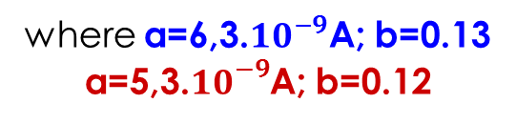

Current measurements
Exponential fitting:
$$y=a.e^{b.x}$$
where a=6,3.${10}^{−9}$A; b=0.13 a=5,3.${10}^{−9}$A; b=0.12
PMMA seeding particles don’t clearly influence the current measurement
[-30kV;0kV]

Slide 16
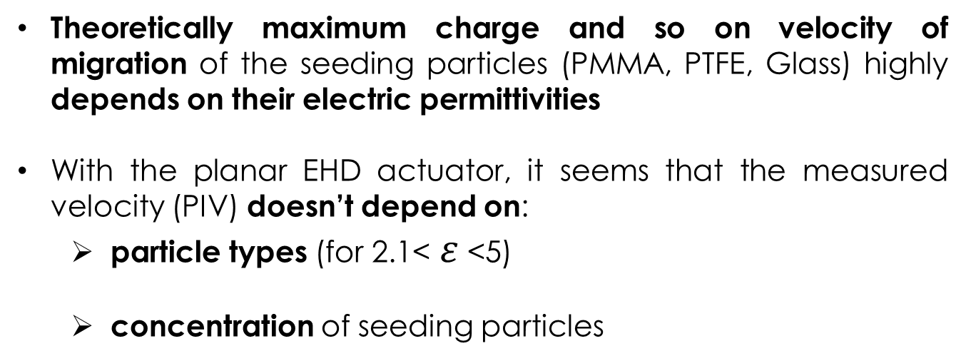
Conclusion
Theoretically maximum charge and so on velocity of migration of the seeding particles (PMMA, PTFE, Glass) highly depends on their electric permittivities
With the planar EHD actuator, it seems that the measured velocity (PIV) doesn’t depend on:
  particle types (for 2.1< $ε$ <5)
  concentration of seeding particles

Slide 17
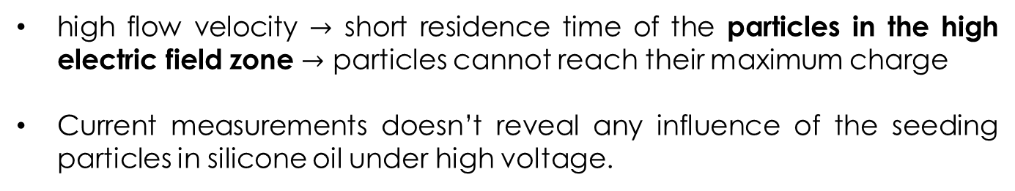
high flow velocity $→$ short residence time of the particles in the high electric field zone $→$ particles cannot reach their maximum charge
Current measurements doesn’t reveal any influence of the seeding particles in silicone oil under high voltage.
[At this stage of the study]
we can reasonnably think that Particle Image Velocimetry (PIV) could be used in silicone oil under high voltage

Slide 18
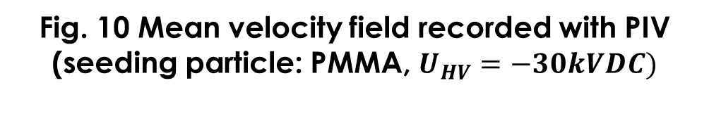
Fig. 10 Mean velocity field recorded with PIV
(seeding particle: PMMA, $U_{HV}=−30kVDC)$
UHV
Dielectric barrier (glass)
Epoxy Resin
Electrodes

Slide 19
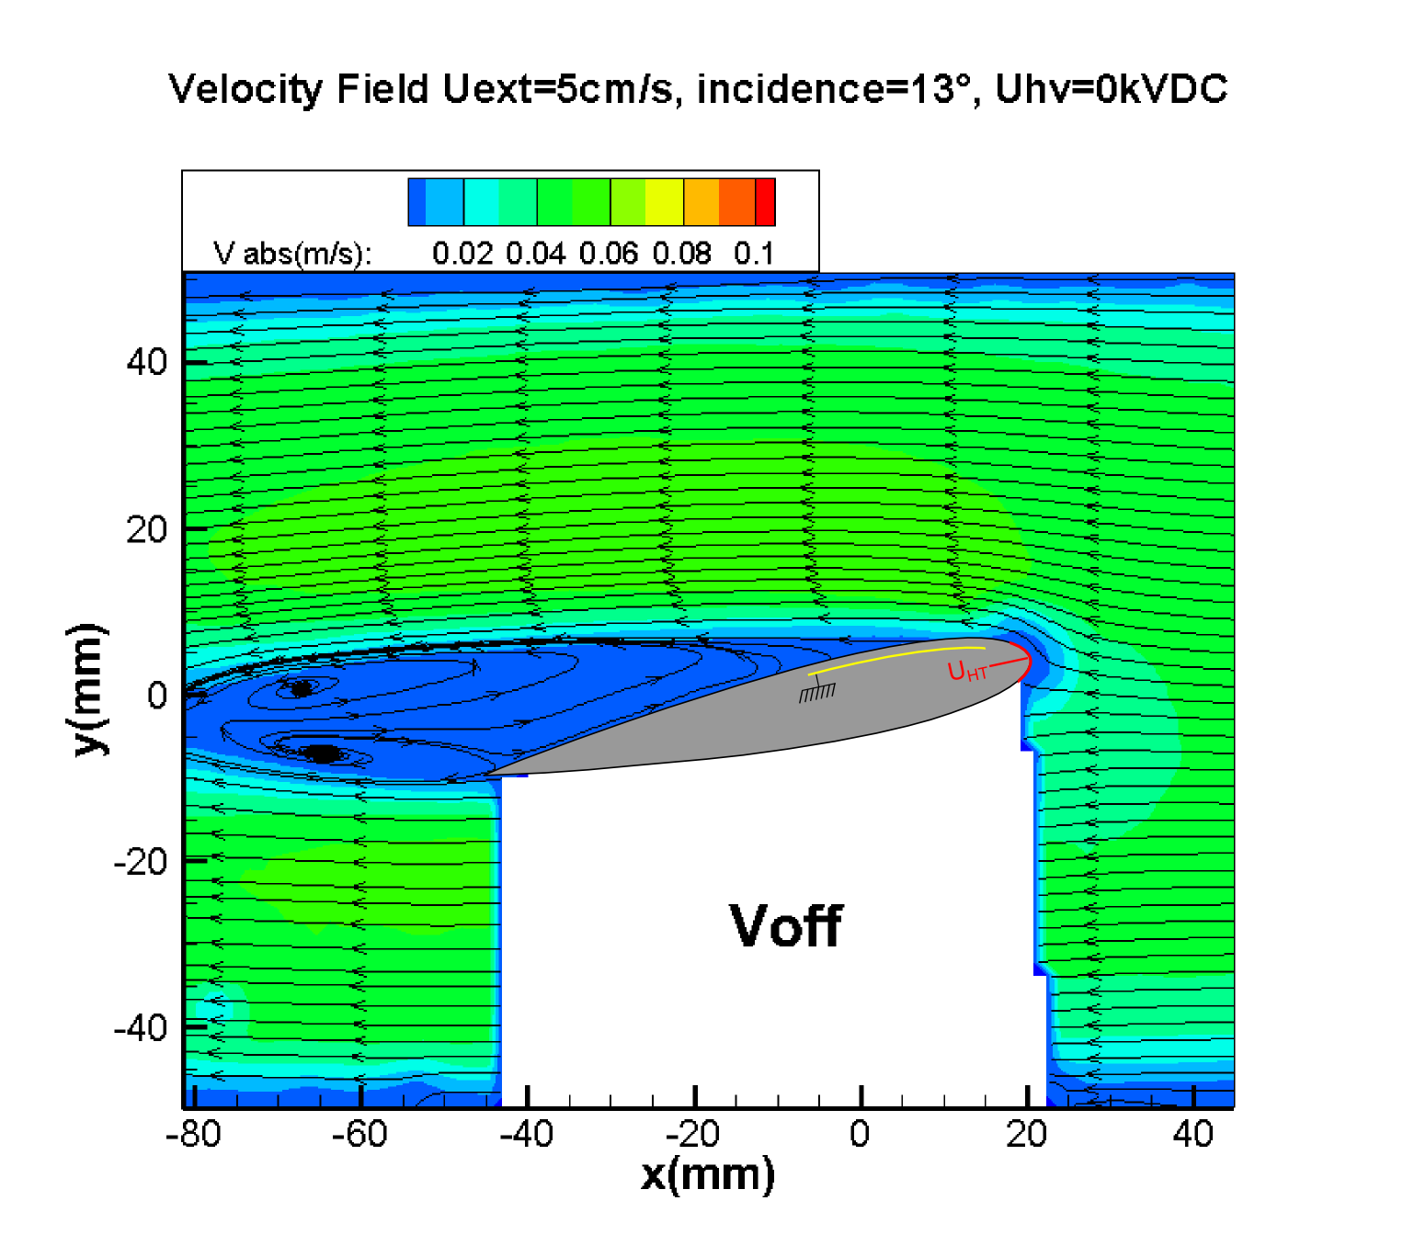
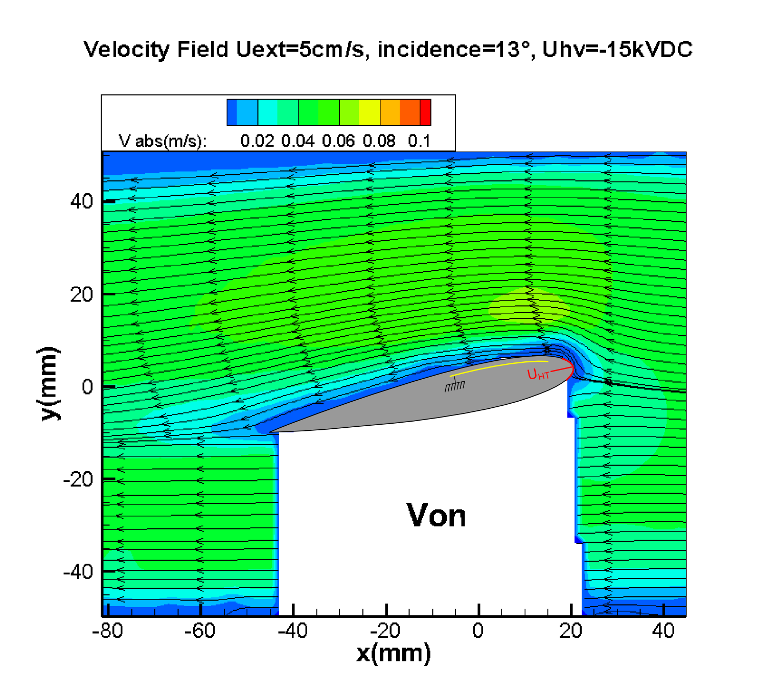
Application: study of flow control in dielectric liquids with PIV
Flow reattachment on the extrados thanks to the EHD actuator!

Slide 20
Thank you for your attention

Slide 21
Prospects
A charging time should be introduced to improve the model of Pauthenier
PIV measurements has been validated also with pressure measurements

Slide 22
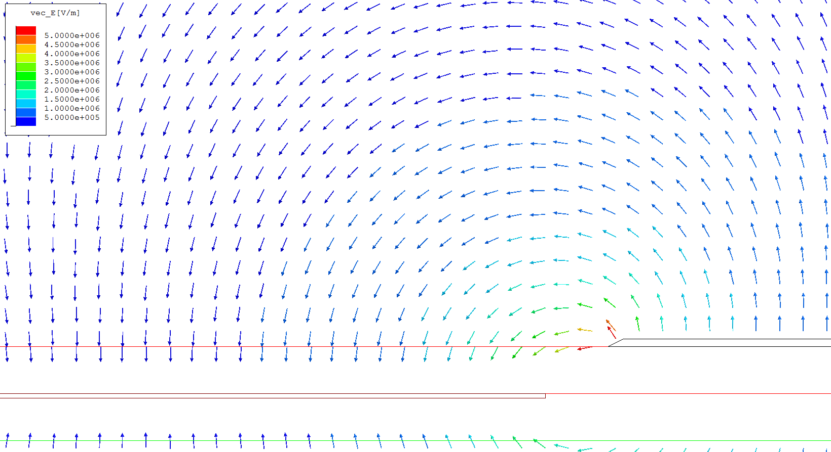

Slide 23
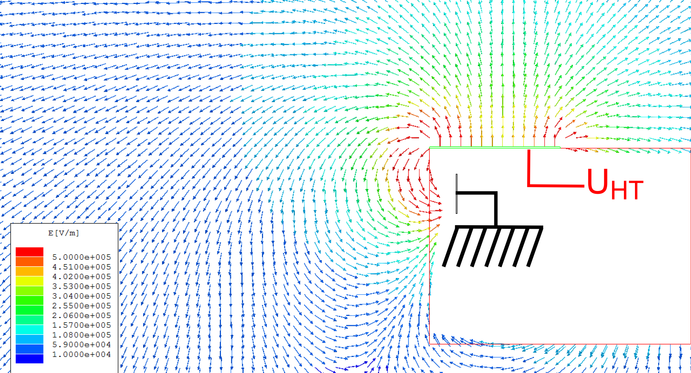

Slide 24
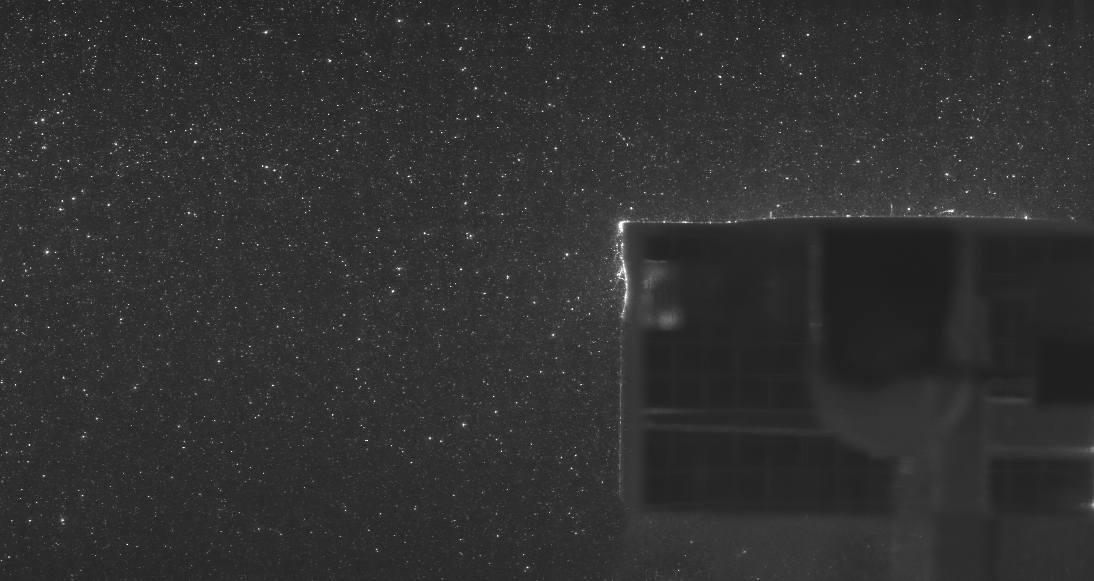
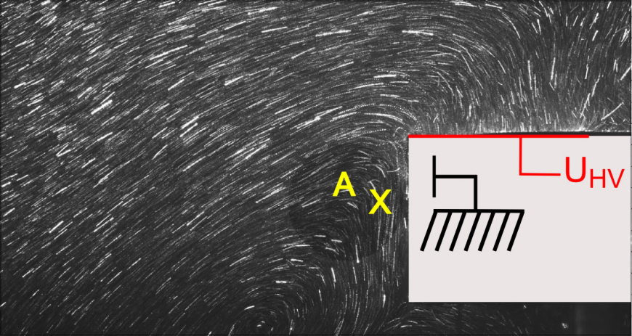
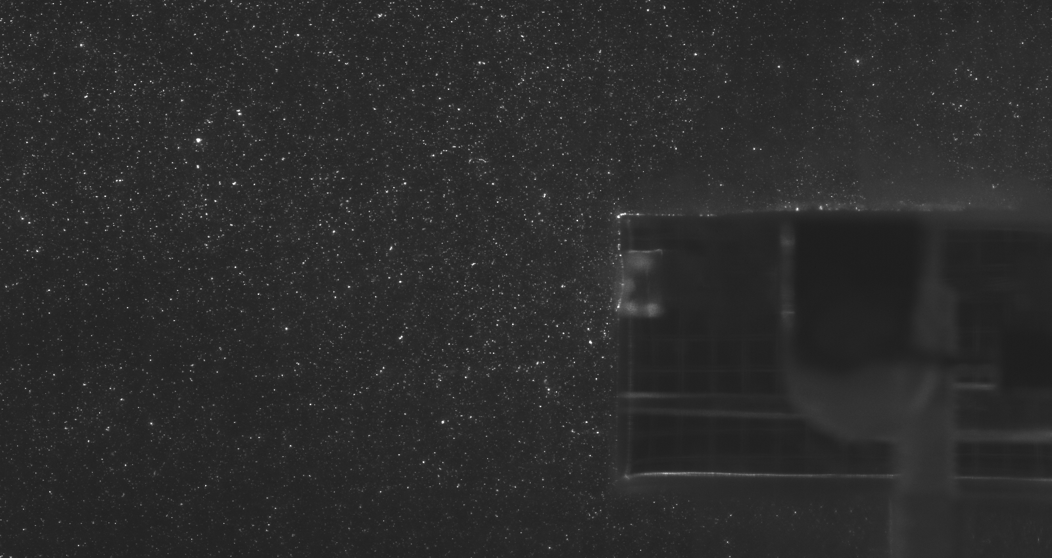
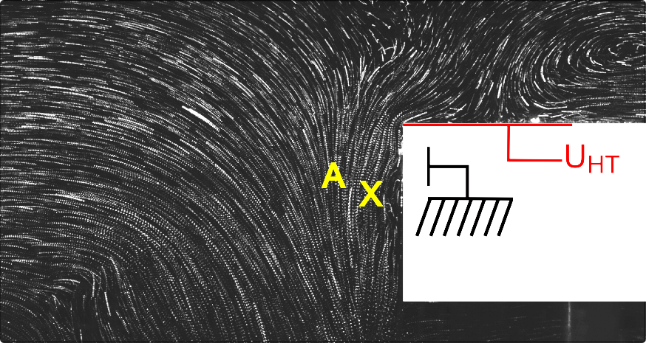
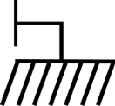
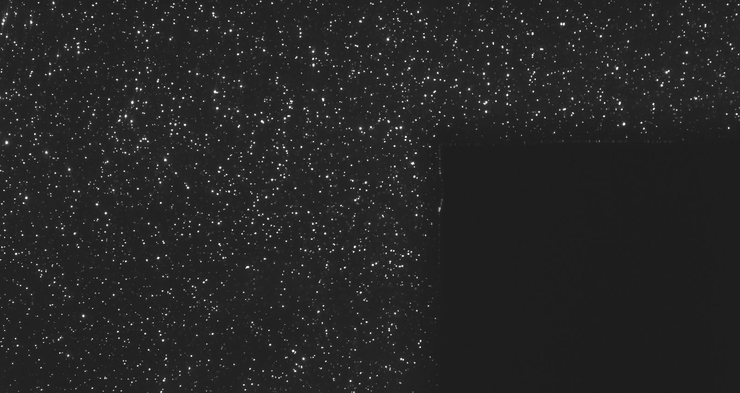
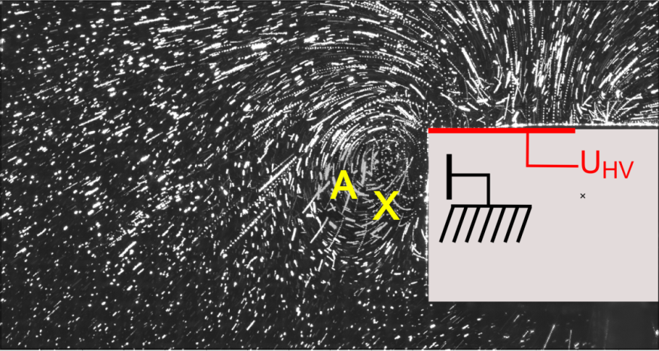
3 types de particules différents
Fig.3 PMMA
UHV
Fig.4 PTFE
UHV
Fig.5 Verre
UHV

