Slide 1







A Consistent Fluid Approach to model Electrical Discharges
Numerical Simulations
F.J. Durán-Olivencia
Philippe Traoré
Christophe Louste
: fjduroli@gmail.com
IWEHD, day: 2 September, 2016
: francisco.duran@univ-poitiers.fr
Notes:
AUTHOR : Francisco J. Durán-Olivencia
Follow Me On : www.fjduroli.com (This web page is now being prepared.)

Slide 2
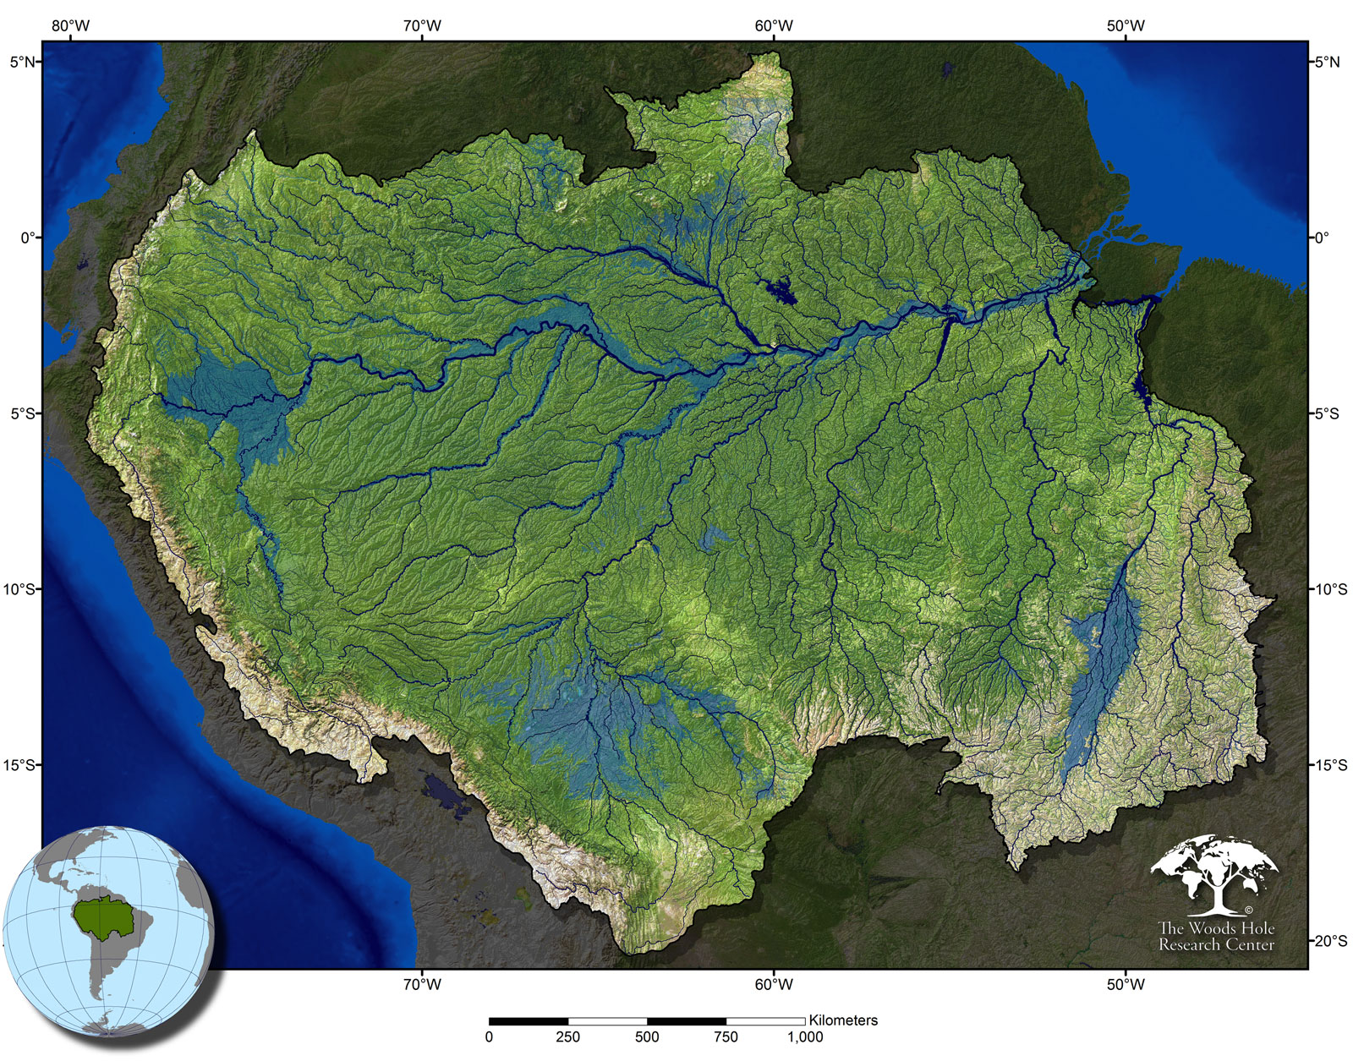
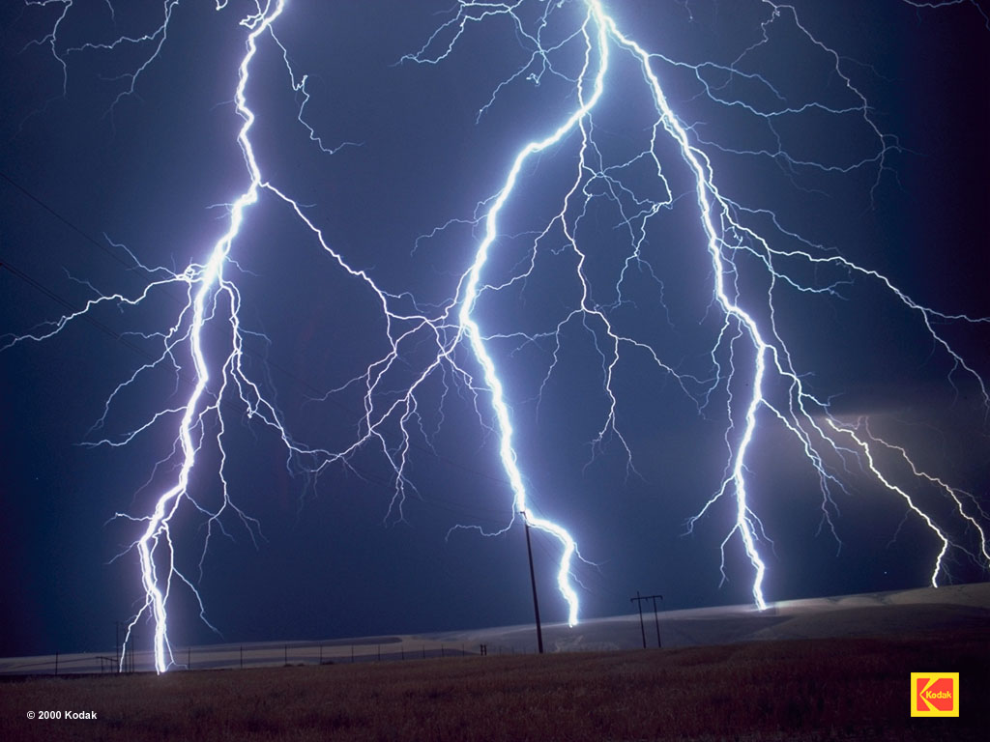
A first glance
Notes:
AUTHOR : Francisco J. Durán-Olivencia
Follow Me On : www.fjduroli.com (This web page is now being prepared.)

Slide 3
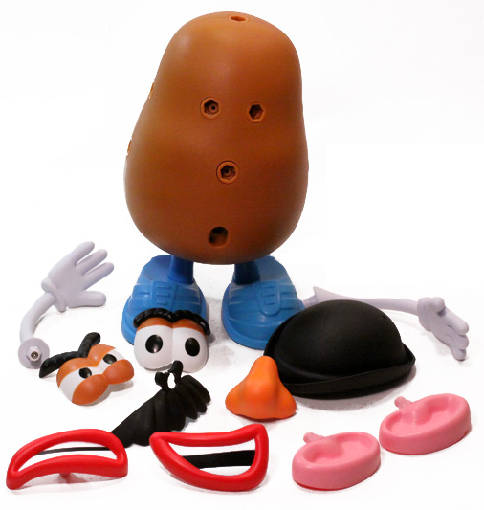
Strictly speaking
Put ‘em all together for a nice picture!
█ Charged Particles
Internally interactive
Strongly sensitive to
electromagnetic fields
█ Fluid Character
Macroscopic description
Notes:
AUTHOR : Francisco J. Durán-Olivencia
Follow Me On : www.fjduroli.com (This web page is now being prepared.)

Slide 4
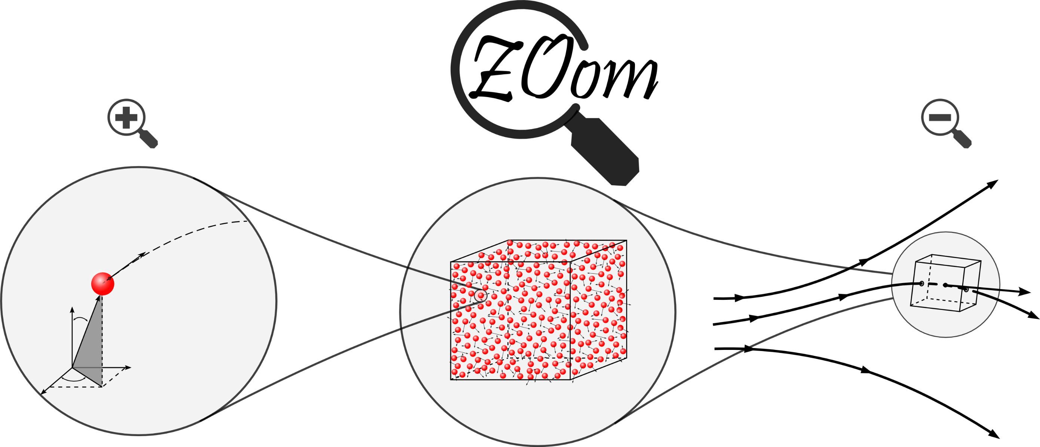
How to build up that connection
Exact Approach
Fluid Approach
path
streamline
streamline
Notes:
AUTHOR : Francisco J. Durán-Olivencia
Follow Me On : www.fjduroli.com (This web page is now being prepared.)

Slide 5
What is the right way?
FA
BE
WCA
BBGKI
Notes:
AUTHOR : Francisco J. Durán-Olivencia
Follow Me On : www.fjduroli.com (This web page is now being prepared.)

Slide 6

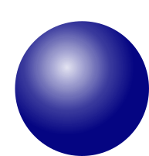

Weak Coupling Approximation
Correlation between particles is reduced to a narrow spatial región
Collision (extended version)
~90º
Binary collisions
Multiple collisions
Notes:
AUTHOR : Francisco J. Durán-Olivencia
Follow Me On : www.fjduroli.com (This web page is now being prepared.)

Slide 7
Weak Coupling Approximation
Correlation between particles is reduced to a narrow spatial región
Collision (extended version)
~90º
Binary collisions
Multiple collisions
weak
hard
Notes:
AUTHOR : Francisco J. Durán-Olivencia
Follow Me On : www.fjduroli.com (This web page is now being prepared.)

Slide 8
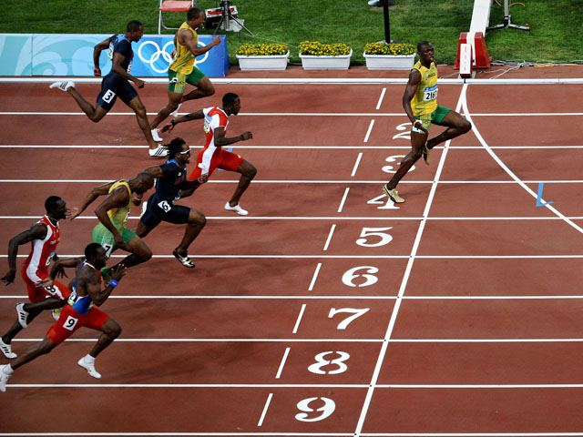

Weakly Ionized Gases
A rare event
Accumulative Effect
The most likely event
Binary Collision
Collision frequency
F.J. Durán-Olivencia
Notes:
AUTHOR : Francisco J. Durán-Olivencia
Follow Me On : www.fjduroli.com (This web page is now being prepared.)

Slide 9
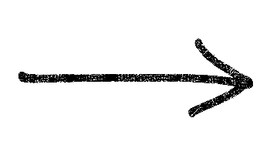
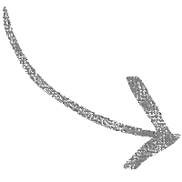
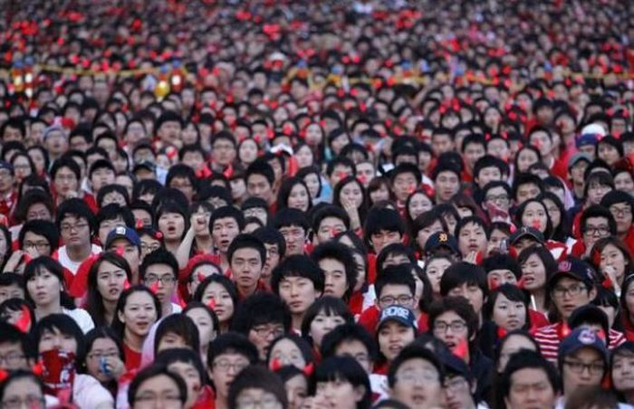
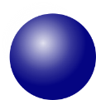
Weak Coupling Approx.
Local Thermodynamic Equilibrium
Mean Field
Pair correlation function
Plasma parameter
( )
Particle–Particle
Debye length
9
Notes:
AUTHOR : Francisco J. Durán-Olivencia
Follow Me On : www.fjduroli.com (This web page is now being prepared.)

Slide 10

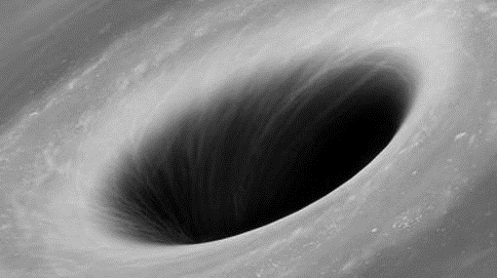



Why do we bother defining a suitable physical scale ?
Typical values:
Debye length
Molecular Chaos hypothesis
Plasma parameter
10
Notes:
AUTHOR : Francisco J. Durán-Olivencia
Follow Me On : www.fjduroli.com (This web page is now being prepared.)

Slide 11



How can we Implement this idea?
Spatial Discretization
Streamline Upwind Petrov-Galerkin
Temporal Discretization
$θ$-Method
Crank-Nicholson
11
Notes:
AUTHOR : Francisco J. Durán-Olivencia
Follow Me On : www.fjduroli.com (This web page is now being prepared.)

Slide 12
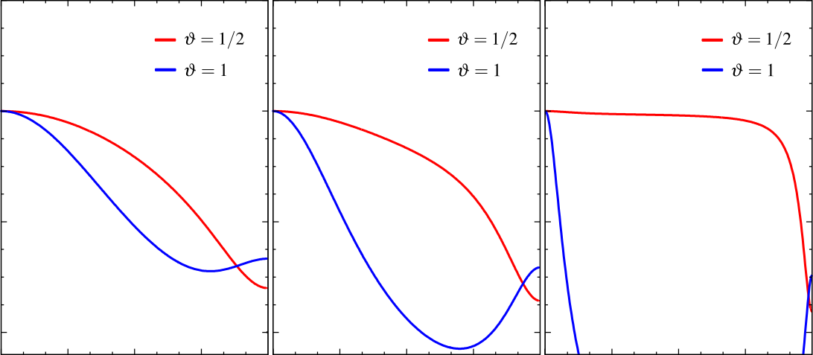



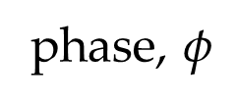





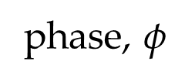
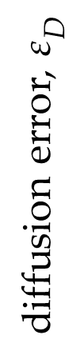
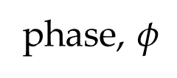

Numerical Results: Convection-Diffusion-Reaction
Damköhler number
<< 1
$$σ=0.5$$
$σ=1.$0
$σ=5.$0
Implicit
HIGH
artificial D
1
Courant Number
Peclet Number
diffusion error, $ε_{D}$
0.75
Num. Length (drift) scale
Diffusion Time Scale
$$σ=\frac{vΔt}{h}∼$$
$$Pe=\frac{vh}{𝒟}∼$$
CN ( )
h <<
High Order
θ=1/2
Mesh Size
Drift Time Scale
0.5
$π/4 π/2 3π/4 π$
$π/4 π/2 3π/4 π$
$π/4 π/2 3π/4 π$
phase, $φ$
phase, $φ$
phase, $φ$
12
Notes:
AUTHOR : Francisco J. Durán-Olivencia
Follow Me On : www.fjduroli.com (This web page is now being prepared.)

Slide 13
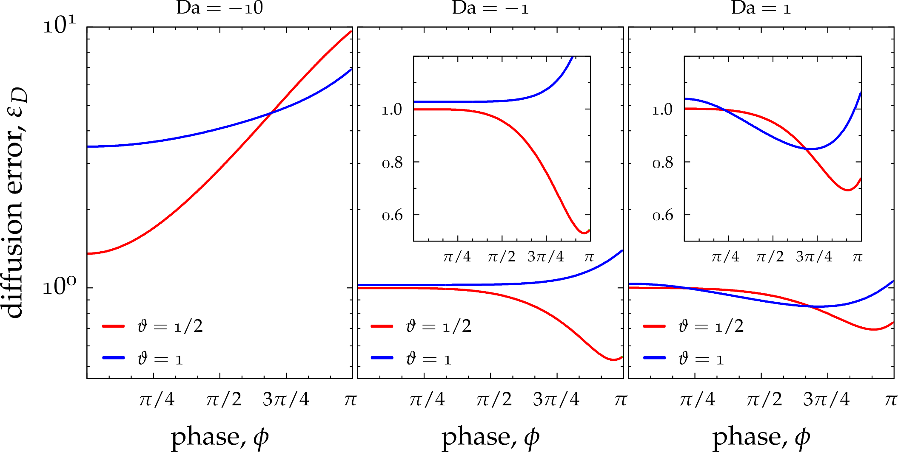

Numerical Results: Convection-Diffusion-Reaction
Courant number :
0.25
θ=1/2
CN ( )
Low-Pass
Filter
Damköhler Number
$$Da=\frac{ν_{en} h}{v}∼$$
Drift Time Scale
Reaction Time Scale
Implicit
( )
Amplifies
CN ( )
performs
better
Implicit
( )
Amplifies
θ=1/2
CN
Low-Pass
Filter
θ=1
θ=1
Distorted
solution
13
Notes:
AUTHOR : Francisco J. Durán-Olivencia
Follow Me On : www.fjduroli.com (This web page is now being prepared.)

Slide 14
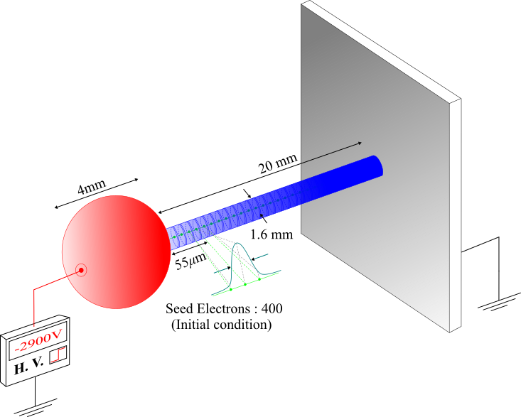
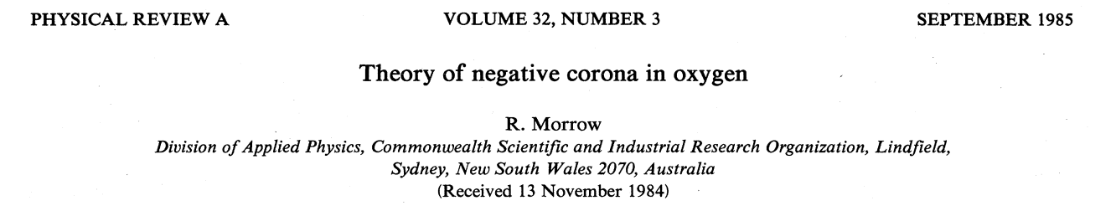
Testing Problem
14
Notes:
AUTHOR : Francisco J. Durán-Olivencia
Follow Me On : www.fjduroli.com (This web page is now being prepared.)

Slide 15
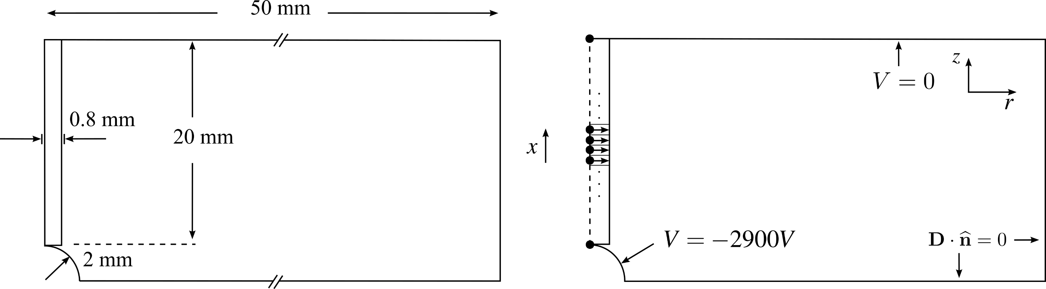
Physical Model
Geometry
Computational Domain
Disk method
Symmetry axis
15
Notes:
AUTHOR : Francisco J. Durán-Olivencia
Follow Me On : www.fjduroli.com (This web page is now being prepared.)

Slide 16
Governing Eqs.
e
+
-
Notes:
AUTHOR : Francisco J. Durán-Olivencia
Follow Me On : www.fjduroli.com (This web page is now being prepared.)

Slide 17
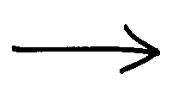

Boundary Conds.
Due to photons emitted by excited
states in discharge volume
-
e
+
Cathode
Due to positive ions in the vecinity of
the electrode
-
Notes:
AUTHOR : Francisco J. Durán-Olivencia
Follow Me On : www.fjduroli.com (This web page is now being prepared.)

Slide 18
Boundary Conds.
-
e
+
Anode
+
Notes:
AUTHOR : Francisco J. Durán-Olivencia
Follow Me On : www.fjduroli.com (This web page is now being prepared.)

Slide 19
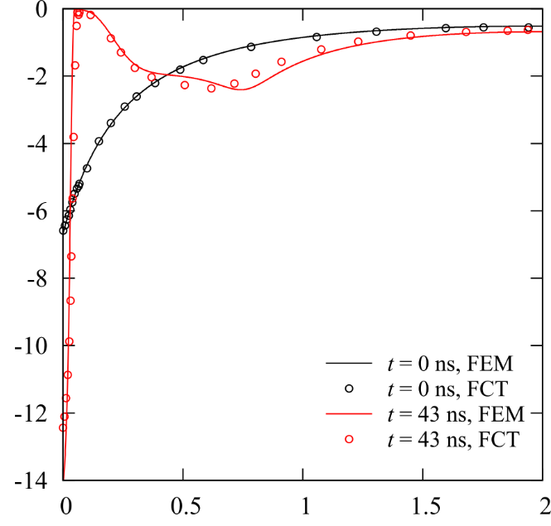


Results.
-
E
5
+
( X 10 V/m )
In good agreement with
original results.
x (cm)
Notes:
AUTHOR : Francisco J. Durán-Olivencia
Follow Me On : www.fjduroli.com (This web page is now being prepared.)

Slide 20
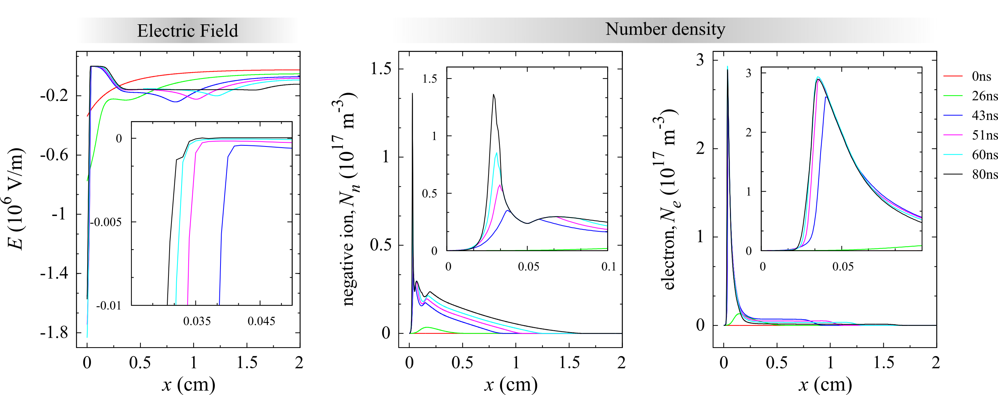
Results.
In good agreement with
original results.
Notes:
AUTHOR : Francisco J. Durán-Olivencia
Follow Me On : www.fjduroli.com (This web page is now being prepared.)

Slide 21
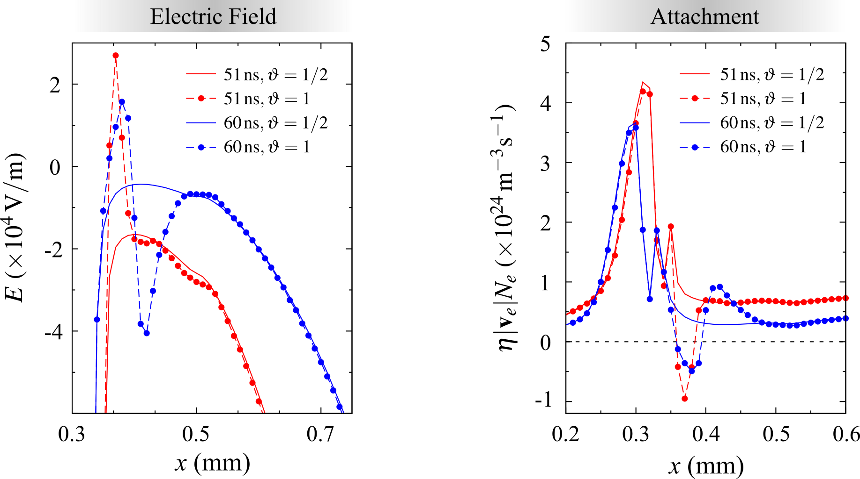


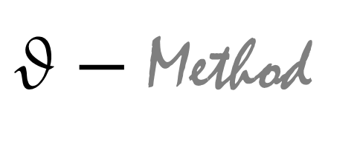
$θ−$ Method
Electric Field
Attachment
O
Seem
to be the
precursor
Notes:
AUTHOR : Francisco J. Durán-Olivencia
Follow Me On : www.fjduroli.com (This web page is now being prepared.)

Slide 22
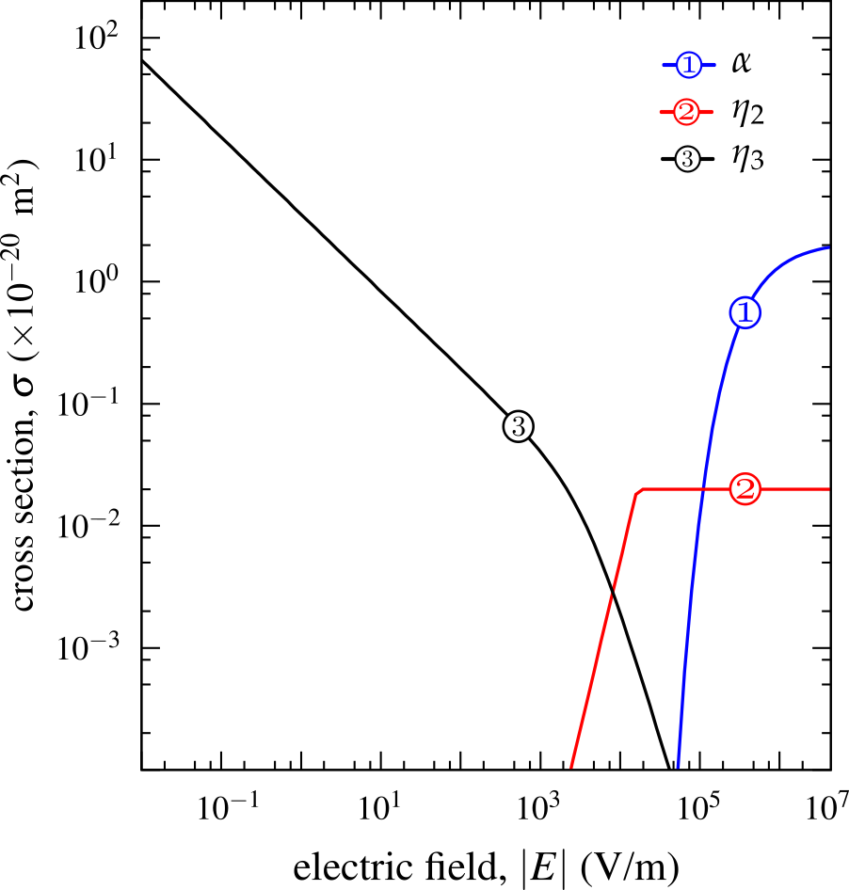
Electric Field
Results.
Transition between
attachment mechanisms
Attachment
Notes:
AUTHOR : Francisco J. Durán-Olivencia
Follow Me On : www.fjduroli.com (This web page is now being prepared.)

Slide 23

Crude Estimation
$$Da=\frac{ν_{en} h}{v}∼σN_{gas}h$$
Mesh Size:
Thus, diffusion error aforementioned
predicts this instability (implicit).
Notes:
AUTHOR : Francisco J. Durán-Olivencia
Follow Me On : www.fjduroli.com (This web page is now being prepared.)

Slide 24



Conclusions
A novel consistent fluid approach to model electrical discharges was presented.
The model combines theoretical and numerical descriptions as a whole.
The model was testing by means of classical corona discharge problem, since it is a highly non-linear problem (shock fronts).
Numerical results obtained are in good agreement with original ones.
The model was able to predict the instabilities what emerge even using
1st order schemes.
Notes:
AUTHOR : Francisco J. Durán-Olivencia
Follow Me On : www.fjduroli.com (This web page is now being prepared.)

Slide 25

Thank you!
This work was funded by a grant of the French Government program “Investissements d’Avenir” (LABEX INTERACTIFS, reference ANR-11-LABEX-0017-01).
Notes:
AUTHOR : Francisco J. Durán-Olivencia
Follow Me On : www.fjduroli.com (This web page is now being prepared.)

Slide 26
Model Successes
1.
Consistent from theoretical and numerical point of view.
Velocity magnitude
2.
It was checked and compared with others high resolution schemes.
3.
It has shown being able to predicts instabilities under 1st order schemes.
Notes:
AUTHOR : Francisco J. Durán-Olivencia
Follow Me On : www.fjduroli.com (This web page is now being prepared.)

